Slide 1

Al Mustaqpal University
College of Health and Medical Technologies
Department of Optical Technologies
Prepared by
Alaa Mohammad
MSc Optometry
Subjective
Prosthesis eye
Lecture two : Anatomy of the face

Slide 2
Skull
The skull is the most complex bony structure of the skeleton.
Functions:
1. Protects the brain
2. Supports the organs of vision, hearing, smelling, and taste
The skull is formed by the cranium and facial bones which contain the paranasal sinuses.
Bones of the cranium The cranium protects the brain and it is composed of eight bones which are:
1. Frontal bone
2. Occipital bone
3. Sphenoid bone
4. Ethmoid bone
5. Two Parietal bones
6. Two Temporal bones The bones of the cranium are separated from each other by immovable joints called

Slide 3
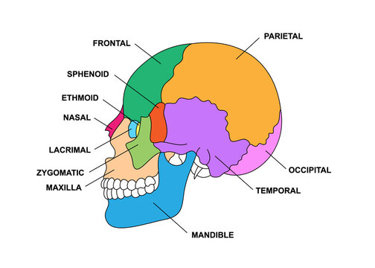
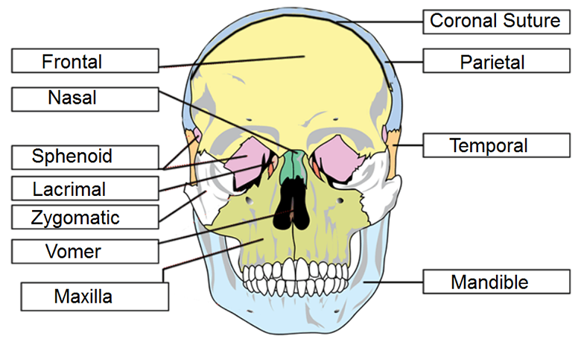
sutures.
Bones of the face
The facial bones supports the soft tissues of the face and determine our facial appearance. They include 14 bones which are:
Two Maxillae bones
Two Palatine bones
Two Zygomatic bones
Two Lacrimal bones
Two Nasal bones
Two Inferior nasal conchae
One Mandible bone
One Vomer bon

Slide 4
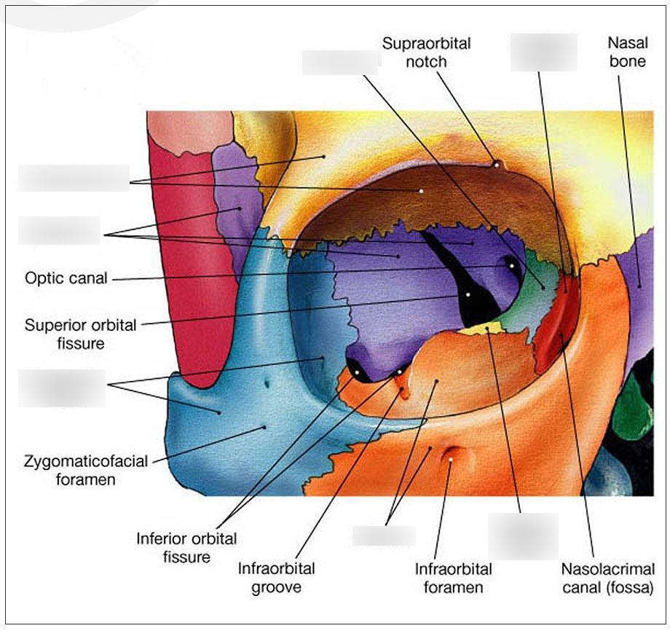
The orbit
• Functions: Protects, supports and maximizes the functions of the eyeball.
• Shape: the orbit is shaped as a quadrilateral pyramid with its base in plane with
the orbital rim.
Bones of the orbit
Frontal bone
2. Zygomatic bone
3. Maxillary bone
4. Sphenoid bone
5. Ethmoid bone
6. Lacrimal bone
7. Palatine bone

Slide 5
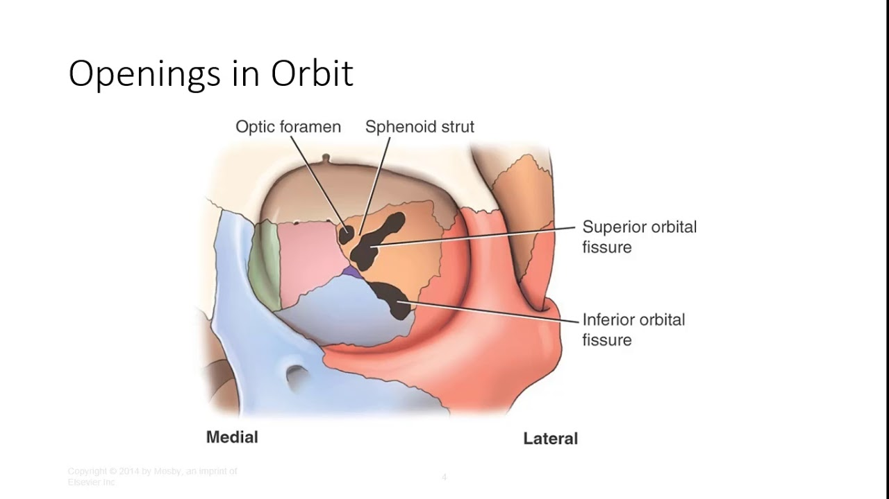
Openings of the orbit
• The main openings of the orbit are:
Superior orbital fissure
2. Inferior orbital fissure
3. Optic foramen/canal
Contents of the orbit
Eyeball
2. Extraocular muscles
3. Fats and orbital fascia
4. Blood vessels
5. Nerves
6. Lacrimal apparatus (lacrimal gland and part of the tear drainage system)

Slide 6
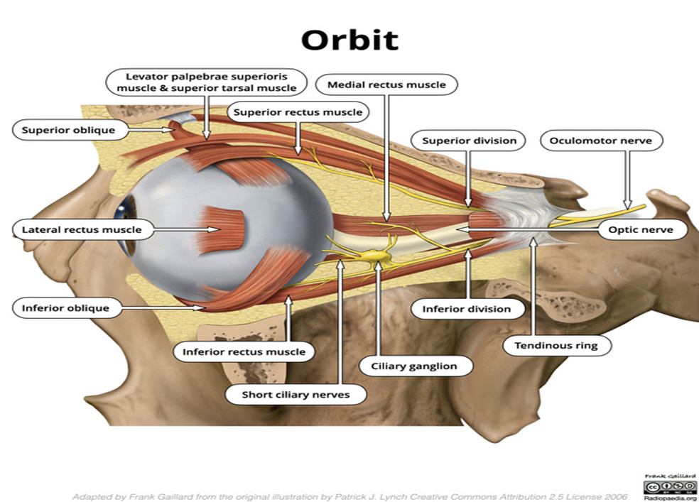

Slide 7
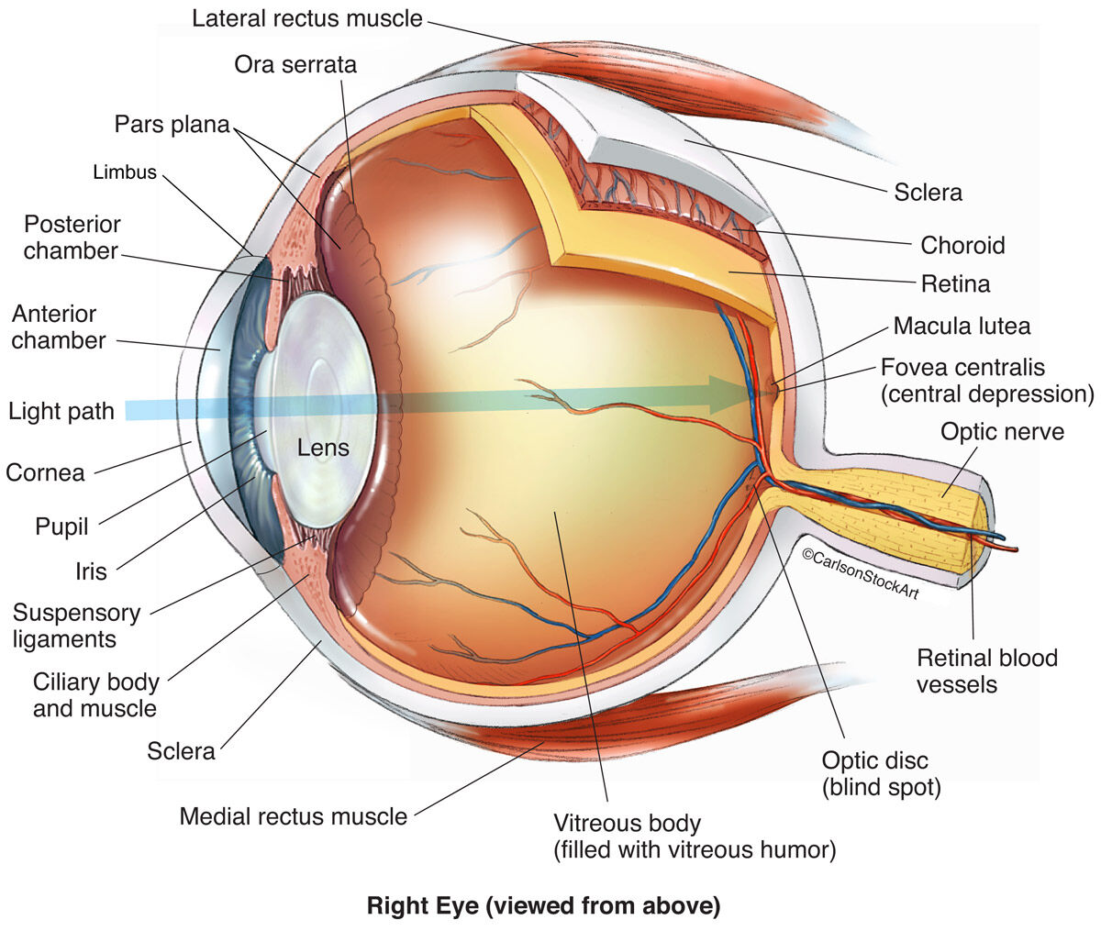
Anatomy of the eye
• Cornea: The transparent front window of the eye which transmits and focuses
(i.e., sharpness or clarity) light into the eye.
• Sclera: The white outer coat of the eye, surrounding the iris. Helps to maintain
the spherical shape of the eyeball.
• Anterior chamber: Lies between the cornea and the iris. Filled with aqueous
humor.
• Iris: Colored part of the eye which helps regulate the amount of light entering
the eye.
• Ciliary body: Intrinsic muscle which supports and modifies the lens shape/focus.
• Choroid: Layer containing blood vessels that lines the back of the eye and is
located between the retina and the sclera.

Slide 8
• Pupil: Rounded opening in the iris through which the light passes.
• Lens: Transparent structure which focuses light rays onto the retina.
• Retina: The inner coat of the eye. Responsible for converting light into nerve
impulses.
• Suspensory ligament: Holds the lens in place.
• Optic nerve: A bundle of more than a million nerve fibers carrying visual
messages from the retina to the brain.
• Vitreous Humor: The, clear, gelatinous substance filling the central cavity of the
eye.
• Optic disc: The area where the optic nerve attaches the retina. Does not contain
any photoreceptors.
• Conjunctiva: Clear, thin membrane that covers part of the front surface of the
eye and the inner surface of the eyelids.

Slide 9
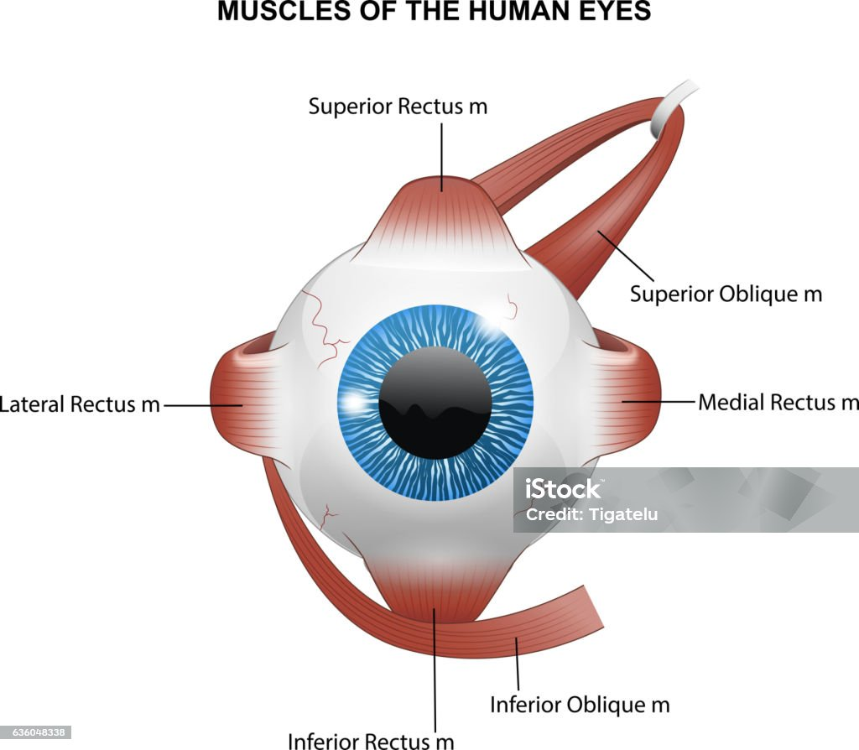
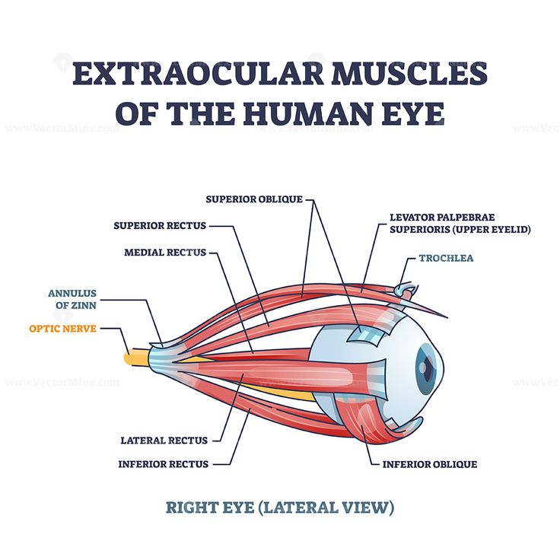
Muscles of the eye
• The eye contains six muscles: 4 recti muscles and 2 oblique muscles which are:
Superior rectus muscle
2. Inferior rectus muscle
3. Medial rectus muscle
4. Lateral rectus muscle
5. Inferior oblique muscle
6. Superior oblique muscle

Slide 10
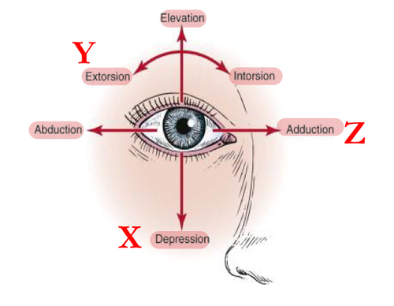
Eye movement
• The movements of the eye are controlled by the extraocular muscles. These
movements include:
Adduction (the eye moves inward toward the nose)
2. Abduction (the eye moves outward toward the ear)
3. Elevation (the eye moves up)
4. Depression (the eye moves down)
5. Intorsion (rotates the top of the eye towards the nose)
6. Extorsion (rotates the top of the eye towards the ear)

Slide 11
Paranasal Sinuses
• Paranasal sinuses:
Air-filled spaces that surround the nasal cavity and lined by
mucous membrane.
• Functions:
Humidify and heat the inhaled air
2. Facilitate the immune response of the respiratory system
3. Reduce the weight of the skull
Types: The four pairs of sinuses are named by their corresponding bones and include :
The maxillary sinuses
2. The frontal sinuses
3. The sphenoidal sinuses
4. The ethmoidal sinuses (or cells

Slide 12
