Slide 1
Headache
Dr. Lamees Abd ALRaheem
M.B.CH.B F.I.C.M.S

Slide 2
Headache
Headache is the symptom of pain in the head parts whether in the face or the scalp.
Headaches are broadly classified as "primary" or "secondary".

Slide 3
Primary headaches
Primary headaches are recurrent headaches
no clear underlying disease or structural problems. For example, migraine.
primary headaches may cause significant daily pain and disability, but are not dangerous.
90% of all headaches are primary headaches.
Primary headaches usually first start when people are between 20 and 40 years old.
The most common types of primary headaches is tension-type headaches.

Slide 4
Secondary headaches
Secondary headaches are caused by an underlying disease
Secondary headaches can be dangerous.
Certain "red flags" or warning signs indicate a secondary headache may be dangerous.

Slide 5
Pathophysiology
The brain itself is not sensitive to pain, because it lacks pain receptors.
Headaches often result from traction to or irritation of the meninges and blood vessels. The pain receptors may be stimulated by head trauma or tumors and cause headaches.
Primary headaches are more difficult to understand than secondary headaches. The exact mechanisms which cause migraines, tension headaches and cluster headaches are not known.

Slide 6
Pathophysiology of Primary Headache
Migraines are currently thought to be caused by dysfunction of the nerves in the brain.
Tension headaches are thought to be caused by activation of peripheral nerves in the head and neck muscles.
Cluster headaches involve over-activation of the trigeminal nerve and hypothalamus in the brain, but the exact cause is unknown.

Slide 7
Migraine
Migraine= criteria for diagnosis
  Unilateral (affecting one side of the head)
  Pulsating
  Moderate or severe pain intensity
  Worsened by or causing avoidance of routine physical activity
+ One or more of the following:
  Nausea and/or vomiting;
  Sensitivity to both light (photophobia) and sound (phonophobia)

Slide 8
Epidimiology
Worldwide, migraine affects nearly 15%. It is more common in women than men
Triggers
Migraine may be induced by triggers, like hunger, sleep deprivation, certain food, hormonal factors like oral contraceptives smoking, and others.
Treatment There are three main aspects of treatment:
Trigger avoidance, acute symptomatic control, and medication for prevention.
Medications the anticonvulsants and the beta blockers propranolol
Analgesics Recommended initial treatment for those with mild to moderate symptoms are simple analgesics such as nonsteroidal anti-inflammatory drugs (NSAIDs) or the combination of paracetamol , aspirin, and caffeine.
Paracetamol, either alone or in combination with metoclopramide, is another effective treatment with a low risk of adverse effects

Slide 9
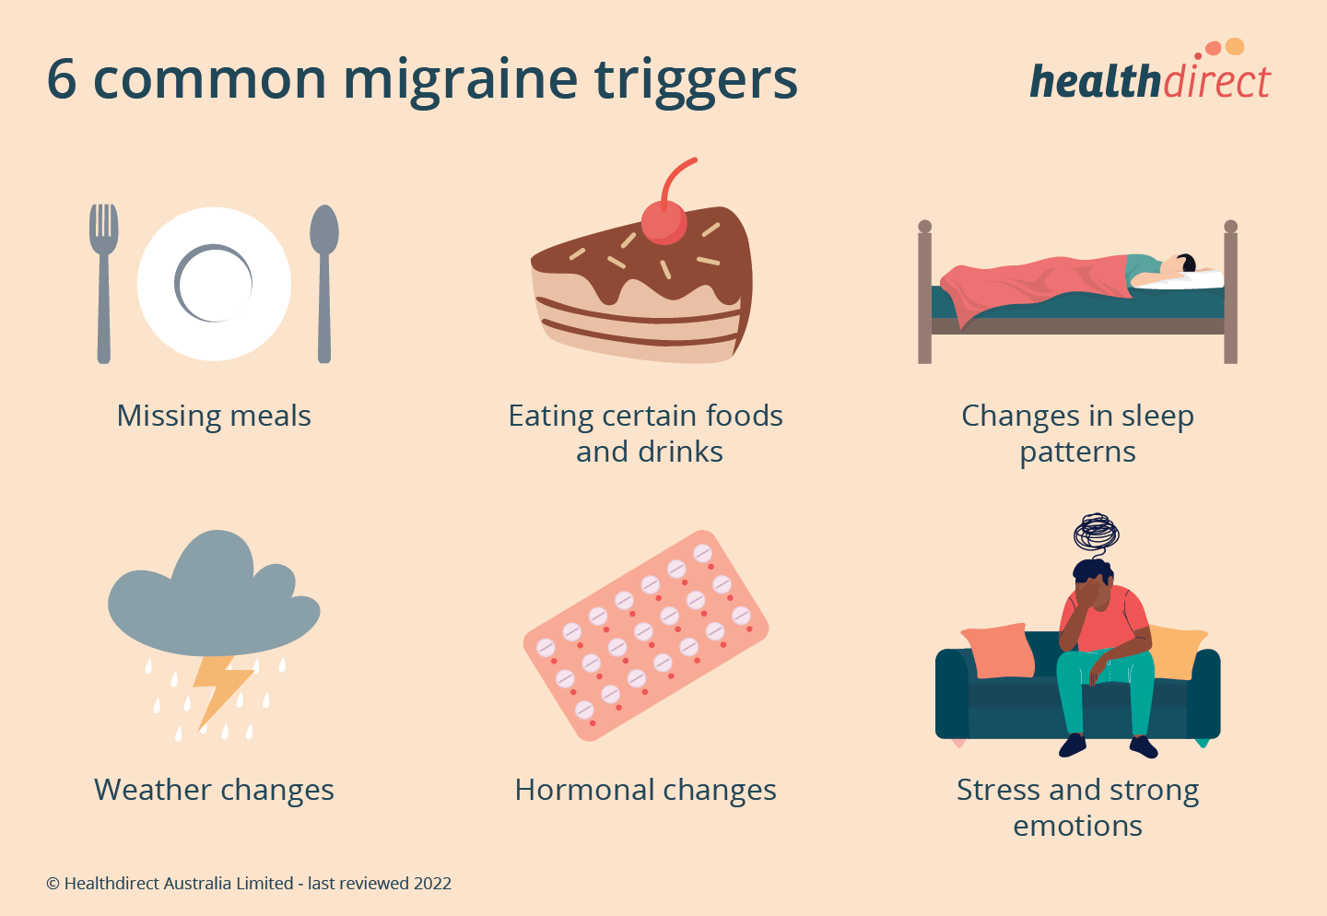

Slide 10
Tension headache
Tension headache, also known as stress headache, or tension-type headache (TTH)
is the most common type of primary headache. The pain affecting both sides of the head as a band of pressure.
Tension-type headaches account for nearly 90% of all headaches

Slide 11
Cluster headache
Cluster headache (CH) is a neurologicaL disorder characterized by recurrent severe headaches on one side of the head, typically around the eye. There is often accompanying eye watering, nasal congestion.
The cause is unknown. Risk factors include a history of exposure to tobacco smoke and a family history of the condition.
Diagnosis is based on symptoms.
management includes lifestyle changes such as avoiding potential triggers.
Treatments for acute attacks include oxygen or a fast-acting triptan.
The condition affects about 0.1% of the general population

Slide 12
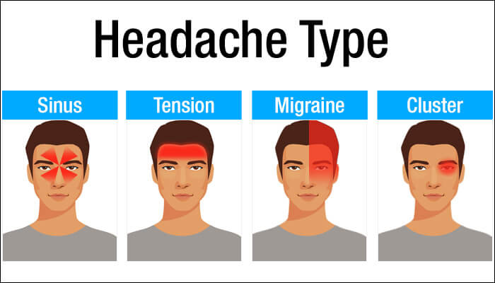

Slide 13
Causes of secondary headaches include the following:
Meningitis: inflammation of the meninges which presents with fever and stiff neck.
Bleeding inside the brain (intracranial hemorrhage)
Subarachnoid hemorrhage (acute, severe headache, stiff neck without fever)
Rupture of …aneurysm, arteriovenous malformation
Brain tumor: dull headache, worse with exertion and change in position, accompanied by nausea and vomiting.
Temporal arteritis: inflammatory disease of arteries common in the elderly (average age 70) with fever, headache, weight loss, jaw claudication
acute closed angle glaucoma (increased pressure in the eyeball): headache that starts with eye pain, blurry vision.
Traumatic headache include fractures and bleeding from trauma .
Headache or facial pain attributed to disorder of the
neck, eyes, ears, nose, sinuses, teeth, mouth or other facial or cervical structure
Headache attributed to psychiatric disorder

Slide 14
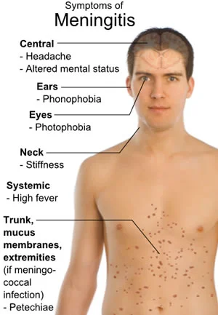
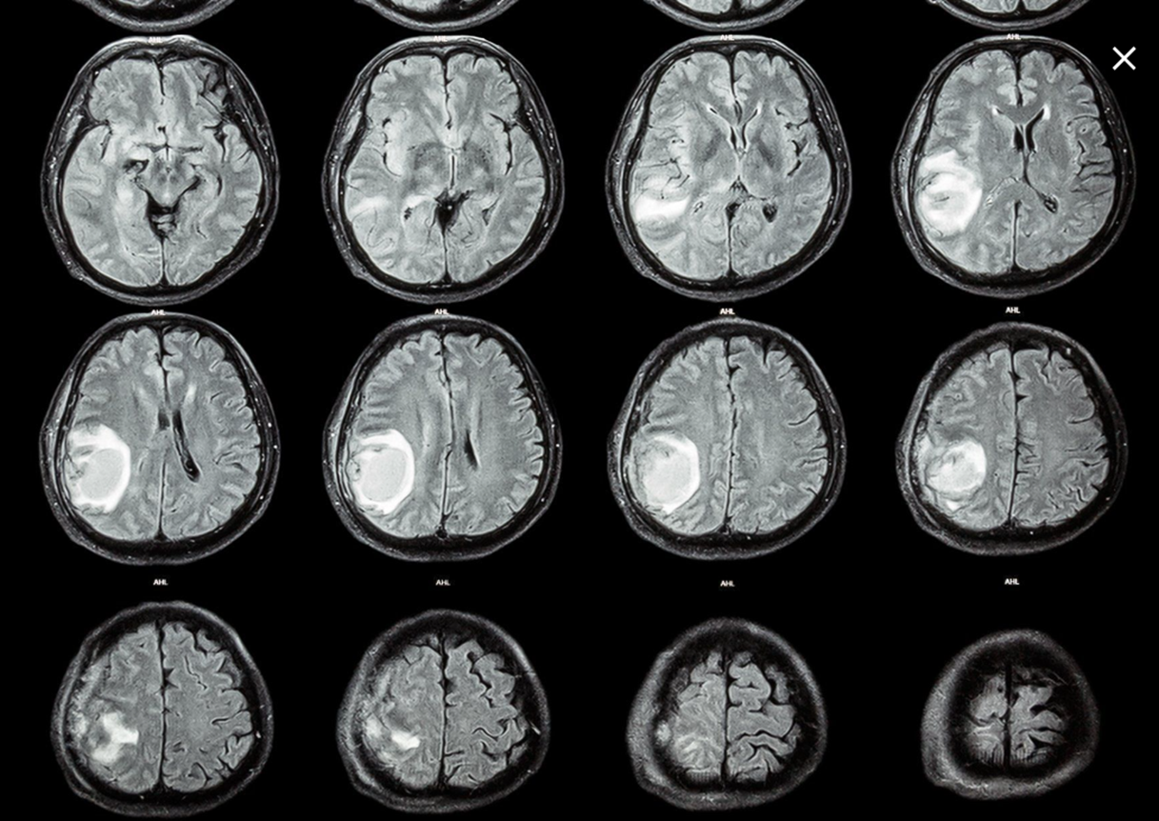

Slide 15
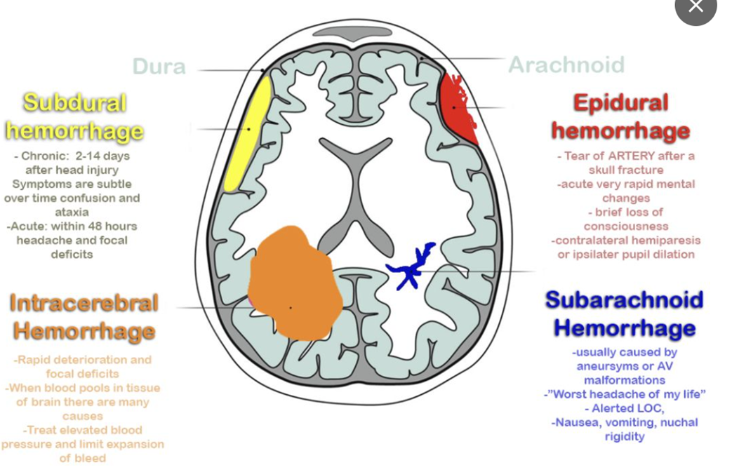
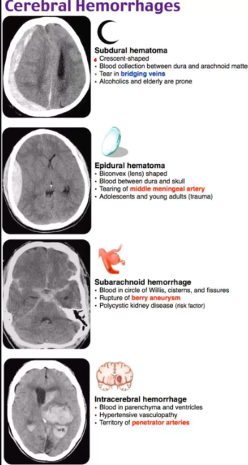

Slide 16
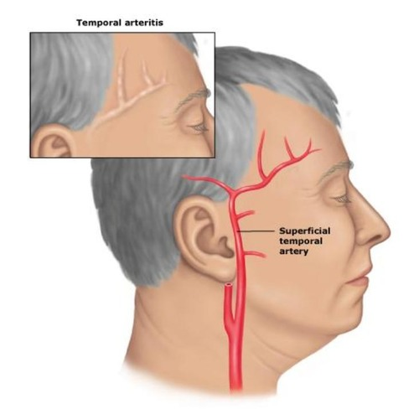
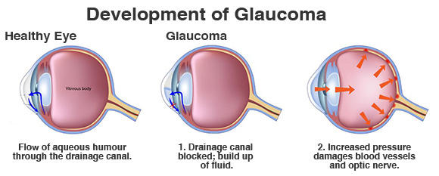

Slide 17
The red flags for identifying a secondary headache
Systemic symptoms (fever or weight loss)
Systemic disease (HIV infection, malignancy)
Neurologic symptoms or signs like Fit or weakness or unilateral parasthesia or change in personality.
Onset sudden (thunderclap headache)
Onset after age 40 years
Previous headache history (first, worst, or different headache)
Severe headache following head trauma
Headache triggered by cough, exertion

Slide 18
Neuroimaging
Old headaches
Most old, chronic headaches do not require neuroimaging.
If a person has the characteristic symptoms of a migraine, neuroimaging is not needed as it is very unlikely the person has an intracranial abnormality.
If the person has neurological findings, such as weakness, on exam, neuroimaging may be considered.

Slide 19
Neuroimaging
New headaches
All people who present with red flags indicating a dangerous secondary headache should receive neuroimaging. The best is Non-contrast computerized tomography (CT) scan is usually the first step in head imaging as it is readily available in Emergency Departments and hospitals and is cheaper than MRI.
Non-contrast CT is best for identifying an acute head bleed.
Magnetic Resonance Imaging (MRI) is best for brain tumors and problems in the posterior fossa, or back of the brain. MRI is more sensitive for identifying intracranial problems

Slide 20


