Slide 1
Hypertension

Slide 2
Factors Influencing Blood Pressure
Blood Pressure
Cardiac Output
Systemic Vascular
Resistance
=
x

Slide 3
Factors Influencing BP
HR
SNS/PNS
Vasoconstriction/vasodilation
Fluid volume
  Renin-angiotensin
  Aldosterone
  ADH

Slide 4
Hypertension
Definition
Hypertension is sustained elevation of BP
  Systolic blood pressure ≥ 140 mm Hg
  Diastolic blood pressure ≥ 90 mm Hg

Slide 5
Blood Pressure Classification
BP Classification | SBP mmHg | DBP mmHg
Normal | < 120 and | < 80
Pre-hypertension* | 120-139 or | 80-89
Stage 1 Hypertension | 140-159 or | 90-99
Stage 2 Hypertension | > 160 or | > 100
*newly recognized, requiring lifestyle modifications

Slide 6
Hypertension
For persons over age 50, SBP is more important than DBP as a CVD risk factor
Starting at 115/75 mmHg, CVD risk doubles with each increment of 20/10 mmHg throughout the BP range

Slide 7
Classification of Hypertension
Primary (Essential) Hypertension
- Elevated BP with unknown cause
- 90% to 95% of all cases
Secondary Hypertension
- Elevated BP with a specific cause
- 5% to 10% in adults

Slide 8
Classification of Hypertension
Primary Hypertension
- Contributing factors:
• ↑ SNS activity
• Diabetes mellitus
• ↑ Sodium intake
• Excessive alcohol intake

Slide 9
Classification of Hypertension
• Secondary Hypertension
- Contributing factors:
• Coarctation of aorta
• Renal disease
• Endocrine disorders
• Neurologic disorders
- Rx: Treat underlying cause

Slide 10
Risk Factors for Primary Hypertension
Age (> 55 for men; > 65 for women)
Alcohol
Cigarette smoking
Diabetes mellitus
Elevated serum lipids
Excess dietary sodium
Gender

Slide 11
Risk Factors for Primary Hypertension
Family history
Obesity (BMI > 30)
Ethnicity (African Americans)
Sedentary lifestyle
Socioeconomic status
Stress

Slide 12
Hypertension
Clinical Manifestations
• Frequently asymptomatic until severe and target organ disease has occurred
  Fatigue, reduced activity tolerance
  Dizziness
  Palpitations, angina
  Dyspnea

Slide 13
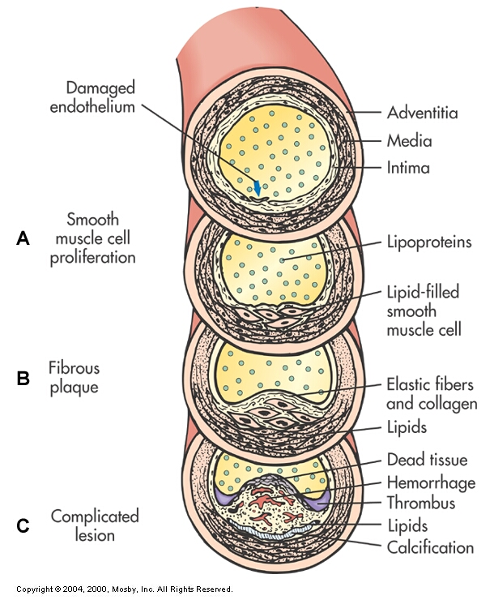
Hypertension: Complications
Complications are primarily related to development of atherosclerosis (“hardening of arteries”), or fatty deposits that harden with age

Slide 14
Hypertension
Complications
The common complications are
target organ diseases occurring in the
Heart
Brain
Kidney
Eyes

Slide 15
Hypertension
Complications
Hypertensive Heart Disease
  Coronary artery disease
  Left ventricular hypertrophy
  Heart failure

Slide 16
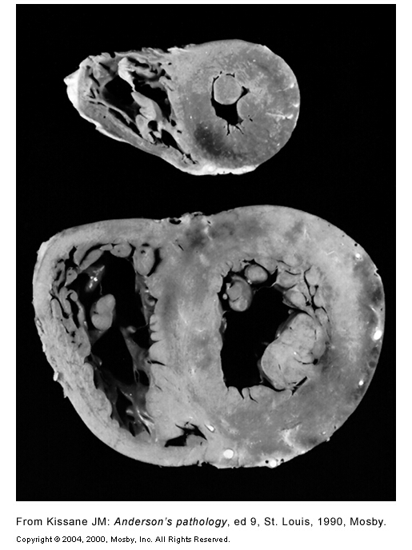
Left Ventricular Hypertrophy
Fig. 32-3

Slide 17
Hypertension
Complications
Cerebrovascular Disease
  Stroke
Peripheral Vascular Disease
Nephrosclerosis
Retinal Damage

Slide 18
Hypertension
Diagnosis
• Diagnosis requires several elevated readings over several weeks (unless > 180/110)
• BP measurement in both arms
- Use arm with higher reading for subsequent measurements

Slide 19
Hypertension
Diagnosis
Ambulatory BP Monitoring
  For “white coat” phenomenon, hypotensive or hypertensive episodes, apparent drug resistance

Slide 20
Hypertension
BP Measurement
See Table 32-12 (p. 794)

Slide 21
Treatment Goals
Goal is to reduce overall cardiovascular risk factors and control BP by the least intrusive means possible
  BP < 140/90
  In patients with diabetes or renal disease, goal is < 130/80

Slide 22
Benefits of Lowering BP
Average Percent Reduction
Stroke incidence 35–40%
Myocardial infarction 20–25%
Heart failure 50%

Slide 23
Algorithm for Treatment of Hypertension
Lifestyle Modifications
Not at Goal Blood Pressure (<140/90 mmHg)
(<130/80 mmHg for those with diabetes or chronic kidney disease)
Initial Drug Choices
Without Compelling
Indications
With Compelling
Indications
Stage 1 Hypertension
(SBP 140–159 or DBP 90–99 mmHg)
Thiazide-type diuretics for most.
May consider ACEI, ARB, BB, CCB,
or combination.
Stage 2 Hypertension
(SBP >160 or DBP >100 mmHg)
2-drug combination for most (usually thiazide-type diuretic and
ACEI, or ARB, or BB, or CCB)
Drug(s) for the compelling indications
Other antihypertensive drugs (diuretics, ACEI, ARB, BB, CCB)
as needed.
Not at Goal
Blood Pressure
Optimize dosages or add additional drugs
until goal blood pressure is achieved.
Consider consultation with hypertension specialist.

Slide 24
Hypertension
Collaborative Care
• Lifestyle Modifications
- Weight reduction
- Dietary changes (DASH diet)
- Limitation of alcohol intake (< 2 drinks/day for men;
< 1/day for women)
- Regular physical activity
- Avoidance of tobacco use
- Stress management

Slide 25
Hypertension
Collaborative Care
• Nutritional Therapy: DASH Diet = Dietary Approahes to Stop HTN
- Sodium restriction
- Rich in vegetables, fruit, and nonfat
dairy products
- Calorie restriction if overweight

Slide 26
Hypertension
Collaborative Care
• Drug Therapy
- Reduce SVR
- Decrease volume of circulating blood

Slide 27
Hypertension
Collaborative Care
• Drug Therapy
  Diuretics
  Adrenergic inhibitors
  β - Adrenergic blockers
  ACE Inhibitors
  Calcium channel blockers

Slide 28
Hypertension: Drug Therapy
Thiazide-type Diuretics
  Inhibit NaCl reabsorption
  Side effects:
    Electrolyte imbalances: ↓ Na, ↓ Cl, ↓ K** (advise K rich foods)
    Fluid volume depletion (monitor for orthostatic hypotension)
    Impotence, decreased libido

Slide 29
Hypertension: Drug Therapy
Adrenergic Inhibitors
  Reduce sympathetic effects that cause HTN by:
    Reducing sympathetic outflow
    Blocking effects of sympathetic activity on vessels
  Side effects
    Hypotension
    Varied, depending on specific drug

Slide 30
Hypertension: Drug Therapy
β – adrenergic blockers (suffix “olol”)
  (metoprolol, propranolol)
  Block β – adrenergic receptors
    ↓ HR, ↓ inotropy, reduces sympathetic vasoconstriction)
  Side effects
    Bradycardia, hypotension, heart failure, impotence

Slide 31
Hypertension: Drug Therapy
ACE Inhibitors (suffix “pril)
  Enalapril, captopril
  Prevents conversion of angiotensin I to angiotensin II, thereby preventing the vasoconstriction associate with A II.
  Side effects
    Hypotension, cough

Slide 32
Hypertension: Drug Therapy
Calcium Channel Blockers
  Block movement of calcium into cells, causing vasodilation
  Side effects
    Brdaycardia, heart block

Slide 33
Hypertension
Collaborative Care
• Drug Therapy and Patient Teaching
- Identify, report, and minimize side effects
• Orthostatic hypotension
• Sexual dysfunction
• Dry mouth
• Frequent urination

Slide 34
Primary Hypertension
Nursing Management
Nursing Diagnoses
- Ineffective health maintenance
- Anxiety
- Sexual dysfunction
- Ineffective therapeutic regimen management r/t
- lack of S/S of HTN, side effects of Rx, cost of Rx, etc.

Slide 35
Primary Hypertension
Nursing Management
Nursing Implementation
Health Promotion
• Individual patient evaluation
• Screening programs
• Cardiovascular risk factor modification

Slide 36
Hypertensive Crisis
• Severe, abrupt elevation in BP
• The rate of ↑ in BP is more important than the absolute value
• Most common in patients with a history of HTN who have failed to comply with medications or who have been under-medicated

Slide 37
Hypertensive Crisis
Clinical Manifestations
- Hypertensive encephalopathy (H/A, N & V,
seizures, confusion, coma)
- Renal insufficiency
- Heart failure
- Pulmonary edema

Slide 38
Hypertensive Crisis
Nursing and Collaborative Management
Hospitalization
- IV drug therapy
- Monitor cardiac and renal function
- Neurologic checks
- Determine cause
- Education to avoid future crises

Slide 39
Supporting Materials
Website www.nhlbi.nih.gov
For patients and the general public
  Facts About the DASH Eating Plan
  Your Guide to Lowering Blood Pressure
For health professionals
  Reference Card

