Slide 1
Lecture #2
First semester
Al-Mustaqbal University College
Nursing Department
2nd Class
Adult Nursing
NURSING CARE OF PATIENT WITH CANCER
:by
professor
Dr. Fakhria Jaber Muhaibes

Slide 2
DEFINITION
A disease process that begins when an abnormal cell is transformed by the genetic mutation of cellular DNA (Normal cells mutate into abnormal cells)
Group of complex diseases; affect different organs and systems.
The abnormal cells have invasive characteristics and infiltrate other tissues. This phenomenon is metastasis.
Cancer cells are described as malignant. These cells demonstrate uncontrolled growth that does not follow physiologic demand.

Slide 3
Incidence and Prevalence
Cancer accounts for about 25% of death on yearly basis.
2. Males: 3 most common types of cancer are prostate, lung and bronchial, colorectal.
3. Females: 3 most common types of cancer are breast, lung and bronchial, and colorectal.

Slide 4
RISK FACTORS
Age
Stress
Heredity
Gender (Females with breast cancer)
Poverty (Stress, diet, not doing screening tests)
Diet (Some preserved food considered genotoxic)
Occupation (healthcare providers exposure to x-ray)
Infection
Tobacco, alcohol, recreational drug use.
Notes:
Age:
Long-term exposure to high dose of promotional agents.
Alter immune response
Free radicals tend to accumulate in the cells over time
Hormonal changes:
Increase risk of breast and uterine cancers in post menopause.
Increase risk of prostate cancer in older men due to breakdown of testosterone into carcinogenic forms.
Stress:

Slide 5
Pathophysiology of the Malignant Process
Normal Cell Growth includes two events
a. Replication of cellular DNA
b. Mitosis (cell division)
Four Phases of Cell Cycle
a. G1: Gap 1 Phase; cell enlarges, synthesizes proteins to prepare for DNA replication
b. Synthesis (S) Phase: DNA replicates and chromosomes duplicate
c. G2: Gap 2 Phase: cell prepares for mitosis
d. Mitosis M Phase: mitosis occurs with 2 copies of cell (daughter cells).

Slide 6
Pathophysiology of the Malignant Process
Cell cycle is under control of cyclins which control process by working with enzymes; some cyclins “brake” (stop) the cellular division.
Forms the basis of how some chemotherapeutic agents work against cancers.
Differentiation: normal process occurring over many cell cycles for special tasks.
Some unproductive differentiations occur (seen on biopsy reports).
1. Hyperplasia: increase in number or density of normal cells.
2. Metaplasia: change of cell type.

Slide 7
NEOPLASM
A neoplasm is a mass of new tissue that grows independently of its surrounding structures and has no physiological purpose.
They are classified as benign or malignant on the basis of their potential to damage the body and on their growth characteristics.

Slide 8
TUMOR INVASION AND METASTASIS
Invasion: the ability of cancer cells to invade adjunct tissues
The pressure of growing tumor can cause atrophy and necrosis to adjunct tissues.
Many cancer cells release enzymes that lyse cell
membranes of normal tissues.
Cancer cells are easily separate from neoplasm and moves into surrounding tissues.
Motile cells are attracted by chemical signals
produced by activity within normal cells

Slide 9
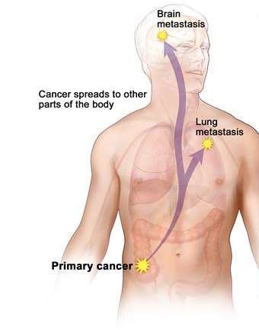
TUMOR INVASION AND METASTASIS
Metastasis: travelling of malignant cells from the primary tumor to invade other tissues and organs of the body and form a secondary tumor.

Slide 10
CANCER IDENTIFICATION
Classification: Naming of the tumor
  Incorporates the Latin stem identifying the tissue from which the tumor arises
Tissue origin | Name | Example
Epithelial tissue | Carcinoma | Adenocarcinoma: a glandular malignancy arising from epithelial tissue
Supportive tissue | Sarcoma | Fibrosarcoma: a cancer of fibrous connective tissue
Germ tissue | Seminoma
Hematopoietic malignancies are usually named by the type of immature blood cell that predominates.
  Ex. Myelocytic leukemia: immature form of the granuloyte is predominate.
Other names incorporate of discoverer. (Hodgken’s disease)

Slide 11
CANCER IDENTIFICATION
Grading: describing tumor aggressiveness
  Evaluates the amount of differentiation of the cell and estimates the rate of growth based on mitotic rate
  The most differentiated is the least malignant (grade 1)
  The least differentiated is the most aggressively malignant
(grade 4)

Slide 12
CANCER IDENTIFICATION
Staging: spread within or beyond the tissue of origin
  Is used to classify solid tumors and refers to the relative size of tumor and extent of the disease.
  TNM staging classification system
    T (tumor): relative tumor size, depth of invasion, and surface
spread
    N (nodes): presence and extent of lymph node involvement
    M (metastasis): presence or absence of distant metastasis

Slide 13
DIAGNOSIS
Diagnostic tests:
  X-ray, CT, ultrasonography, and MRI to locate abnormal tissues or tumor.
  Microscopic histologic and cytologic examination to know the type of cell and its structural differences from the parent tissue.
  Lymph nodes biopsy to determine whether metastasis has begun.
  Blood tests to check the tumor markers (Antigens, hormones, proteins, or enzymes)
  Nuclear imaging
  Direct visualization (i.e. endoscopy, cystoscopy)

Slide 14
TREATMENT
The goals of treatment are aimed to cure, control, or palliation of symptoms.
Treatment can be through:
  Surgery
  Chemotherapy
  Radiation therapy
  Bone marrow and stem cell transplants

Slide 15
TREATMENT- SURGERY
Prophylactic surgery:
  Aims to remove tissue or organs that are likely to develop cancer
  Ex. Mastectomy can be done for a woman with a strong history of breast cancer, abnormal findings of mammography.
Diagnostic surgery:
  Aims to ensure histologic diagnosis and staging of cancer.
  Ex. Biopsy, endoscopy, laparoscopy, and open surgical exploration.

Slide 16
TREATMENT- SURGERY
Treatment surgery:
  Aims to remove the entire tumor and involved surrounding tissue and lymph nodes as much as possible and feasible.
Palliative surgery:
  If the tumor is in a nonresectable location or deeply invasive with metastasis.
  Aims to allow the involved organs to function as long as possible, to relieve pain and provide comfort, or to bypass an obstruction.

Slide 17
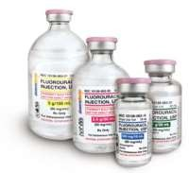
TREATMENT- CHEMOTHERAPY
Chemotherapy: the use of cytotoxic medications to cure some cancers, decrease tumor size, or to prevent or treat suspected metastasis.
It works by:
  Disrupting the cell cycle in various phases by
interrupting cell metabolism and replication.
  Interfering with the ability of the malignant cell to synthesize vital enzymes and chemicals.

Slide 18
TREATMENT- CHEMOTHERAPY
The cell-kill hypothesis:
  The chemotherapy kills fixed percentage of cells and leaves some behind.
  The patient will receive several doses till the remains cells become small enough that body’s immune system can finish the job.

Slide 19
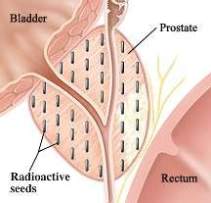
TREATMENT- RADIATION THERAPY
Delivering ionized radiations of gamma and x-rays in one of two ways:
  Teletherapy: external radiation
  Brachytherapy: internal radiation
    Placing the radioactive material directly into or adjunct to the
tumor
    High dose to the tumor and lower dose to tissues

Slide 20
TREATMENT- RADIATION THERAPY
Radiation kills cells by causing lethal injury to DNA, especially cells in fast growth.
The goal of the radiation therapy is to achieve maximum tumor control with a minimum of damage to normal tissue.

Slide 21
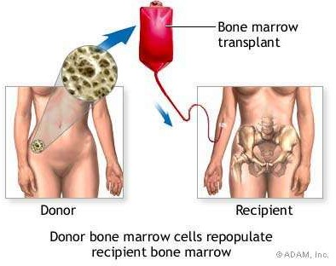
TREATMENT- BONE MARROW AND PERIPHERAL BLOOD STEM CELL TRANSPLANTATIONS
BMT is an accepted treatment to stimulate a nonfunctioning marrow or to replace marrow.

Slide 22
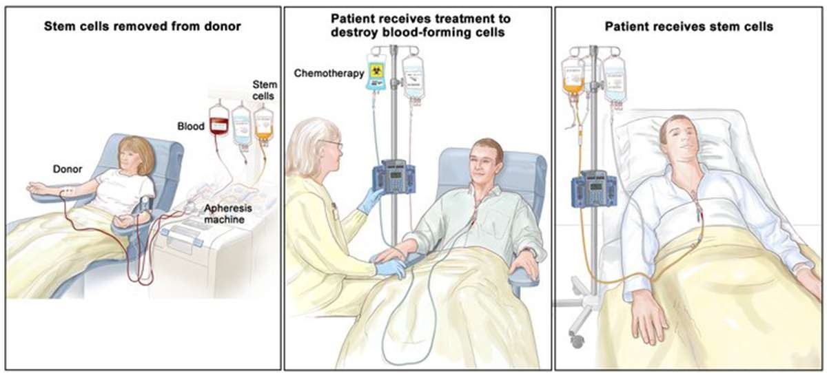
TREATMENT- BONE MARROW AND PERIPHERAL BLOOD STEM CELL TRANSPLANTATIONS
PBSCT is the process of removing circulation stem cells from the peripheral blood through apheresis and returning these cells to the patient after dose-intensive chemotherapy.

Slide 23
NURSING CARE
Nursing diagnosis and interventions
Anxiety
  Carefully assess the client’s level of anxiety
  Establish a therapeutic relationship
  Encourage the client to express his feelings
Disturbed body image
  Provide supportive environment
  Teach strategies for minimizing physical changes, such as providing
skin care during radiation therapy
  Encourage wearing colorful head cover

Slide 24
NURSING CARE
Anticipatory grieving
  Use therapeutic communication skills
  Answer questions about illness
Risk of infection
  Monitor vital signs
  Monitor WBCs
  Protect skin and mucus membrane from injuries
  Encourage high protein diet
Imbalanced nutrition: less than body requirement
  Assess current eating pattern
  Teach the principles of maintaining good nutrition

Slide 25
NURSING CARE
Impaired tissue integrity
  Carefully assess and evaluate the type of tissue impairment
present. Identify possible sources such as chemotherapy.
  Observe for systemic signs of infection
  Monitor for the dry mouth and lubricate it with moisturizing agent
Acute pain
  Use relaxation techniques
  Administer medications as prescribed

