Slide 1
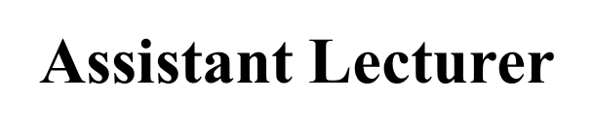
Physical Examination of Head , Face &Ear
Alaa Hamza Hermis
Lecture -3-

Slide 2
Objectives:
At the end of this lab the student will be able to:
I . Demonstrate the ability to safely and accurately complete a comprehensive examination of Head, ear ,face .
2. Demonstrate the ability to accurately & comprehensively document assessment data in organized and legible manner.
3. Evaluate assessment data to determine problems and identify client's concerns.

Slide 3
Preparation
Nurse
Environment
Client
Equipment

Slide 4
(General Approach to assess (Ears , FACE )
1. Greet the patient and explain the assessment techniques that using.
2. Use a quiet room that will be free from interruptions.
3. Ensured that the light in the room provides sufficient brightness adequate observation of the patient.
4. Place the patient in an upright sitting position or for patients who cannot tolerated he sitting position assess head so that it can be rotated from side to side
5. Visualize the underlying structures during the assessment allow adequate description of findings.
6. Always compare right and left ears, as well as right and left nose, sinuses, mouth, and throat ect..

Slide 5
Head Assessment
Inspection:
Symmetry : symmetrical
Shape : Normocephalic
Abnormal :
Hydrocephalic: enlargement of the head without change facial
structure .
Acromegaly: enlargement of skull and facial bones cause by excessive secretion of growth hormone.
Scalp should be intact, free of lesion and laceration (wound)

Slide 6
Palpation :
Palpate scalp begin with frontal ,parietal, temporal and occipital
Normal skull should be smooth ,no
tenderness and no masses
Assess temporal artery it should be smooth ,non tender pulse is within +1
Abnormal: artery may be tender, hard consistency because of arteritis

Slide 7
Face
Inspection:
Color : evenly white ,brown ,free of pigmentation
Abnormal: Butterfly distributed on cheeks and nose
Shape: symmetry ,rounded ,oval or square
Hair distribution: evenly distributed on eye brow
Movement: ask client to close his eyes, clench his eye brow and elevate them , smile than puffy his cheeks it should be symmetry

Slide 8
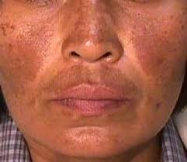
Abnormal: tremors , affected eye cannot close completely with drooping of lip
( Bell’s palsy)

Slide 9
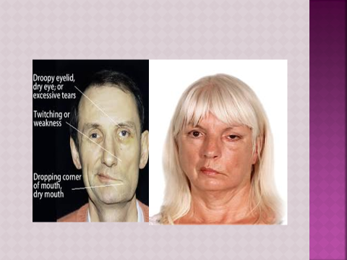
Bell’s palsy

Slide 10
Ear Examination

Slide 11
Equipment
Tongue blade
Watch
Gauze square
Clean gloves
Cotton-tipped applicator
Otoscope with earpieces of different
sizes and pneumatic attachment
Nasal speculum
Penlight
Tuning fork (512)Hz

Slide 12
Sings & Symptoms:
History of hearing problem
Family history
Medication history
Ringing in ears hearing difficulty ,onset ,factors contributing to it, and how it interferes with living activities of daily , corrective hearing device
Pain ,discharge , and lesion

Slide 13
AURICLES
Inspect the auricle for colors, symmetry of size and position 'To inspect position . Note the level at which the superior aspect of the auricle attach to the head in relation to the eye
Normal :
Color same as facial skin
Symmetrical
Auricle aligned with outer canthus of eye, about 1 0" from vertical.
Abnormal:
Bluish color of earlobes(cyanosis) , pallor( cold weather) excessive redness (inflammation or fever)
Asymmetry
Low-set( associate with congenital abnormality as Downs syndrome

Slide 14
Palpate the auricles for texture' elasticity,
and tenderness'
- Gent pull he auricles up-down and back war '
- Fold the Pinna forward (it should recoil).
- apply pressure on the mastoid
Normal
Mobile, firm , and not tender pinna recoils after it is folded
Abnormal
Lesions , scaly skin ,tenderness (infection of external ear)

Slide 15
External Ear Canal :
Using otoscop inspect the external ear canal for cerumen, skin lesion ,pus or blood
Normal: pink in color , dry , hairy , dry yellow or brow cerumen , free of discharge blood and lesion
Abnormal:
Redness , discharge excessive cerumen or lesion
Inspect tympanic membrane :
Color: gray , shinny ,semitransparent
Abnormal:
Pink or red ,blue bleeding , yellow infection with dull surface

Slide 16
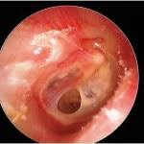
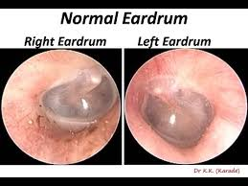
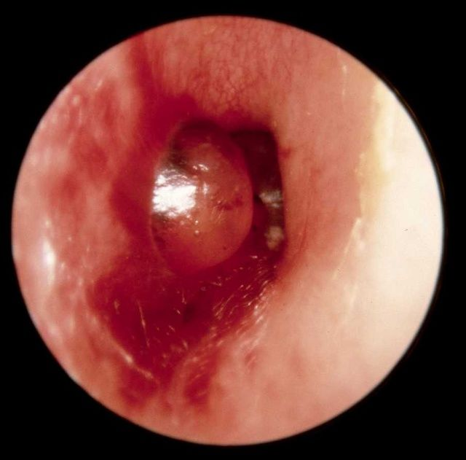

Slide 17
Hearing acuity :
1- Assess client responses to normal voice : audible
Abnormal: request for repeat , lean, cups ear
2- Watch tick test : able to hear ticking in both ear
Abnormal: unable to hear
3- Tuning fork test :
Weber’s test
Rinne test
Romberg test

Slide 18
Weber Test
Purpose ; To Assess Bone Conduction
Forehead
Top the center of the head
Normal ; Centralization of Sound
Weber Test -Ve
Abnormal; Lateralization of Sound
Weber Test +Ve

Slide 19
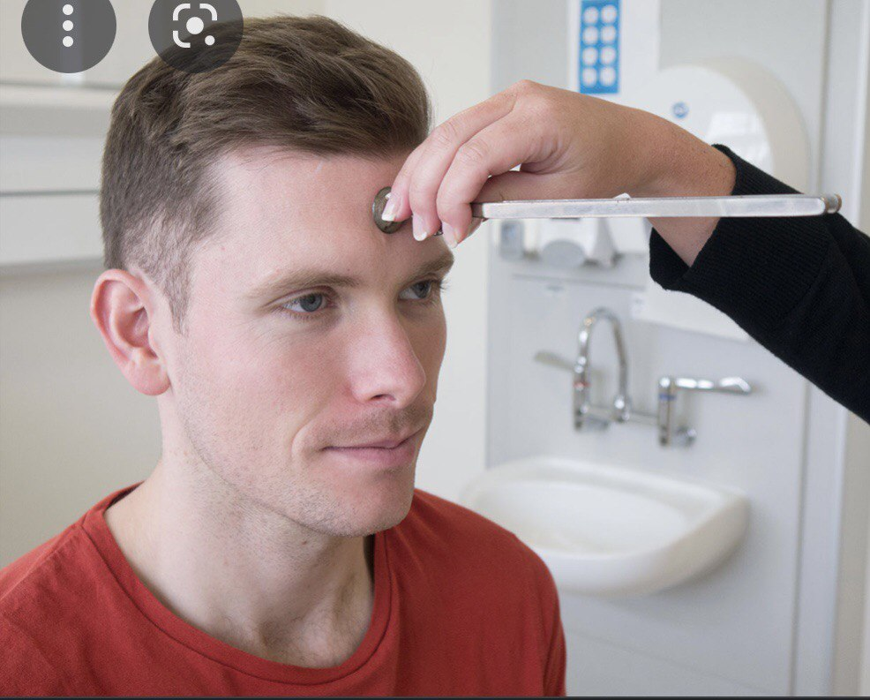
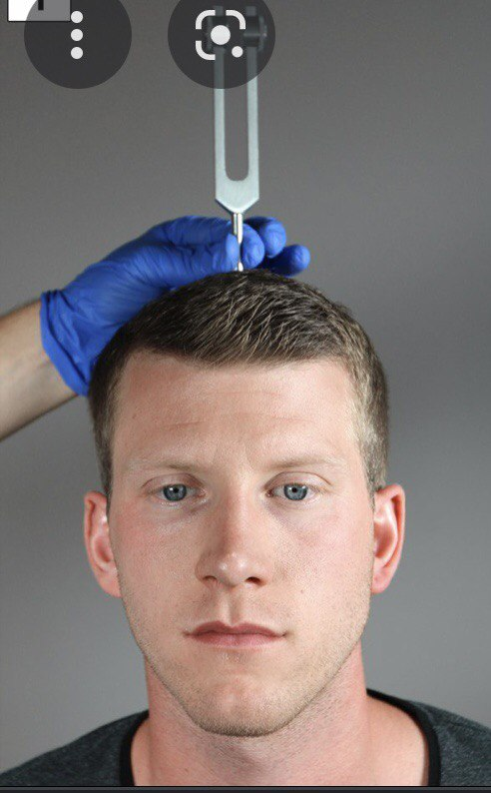
Weber Test

Slide 20
Rinne Test
Purpose; To Compare Between Air
Conduction And Bone Conduction (Time)
Normal :Air Conduction > Bone Conduction
Abnormal: Bone Conduction < Air Conduction

Slide 21
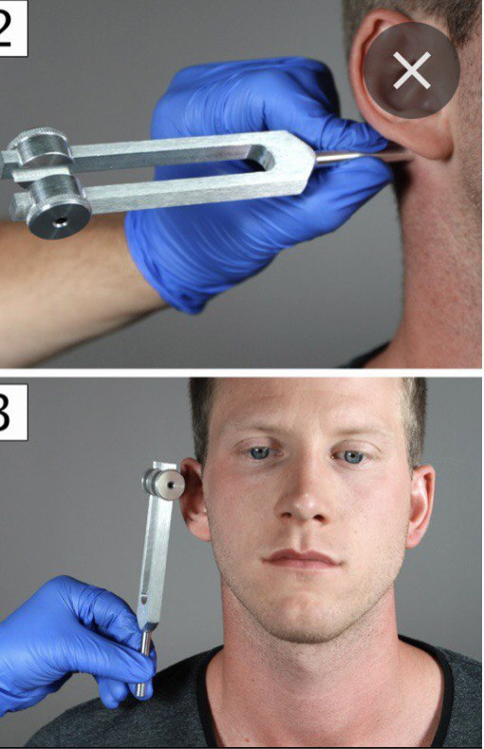
Rinne Test

