Slide 1

Lung & Thorax Assessment
Alaa Hamza Hermis
Lecture -7-

Slide 2
Lung Examination
Objectives:
At the end of this lab, the students will be able to:
1. Demonstrate the ability to safely & accurately complete thorax & lung assessment.
2. Demonstrate the ability to accurately document thorax & lung assessment data in organized
manner.
Equipment Needed
1. Stethoscope
2. Small ruler, marked in centimeters
3. Marking pen
4. Alcohol swab

Slide 3
Preparation
1. Ask the client to sit upright & the male to disrobe to the waist.
2. For female, leave the gown on & open at the back.
3. When examining the anterior chest, lift up the gown & drape it on her shoulders rather than removing it completely.
4. For farther comfort: a warm room, a warm diaphragm end piece.
5. Private examination time with no interruption.

Slide 4
Subjective data:
Cough
Past history of respiratory infections
Self-care behaviors
Shortness of breath
Smoking history
Chest pain with breathing
Environmental exposure

Slide 5
Chest Landmarks
Anterior : Right anterior axillary line ,
Right midclavicular line ,
Mid sternum line
left midclavicular line ,
left anterior axillary line
Mid axillary line
Posterior: L . posterior axillary line , L .mid scapular line ,mid spinal line , R. mid scapular line and R. posterior axillary line ,

Slide 6
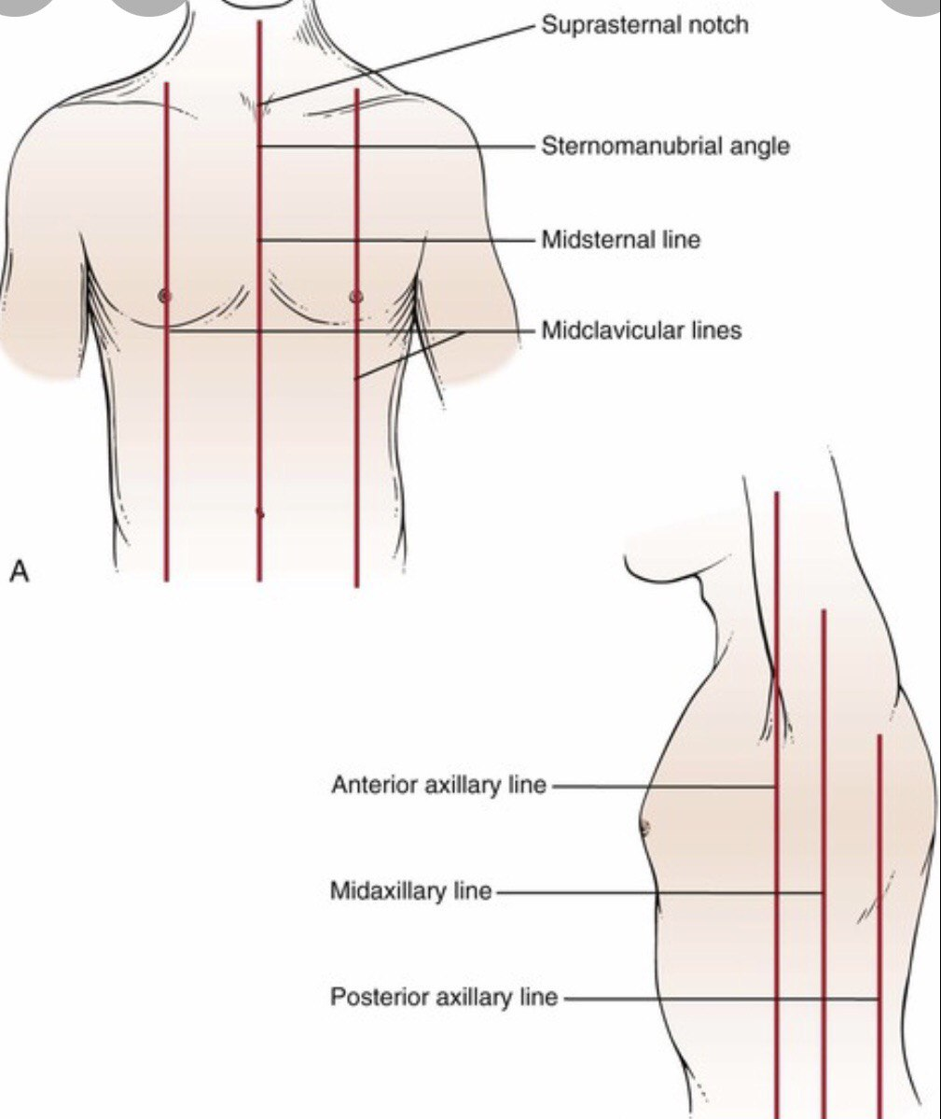

Slide 7
Inspect anterior, posterior, & lateral thorax for the following:
Color : Pink
Intercostals spaces : Even
Chest symmetry: Equal
Rib slope : Less than 90 degree downward
Respiration (rate, rhythm , depth) Even, 14-20 Breath/min
Shape & position of sternum : level with ribs
Position of trachea :Midline

Slide 8

Breathing Pattern
1-Eupnea: Normal breathing is relaxed, effortless, and regular at 14-16 breath\minute
3-Tachypnea: Rapid shallow breathing is a rate above 20 breaths per minute, associated with increased activity or a disease process

Slide 9
4-Bradypnea: slow breathing is a rate blow 12 breath per minute with normal depth and rhythm , associated with Sedation , anesthesia
5-Hypoventilation : Shallow irregular
breathing hypercapnia and hypoxemia such as in COPD
6-Hyperventilation ; increased depth and rate of breathing (kussmaul ‘s respiration caused by diabetic ketoacidosis

Slide 10
7-Cheyne-Stokes : is the term for cycles of breathing characterized by deep, rapid breaths for about 30 seconds, followed by absence of respirations for 10 to 30 seconds. Cheyne-Stokes respirations constitute a serious symptom and precedes death in cerebral hemorrhage, uremia, or heart disease
8- Biot's respiration
rapid, short breathing with pauses of several seconds, indicating increased intracranial pressure.

Slide 11
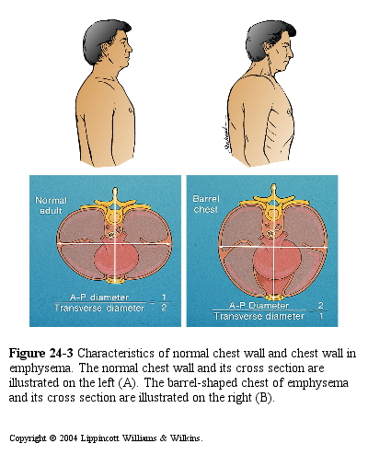
Inspection
Normal chest
  Slight retraction of intercostal spaces

Slide 12
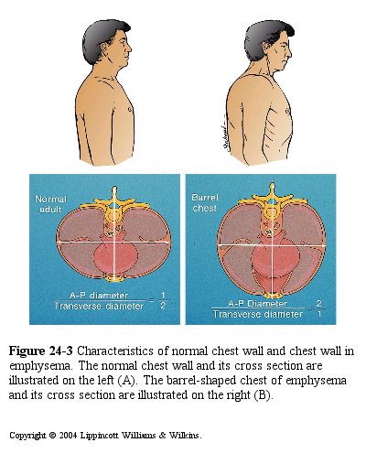
Inspection
Barrel chest

Slide 13
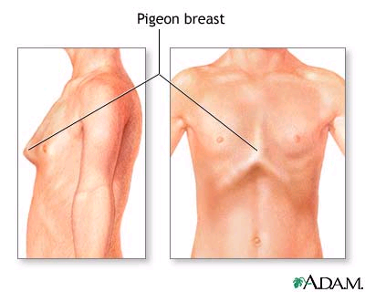
Inspection
Pigeon chest
  Sternum protrudes outward

Slide 14

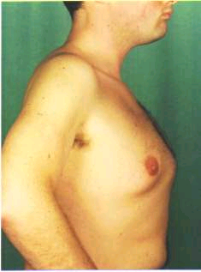
Pigeon Chest

Slide 15
Funnel Chest
Pectus Excavatum ;is a condition in which the Breast Bone (Sternum) appears Sunken and the chest Concave it is sometimes called Funnel Chest

Slide 16
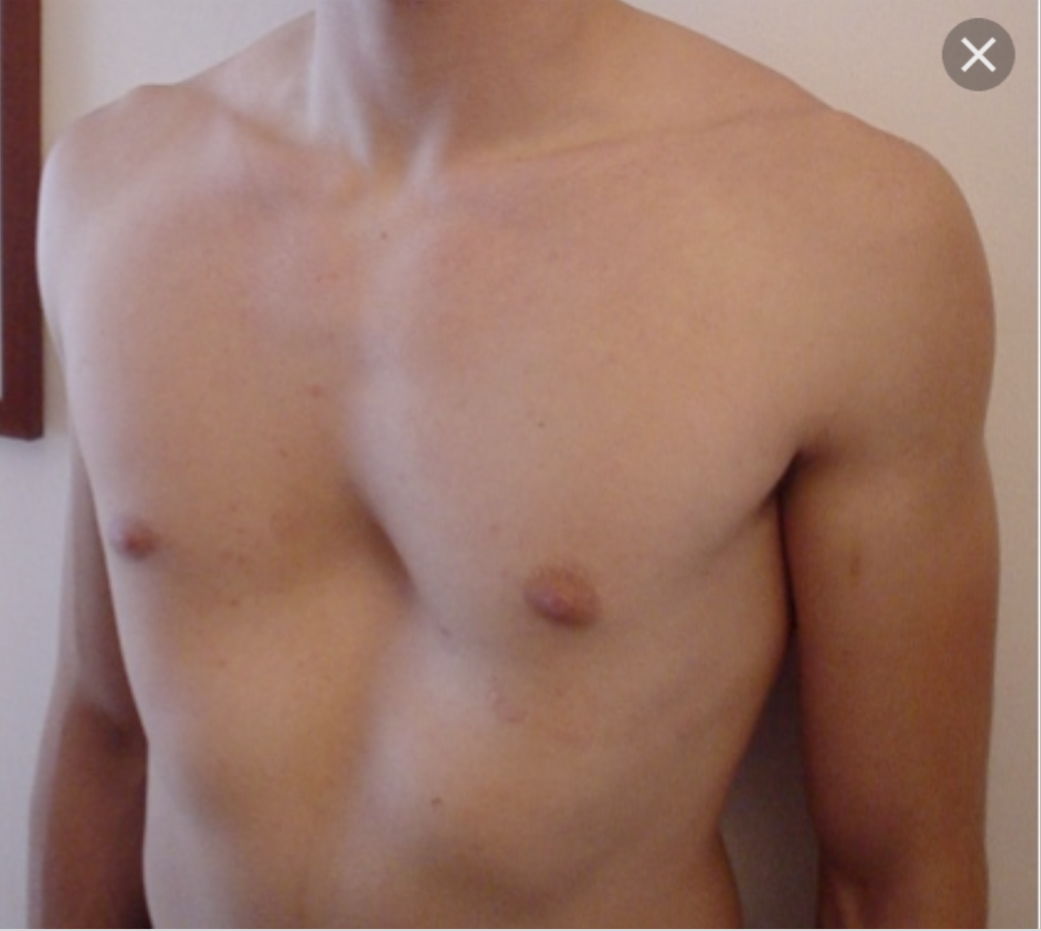
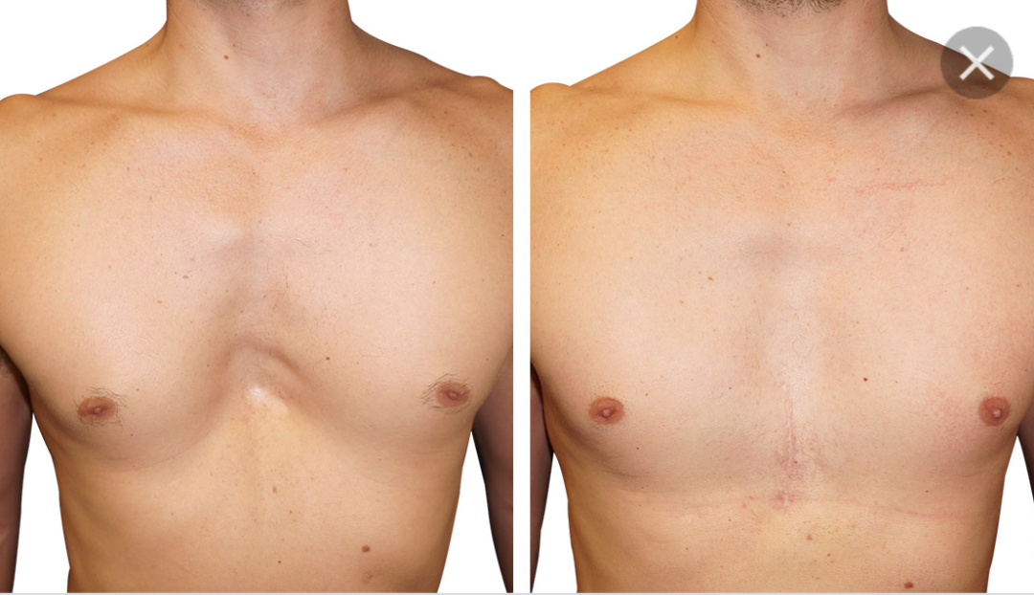
Funnel Chest

Slide 17
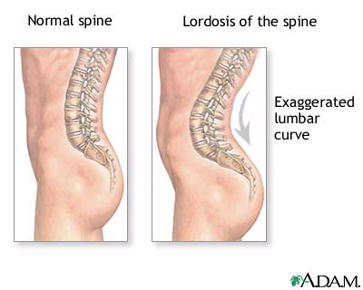
Inspection
Lordosis
    S way-back
  Abnormal curvature of the lumbar spine

Slide 18
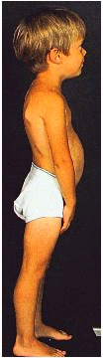
Lordosis

Slide 19
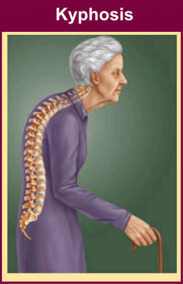
Inspection
Kyphosis
  Abnormal curvature of the thoracic spine

Slide 20
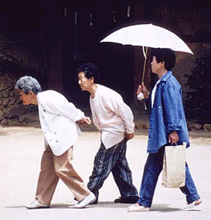
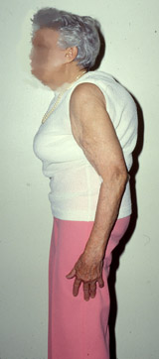
Kyphosis

Slide 21
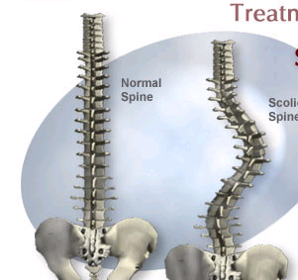
Inspection
Scoliosis
  Lateral curvature of thoracic spine
  Assessment
    Shoulders elevated?
  Complications
    Lung & heart damage
    Back problems
    Body image
Notes:
Scoliosis Complications
emotional problems or lowered self-esteem may occur as a result of the condition or its treatment (specifically bracing)
spinal cord or nerve damage from surgery or severe, uncorrected curve
low back arthritis and pain as an adult
respiratory dysfunction from severe curve

Slide 22
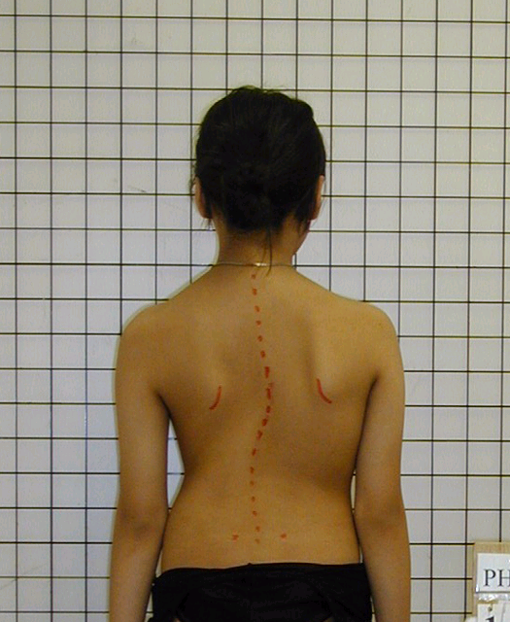
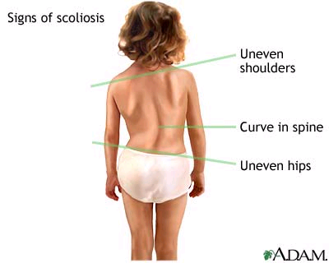
Scoliosis

Slide 23
Palpate thorax at three levels for the following:
1-Sensation : no pain or tenderness
2-Vocal fremitus ( tactius) as client says 99Use either the palm base (the ball) of fingers, or the ulnar edge of one hand.
- Touch the client's chest- Ask the client to repeat a resonant phrases that generate strong vibration
Like 99.
Start over the lung apices & palpate from side to another.- Avoid palpating over the scapulae.
Vibration decreased over periphery of lungs & increased over major airways .

Slide 24
3- Palpate chest expansion :
Posterior : placing your warmed hand on the poster lateral chest wall
- The thumbs should be at level of T9 or T10.
- Slide your hands medially to pinch up a small fold between your thumbs.
- Ask the client to take deep breath.
- Your thumb should move with respiration.
Anterior: placing your warmed hand on the anterolateral wall.
- Thumbs should be along the costal margins & pointing toward the xiphoid process. - Ask the client to take deep breath.
- Watch your thumbs move with respiration.

Slide 25
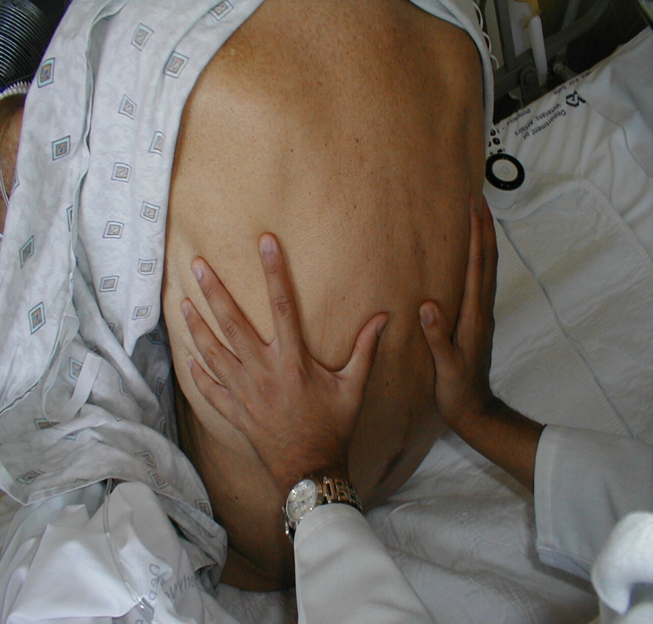
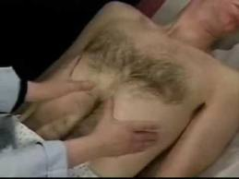
2 to 3-inch symmetrical thoracic expansion.
Symmetrical expansion (thumbs move apart equal distance in both directions).

Slide 26
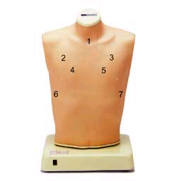
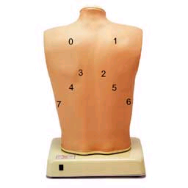
Auscultation
Purpose
Asses normal and abnormal air flow through bronchial tree by using
Diaphragm of stethoscope
Compare R to L

Slide 27
Auscultation: normal lung sound
1-Bronchial : Trachea , high , inspiration shorter than expiration
2-Bronchovesicular :
  Moderate , Between scapulae
  Side of sternum intercostals space , inspiration equal with expiration
  3-Vesicular : Lung field , inspiration longer than expiration is it soft and low

Slide 28
Abnormal Lung sound
1-Crackles (fine):
pneumonia, congestive heart failure or bronchitis and asthma
2-Coarse crackles:
pneumonia , pulmonary edema client with COPD
3-Wheezing :
asthma or emphysema ,bronchitis , sleeping apnea

Slide 29
4-Stridor:
broncholaryngospasm as in croup
5-Pleural friction rub:
pleuritic

