Slide 1
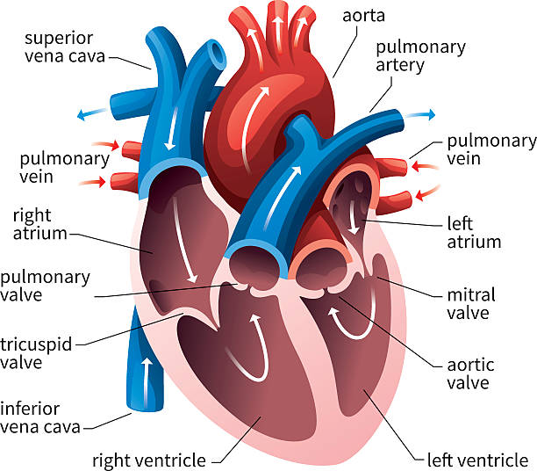
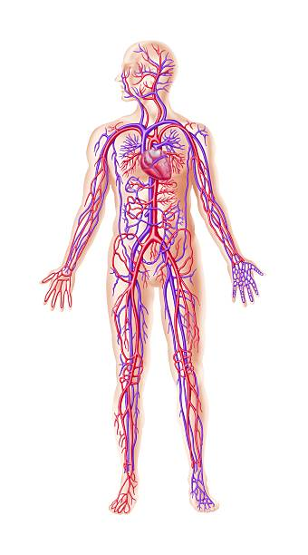
Medical Terminology of the Cardiovascular
System

Slide 2
Cardiovascular System is composed from ;
1-Heart 2- Blood vesseles 3- Blood
Cardi/o Vas/o ,Vascul/o Ang/o Ham/o ,Haem/o Two Atria (Atrium) Arteries (Artery) Leucocytes (wBc)
Atrio Arteri/o Leuco/cyto
Two Ventricles (Ventricule) Vein Erythrocytes
Ventricul/o Veno Erythr/o ,Erythocyt/o
Valve (Valv/o) (Valvul/o) Phleb/o Thrombocytes(platelet)
Example ; 1-Cardiomegaly 2-Cardiovascular 3-Artiomegaly
4-Ventriculomegaly 5-Ventricular dysarrythermia 6-Valvulitis
Examples for blood vessels; 1-Arteriosclerosis 2-Venoclosis
3-phlebistis 4-phlebocarcinoma 5-Vasodilation 6-Angioma 7-Angitis
8-Angiography Examples for Blood 1-Hematuria 2-Hypoxia
3-thrombocytopania 2-Thrombitis 3-Thrombogenesis 4-Leuckopenia
5-Leuckcytogenesis 6-Erthocytopenia 7-Erthocytogensis

Slide 3
Definition | Root Word | Definition | Root Wood
Epicardium | Epi cardi(o) | Vessel | Angio
Pericardium | Pericardi (o) | Aorta | Aort(o)
Myocardium | Myocardi(o) | Artery Arteriole | Arter(o) Arteri(o) Arteriol(o)
Atrium | Atri(o) | Vein | Ven(o)
Ventricle | Ventricul(o) | Venule | Venul(o)
Mediastinum | Mediastin (o) | Valve | Valv(o)
Sound | Ech(o) | Heart | Cardi(o)
sinus | Sin(o) | Endocardium | Endocardi(o)
Word Root and Combining Vowel for Cardiovascular Terms

Slide 4
Diseases and Conditions of the Cardiovascular System
(Atheroscro sisAAtherosclerosistherosclerosis
TERM | DEFINITION
Angiopathy
is a disease of the blood vessels.
Angina pectoris
Angina pectoris is thoracic pain caused by spasms in the coronary arteries caused by not enough oxygen to the myocardium of the heart (angi= blood vessel,pector=breast)
Atherosclerosis
Ather(o) refers to an artery.
sclerosis refers to hardening
means the build-up of fatty plaque or cholesterol in the lining of
the arteries. The walls become thick, fibrotic and calcified
Arteriosclerosis
hardening of the arteries due to calcification, thickening and loss of elasticity.
Arrhythmia
Arrhythmia means an irregular heart rhythm.
Blood pressure
the pressure exerted on the walls of the arteries by the circulating blood volume.
Bradycardia
means a heart rate less than 60 beats per minute.

Slide 5
Cardiovascular Specialties
Definition | Term
The study of disorder of the heart | Cardiology
Specialized in dis order of heart | Cardiologist
Subspeciality cardiologist can perform advanced cardiac procedure such Catherazition of the heart | Intervential Cardiologist
Person can perform procedure on the heart and the blood vessels | Cardio surgeon
Person who works with body electrical and biological function | Electrophysiologist
Person study the heart electrical impulse | Electrophysiologist Cardiologist

Slide 6
Procedures of the Cardiovascular System
Coronary artery by pass
graft (CABG)
TERM | DEFINITION
A cardiac catheterization is the introduction of the catheter through an incision into a large vein and guided through circulation into the heart
Cardiac catheterization
Cardiopulmonary resuscitation (CPR)
Cardiopulmonary resuscitation is an emergency procedure that involves external cardiac massage and artificial respirations to revive and sustain
the cardiac and respiratory function
A CABG is an open heart surgery in which a vein is taken from a different part of the body (saphenous or mammary) and grafted into a section of a coronary artery to bypass a blockage.
Defibrillation
Defibrillate means to stop the ventricles from fibrillating by delivering an electrical shock.

Slide 7
Endarterectomy Is surgical removal of the intimal layer
of the artery
Percutaneous Transluminal Coronary Angioplasty (PTCA)
A PTCA is a procedure in which a catheter is threaded through the vessel and a balloon is inflated in the treatment of atherosclerotic heart disease
A pericardiocentesis is a procedure used to aspirate fluid which has accumulated in the pericardial spaces.
Pericardiocentesis
Thoracotomy
is a surgical opening into the thoracic cavity.
Thoracentesis
is the perforation of the chest wall or pleural space with a needle to aspirate fluid.
is the transfer of tissue or an organ from one person to another or one organism to another
Transplantation

Slide 8
Diagnostic Studies of the Cardiovascular System
TERM | DEFINITION
Doppler echocardiography | An echo is the reflection of an ultrasound wave off a structure which back to the transducer is sent
A Doppler echocardiography uses Doppler ultrasonography to evaluate blood flow patterns and directions in the heart and records them
Doppler ultrasonography | Ultra means beyond, farther.
Doppler ultrasonography uses ultrasound imaging to look at the structures and blood flow of the beating heart.
Echocardiogram
An echocardiogram is a graphic reading of the heart movement from an
ultrasonography.
Echocardiography
A echocardiography is a noninvasive diagnostic procedure used to record the movement and structure of the heart.

Slide 9
Coronary artery
disease (CAD) is a condition affecting the arteries of the heart that cause
a reduction of blood flow to the myocardium
Myocardial Infarction
Thrill is a vibration felt over an area of the patient’s body caused by turbulent blood flow.
Hypertension
is a common condition characterized by an elevated blood pressure when there is an abnormally high amount of pressure on the arteries.
Hypotension
is a condition characterized by a low blood pressure or when there is not an adequate amount of pressure in the arteries for normal perfusion.
An MI is necrosis of part of the cardiac muscle caused by an obstruction of the coronary artery that affects the heart ability to pump.
Pericardial effusion
is the escape of fluid into the pericardial sac
Pericarditis
is the inflammation of the pericardium
Murmur
is a humming or a gentle blowing such as a heart murmur.

Slide 10
Tachycardia means heart beats is more100 per minute
Bruit A blowing or swishing sound caused by turbulent blood flow heard when auscultating diseased carotid arteries
Cardiac arrest A cardiac arrest is a sudden stoppage of cardiac circulation and cardiac output
Cardiogenic shock The condition charactised by inadequate blood flow to
the body associated with myocardial infraction resulting in
low output
Cardiomyopathy is a disease of the myocardium causing enlargement of heart
Congestive heart is condition in which the cardiac output is impaired and
Failure unable to meet the need of the body causing an abnormal
accumulation of fluid or backup of fluid and peripheral edema
Hemostasis is the halting of bleeding by the coagulation process or by chemical
or mechanical means
Endocarditis is the inflammation of the endocardium and heart valve
Ischemia
is a decreased blood supply to a body part.

Slide 11
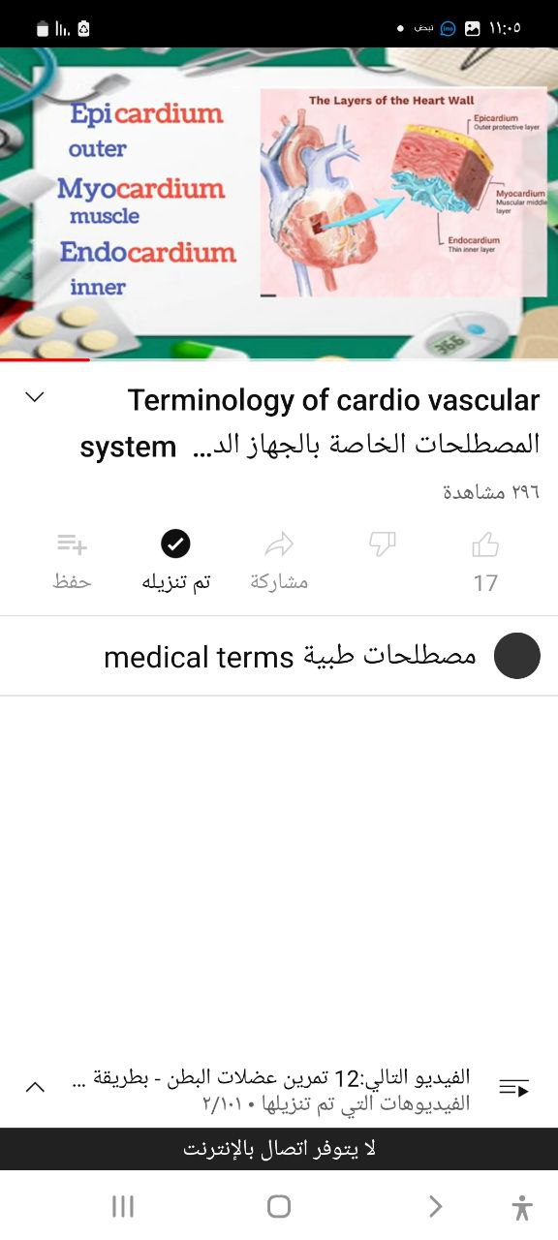
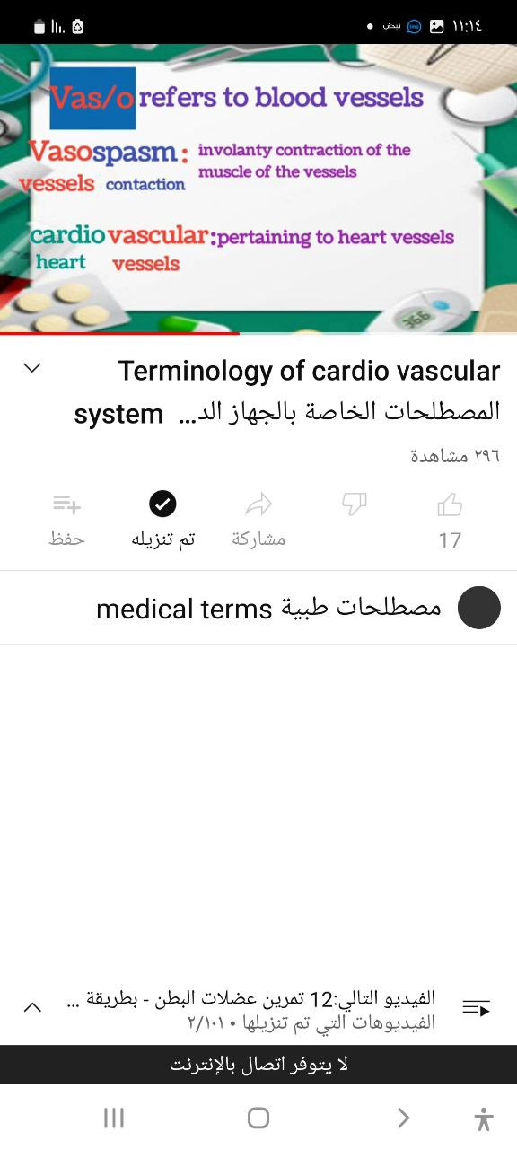
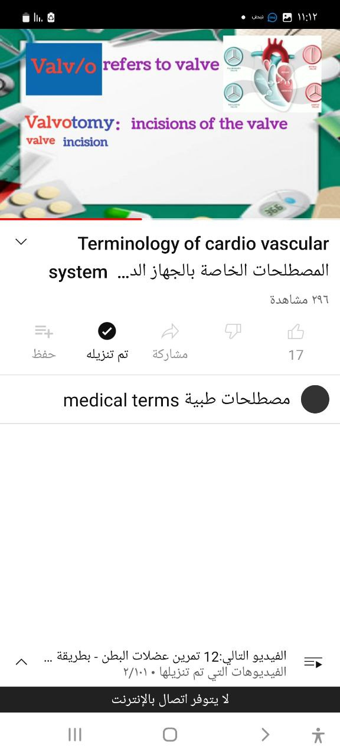
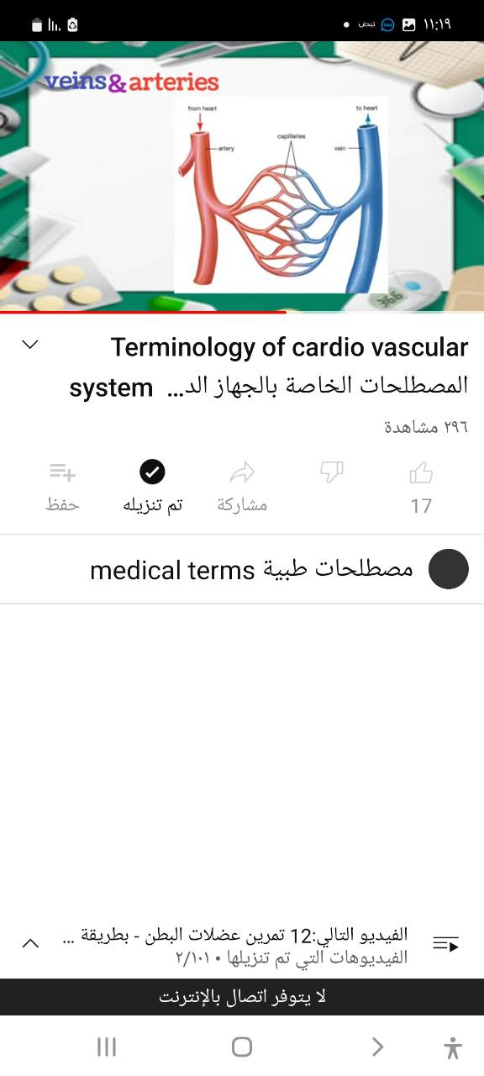

Slide 12
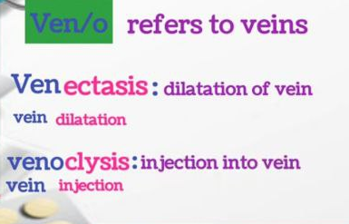
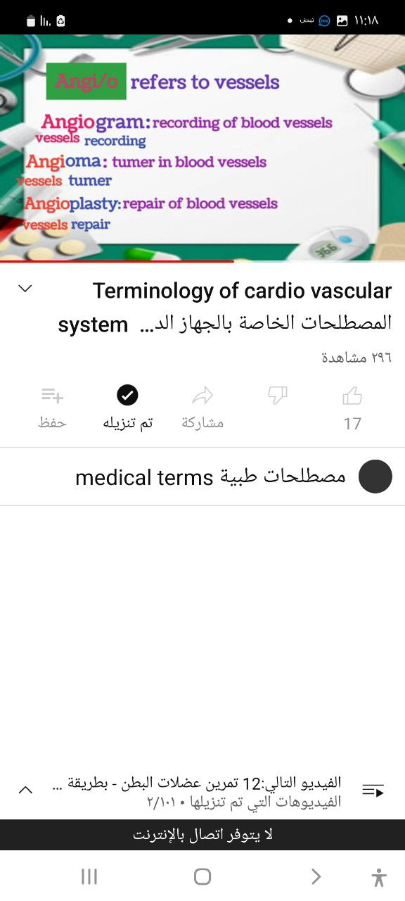
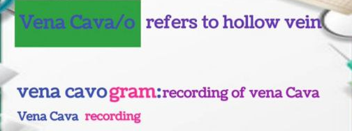

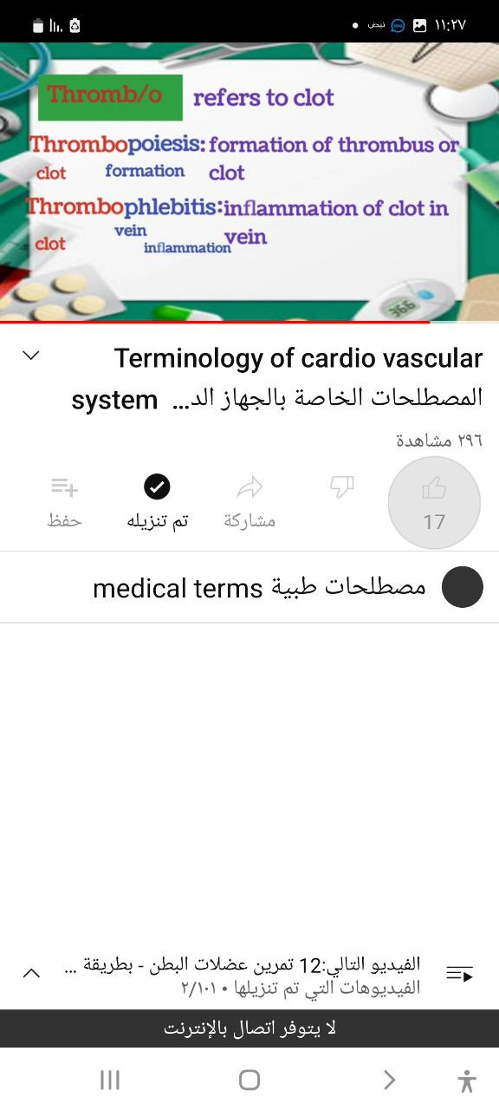
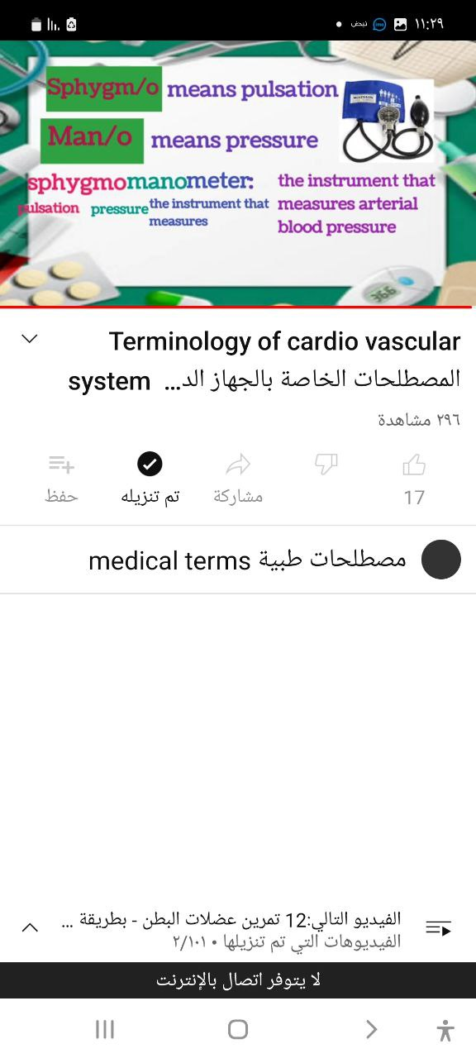

Slide 13
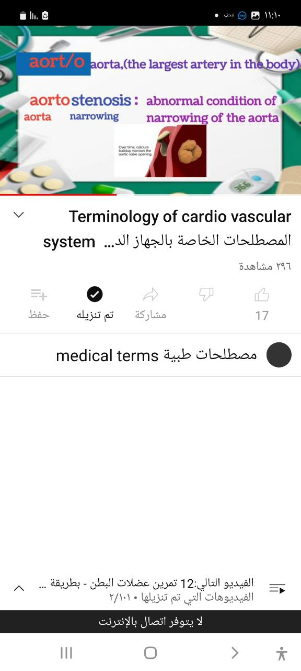
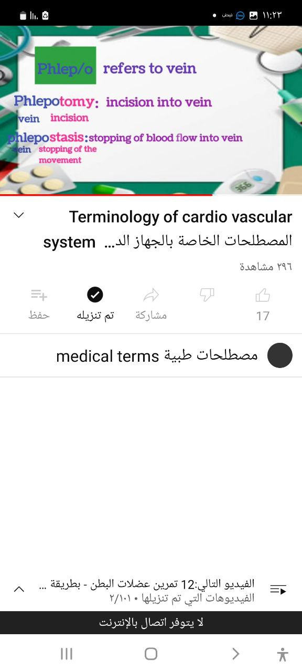
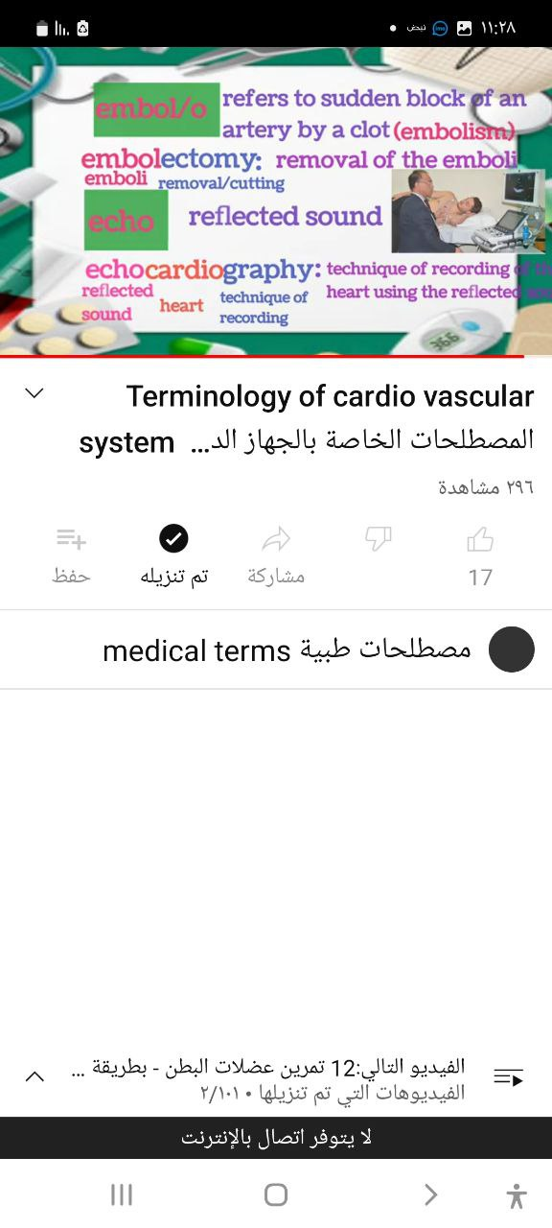
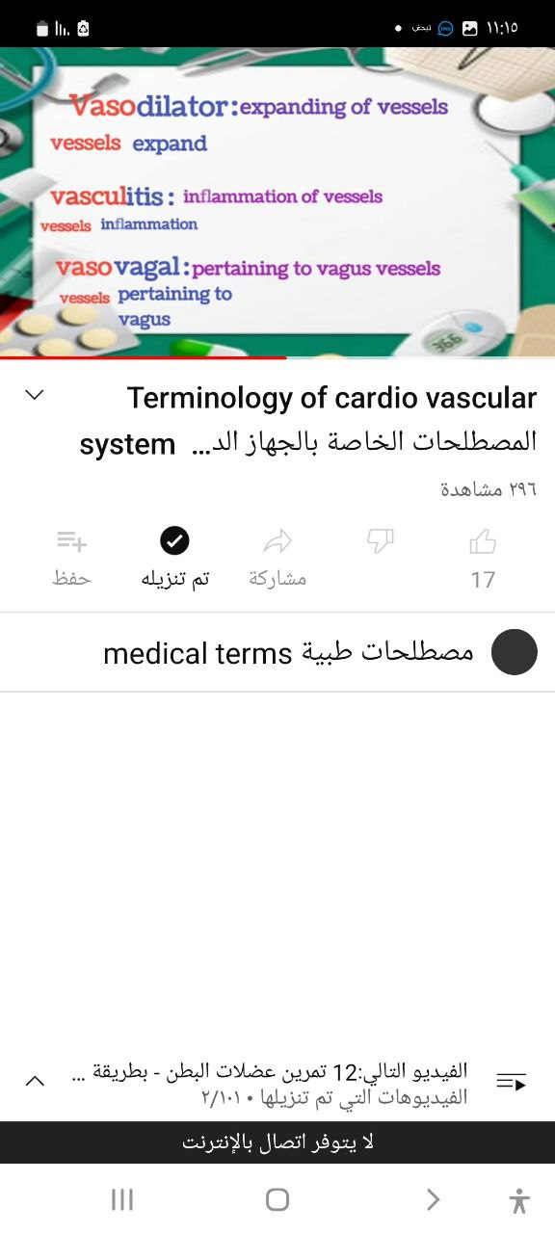
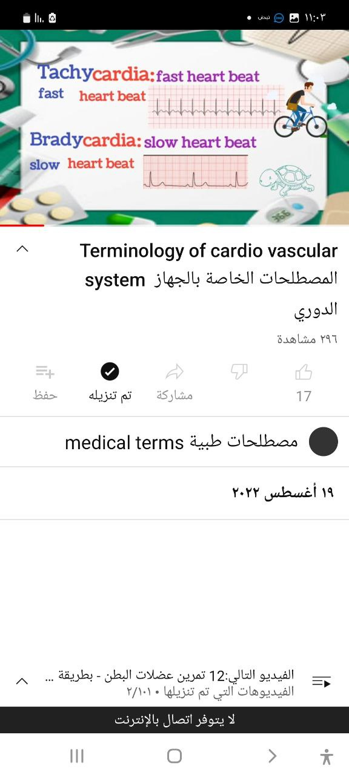

Slide 14
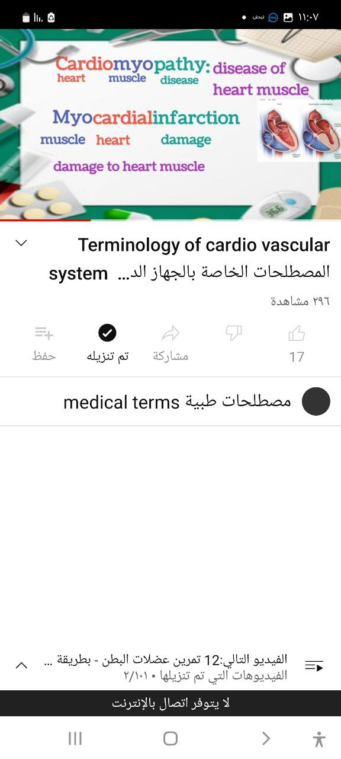
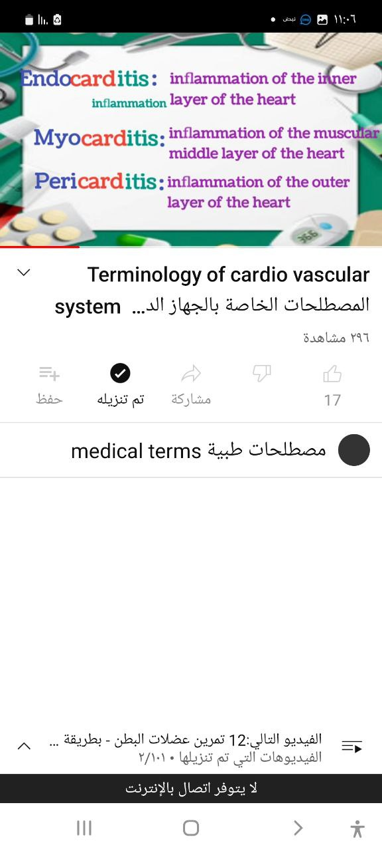
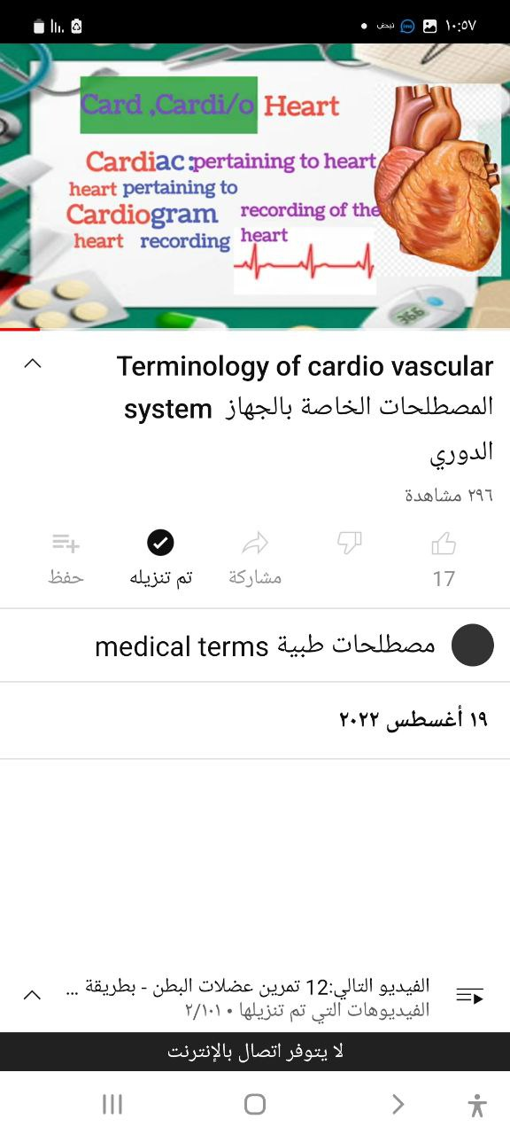
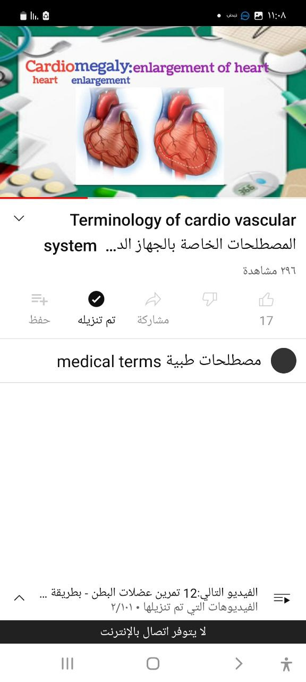

Slide 15

Thank you

