Slide 1
Medical terminology
2nd stage
The presentation is done by
Dr.Talib chichan
M.B.CH.B D.O.S
Department of anesthesia techniques
Al-Mustaqbal University college

Slide 2
The respiratory system
There are 2 divisions of the respiratory system
1-Upper respiratory system consist of the nose,pharynx,pharynx and trachea
2-Lower respiratory system include right and left bronchi and right left lungs

Slide 3
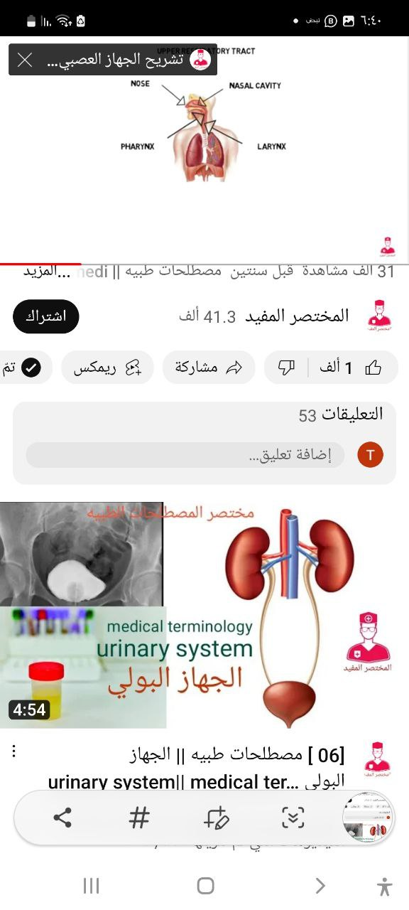
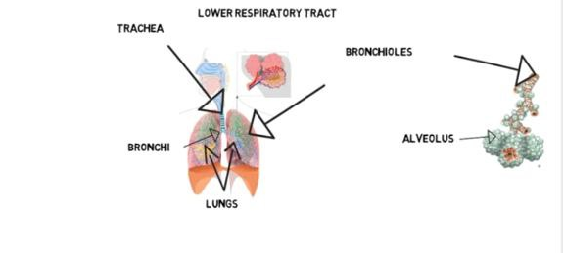

Slide 4
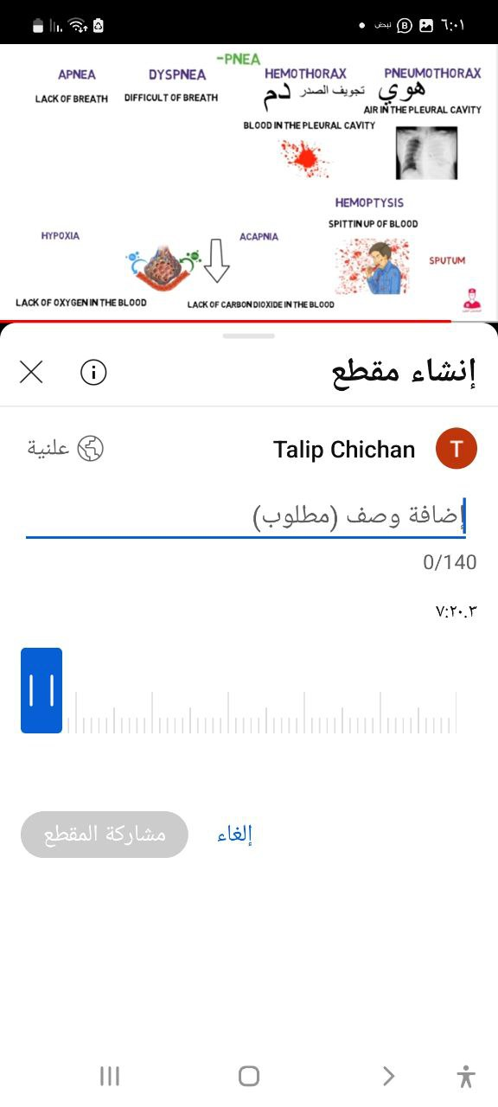

Slide 5
Word Root and Combining Vowel for the Respiratory System
Definition | Root
bronchus Trach(o) Trachea | Bronch( (o)
Bronchioles Pharyng(o) Pharynx | Bronchi(o)
Larynx Thorac(o) chest | Laryng(o)
Lob , round prominence pleur(o) Pleura | Lob (o)
Nose | Nos(o) ,Rhin(o)
Lung ,air | Plum(o)
Lung | Pneum(o)
Lung | Pneumon(o)

Slide 6
Diagnostic Studies of the Respiratory System
TERM | DEFINITION
Arterial blood gases (ABGs) | The measurement of the oxygen and the carbon dioxide contents in arterial blood. This gives information about acid base balance and oxygenation.
Bronchoscopy | Bronch(o) refers to the bronchus
 | -scopy is the visual examination with a lighted instrument.
Computed tomography (CT) | A technique that uses radiographic to produce an image of the cross section of tissue. This procedure can be used to find masses or tumors in lung

Slide 7
Laryngoscopy | Laryng(o) refers to larynx
Lung biopsy | A test to gather specimen of pulmonary tissue for diagnosis.
Lung scan | A radiographic examination of the lung to gather information about the lung and the function of the lung.
Magnetic Resonance Imaging (MRI)
Pulmonary angiography | Pulmonary means pertaining to the lungs, Angio refers to Blood vessel ,graphy refers to the proccess of recording so examination of blood vessel of lung
Oximetry | ,Oxi- refers to oxygen=method for measuring of oxygen in arterial blood
Pulmonary function test (PFT) | An examination that test the ability of the lungs to exchange oxygen and carbon dioxid

Slide 8
Respiratory Suffixes and Prefixes
Definition | Term
Breathing | Pneia
Epiglottis | Epiglott-
Nose Rhin(o) | Nos-
Pressure of oxygen | Oxi oxy
Condition of oxygen | Oxia
Respiratory Specialties
TERMS | DEFINITION
Pulmonology | The science dealing with the anatomy, physiology, and pathology of the lungs.
Pulmonologist | A person skilled in pulmonology.

Slide 9
Procedures of the Respiratory System
Endo=inward ,within tracheal= trachea intubation refers to insertion of the tube in opening in body | Endo-tracheal intubation
Surgical puncture in the chest to remove or aspirate the fluid | Tharcocentesis
Opening in the chest wall | Tharcotomy
Formation of an opening through the neck into trachea to access to airway below blockage | Thracheostomy

Slide 10
Diseases and Conditions of the Respiratory system
Definition | Term
The condition of the lung caused by the inhalation of foreign | Aspiration pneumonia
Respiratory condition caused by constriction of the bronchi causing wheeze ,cough &thick bronchi secretion | Asthma
A elect (Greek ) =Incomplete , ecstasies = dilation , extenuation collapse of the alveoli which prevent gas exchange in the alveoli | Atelectasis
Inflammation of tracheo –bronchiole tree caused by viral or bacterial infection | Bronchitis
Asthma ,Chronic bronchitis,Emphyemia Chronic bronchiectasis lead to difficulty in inspiration & expiration | Chronic obstructive ,diseases (COPD )
Em=in ,on, physema = over inflation or destruction of alveolar wall causing and decreased gas exchange | Emphysema

Slide 11
Hem(o) =blood , ptysis=splitting means cough up of blood from respiratory tract | Hemoptysis
The acclamations of the blood in the pleural space of the chest | Hemothorax
Hypo means insuffient Oxi=oxygen ,So inadequate oxygen in the body | Hypoxia
Abnormal acclamation of the fluid in pleura space | Pleural effusion
Hyper =Excessive ,Ventilation means air in and out of the lung (expiration and inspiration) | Hyper ventilation
Hypo =insuffient means decrease in amount of air taken in which is inadequate to metabolic demands | Hypo ventilation
Inflammation of parietal layer of the lung | Pleurisy
Pneumo =air ,thorax= chest ,means an acclimation of air in the pleural space of the chest causing the lung to collapse | Pneumothorax
Pulmon= lung , embolism= thrombus, air or object that circulate in blood stream causing blockage of pulmonary artery by thrombus usually travelling from peripheral vein | Pulmonary embolism

Slide 12
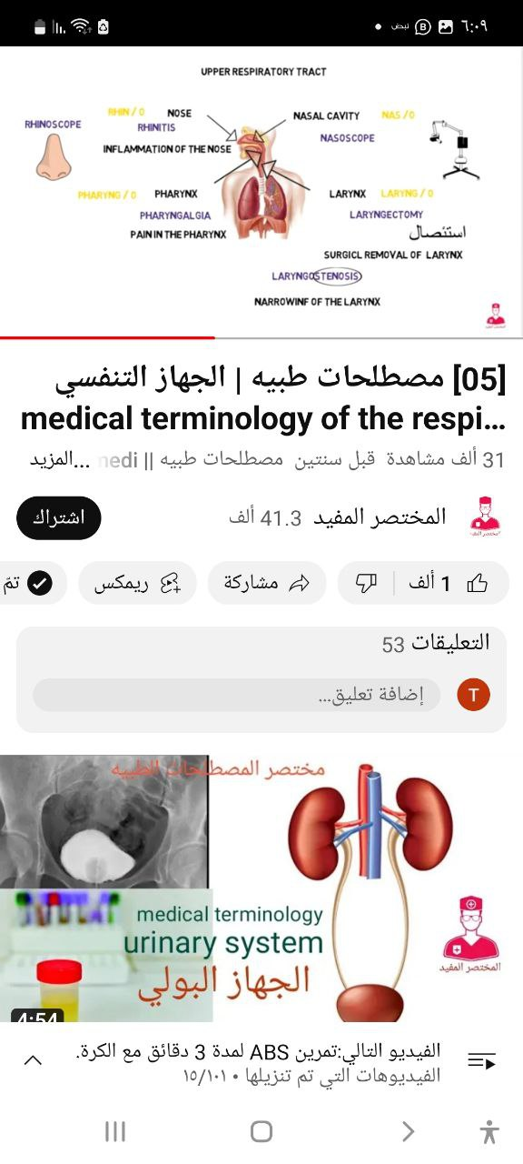

Slide 13
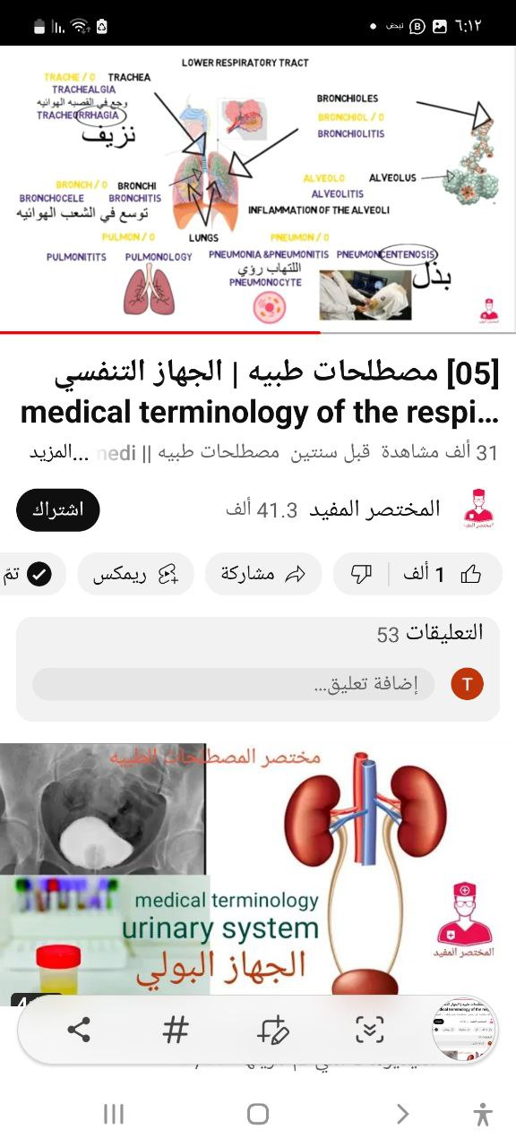

Slide 14
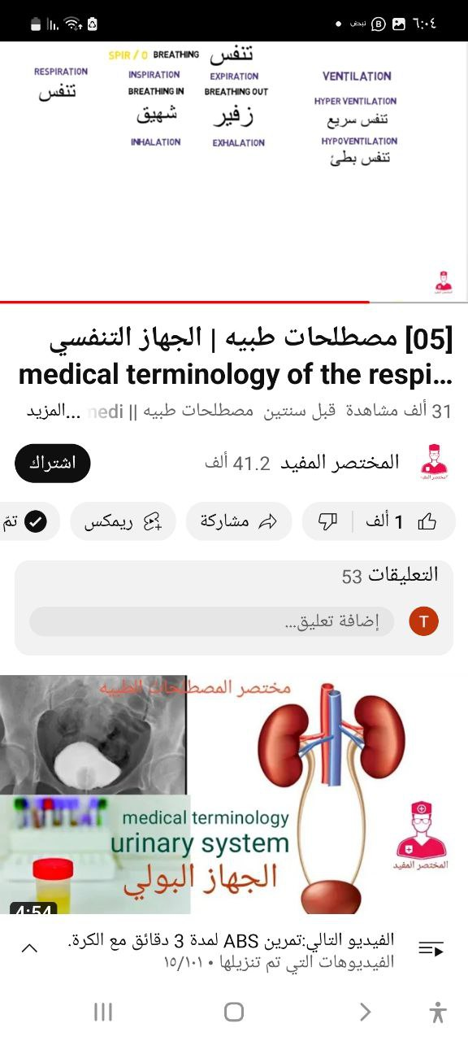
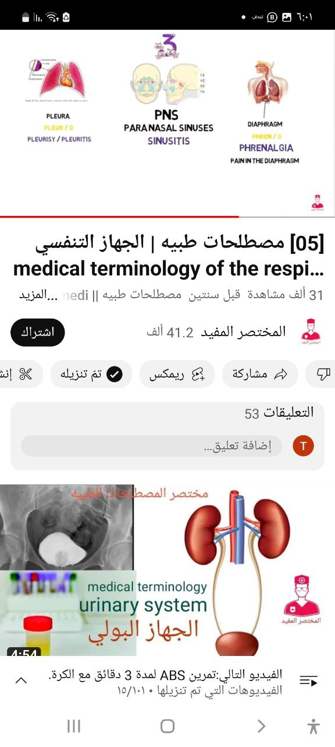

Slide 15

Good luck
Thank you

