Slide 1
Medical terminology
2nd stage
The presentation is done by
Dr.Talib chichan
M.B.CH.B D.O.S
Department of anesthesia techniques
Al-Mustaqbal University college

Slide 2
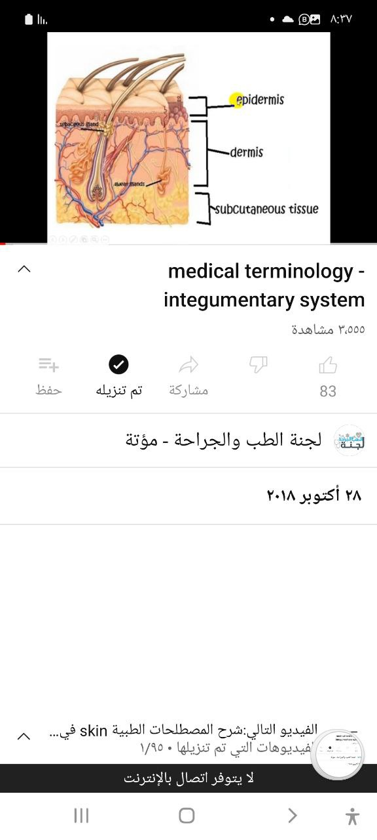
Integumentary System
The integumentary system consist of :-
1- Skin ( epidermis , dermis ,hypodermis(subcutaneous)
2-Accessory organs ( hair ,Nail , Sebaceous glands ,Sweat glands)
The skin is the largest organ in body and protect the body from external
environment.

Slide 3
Normal structure and function
Skin from( Latin cutis , meaning skin) | cutaneous
The layer of the skin between epidermis and subcutaneous tissue the true skin or corium | dermis
The outermost layer of the skin (epi=over ) derm=skin | Epidermis
Threadlike Keratinized outgrowth from skin( trich/o ) | hair
The in which a hair develop | Hair follicle
A protein that thickens and toughens the skin and makes up hair and nail (root Kerat/o ) | Keratin
A black pigment that gives color to the hair and skin and protects the skin against the sun s radiation ( root, melan/o ) | melanin
A gland that produce sebum, usually associated with a hair follicle (root,seb/o ) | Sebaceous gland

Slide 4
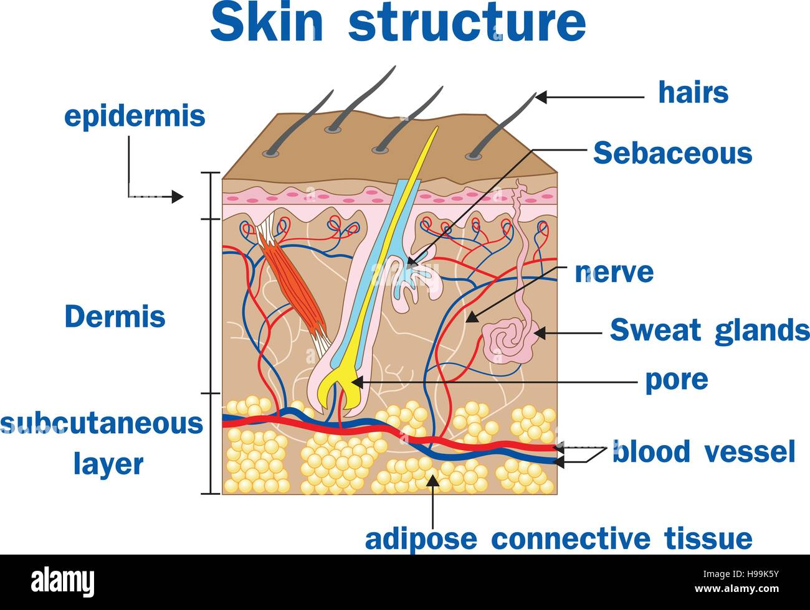
A fatty secretion of sebaceous gland | sebum
the tissue that covers the body ( root, derm/o dermat/o) | Skin
The layer of tissue beneath the skin called hypo dermis | subcutaneous tissue
A sweat gland ( root ,hidr/o ,idr/o ) | Sudoriferous gland

Slide 5
Function of Skin
1-The skin water proofs the body and prevents fluid loss.
2-Intact skin play an important role in immune system by blocking the entrance of pathogens into the body.
3 -Skin is the major receptor for the touch , tempture,pressure
4- Skin helps the body synthesize vitamin D3,from the sun$ ultraviolet light

Slide 6
Roots Pertaining to Skin
 | Definition of Example | Example | meaning | Root
 | Surgical procedure to resurface the skin and remove imperfection | dermabrasion | Skin | derm/o, Dermot/o
 | Horny growth of skin | Keratosis | Keratin,horny layer of skin | Kerat/o
 | A small body in cell that produce melanin | melanosome | Dark ,black ,melanin | Melan/o
 | Abnormally high production of sweat | hyperhidrosis | Sweat ,perspiration | Hidr/o,idr/o
 | Excess flow of sebum | seborrhea | Sebum,sebaceous gland | Seb/o

Slide 7
Definition of example s | Example | Meaning | Root
Fungal infection of hair | Trichomycosis | Hair | Trich/o
Inflammation of nail&nail bed | Onychia | Nail | Oncyh/o
Abnormal softening of nail | Onychomalacia | Nail | Oncyh/o
Any diseases cause atrophy of hair | Tricho pathy | Hair | Trich/ o
Growth of hair in a dermoid cyst or in sinus opening on the skin | Pilo nidal sinus | Hair | Pil/o
Treatment with nitrogen | Cryotherapy | Cold | Cryo
Inflammation hair follicle | Erythemia Folliculitis | Red Follicle | Erythe Follicul/o

Slide 8
Definition | Terms
Hereditary allergic disease ,chronic inflammation of skin with pruritus ,eczema | Atopic dermatitis
Inflammation of the skin associated with redness &itching may be caused by irritant allergy | dermatitis
Study of the skin and diseases of the skin | Dermatology
Instrument for cutting thin sections of skin for skin graft | Dermatome
Remove of dead or damaged tissue, as from wound | Debridement
Splitting or bursting ,as when the layers a wound separate | Dehiscence
A general term for a inflammation of the skin with redness ,lesion, and itching , atopic dermatitis | Eczema
Removal of scab tissue (eschar) resulting from burn or other skin | Escharotomy
Injuries
Material,which may include fliud,cell, pus,or blood that escape | Exudate
From damaged tissue
Cancerous lesion of the skin and other tissues seen most in patient with AIDS | Kaposi sarcoma

Slide 9
Definition | Term
A chronic inflammatory auto immune disease of connective tissue that often involves the skin | Lupus erythematous LE
A metastasizing pigment tumor of the skin | malignant melanoma
An ulcer caused by pressure to an area of the body | Pressure ulcer
A chronic hereditary dermatitis with red lesion covered by slivery scales | Psoriasis
A method for estimating the extent of body surface area involved in a burn by assigning percentages of nine to various region of the body | Rules of nine
An epidermal cancer that may invade deeper tissues but tends not to metastasize | Squamous cell carcinoma
Absence of sweating | Anhidrosis
Fungal infection of the hair | Trichomycosis
Profuse sweating | Diaphoresis
Collection of blood under the skin | Ecchymosis

Slide 10
Definition | Diseases
An inflammatory disease of sebaceous glands and hair follicle usually associated with excess secretion of sebum | Acne
A hereditary lake of pigment in the skin, hair ,and eyes | Albinism
Pertaining to the radiant energy ,such sunlight ,ultraviolet light and x-ray | Actinic
Absence of hair, baldness | Alopecia
Fungal infection of the skin especially between the toes(,phyt/o ) root means plant | Dermatophytosis
A collection of blood under the skin caused leakage from small vessels | Ecchymosis
A benign tumor of blood vessel under the skin (birthmarks orport wine stain ) | Hemangioma
Excessive growth of hair | Hirsutism
Infestation with lice | Pediculosis
Sever itching | Pruritus

Slide 11
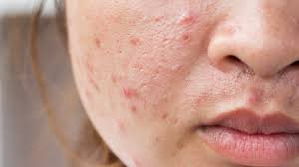
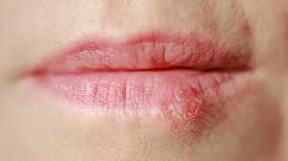
Types of skin lesions
Acne
Cold sore

Slide 12
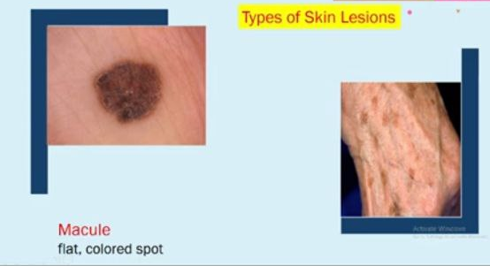
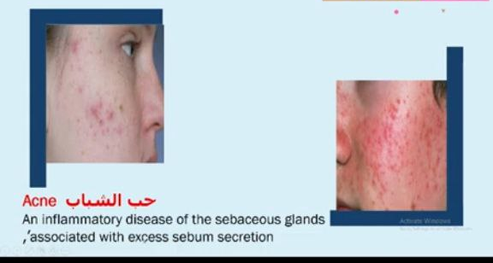

Slide 13
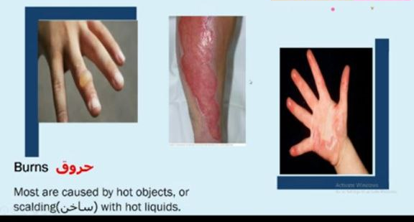
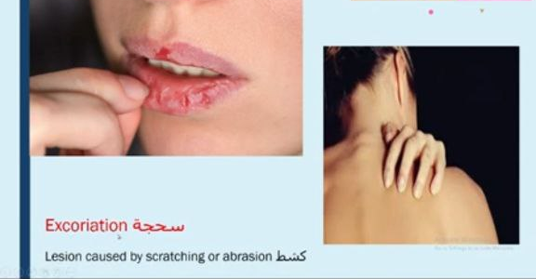

Slide 14
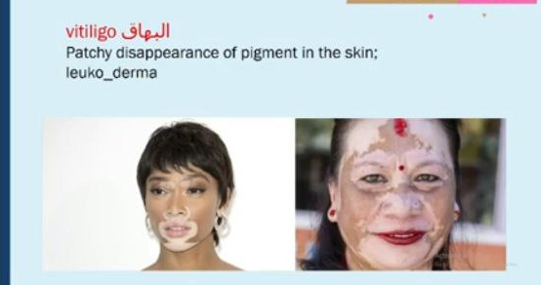
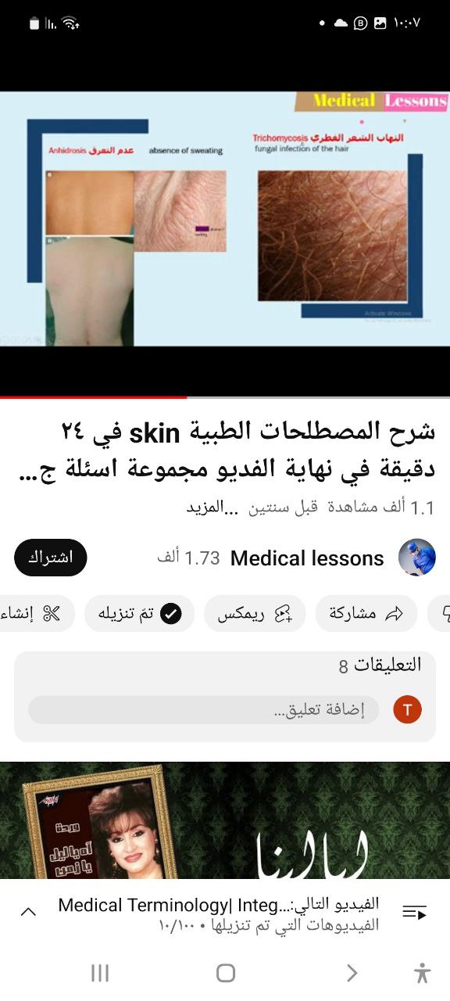

Slide 15
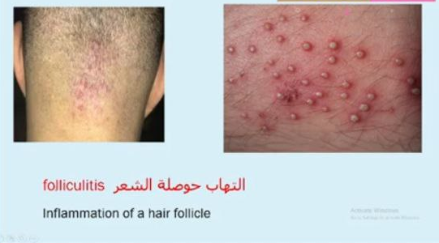
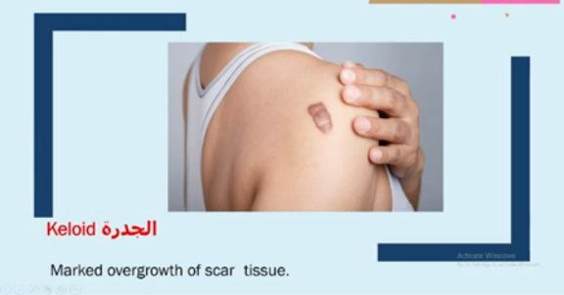

Slide 16
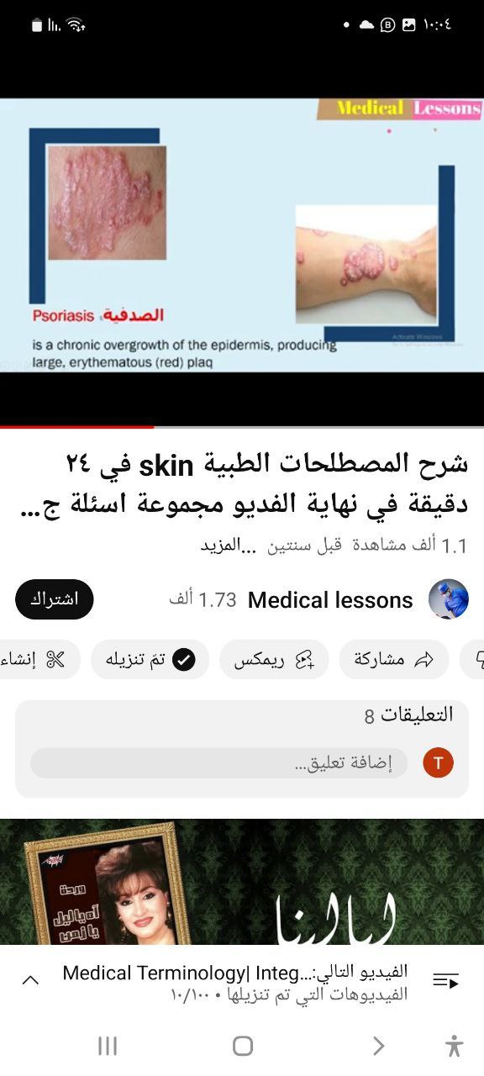
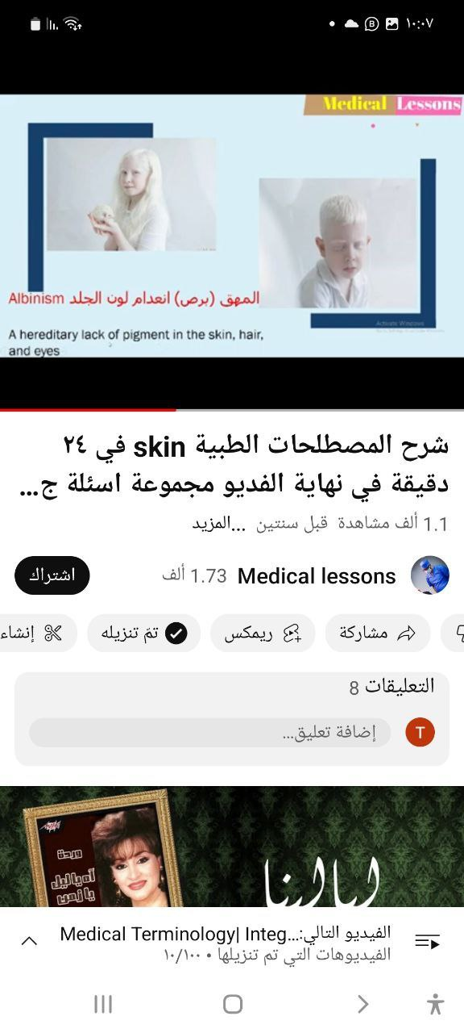

Slide 17
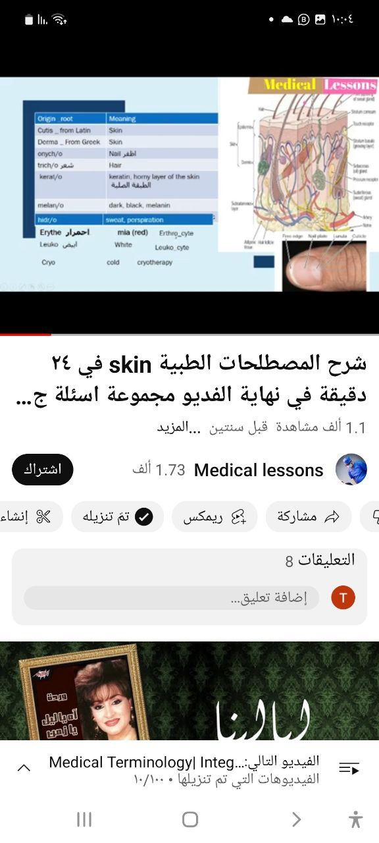
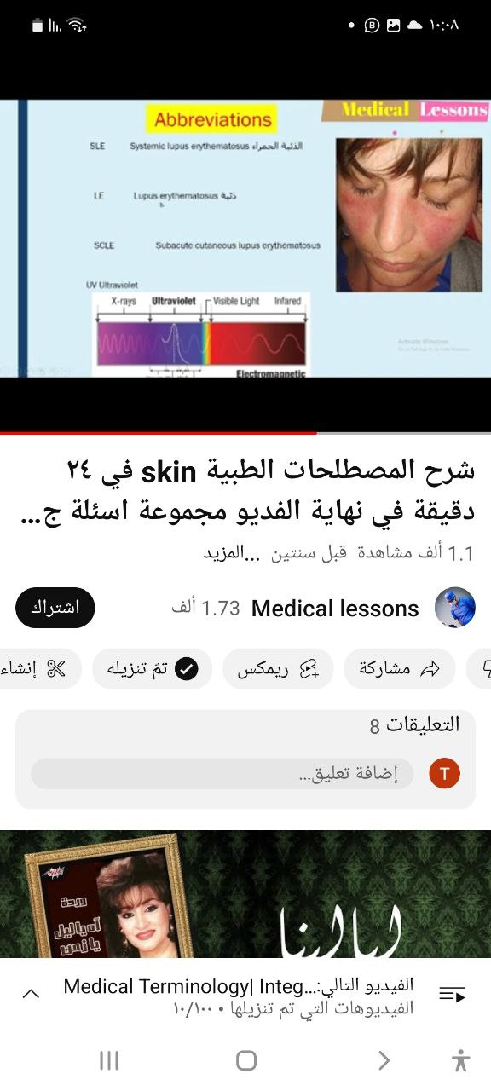

Slide 18
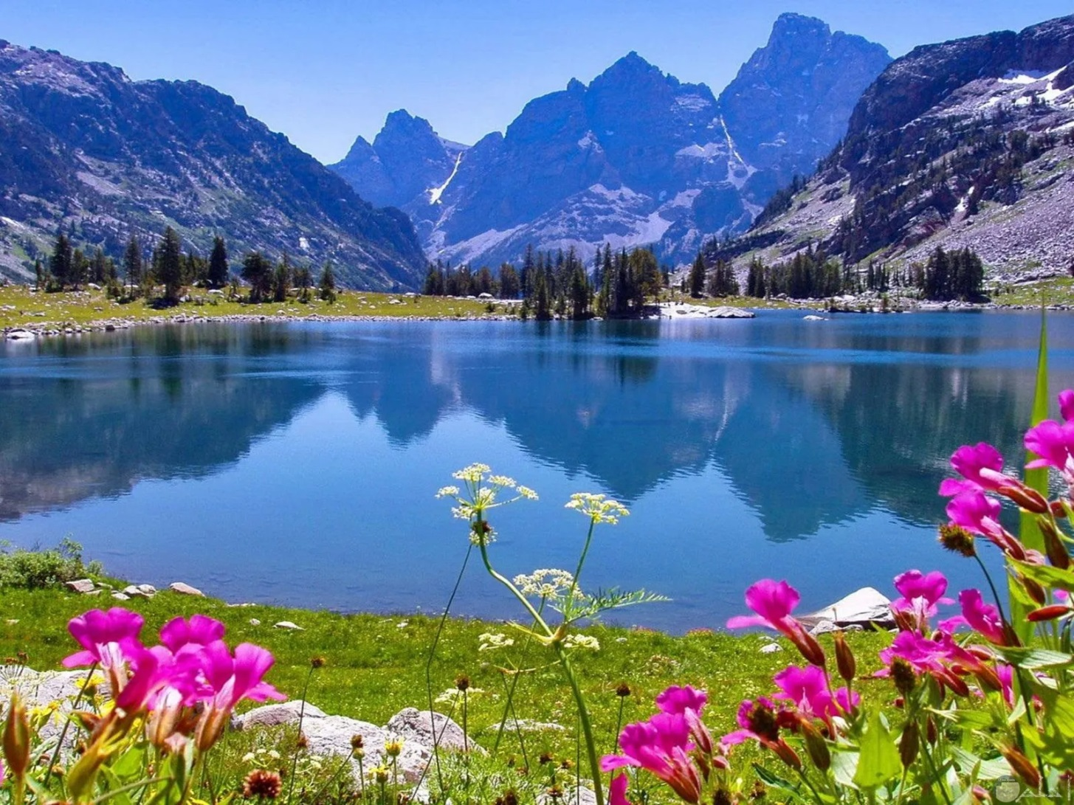
Thank you

