Slide 1
Engineering Drawing
Lecture 3 and 4
Geometric Construction

Slide 2
Geometric Construction
Construction of primitive geometric
forms (points, lines and planes etc.) that serve as the building blocks for more complicated geometric shapes.
Defining the position of the object in space
Primitive geometric forms
Point
Line
Plane
Solid ……etc

Slide 4
solids

Slide 6
The basic 2-D geometric primitives, from which other more complex geometric forms are derived.
Points,
Lines,
Circles, and
Arcs.

Slide 7
point
A theoretical location that has neither width, height, nor depth. Describes exact location in space. A point is represented in technical drawing as a small cross made of dashes that are approximately 3 mm long

Slide 8
Line
A geometric primitive that has length and direction, but no thickness.
It may be straight, curved or a combination of these.
Lines also have important relationship or conditions, such as parallel, intersecting, and tangent.
Lines – specific length and non-specific length
Ray – Straight line that extends to infinity from a specified point

Slide 14
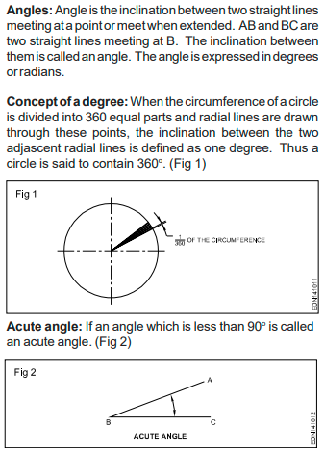
Geometrical Figures types of angles

Slide 16
Triangles

