Slide 1
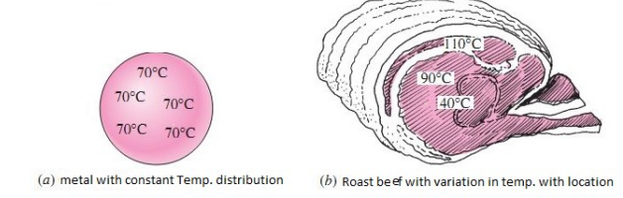

Transient Heat conduction
In this case the temperature be function on time as it is function of dimensions.
$T=T\left(x,y,z, τ\right)$
LUMPED SYSTEM CONCEPT

Slide 2
Consider a cold solid of arbitrary shape, with mass m, initially at a uniform temperature To, suddenly immersed into a higher-temperature environment. As heat flows the hot environment into the cold body, the temperature of the solid increases. It is assumed that the lumped system approximation is applicable, namely, that the distribution of temperature within the solid at any instant can be regarded as almost uniform (i.e., the temperature gradients within the solid are neglected).

Slide 3
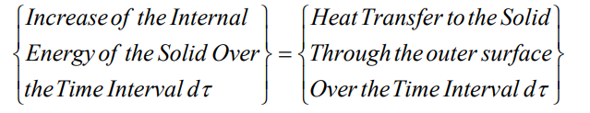
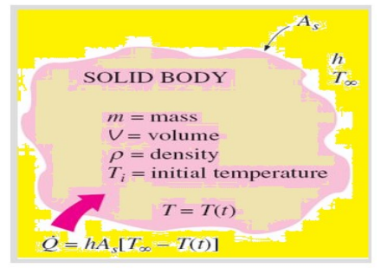

Slide 4
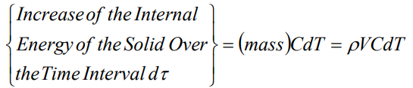
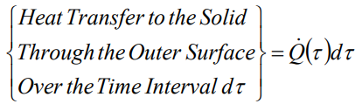
Where ρ, C, and V are density, specific heat, and volume of the solid body respectively. The temperature of the solid body T is a function of time, T=T(τ).
Let Q(τ) be the total heat rate following into the body through its boundary surfaces at any instant τ.

Slide 5
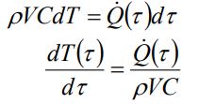


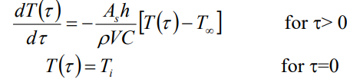
For Convection Heat Transfer

Slide 6

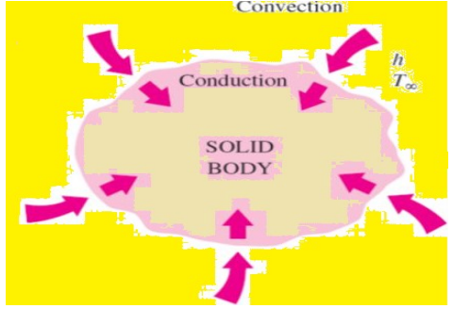
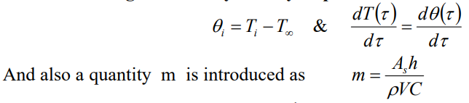

For convenience in the analysis, we measure the temperature in excess of the ambient temperature $T_{∞}$; that is, we choose $T_{∞}$ as the reference temperature. Then assume that:

Slide 7
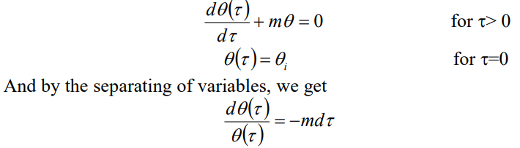



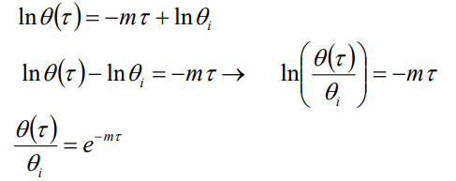

Where m has the dimension of ${\left(time\right)}^{−1}$.

Slide 8

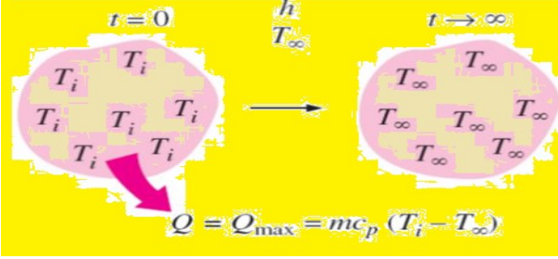



We can now find the relation of the characteristic length ($L_{c}$) value for some geometries such as

Slide 9
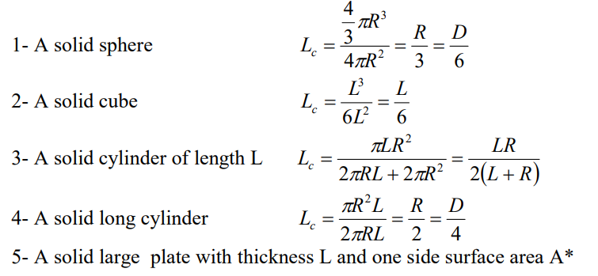


$L_{C}=\frac{V}{A_{s}}$

Slide 10
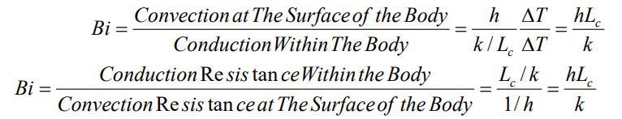

A small Biot number means that a small heat conduction resistance and thus a small temperature gradient within the body. In general, the analysis lumped system can be applied

Slide 11
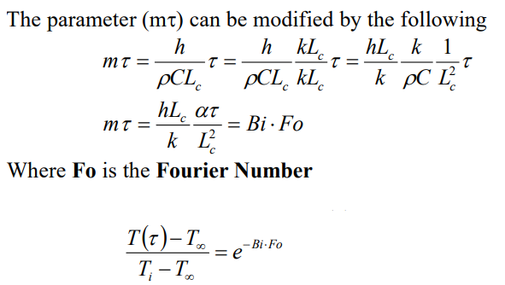

Slide 12
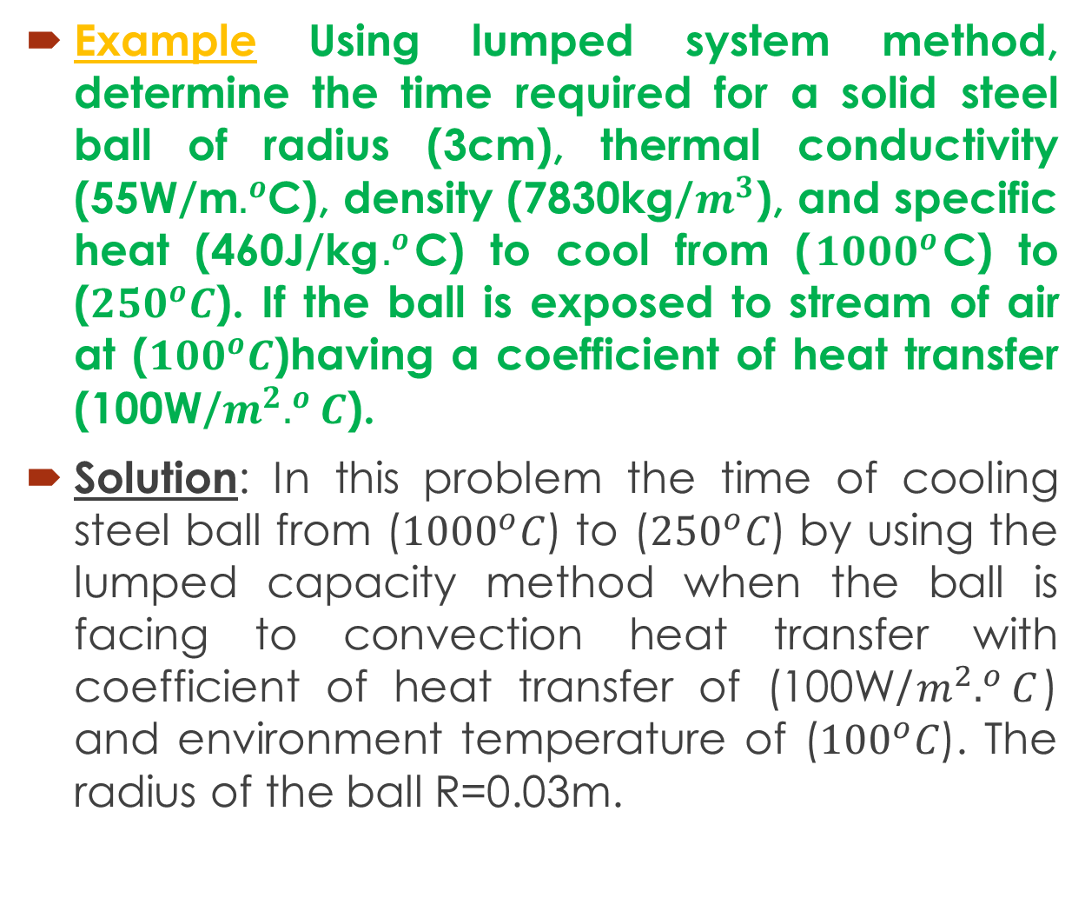
Example Using lumped system method, determine the time required for a solid steel ball of radius (3cm), thermal conductivity (55W/m$.^{o}$C), density (7830kg/$m^{3}$), and specific heat (460J/kg$.^{o}$C) to cool from ($1000^{o}$C) to (${250}^{o}C$). If the ball is exposed to stream of air at (${100}^{o}C$)having a coefficient of heat transfer (100W/$m^{2}.^{o}C$).
Solution: In this problem the time of cooling steel ball from (${1000}^{o}C$) to (${250}^{o}C$) by using the lumped capacity method when the ball is facing to convection heat transfer with coefficient of heat transfer of (100W/$m^{2}.^{o}C$) and environment temperature of (${100}^{o}C$). The radius of the ball R=0.03m.

Slide 13
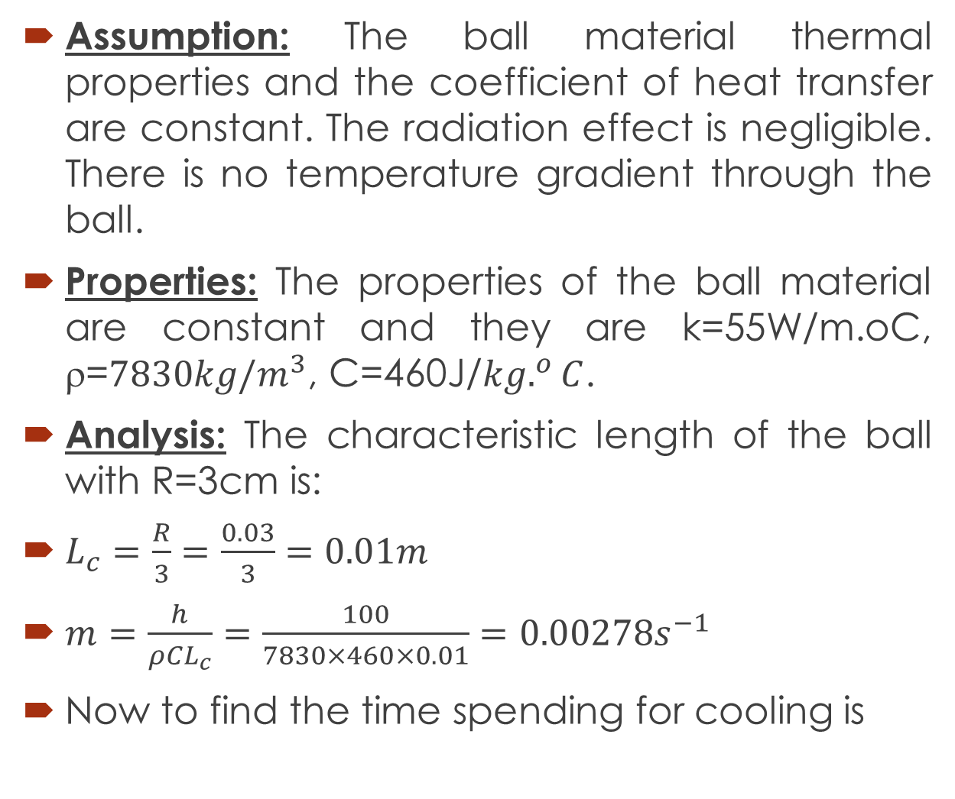
Assumption: The ball material thermal properties and the coefficient of heat transfer are constant. The radiation effect is negligible. There is no temperature gradient through the ball.
Properties: The properties of the ball material are constant and they are k=55W/m.oC, ρ=${7830kg/m}^{3}$, C=460J/${kg.}^{o}C$.
Analysis: The characteristic length of the ball with R=3cm is:
$L_{c}=\frac{R}{3}=\frac{0.03}{3}=0.01m$
$m=\frac{h}{ρCL_{c}}=\frac{100}{7830×460×0.01}=0.00278s^{−1}$
Now to find the time spending for cooling is

Slide 14
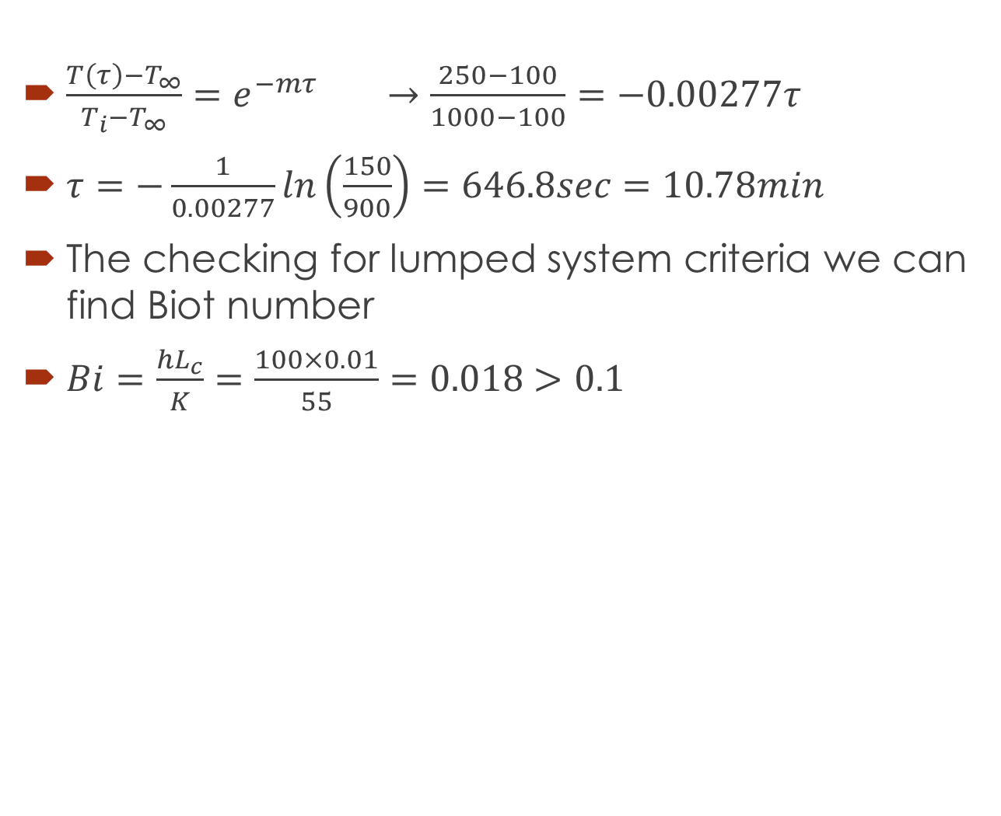
$\frac{T\left(τ\right)−T_{∞}}{T_{i}−T_{∞}}=e^{−mτ}$ $→\frac{250−100}{1000−100}=−0.00277τ$
$τ=−\frac{1}{0.00277}ln\left(\frac{150}{900}\right)=646.8sec=10.78min$
The checking for lumped system criteria we can find Biot number
$Bi=\frac{hL_{c}}{K}=\frac{100×0.01}{55}=0.018>0.1$

