Slide 1
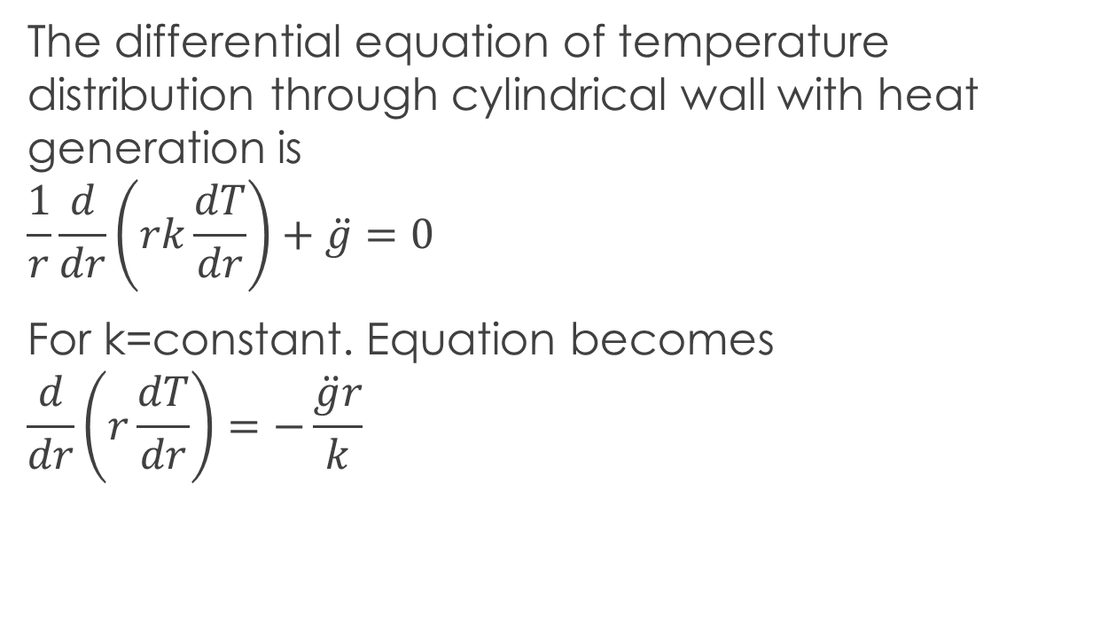
Conduction In cylindrical wall with heat generation
The differential equation of temperature distribution through cylindrical wall with heat generation is
$$\frac{1}{r}\frac{d}{dr}\left(rk\frac{dT}{dr}\right)+\ddot{g}=0$$
For k=constant. Equation becomes
$$\frac{d}{dr}\left(r\frac{dT}{dr}\right)=−\frac{\ddot{g}r}{k}$$

Slide 2
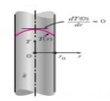
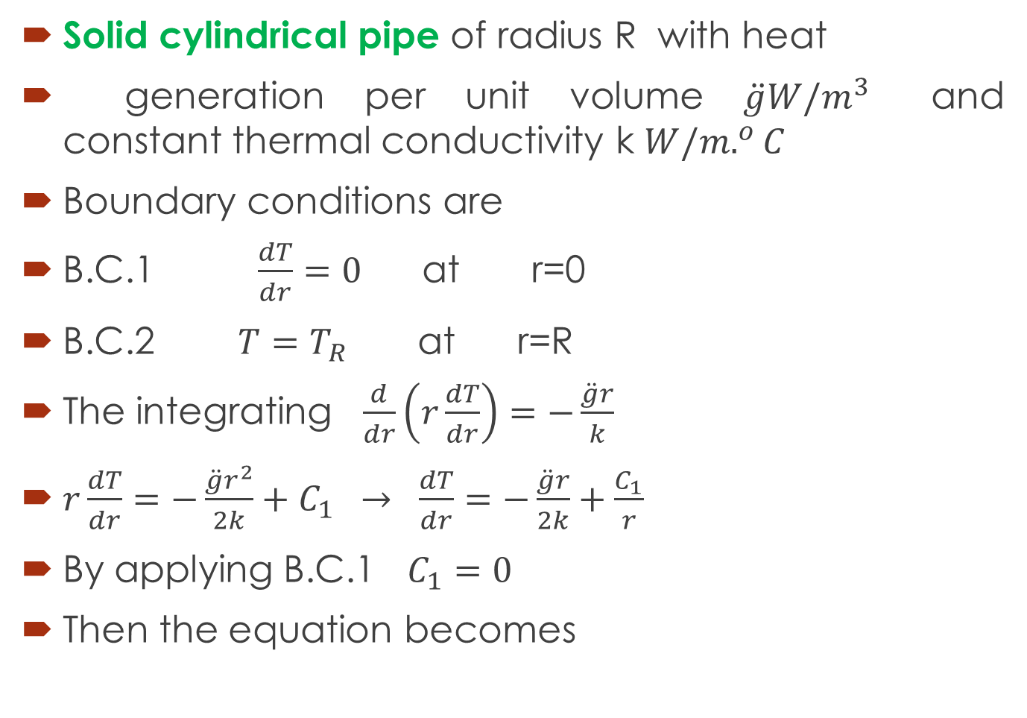
Solid cylindrical pipe of radius R with heat
generation per unit volume $\ddot{g}W/m^{3}$ and constant thermal conductivity k $W/m.^{o}C$
Boundary conditions are
B.C.1 $\frac{dT}{dr}=0$ at r=0
B.C.2 $T=T_{R}$ at r=R
The integrating $\frac{d}{dr}\left(r\frac{dT}{dr}\right)=−\frac{\ddot{g}r}{k}$
$r\frac{dT}{dr}=−\frac{\ddot{g}r^{2}}{2k}+C_{1} → \frac{dT}{dr}=−\frac{\ddot{g}r}{2k}+\frac{C_{1}}{r}$
By applying B.C.1 $C_{1}=0$
Then the equation becomes

Slide 3
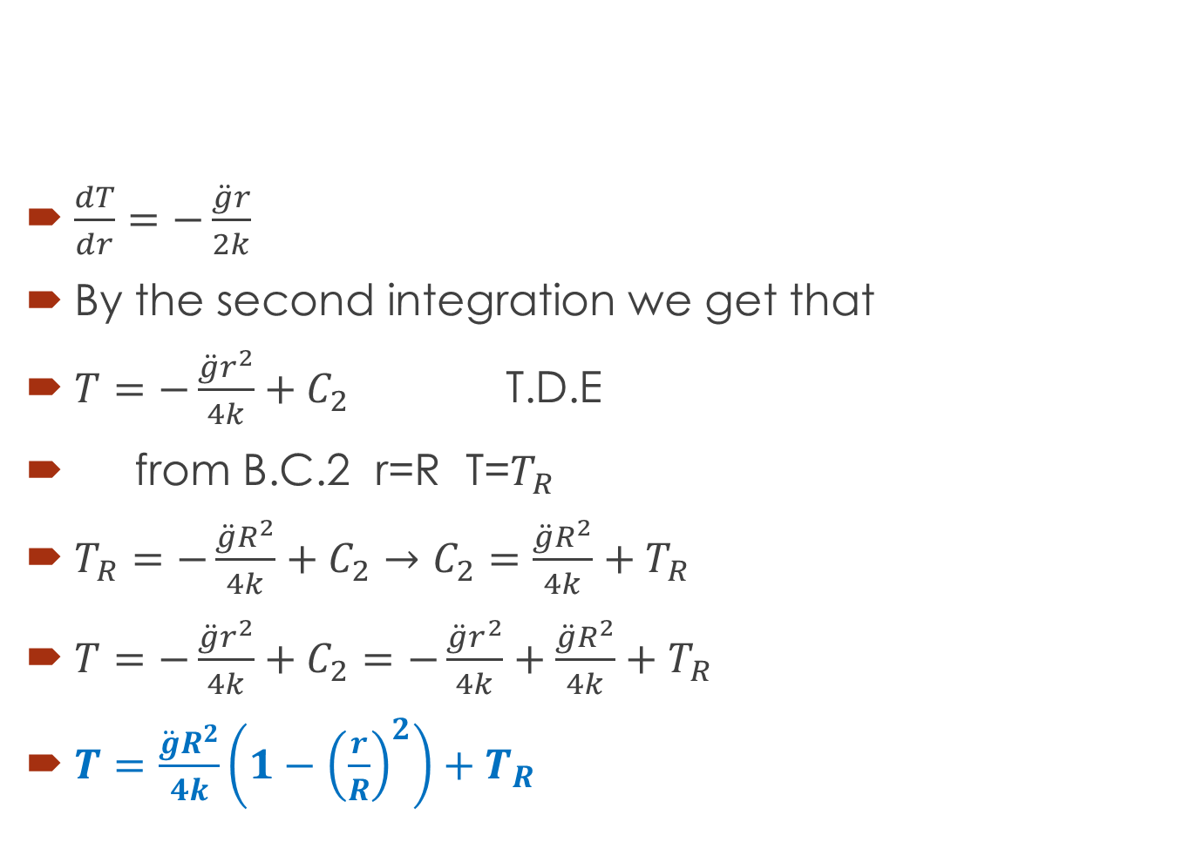
$\frac{dT}{dr}=−\frac{\ddot{g}r}{2k}$
By the second integration we get that
$T=−\frac{\ddot{g}r^{2}}{4k}+C_{2}$ T.D.E
from B.C.2 r=R T=$T_{R}$
$T_{R}=−\frac{\ddot{g}R^{2}}{4k}+C_{2}→C_{2}=\frac{\ddot{g}R^{2}}{4k}+T_{R}$
$T=−\frac{\ddot{g}r^{2}}{4k}+C_{2}=−\frac{\ddot{g}r^{2}}{4k}+\frac{\ddot{g}R^{2}}{4k}+T_{R}$
$T=\frac{\ddot{g}R^{2}}{4k}\left(1−{\left(\frac{r}{R}\right)}^{2}\right)+T_{R}$

Slide 4
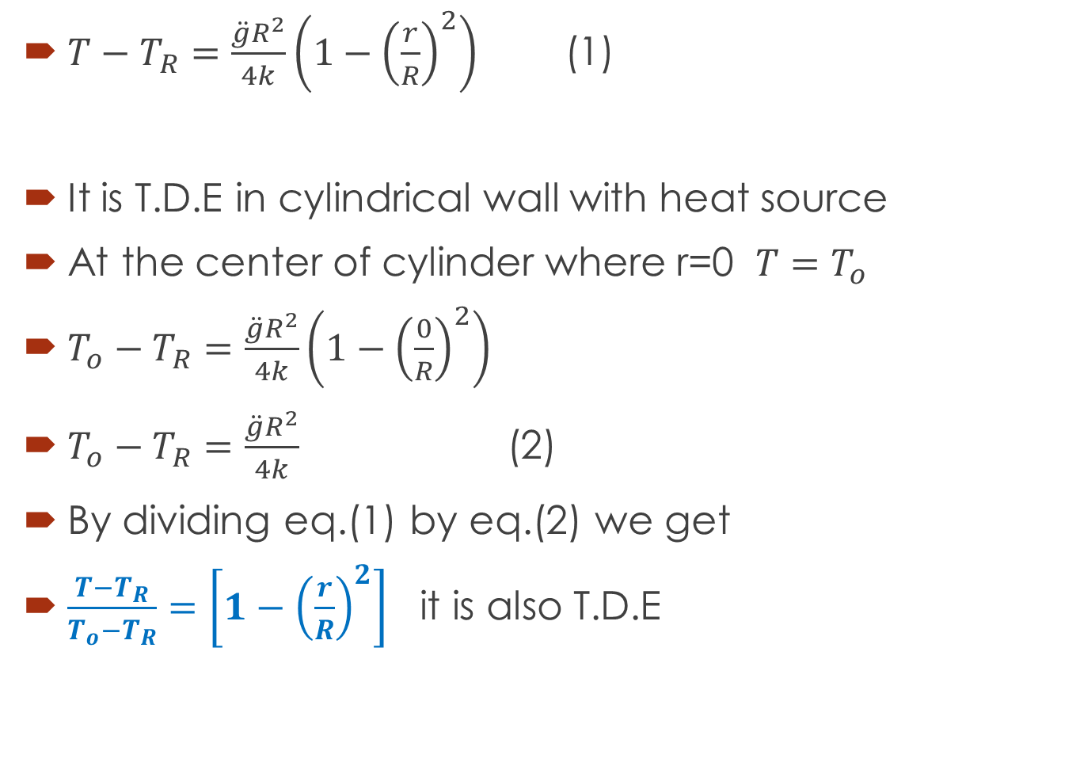
$T−T_{R}=\frac{\ddot{g}R^{2}}{4k}\left(1−{\left(\frac{r}{R}\right)}^{2}\right)$ (1)
It is T.D.E in cylindrical wall with heat source
At the center of cylinder where r=0 $T=T_{o}$
$T_{o}−T_{R}=\frac{\ddot{g}R^{2}}{4k}\left(1−{\left(\frac{0}{R}\right)}^{2}\right)$
$T_{o}−T_{R}=\frac{\ddot{g}R^{2}}{4k}$ (2)
By dividing eq.(1) by eq.(2) we get
$\frac{T−T_{R}}{T_{o}−T_{R}}=\left[1−{\left(\frac{r}{R}\right)}^{2}\right]$ it is also T.D.E

Slide 5
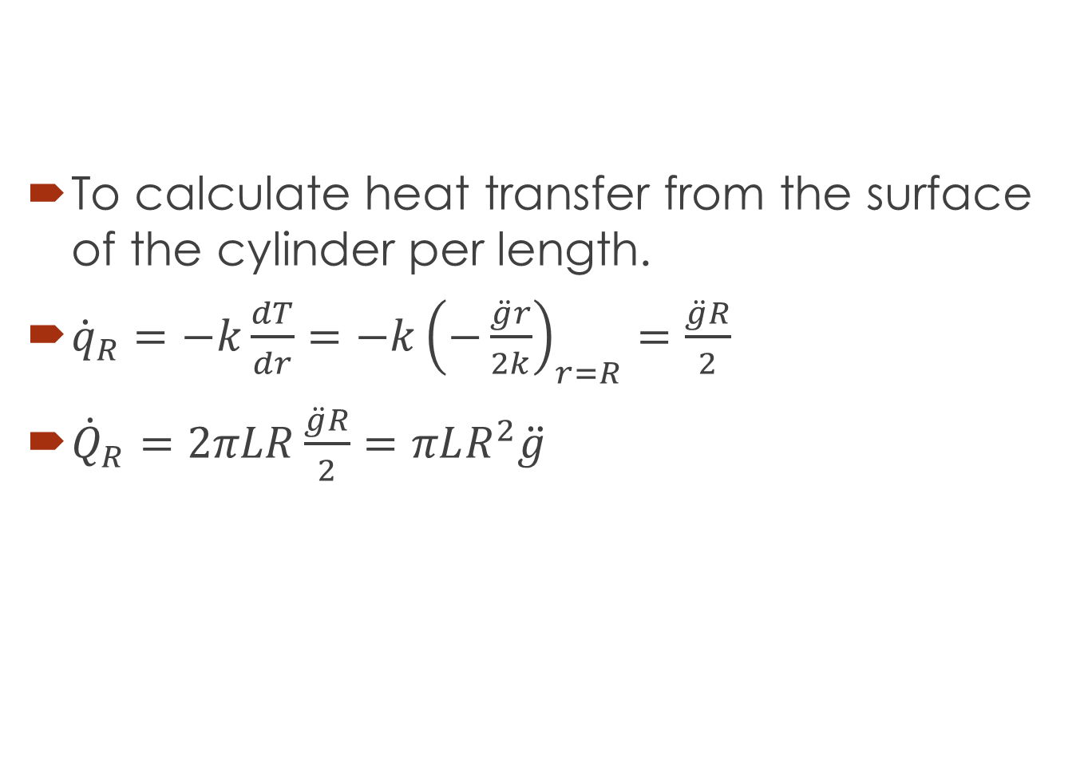
To calculate heat transfer from the surface of the cylinder per length.
${\dot{q}}_{R}=−k\frac{dT}{dr}=−k{\left(−\frac{\ddot{g}r}{2k}\right)}_{r=R}=\frac{\ddot{g}R}{2}$
${\dot{Q}}_{R}=2πLR\frac{\ddot{g}R}{2}=πLR^{2}\ddot{g}$

Slide 6
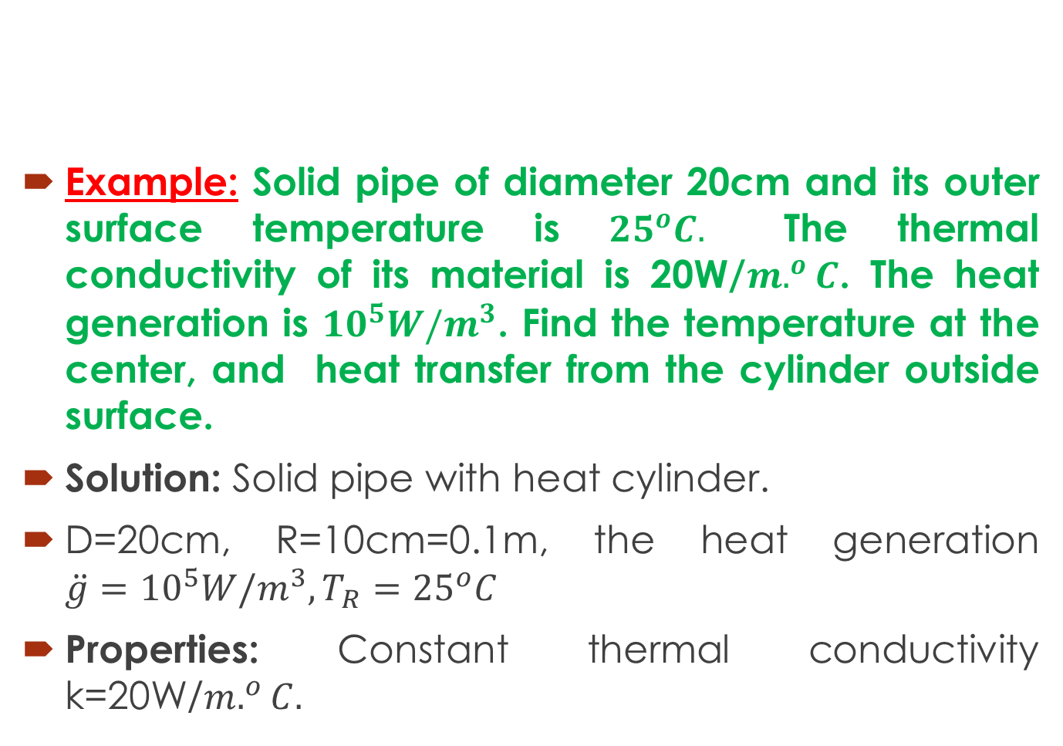
Example: Solid pipe of diameter 20cm and its outer surface temperature is ${25}^{o}C.$ The thermal conductivity of its material is 20W/$m.^{o}C$. The heat generation is ${10}^{5}W/m^{3}$. Find the temperature at the center, and heat transfer from the cylinder outside surface.
Solution: Solid pipe with heat cylinder.
D=20cm, R=10cm=0.1m, the heat generation $\ddot{g}={10}^{5}{W/m}^{3}, T_{R}={25}^{o}C$
Properties: Constant thermal conductivity k=20W/$m.^{o}C.$

Slide 7
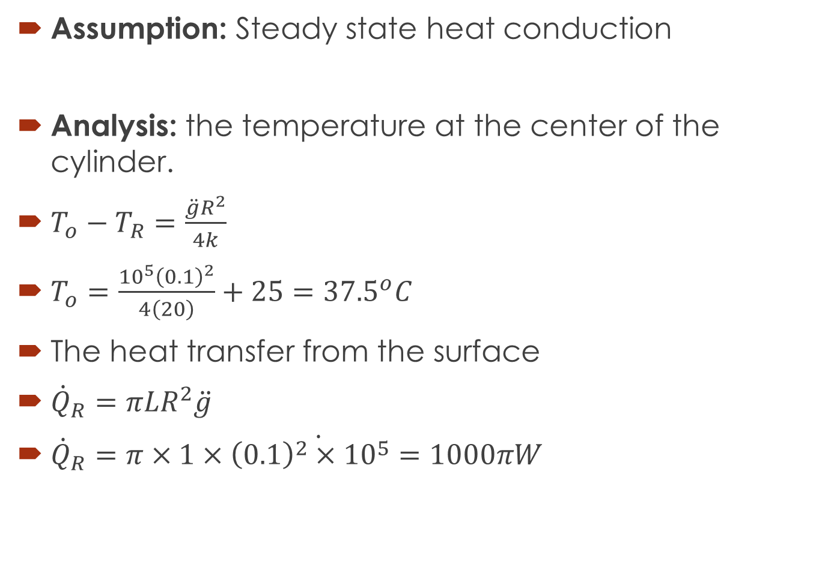
Assumption: Steady state heat conduction
Analysis: the temperature at the center of the cylinder.
$T_{o}−T_{R}=\frac{\ddot{g}R^{2}}{4k}$
$T_{o}=\frac{{10}^{5}{\left(0.1\right)}^{2}}{4\left(20\right)}+25={37.5}^{o}C$
The heat transfer from the surface
${\dot{Q}}_{R}=πLR^{2}\ddot{g}$
${\dot{Q}}_{R}\dot{=π×1×{\left(0.1\right)}^{2}×{10}^{5}=1000πW}$

Slide 8
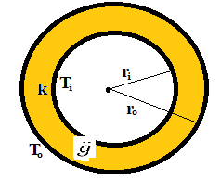
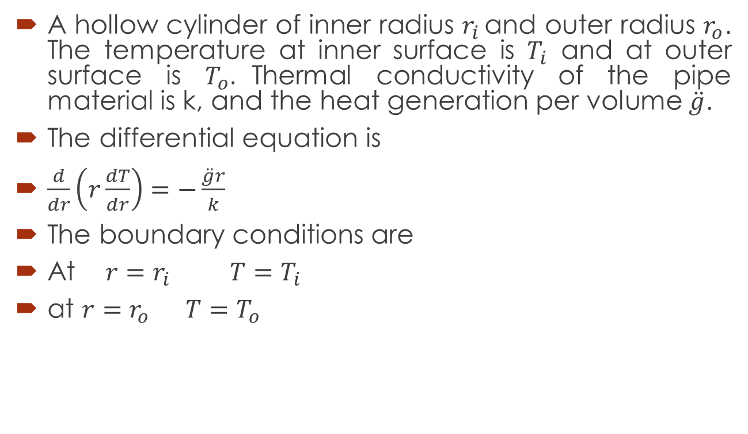
Heat generation in hollow cylinder
A hollow cylinder of inner radius $r_{i }$and outer radius $r_{o}$. The temperature at inner surface is $T_{i}$ and at outer surface is $T_{o}.$Thermal conductivity of the pipe material is k, and the heat generation per volume $\ddot{g}$.
The differential equation is
$\frac{d}{dr}\left(r\frac{dT}{dr}\right)=−\frac{\ddot{g}r}{k}$
The boundary conditions are
At $r=r_{i}$ $T=T_{i}$
at $r=r_{o}$ $T=T_{o}$

Slide 9
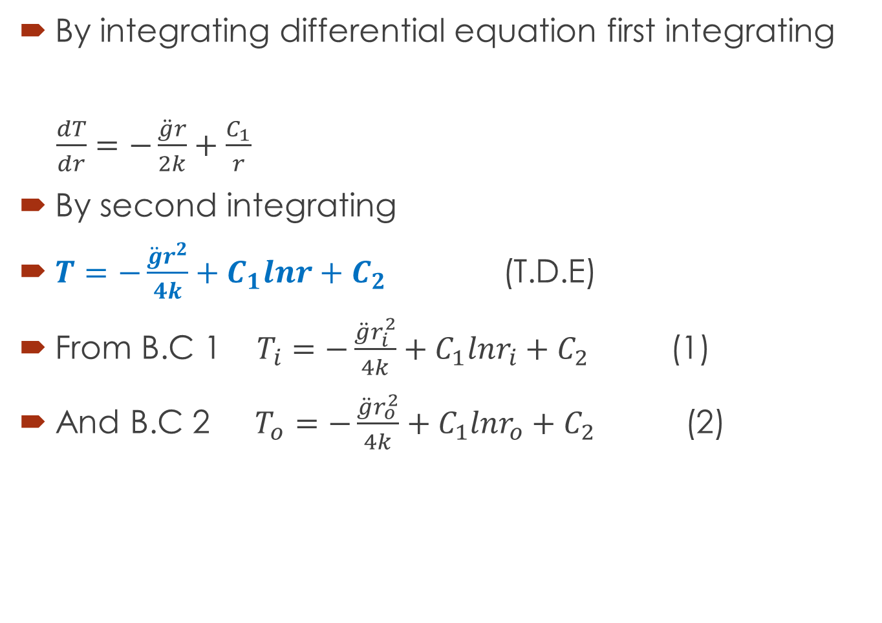
By integrating differential equation first integrating
$\frac{dT}{dr}=−\frac{\ddot{g}r}{2k}+\frac{C_{1}}{r}$
By second integrating
$T=−\frac{\ddot{g}r^{2}}{4k}+C_{1}lnr+C_{2}$ (T.D.E)
From B.C 1 $T_{i}=−\frac{\ddot{g}r_{i}^{2}}{4k}+C_{1}lnr_{i}+C_{2}$ (1)
And B.C 2 $T_{o}=−\frac{\ddot{g}r_{o}^{2}}{4k}+C_{1}lnr_{o}+C_{2}$ (2)

Slide 10
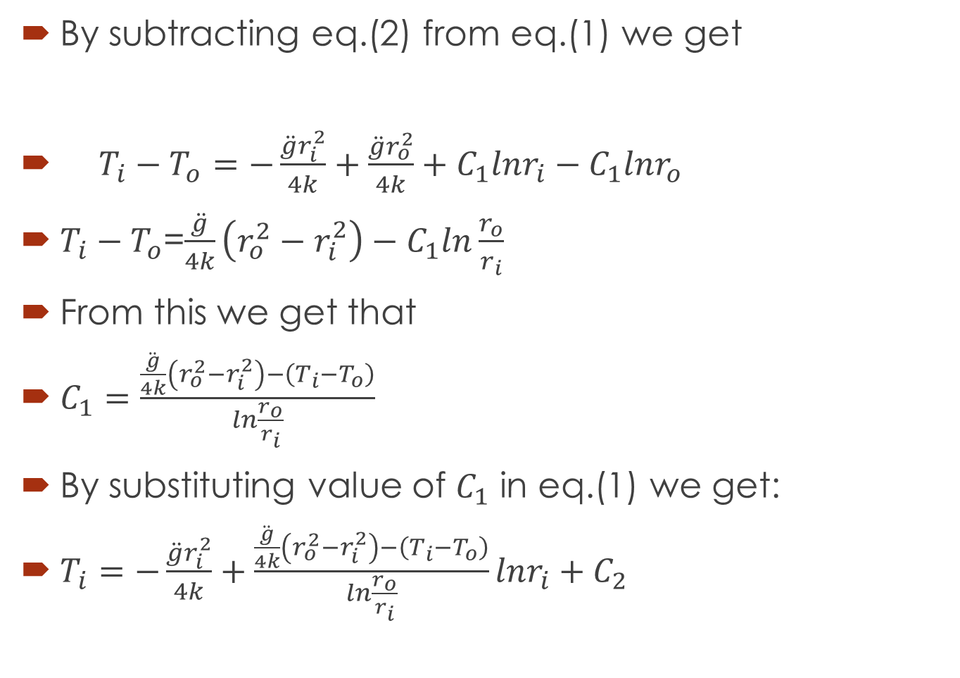
By subtracting eq.(2) from eq.(1) we get
$T_{i}−T_{o}=−\frac{\ddot{g}r_{i}^{2}}{4k}+\frac{\ddot{g}r_{o}^{2}}{4k}+C_{1}lnr_{i}−C_{1}lnr_{o}$
$T_{i}−T_{o}$=$\frac{\ddot{g}}{4k}\left(r_{o}^{2}−r_{i}^{2}\right)−C_{1}ln\frac{r_{o}}{r_{i}}$
From this we get that
$C_{1}=\frac{\frac{\ddot{g}}{4k}\left(r_{o}^{2}−r_{i}^{2}\right)−\left(T_{i}−T_{o}\right)}{ln\frac{r_{o}}{r_{i}}}$
By substituting value of $C_{1}$ in eq.(1) we get:
$T_{i}=−\frac{\ddot{g}r_{i}^{2}}{4k}+\frac{\frac{\ddot{g}}{4k}\left(r_{o}^{2}−r_{i}^{2}\right)−\left(T_{i}−T_{o}\right)}{ln\frac{r_{o}}{r_{i}}}lnr_{i}+C_{2}$

Slide 11
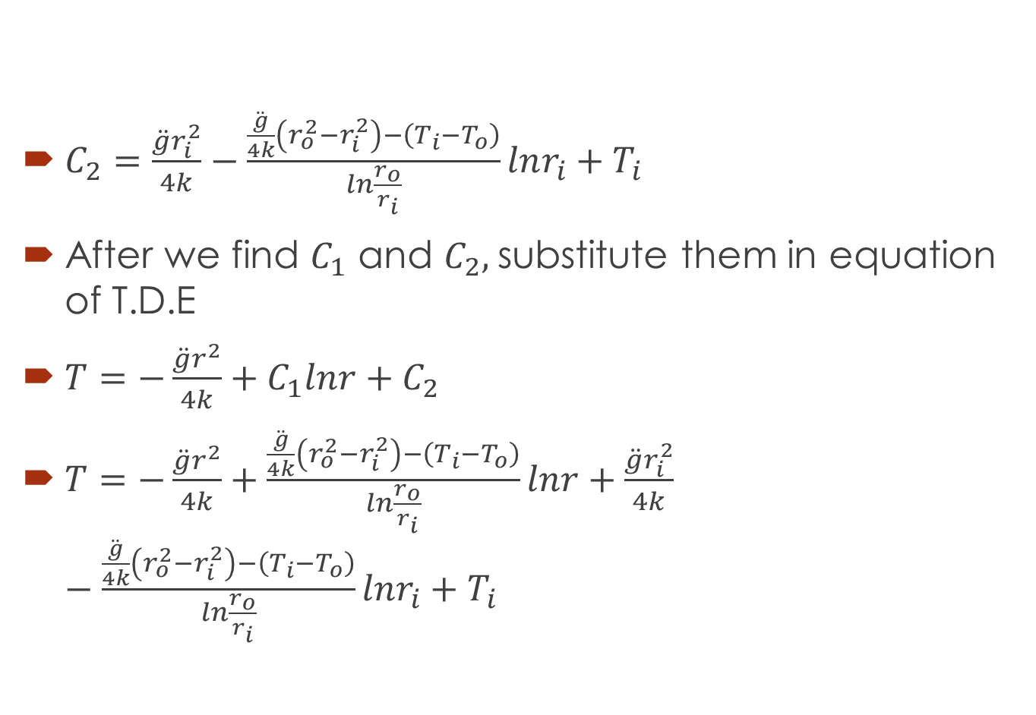
$C_{2}=\frac{\ddot{g}r_{i}^{2}}{4k}−\frac{\frac{\ddot{g}}{4k}\left(r_{o}^{2}−r_{i}^{2}\right)−\left(T_{i}−T_{o}\right)}{ln\frac{r_{o}}{r_{i}}}lnr_{i}+T_{i}$
After we find $C_{1}$ and $C_{2},$substitute them in equation of T.D.E
$T=−\frac{\ddot{g}r^{2}}{4k}+C_{1}lnr+C_{2}$
$T=−\frac{\ddot{g}r^{2}}{4k}+\frac{\frac{\ddot{g}}{4k}\left(r_{o}^{2}−r_{i}^{2}\right)−\left(T_{i}−T_{o}\right)}{ln\frac{r_{o}}{r_{i}}}lnr+\frac{\ddot{g}r_{i}^{2}}{4k}−\frac{\frac{\ddot{g}}{4k}\left(r_{o}^{2}−r_{i}^{2}\right)−\left(T_{i}−T_{o}\right)}{ln\frac{r_{o}}{r_{i}}}lnr_{i}+T_{i}$

Slide 12
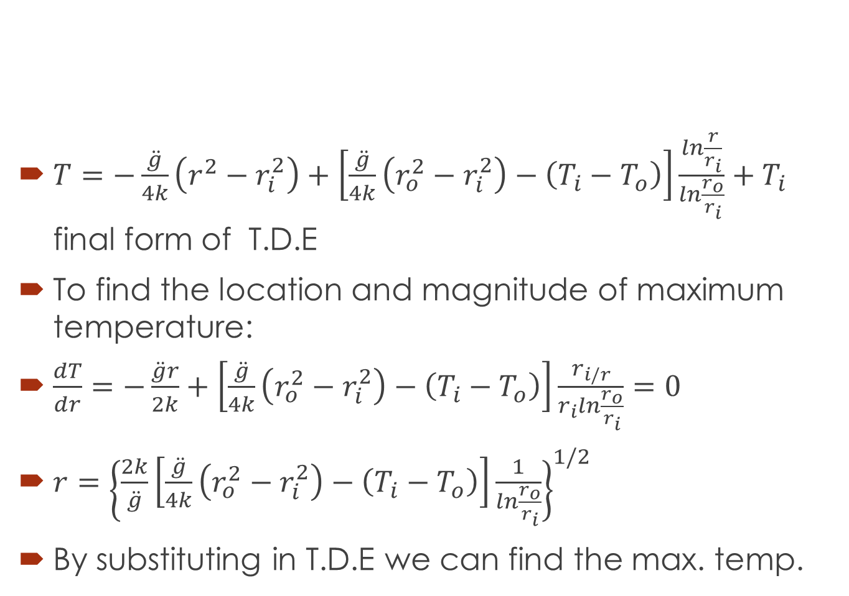
$T=−\frac{\ddot{g}}{4k}\left(r^{2}−r_{i}^{2}\right)+\left[\frac{\ddot{g}}{4k}\left(r_{o}^{2}−r_{i}^{2}\right)−\left(T_{i}−T_{o}\right)\right]\frac{ln\frac{r}{r_{i}}}{ln\frac{r_{o}}{r_{i}}}+T_{i}$ final form of T.D.E
To find the location and magnitude of maximum temperature:
$\frac{dT}{dr}=−\frac{\ddot{g}r}{2k}+\left[\frac{\ddot{g}}{4k}\left(r_{o}^{2}−r_{i}^{2}\right)−\left(T_{i}−T_{o}\right)\right]\frac{r_{i/r}}{r_{i}ln\frac{r_{o}}{r_{i}}}=0$
$r={\left\{\frac{2k}{\ddot{g}}\left[\frac{\ddot{g}}{4k}\left(r_{o}^{2}−r_{i}^{2}\right)−\left(T_{i}−T_{o}\right)\right]\frac{1}{ln\frac{r_{o}}{r_{i}}}\right\}}^{1/2}$
By substituting in T.D.E we can find the max. temp.

Slide 13
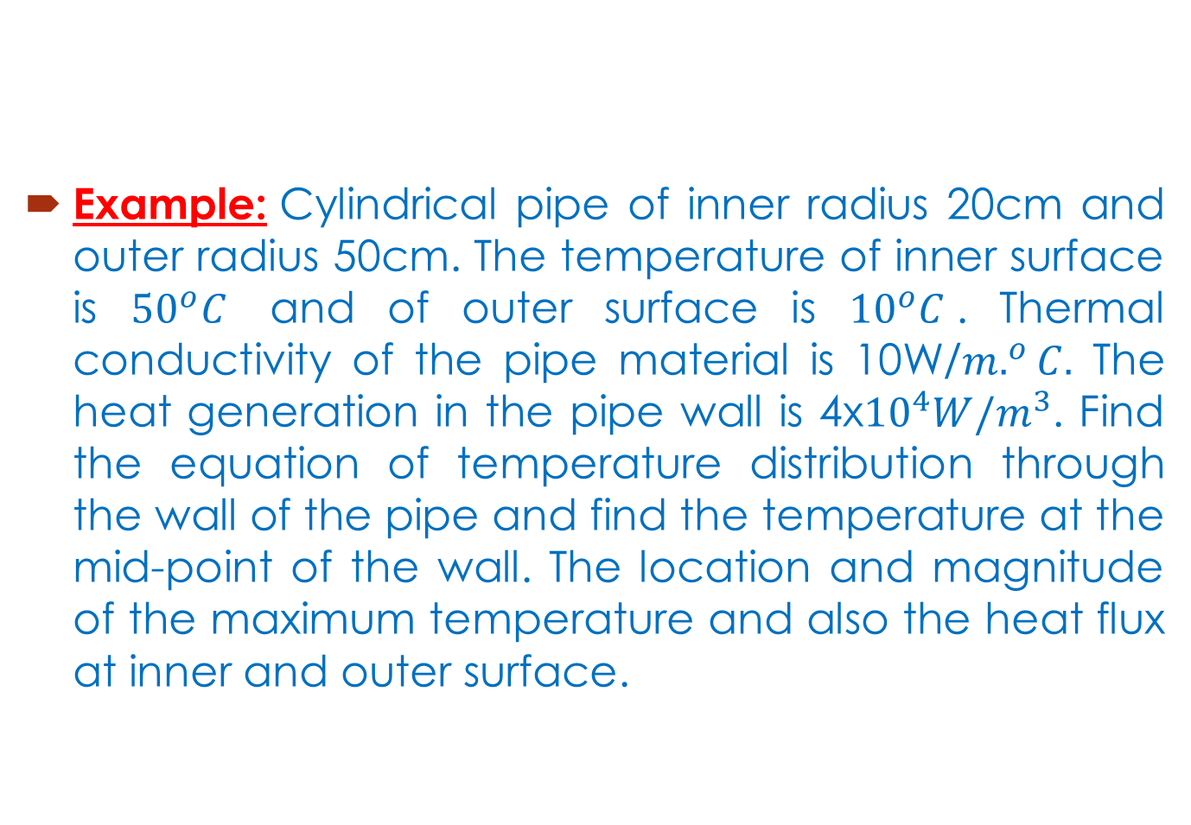
Example: Cylindrical pipe of inner radius 20cm and outer radius 50cm. The temperature of inner surface is ${50}^{o}C$ and of outer surface is ${10}^{o}C$. Thermal conductivity of the pipe material is 10W/$m.^{o}C.$ The heat generation in the pipe wall is 4x${10}^{4}W/m^{3}$. Find the equation of temperature distribution through the wall of the pipe and find the temperature at the mid-point of the wall. The location and magnitude of the maximum temperature and also the heat flux at inner and outer surface.

Slide 14
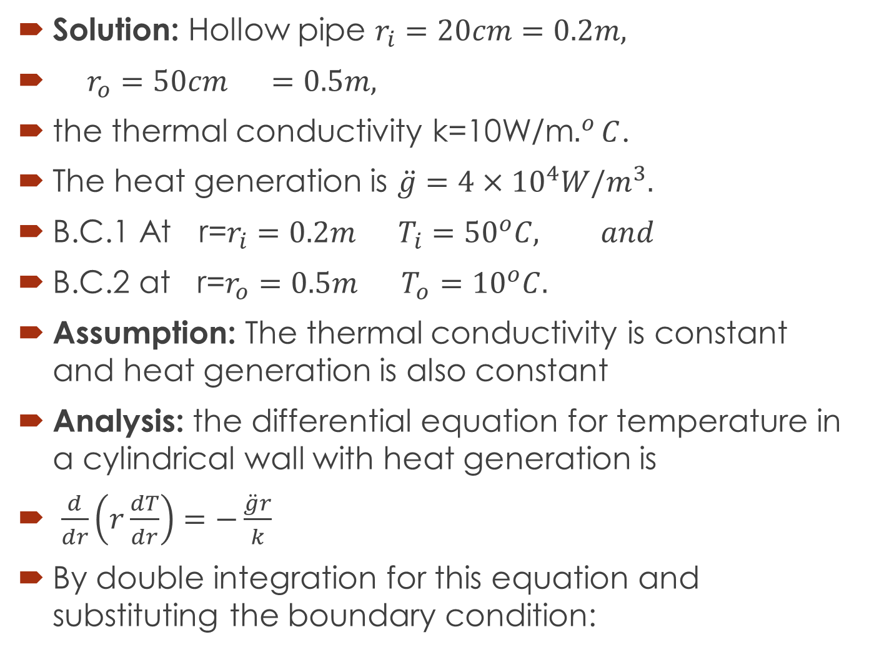
Solution: Hollow pipe $r_{i}=20cm=0.2m,$
$r_{o}=50cm =0.5m,$
the thermal conductivity k=10W/m$.^{o}C$.
The heat generation is $\ddot{g}=4×{10}^{4}W/m^{3}.$
B.C.1 At r=$r_{i}=0.2m T_{i}={50}^{o}C,$ $and$
B.C.2 at r=$r_{o}=0.5m$ $T_{o}={10}^{o}C.$
Assumption: The thermal conductivity is constant and heat generation is also constant
Analysis: the differential equation for temperature in a cylindrical wall with heat generation is
$\frac{d}{dr}\left(r\frac{dT}{dr}\right)=−\frac{\ddot{g}r}{k}$
By double integration for this equation and substituting the boundary condition:

Slide 15
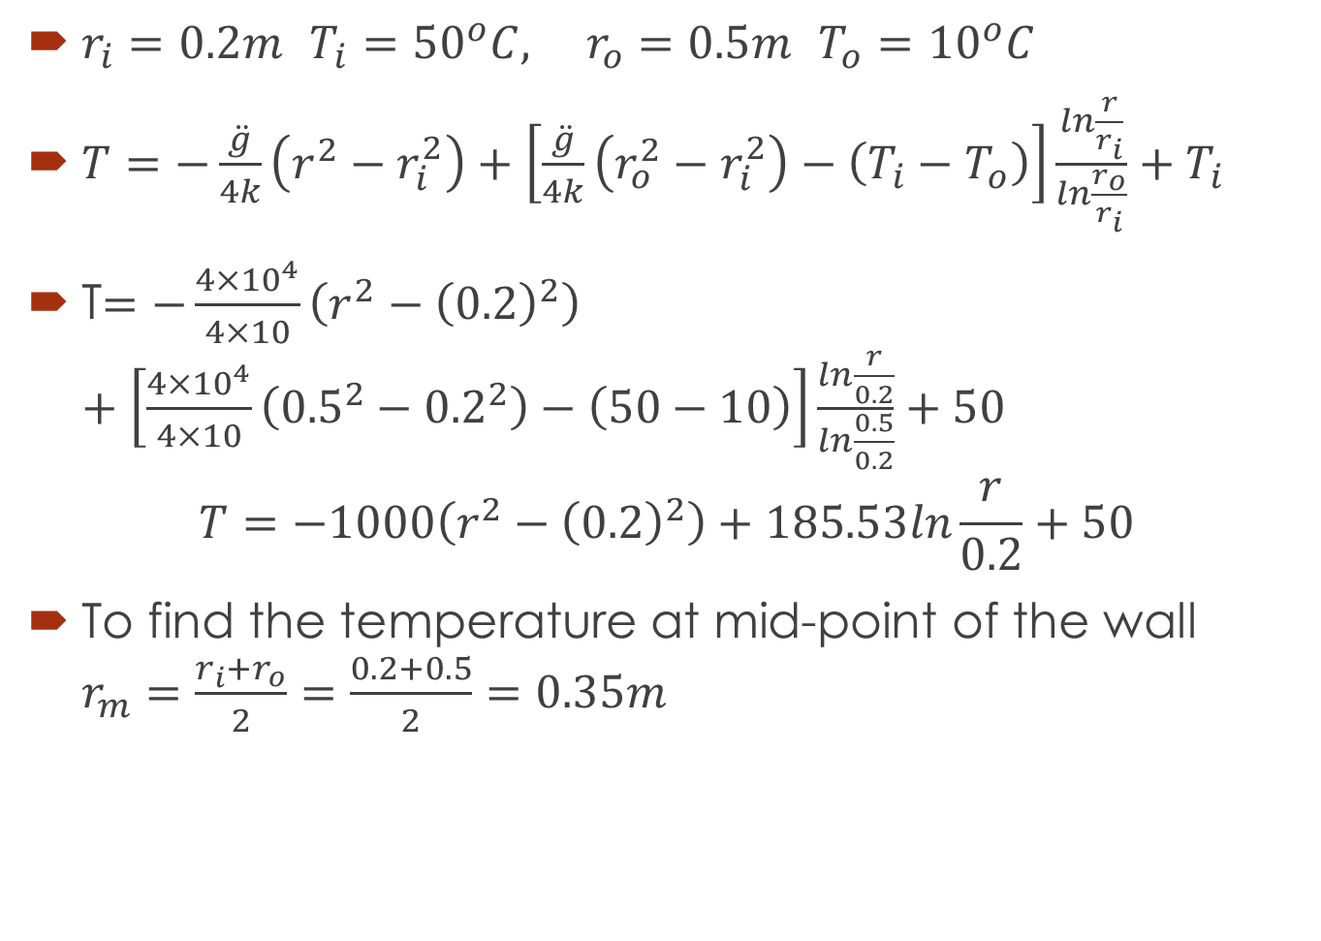
$r_{i}=0.2m$ $T_{i}={50}^{o}C, r_{o}=0.5m$ $T_{o}={10}^{o}C$
$T=−\frac{\ddot{g}}{4k}\left(r^{2}−r_{i}^{2}\right)+\left[\frac{\ddot{g}}{4k}\left(r_{o}^{2}−r_{i}^{2}\right)−\left(T_{i}−T_{o}\right)\right]\frac{ln\frac{r}{r_{i}}}{ln\frac{r_{o}}{r_{i}}}+T_{i}$
T$=−\frac{{4×10}^{4}}{4×10}\left(r^{2}−{\left(0.2\right)}^{2}\right)+\left[\frac{4×{10}^{4}}{4×10}\left({0.5}^{2}−{0.2}^{2}\right)−\left(50−10\right)\right]\frac{ln\frac{r}{0.2}}{ln\frac{0.5}{0.2}}+50$
$$T=−1000\left(r^{2}−{\left(0.2\right)}^{2}\right)+185.53ln\frac{r}{0.2}+50$$
To find the temperature at mid-point of the wall $r_{m}=\frac{r_{i}+r_{o}}{2}=\frac{0.2+0.5}{2}=0.35m$

Slide 16
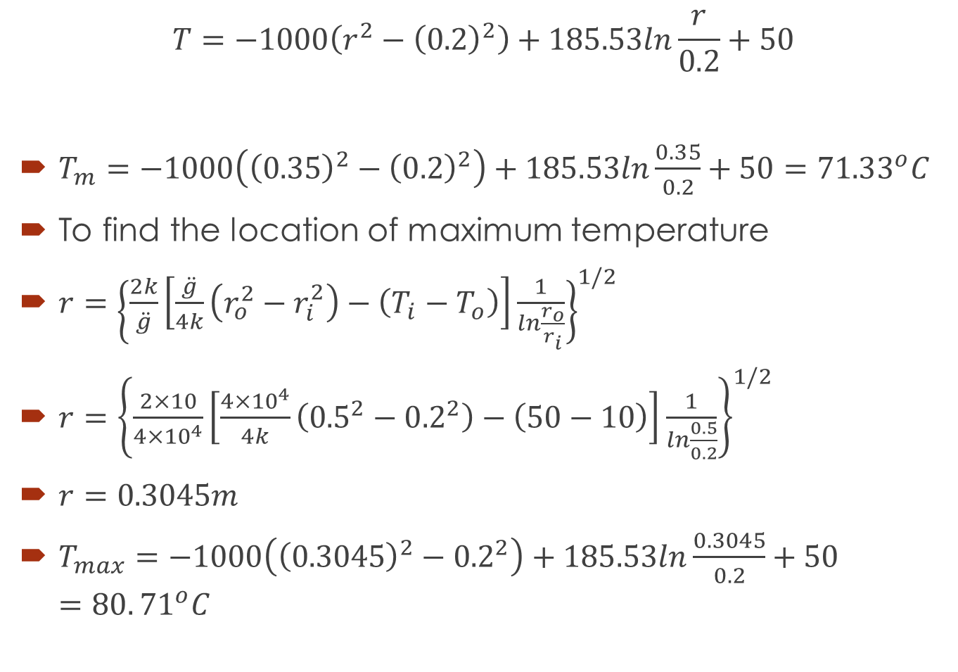
$$T=−1000\left(r^{2}−{\left(0.2\right)}^{2}\right)+185.53ln\frac{r}{0.2}+50$$
$T_{m}=−1000\left({\left(0.35\right)}^{2}−{\left(0.2\right)}^{2}\right)+185.53ln\frac{0.35}{0.2}+50=71.33^{o}C$
To find the location of maximum temperature
$r={\left\{\frac{2k}{\ddot{g}}\left[\frac{\ddot{g}}{4k}\left(r_{o}^{2}−r_{i}^{2}\right)−\left(T_{i}−T_{o}\right)\right]\frac{1}{ln\frac{r_{o}}{r_{i}}}\right\}}^{1/2}$
$r={\left\{\frac{2×10}{4×{10}^{4}}\left[\frac{4×{10}^{4}}{4k}\left({0.5}^{2}−{0.2}^{2}\right)−\left(50−10\right)\right]\frac{1}{ln\frac{0.5}{0.2}}\right\}}^{1/2}$
$r=0.3045m$
$T_{max}=−1000\left({\left(0.3045\right)}^{2}−{0.2}^{2}\right)+185.53ln\frac{0.3045}{0.2}+50=80.{71}^{o}C$

Slide 17
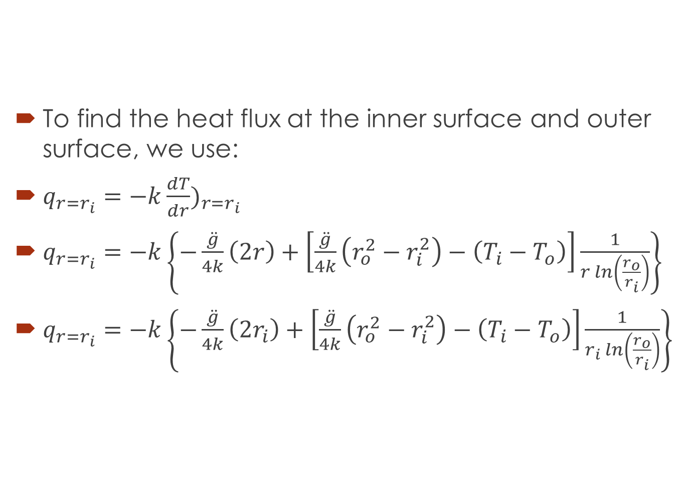
To find the heat flux at the inner surface and outer surface, we use:
$q_{r=r_{i}}=−k{\frac{dT}{dr})}_{r=r_{i}}$
$q_{r=r_{i}}=−k\left\{−\frac{\ddot{g}}{4k}\left(2r\right)+\left[\frac{\ddot{g}}{4k}\left(r_{o}^{2}−r_{i}^{2}\right)−\left(T_{i}−T_{o}\right)\right]\frac{1}{r ln\left(\frac{r_{o}}{r_{i}}\right)}\right\}$
$q_{r=r_{i}}=−k\left\{−\frac{\ddot{g}}{4k}\left(2r_{i}\right)+\left[\frac{\ddot{g}}{4k}\left(r_{o}^{2}−r_{i}^{2}\right)−\left(T_{i}−T_{o}\right)\right]\frac{1}{r_{i} ln\left(\frac{r_{o}}{r_{i}}\right)}\right\}$

Slide 18
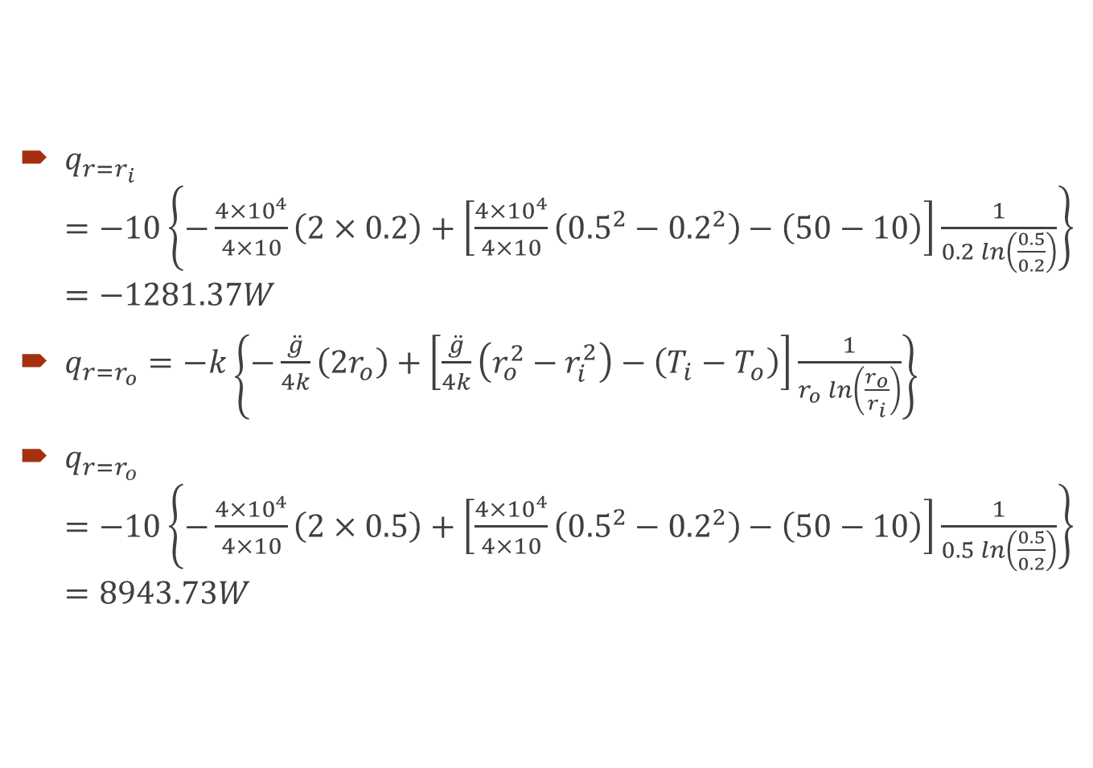
$q_{r=r_{i}}=−10\left\{−\frac{4×{10}^{4}}{4×10}\left(2×0.2\right)+\left[\frac{4×{10}^{4}}{4×10}\left({0.5}^{2}−{0.2}^{2}\right)−\left(50−10\right)\right]\frac{1}{0.2 ln\left(\frac{0.5}{0.2}\right)}\right\}=−1281.37W$
$q_{r=r_{o}}=−k\left\{−\frac{\ddot{g}}{4k}\left(2r_{o}\right)+\left[\frac{\ddot{g}}{4k}\left(r_{o}^{2}−r_{i}^{2}\right)−\left(T_{i}−T_{o}\right)\right]\frac{1}{r_{o} ln\left(\frac{r_{o}}{r_{i}}\right)}\right\}$
$q_{r=r_{o}}=−10\left\{−\frac{4×{10}^{4}}{4×10}\left(2×0.5\right)+\left[\frac{4×{10}^{4}}{4×10}\left({0.5}^{2}−{0.2}^{2}\right)−\left(50−10\right)\right]\frac{1}{0.5 ln\left(\frac{0.5}{0.2}\right)}\right\}=8943.73W$

Slide 19
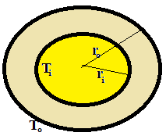
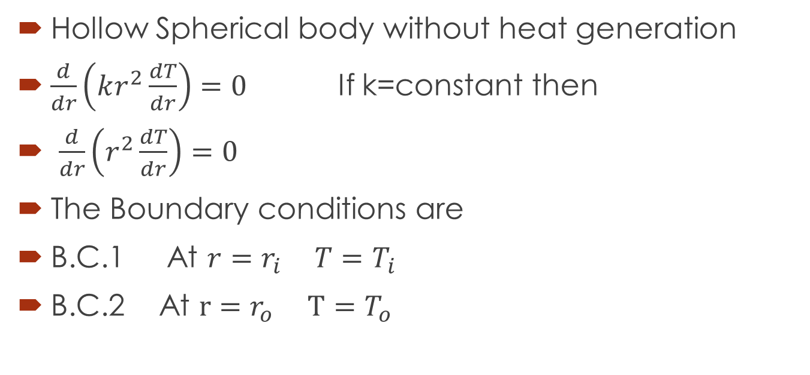
Heat Conduction in Spherical Body
Hollow Spherical body without heat generation
$\frac{d}{dr}\left(kr^{2}\frac{dT}{dr}\right)=0$ If k=constant then
$\frac{d}{dr}\left(r^{2}\frac{dT}{dr}\right)=0$
The Boundary conditions are
B.C.1 At ${r=r}_{i}$ $T=T_{i}$
B.C.2 At $r=r_{o}$ $T=T_{o}$

Slide 20
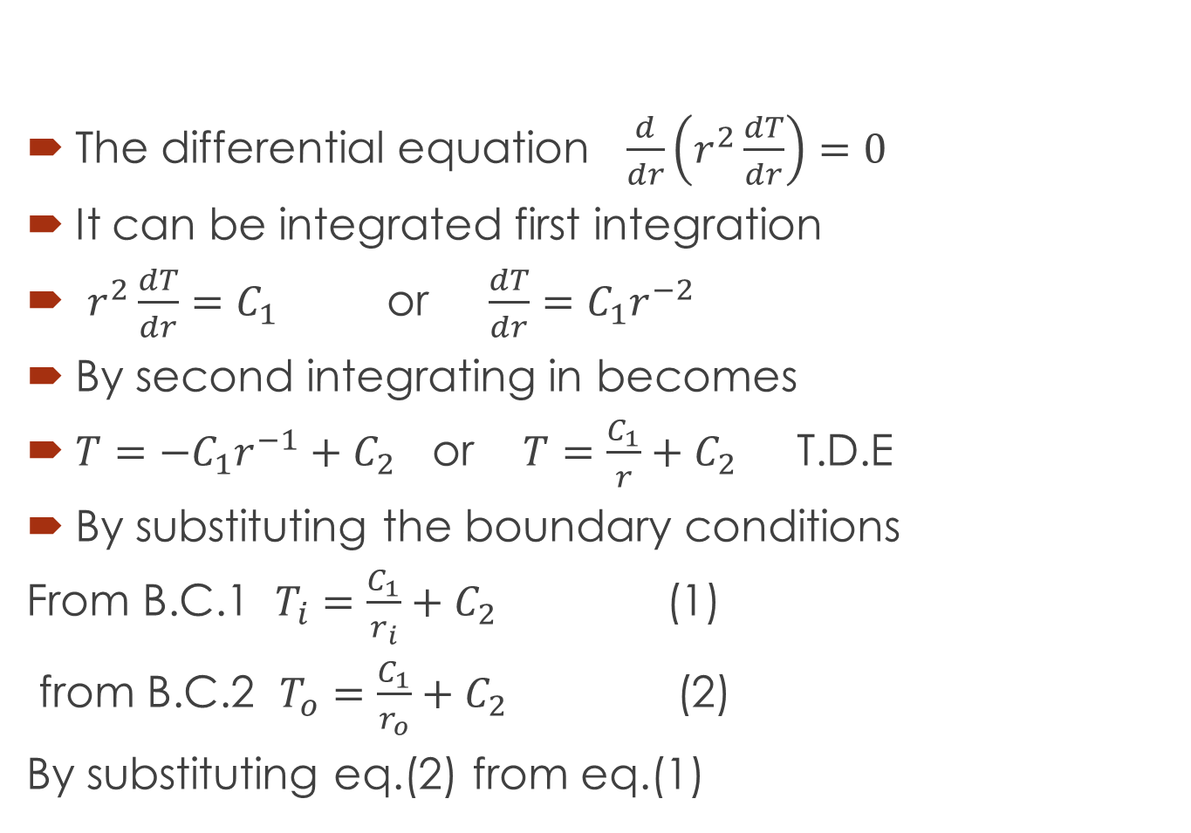
The differential equation $\frac{d}{dr}\left(r^{2}\frac{dT}{dr}\right)=0$
It can be integrated first integration
$r^{2}\frac{dT}{dr}=C_{1}$ or $\frac{dT}{dr}=C_{1}r^{−2}$
By second integrating in becomes
$T={−C}_{1}r^{−1}+C_{2}$ or $T=\frac{C_{1}}{r}+C_{2}$ T.D.E
By substituting the boundary conditions
From B.C.1 $T_{i}=\frac{C_{1}}{r_{i}}+C_{2}$ (1)
from B.C.2 $T_{o}=\frac{C_{1}}{r_{o}}+C_{2}$ (2)
By substituting eq.(2) from eq.(1)

Slide 21
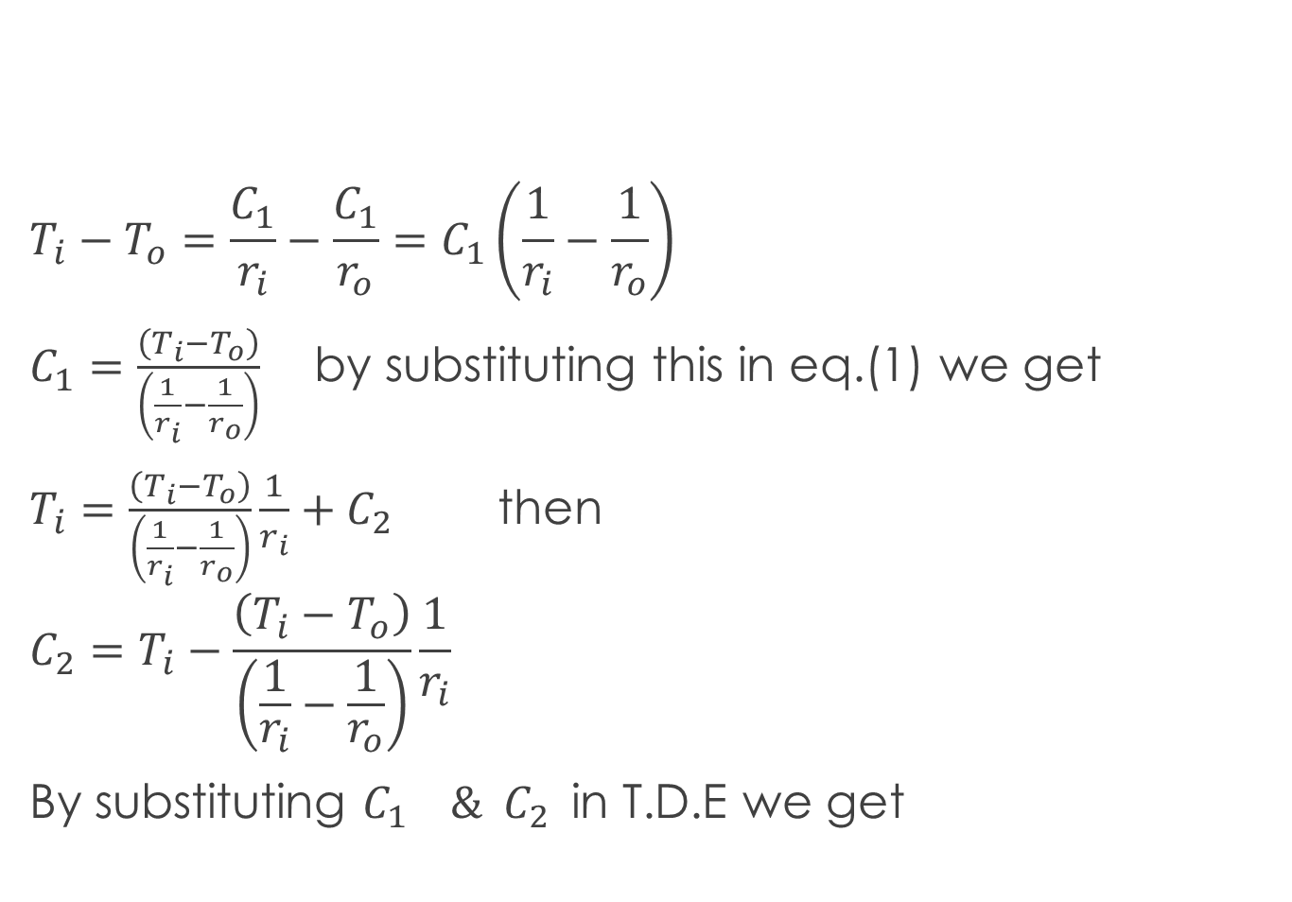
$$T_{i}−T_{o}=\frac{C_{1}}{r_{i}}−\frac{C_{1}}{r_{o}}=C_{1}\left(\frac{1}{r_{i}}−\frac{1}{r_{o}}\right)$$
$C_{1}=\frac{\left(T_{i}−T_{o}\right)}{\left(\frac{1}{r_{i}}−\frac{1}{r_{o}}\right)}$ by substituting this in eq.(1) we get
$T_{i}=\frac{\left(T_{i}−T_{o}\right)}{\left(\frac{1}{r_{i}}−\frac{1}{r_{o}}\right)}\frac{1}{r_{i}}+C_{2}$ then
$${C_{2}=T}_{i}−\frac{\left(T_{i}−T_{o}\right)}{\left(\frac{1}{r_{i}}−\frac{1}{r_{o}}\right)}\frac{1}{r_{i}}$$
By substituting $C_{1} \& C_{2}$in T.D.E we get

Slide 22

$T=\frac{\left(T_{i}−T_{o}\right)}{\left(\frac{1}{r_{i}}−\frac{1}{r_{o}}\right)}\frac{1}{r}+T_{i}−\frac{\left(T_{i}−T_{o}\right)}{\left(\frac{1}{r_{i}}−\frac{1}{r_{o}}\right)}\frac{1}{r_{i}}$ or
$T−T_{i}=\left(T_{i}−T_{o}\right)\frac{\left(\frac{1}{r}−\frac{1}{r_{i}}\right)}{\left(\frac{1}{r_{i}}−\frac{1}{r_{o}}\right)}$ or
$\frac{\left(T−T_{i}\right)}{\left(T_{o}−T_{i}\right)}=\frac{\left(\frac{1}{r_{i}}−\frac{1}{r}\right)}{\left(\frac{1}{r_{i}}−\frac{1}{r_{o}}\right)}$ T.D.E

Slide 23
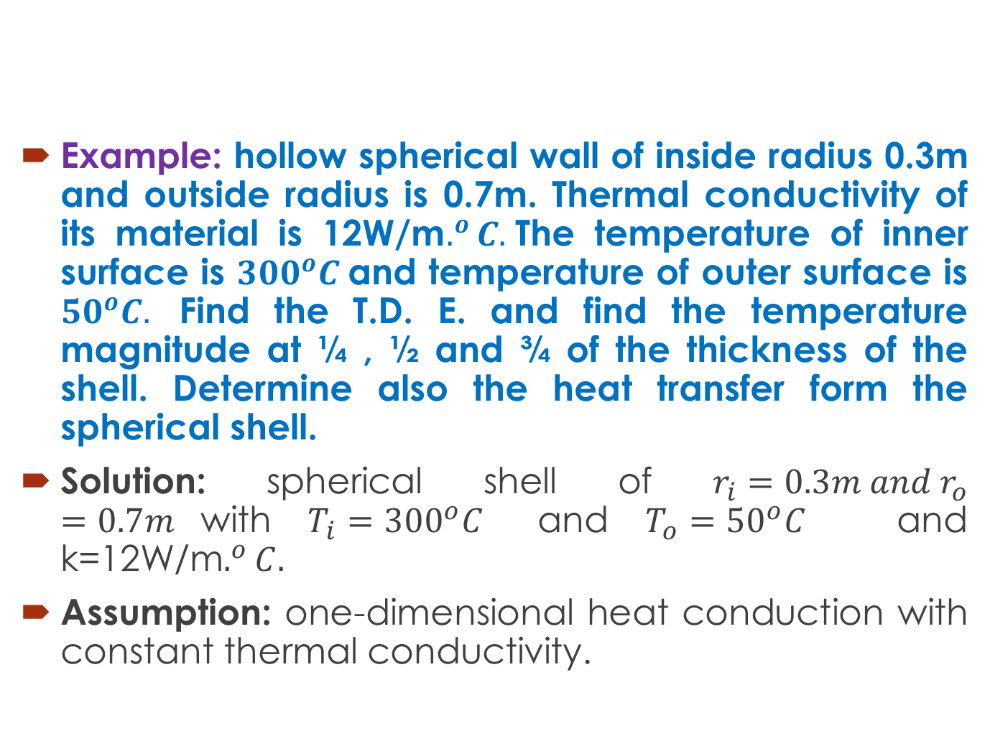
Example: hollow spherical wall of inside radius 0.3m and outside radius is 0.7m. Thermal conductivity of its material is 12W/m$.^{o}C.$The temperature of inner surface is ${300}^{o}C$and temperature of outer surface is ${50}^{o}C.$ Find the T.D. E. and find the temperature magnitude at ¼ , ½ and ¾ of the thickness of the shell. Determine also the heat transfer form the spherical shell.
Solution: spherical shell of $r_{i}=0.3m and r_{o}=0.7m$with $T_{i}=300^{o}C$ and $T_{o}={50}^{o}C$ and k=12W/m$.^{o}C.$
Assumption: one-dimensional heat conduction with constant thermal conductivity.

Slide 24
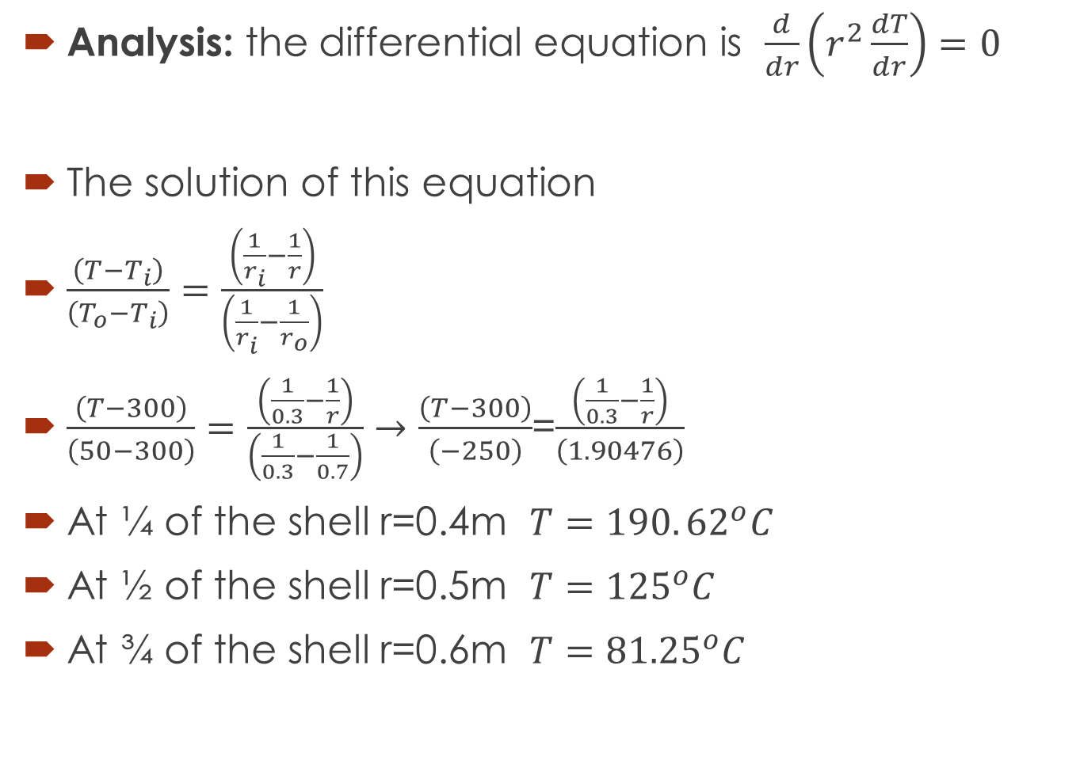
Analysis: the differential equation is $\frac{d}{dr}\left(r^{2}\frac{dT}{dr}\right)=0$
The solution of this equation
$\frac{\left(T−T_{i}\right)}{\left(T_{o}−T_{i}\right)}=\frac{\left(\frac{1}{r_{i}}−\frac{1}{r}\right)}{\left(\frac{1}{r_{i}}−\frac{1}{r_{o}}\right)}$
$\frac{\left(T−300\right)}{\left(50−300\right)}=\frac{\left(\frac{1}{0.3}−\frac{1}{r}\right)}{\left(\frac{1}{0.3}−\frac{1}{0.7}\right)}→\frac{\left(T−300\right)}{\left(−250\right)}$=$\frac{\left(\frac{1}{0.3}−\frac{1}{r}\right)}{\left(1.90476\right)}$
At ¼ of the shell r=0.4m $T=190.{62}^{o}C$
At ½ of the shell r=0.5m $T=125^{o}C$
At ¾ of the shell r=0.6m $T=81.25^{o}C$

Slide 25

To find the heat transfer from the spherical shell
$Q=\frac{\left(T_{i}−T_{o}\right)}{\frac{1}{4πk}\left(\frac{1}{r_{i}}−\frac{1}{r_{o}}\right)}=\frac{\left(300−50\right)}{\frac{1}{4π×12}\left(\frac{1}{0.3}−\frac{1}{0.7}\right)}=19792W$
r | T
0.3 | 300
0.4 | 190.62
0.5 | 125
0.6 | 81.25
0.7 | 50

Slide 26
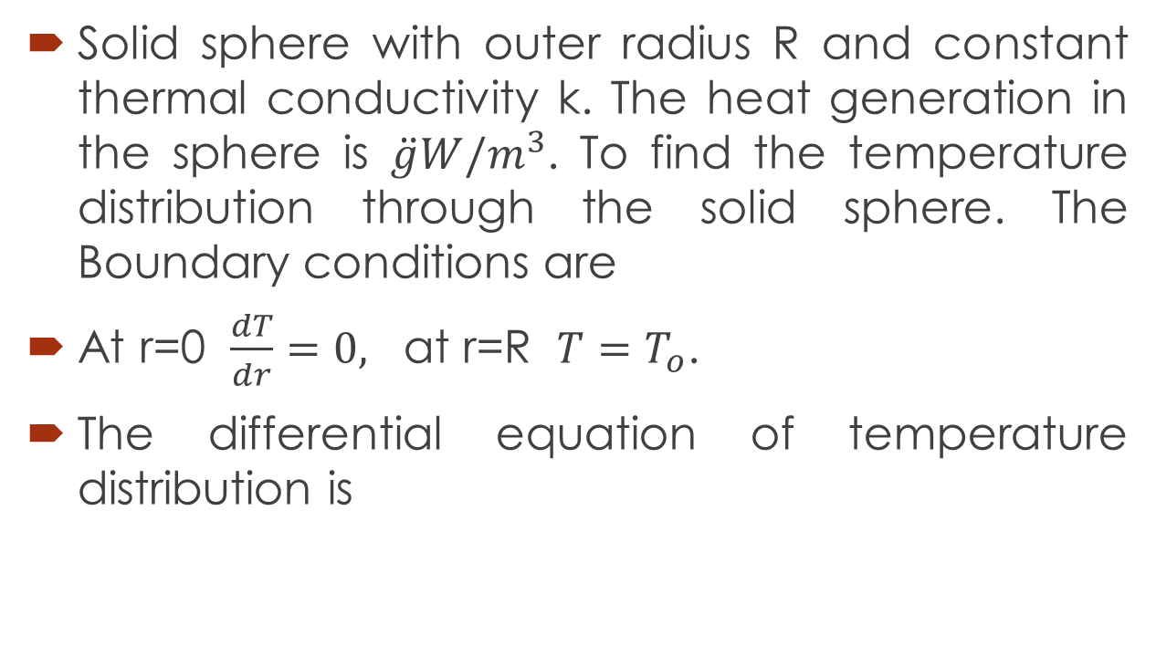
Heat conduction in solid Sphere with heat generation
Solid sphere with outer radius R and constant thermal conductivity k. The heat generation in the sphere is $\ddot{g}W/m^{3}$. To find the temperature distribution through the solid sphere. The Boundary conditions are
At r=0 $\frac{dT}{dr}=0,$ at r=R $T=T_{o}$.
The differential equation of temperature distribution is

Slide 27
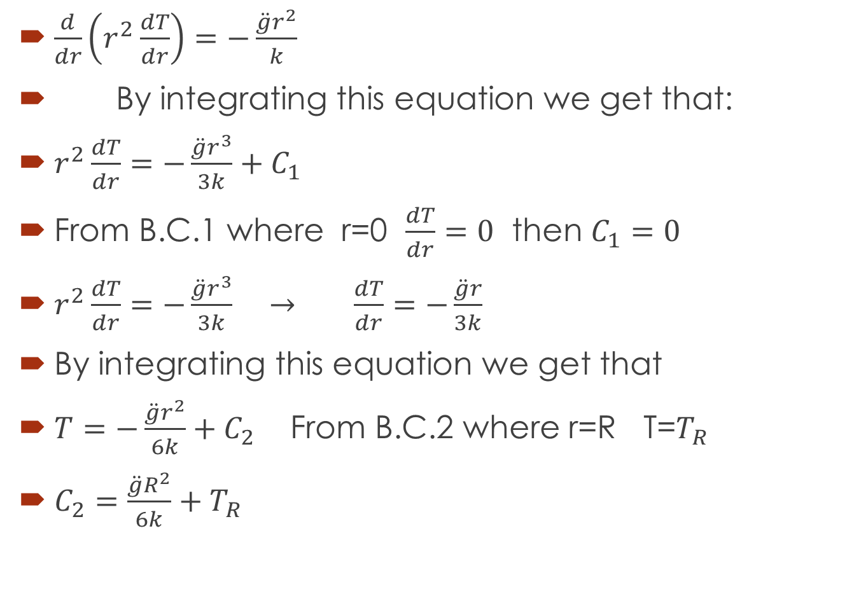
$\frac{d}{dr}\left(r^{2}\frac{dT}{dr}\right)=−\frac{\ddot{g}r^{2}}{k}$
By integrating this equation we get that:
$r^{2}\frac{dT}{dr}=−\frac{\ddot{g}r^{3}}{3k}+C_{1}$
From B.C.1 where r=0 $\frac{dT}{dr}=0$ then $C_{1}=0$
$r^{2}\frac{dT}{dr}=−\frac{\ddot{g}r^{3}}{3k} → \frac{dT}{dr}=−\frac{\ddot{g}r}{3k}$
By integrating this equation we get that
$T=−\frac{\ddot{g}r^{2}}{6k}+C_{2}$ From B.C.2 where r=R T=$T_{R}$
$C_{2}=\frac{\ddot{g}R^{2}}{6k}+T_{R}$

Slide 28
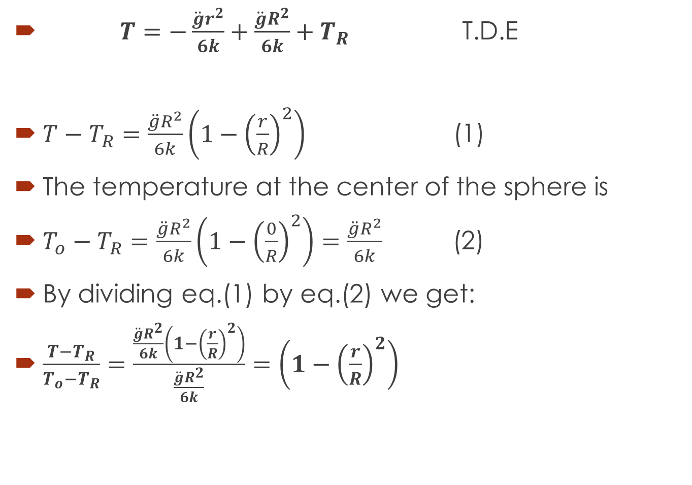
$T=−\frac{\ddot{g}r^{2}}{6k}+\frac{\ddot{g}R^{2}}{6k}+T_{R}$ T.D.E
$T−T_{R}=\frac{\ddot{g}R^{2}}{6k}\left(1−{\left(\frac{r}{R}\right)}^{2}\right)$ (1)
The temperature at the center of the sphere is
$T_{o}−T_{R}=\frac{\ddot{g}R^{2}}{6k}\left(1−{\left(\frac{0}{R}\right)}^{2}\right)=\frac{\ddot{g}R^{2}}{6k}$ (2)
By dividing eq.(1) by eq.(2) we get:
$\frac{T−T_{R}}{T_{o}−T_{R}}=\frac{\frac{\ddot{g}R^{2}}{6k}\left(1−{\left(\frac{r}{R}\right)}^{2}\right)}{\frac{\ddot{g}R^{2}}{6k}}=\left(1−{\left(\frac{r}{R}\right)}^{2}\right)$

Slide 29
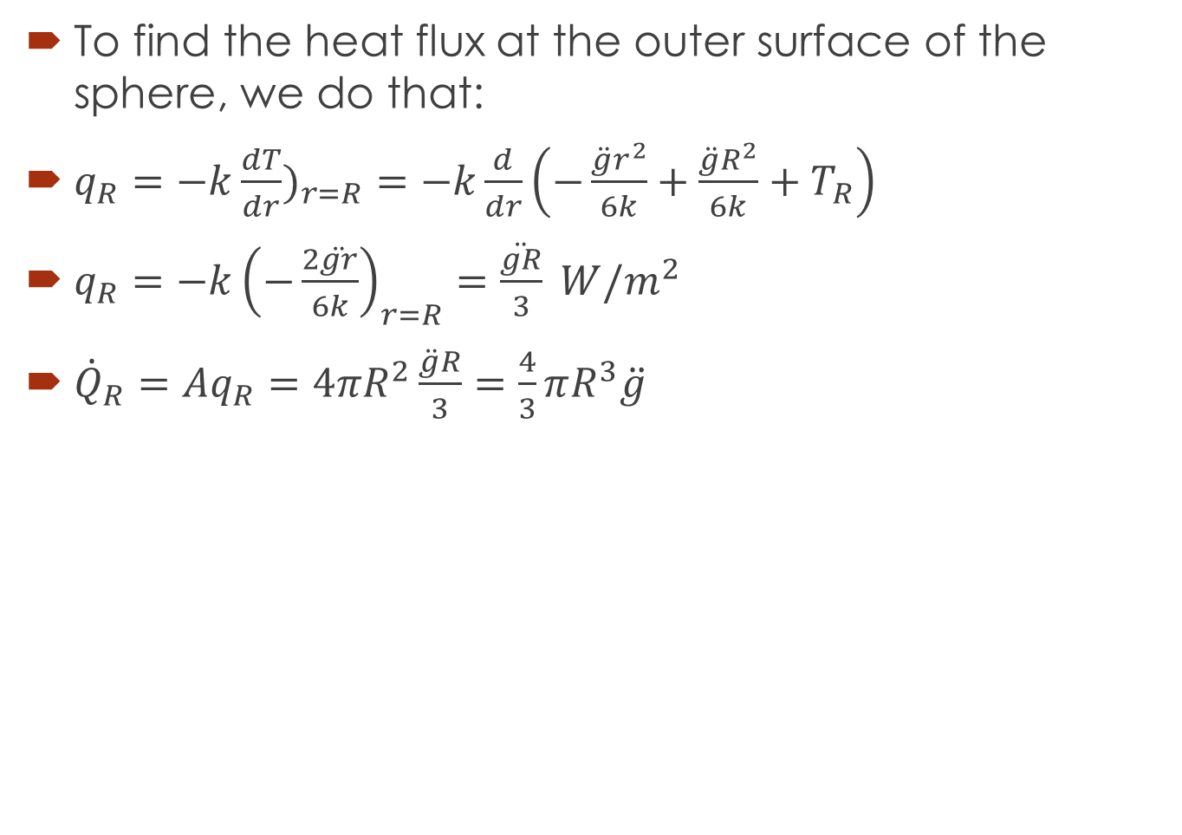
To find the heat flux at the outer surface of the sphere, we do that:
$q_{R}=−k\frac{dT}{dr})_{r=R}=−k\frac{d}{dr}\left(−\frac{\ddot{g}r^{2}}{6k}+\frac{\ddot{g}R^{2}}{6k}+T_{R}\right)$
$q_{R}=−k{\left(−\frac{2\ddot{gr}}{6k}\right)}_{r=R}=\frac{\ddot{gR}}{3} W/m^{2}$
${\dot{Q}}_{R}=Aq_{R}=4πR^{2}\frac{\ddot{g}R}{3}=\frac{4}{3}πR^{3}\ddot{g}$

Slide 30
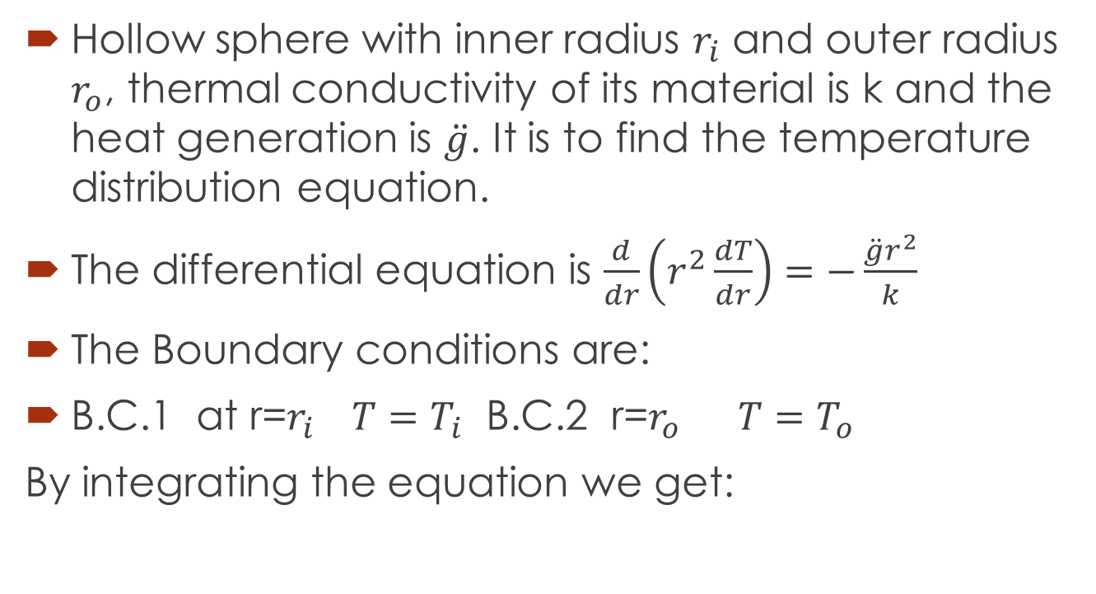
Heat Conduction in a Hollow sphere with heat generation
Hollow sphere with inner radius $r_{i}$ and outer radius $r_{o}$, thermal conductivity of its material is k and the heat generation is $\ddot{g}$. It is to find the temperature distribution equation.
The differential equation is $\frac{d}{dr}\left(r^{2}\frac{dT}{dr}\right)=−\frac{\ddot{g}r^{2}}{k}$
The Boundary conditions are:
B.C.1 at r=$r_{i} T=T_{i}$ B.C.2 r=$r_{o}$ $T=T_{o}$
By integrating the equation we get:

Slide 31
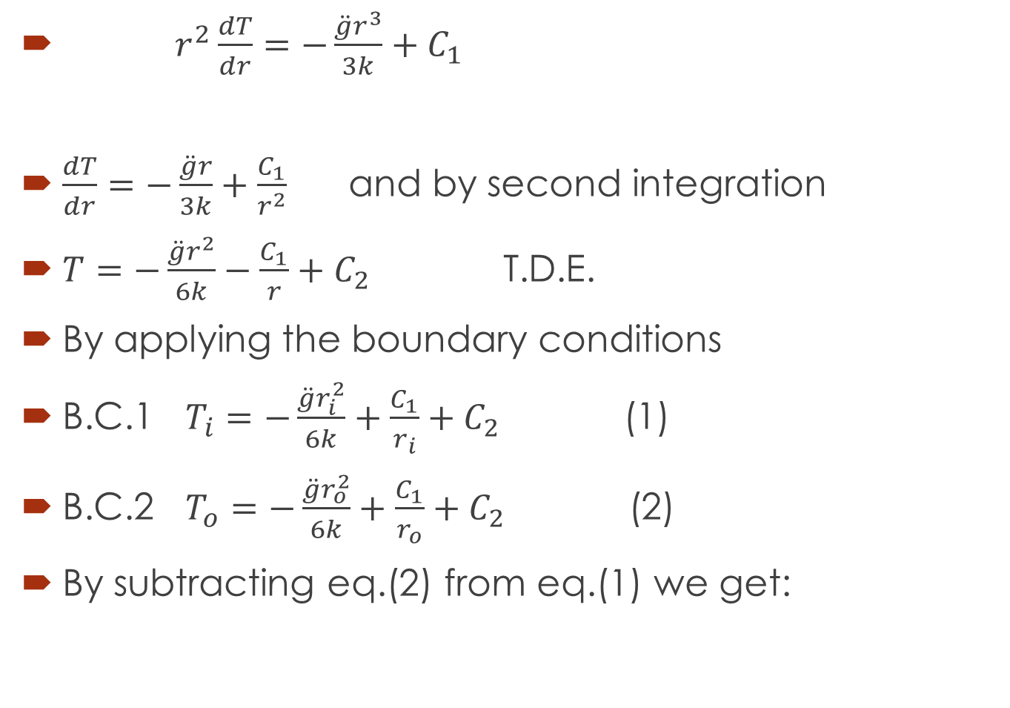
$r^{2}\frac{dT}{dr}=−\frac{\ddot{g}r^{3}}{3k}+C_{1}$
$\frac{dT}{dr}=−\frac{\ddot{g}r}{3k}+\frac{C_{1}}{r^{2}}$ and by second integration
$T=−\frac{\ddot{g}r^{2}}{6k}−\frac{C_{1}}{r}+C_{2}$ T.D.E.
By applying the boundary conditions
B.C.1 $T_{i}=−\frac{\ddot{g}r_{i}^{2}}{6k}+\frac{C_{1}}{r_{i}}+C_{2}$ (1)
B.C.2 $T_{o}=−\frac{\ddot{g}r_{o}^{2}}{6k}+\frac{C_{1}}{r_{o}}+C_{2}$ (2)
By subtracting eq.(2) from eq.(1) we get:

Slide 32
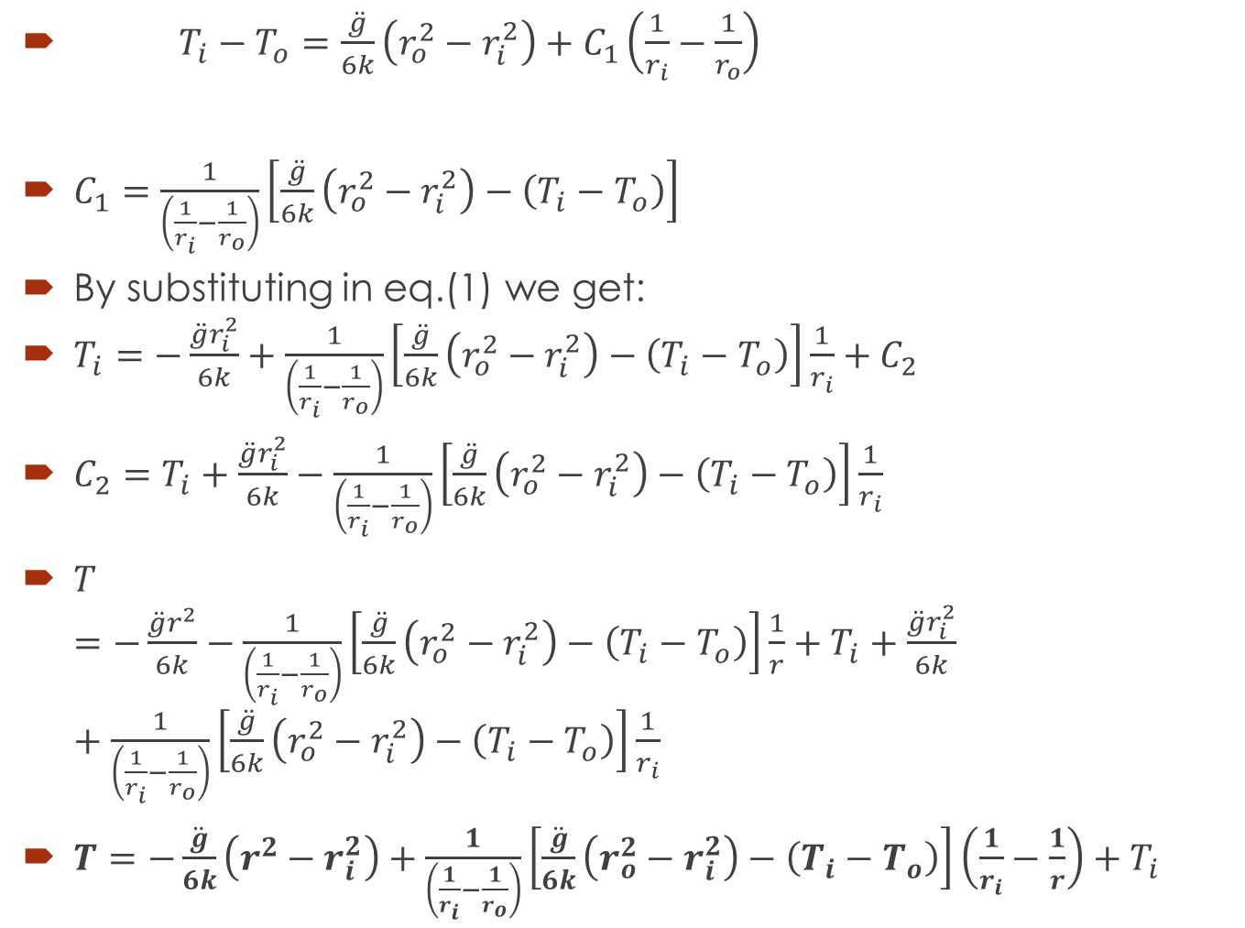
$T_{i}−T_{o}=\frac{\ddot{g}}{6k}\left(r_{o}^{2}−r_{i}^{2}\right)+C_{1}\left(\frac{1}{r_{i}}−\frac{1}{r_{o}}\right)$
$C_{1}=\frac{1}{\left(\frac{1}{r_{i}}−\frac{1}{r_{o}}\right)}\left[\frac{\ddot{g}}{6k}\left(r_{o}^{2}−r_{i}^{2}\right)−\left(T_{i}−T_{o}\right)\right]$
By substituting in eq.(1) we get:
$T_{i}=−\frac{\ddot{g}r_{i}^{2}}{6k}+\frac{1}{\left(\frac{1}{r_{i}}−\frac{1}{r_{o}}\right)}\left[\frac{\ddot{g}}{6k}\left(r_{o}^{2}−r_{i}^{2}\right)−\left(T_{i}−T_{o}\right)\right]\frac{1}{r_{i}}+C_{2}$
$C_{2}=T_{i}+\frac{\ddot{g}r_{i}^{2}}{6k}−\frac{1}{\left(\frac{1}{r_{i}}−\frac{1}{r_{o}}\right)}\left[\frac{\ddot{g}}{6k}\left(r_{o}^{2}−r_{i}^{2}\right)−\left(T_{i}−T_{o}\right)\right]\frac{1}{r_{i}}$
$T=−\frac{\ddot{g}r^{2}}{6k}−\frac{1}{\left(\frac{1}{r_{i}}−\frac{1}{r_{o}}\right)}\left[\frac{\ddot{g}}{6k}\left(r_{o}^{2}−r_{i}^{2}\right)−\left(T_{i}−T_{o}\right)\right]\frac{1}{r}+T_{i}+\frac{\ddot{g}r_{i}^{2}}{6k}+\frac{1}{\left(\frac{1}{r_{i}}−\frac{1}{r_{o}}\right)}\left[\frac{\ddot{g}}{6k}\left(r_{o}^{2}−r_{i}^{2}\right)−\left(T_{i}−T_{o}\right)\right]\frac{1}{r_{i}}$
$T=−\frac{\ddot{g}}{6k}\left(r^{2}−r_{i}^{2}\right)+\frac{1}{\left(\frac{1}{r_{i}}−\frac{1}{r_{o}}\right)}\left[\frac{\ddot{g}}{6k}\left(r_{o}^{2}−r_{i}^{2}\right)−\left(T_{i}−T_{o}\right)\right]\left(\frac{1}{r_{i}}−\frac{1}{r}\right)+T_{i}$

