Slide 1



Fundamental of Control Engineering
Time Response Analysis Lecure-6

Slide 2

Time Response Analysis
1- First step in analysing any control systems is to derive its mathematical model.
2- In analyzing and designing any control system we must have a basis of performance comparison with different control systems
3- This basis may be setup by specifying particular test input signals and by comparing the responses of various control systems to these input signals.
4- System is effected by changing the input test signal or its initial conditions.
5-

Slide 3
Time Response Analysis
5- Typical test signals which commonly used in testing are of the type of: -Step functions - Ramp function - Impulse functions and Sinusoidal functions.
6- Time response analysis can be performed only for stable systems.
7- Time response of any system consists from Transient response and steady- state response.
8- Stability and steady state error are the most important characteristics in any control system.

Slide 4
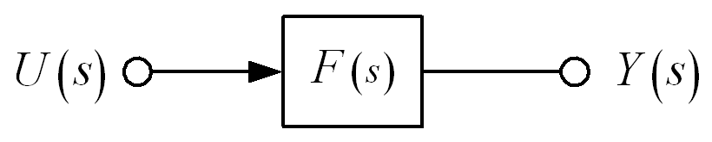
Definition of Pole and Zero
Consider the transfer function F(s):
Numerator polynomial
Denominator polynomial
The system response is given by:
The poles are the values of s for which the denominator A(s) = 0.
The zeros are the values of s for which the numerator B(s) = 0.

Slide 5
Effect of Pole Locations
Chapter 3
Dynamic Response
Consider the transfer function F(s):
A form of first-order transfer function
The impulse response will be an exponential function:
How?
When σ > 0, the pole is located at s < 0,
➔ The exponential expression y(t) decays.
➔ Impulse response is stable.
When σ < 0, the pole is located at s > 0,
➔ The exponential expression y(t) grows with time.
➔ Impulse response is referred to as unstable.

Slide 6
Effect of Pole Locations
Chapter 3
Dynamic Response
Example:
Find the impulse response of H(s),
PFE
The terms e^{–t} and e^{–2t}, which are stable, are determined by the poles at s = –1 and –2. This is true for more complicated cases as well.
In general, the response of a transfer function is determined by the locations of its poles.

Slide 7
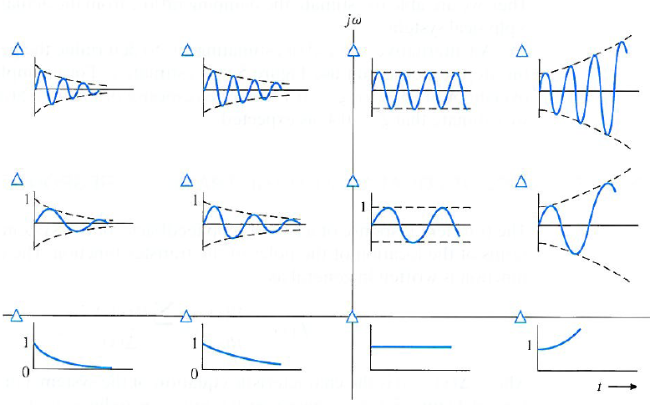
Effect of Pole Locations
Chapter 3
Dynamic Response
Time function of impulse response assosiated with
the pole location in s-plane
LHP
RHP
LHP : left half-plane
RHP : right half-plane

