Slide 1

Introduction to Carbohydrates
Dr. Shaimaa Munther

Slide 2
Carbohydrates
Carbohydrates are the most abundant organic molecules in nature.
Organic compounds containing C, H and O.
The empiric formula for many of the simpler carbohydrates is (CH2O)n, hence the name “hydrate of carbon.”
Notes:
Hydrogen and Oxygen in Carbohydrates were found to be present in the same proportion as in water. (2:1).(E.g. Glucose C6H12O6 or C6 (H2O)6).

Slide 3
Carbohydrates functions
Carbohydrates serve as energy source.
Ribose and deoxyribose sugars form part of of RNA and DNA.
Polysaccharides are structural elements in the cell .
Carbohydrates are linked to many proteins and lipids, forming different molecular classes are the proteoglycans, the glycoproteins and the glycolipids.

Slide 4
Carbohydrates Classification
Carbohydrates Classified based on:
  Number of sugar units
  Size of base carbon chain
  Location of C=O group
  Stereochemistry

Slide 5
Types of Carbohydrates
Classifications based on number of sugar units in total chain.
Monosaccharides : Single sugar unit
Disaccharides: Two sugar units
Oligosaccharides: 3 to 10 sugar units
Polysaccharides: More than 10 units
Chaining relies on ‘bridging’ of oxygen atoms glycoside bonds

Slide 6
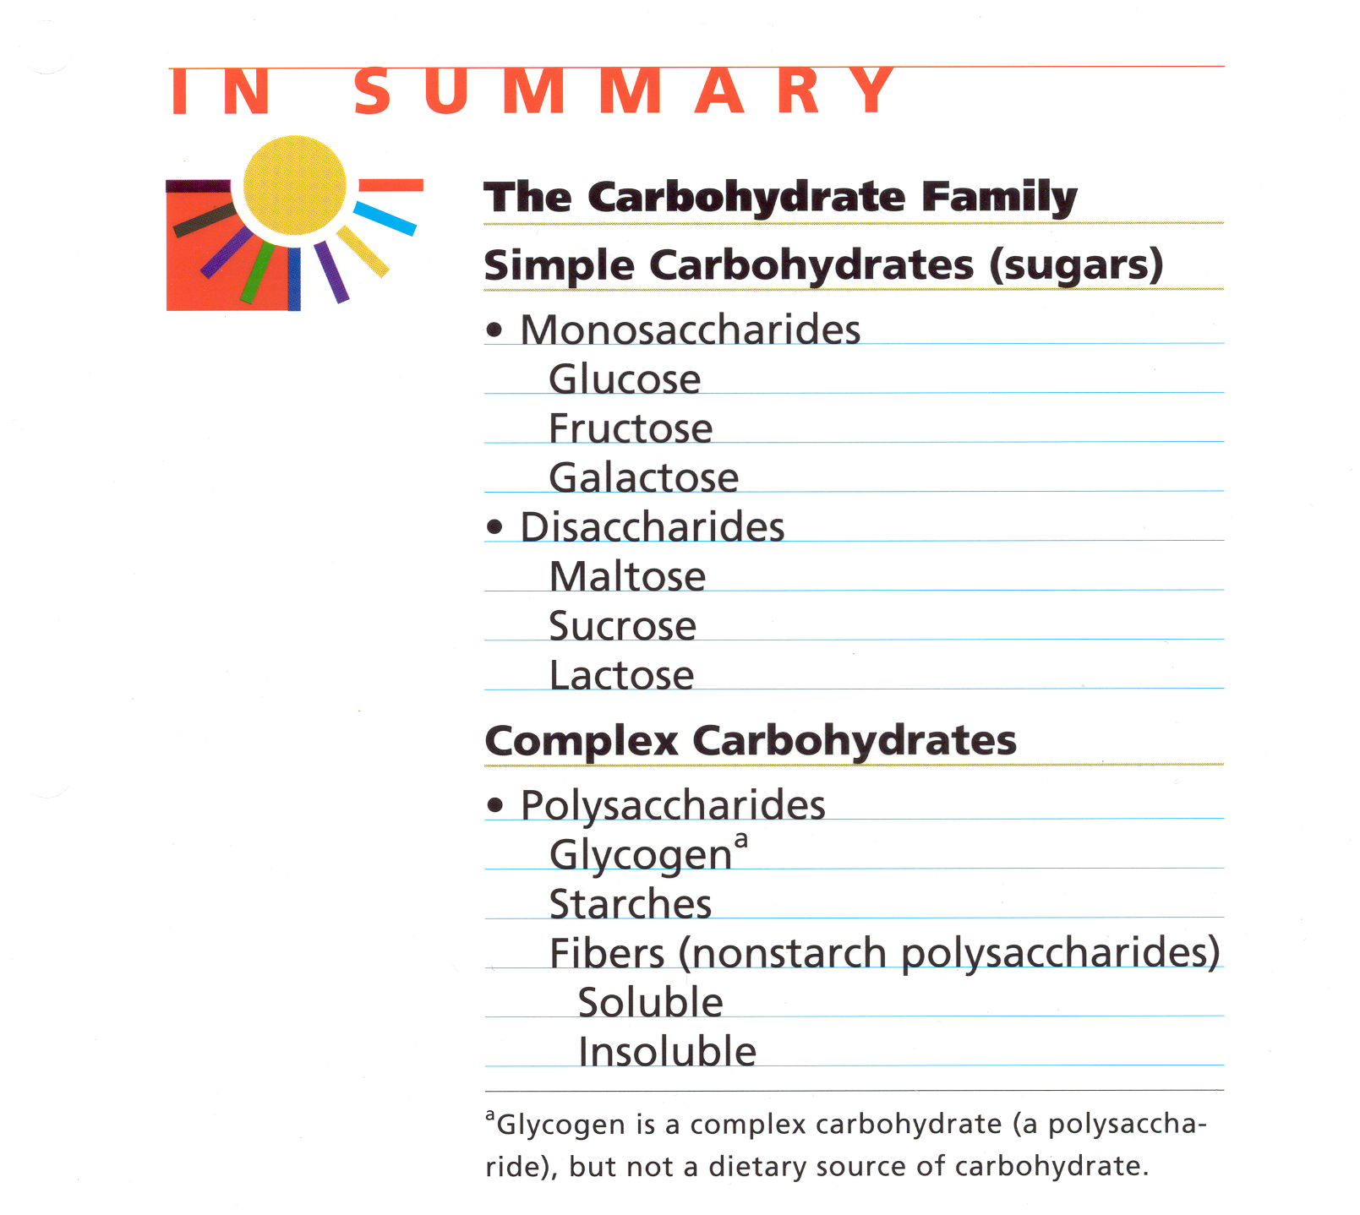
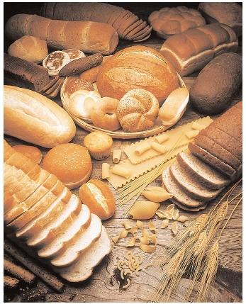
(Cellulose)

Slide 7
MONOSACCHARIDES
Monosaccharides are those carbohydrates which can not be hydrolyzed further into more simple carbohydrates.
Thus, they are the Simplest form of Carbohydrates.

Slide 8
Monosaccharides are further classified on the basis of:
  Aldehyde or Ketone :
    Aldomonosaccharides (Aldoses).
    Ketomonosaccharides (Ketoses).
  Carbon Chain Length.
    Trioses.
    Tetroses.
    Pentoses.
    Hexoses.
    Heptoses.

Slide 9
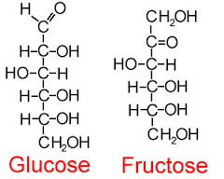
Monosaccharides Classification
The first classification, is Based on location of functional group .
The functional group is the carbonyl group C=O which may be either
Aldose Ketose
Aldehyde C=O ketone C=O

Slide 10
Monosaccharide classifications
Number of carbon atoms in the chain
H
|
C=O
|
H-C-OH
|
CH₂OH
H
|
C=O
|
H-C-OH
|
H-C-OH
|
CH₂OH
H
|
C=O
|
H-C-OH
|
H-C-OH
|
H-C-OH
|
CH₂OH
H
|
C=O
|
H- C- OH
|
H- C-OH
|
H - C-OH
|
H-C-OH
|
CH₂OH
Triose Tetrose Pentose Hexose
Can be either aldose or ketose sugar.

Slide 11
Examples of Monosaccharides
No. of carbon atoms | Aldo | keto
3c trioses | Glyceraldehyde | Dihydroxyacetone
4c tetroses | Erythrose | Erythrulose
5c pentoses | Ribose, Xylose | Ribulose, Xylullose
s6c hexose | Glucose, Galactose, Mannose | Fructose
7c heptoses | _______ | Psedheptulose

Slide 12
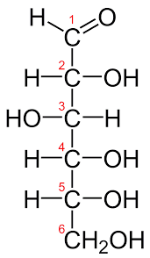
D-glucose
Glucose is an aldohexose sugar.
Common names include dextrose, grape sugar, blood sugar.
Most important sugar in our diet.
Most abundant organic compound found in nature.
Level of fasting blood glucose ( 65-110 mg/ dl)

Slide 13
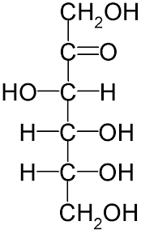
D-Fructose
Another common sugar.
It is a ketohexose.
Sweetest of all sugars.
CH₂OH
|
C=O
|
HO-C-H
|
H-C-OH
|
H-C-OH
|
CH₂OH

Slide 14
Isomers and Epimers
Isomers:
Compounds that have the same chemical formula but have different structures are called isomers. For example:
  fructose, glucose, mannose, and galactose are all isomers of each other, having the same chemical formula, C6H12O6.
Epimers:
Carbohydrate isomers that differ in configuration around only one specific carbon atom (with the exception of the carbonyl carbon) are defined as epimers of each other. Example:
  Glucose and galactose are C-4 epimers (their structures differ only in the position of the –OH group at carbon 4).
  Glucose and mannose are C-2 epimers.
Notes:
Note: The carbons in sugars are numbered beginning
at the end that contains the carbonyl carbon—that is, the aldehyde
OHowever, galactose and mannose are NOT epimers—they differ in the position of –OH groups at two carbons (2 and 4) and are, therefore, defined only as isomers .r keto group (Figure 7.4).]

Slide 15
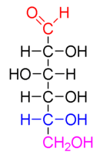
Straight Chain Structure of Typical Monosaccharide (Glucose)
Anomeric Carbon
Epimeric Carbons
Penultimate Carbon
Terminal Alcohol Carbon

Slide 16
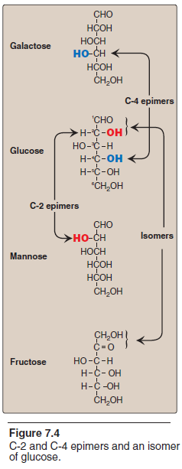
Notes:
Note: The carbons in sugars are numbered beginning
at the end that contains the carbonyl carbon—that is, the aldehyde
OHowever, galactose and mannose are NOT epimers—they differ in the position of –OH groups at two carbons (2 and 4) and are, therefore, defined only as isomers .r keto group (Figure 7.4).]

Slide 17
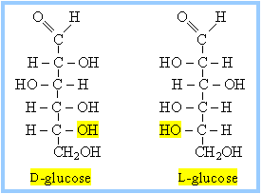
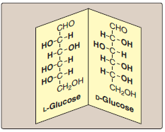
Enantiomers
A special type of isomerism is found in the pairs of structures that are mirror images of each other.
These mirror images are called enantiomers, and the two members of the pair are designated as a D- and an L-sugar .
The vast majority of the sugars in humans are D-sugars.
In the D isomeric form, the –OH group on the asymmetric carbon (a carbon linked to four different atoms or groups) farthest from the carbonyl carbon is on the right, whereas in the L-isomer it is on the left.
Notes:
D and L isomerism: The designation of a sugar isomer as the D form or of its mirror image as the L form is determined by its spatial relationship to the parent compound of the carbohydrates, the three-carbon sugar glycerose (glyceraldehyde). The L and D forms of this sugar, and of glucose, are shown in Figure 14–2. The orientation of the —H and — OH groups around the carbon atom adjacent to the terminal primary alcohol carbon (carbon 5 in glucose) determines whether the sugar belongs to the D or L series. When the — OH group on this carbon is on the right (as seen in Figure 14–2), the sugar is the D isomer; when it is on the left, it is the L isomer. Most of the naturally occurring
monosaccharides are D sugars, and the enzymes responsible for their metabolism are specific for this configuration.
The presence of asymmetric carbon atoms also confers optical activity on the compound. When a beam of plane-polarized light is passed through a solution of an optical isomer, it rotates either to the right, dextrorotatory (+), or to the left, levorotatory (–). The direction of rotation of polarized light is independent of the stereochemistry of the
sugar, so it may be designated D(–), D(+), L(–), or L(+). For example, the naturally occurring form of fructose is the D(–) isomer. In solution, glucose is dextrorotatory, and glucose solutions are sometimes known as dextrose.

Slide 18
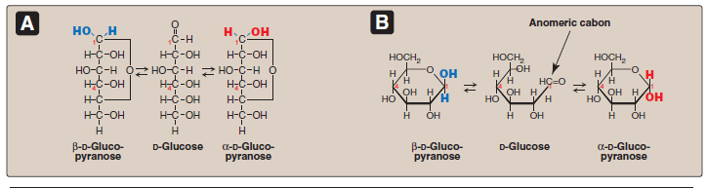
Cyclization of Monosaccharides
Less than 1% of each of the monosaccharides with five or more carbons exists in the open-chain (acyclic) form.
Rather, they are predominantly found in a ring (cyclic) form, in which the aldehyde (or keto) group has reacted with an alcohol group on the same sugar, making the carbonyl carbon (carbon 1 for an aldose or carbon 2 for a ketose) asymmetric.
Note:
Pyranose refers to a six-membered ring consisting of five carbons and one oxygen, for example, glucopyranose whereas furanose denotes a five-membered ring with four carbons and one oxygen.

Slide 19
Anomeric carbon: Cyclization creates an anomeric carbon
Anomeric carbon: Cyclization creates an anomeric carbon (the former carbonyl carbon), generating the α and β configurations of the sugar, for example, α-D-glucopyranose and β-D-glucopryanose.
These two sugars are both glucose but are anomers of each other.
Note:
In the α configuration, the OH on the anomeric C projects to the same side as the ring in a modified Fischer projection formula and is trans to the CH2OH group in a Haworth projection formula.
Enzymes are able to distinguish between these two structures and use one or the other preferentially. For example, glycogen is synthesized from α-D-glucopyranose, whereas cellulose is synthesized from β-D-glucopyranose.
The cyclic α and β anomers of a sugar in solution are in equilibrium with each other, and can be spontaneously interconverted (a process called mutarotation).
Notes:
Because the α and β forms are not mirror images, they are
referred to as diastereomers.]

Slide 20
Cyclization of D-glucose
Fischer vs. Haworth projections
α -D - glucose
CH
OH
2
H
O
H
H
O
OH
H
H
C
OH
OH
H
C
OH
H
OH
HO
C
H
β - D - glucose
H
C
OH
CH
OH
2
H
C
OH
H
O
OH
CH
OH
H
2
OH
H
OH
H
H
OH

Slide 21
Cyclization of D-fructose
α - D - fructose
CH
OH
CH₂OH
2
O
H
OH
CH
OH
2
H
OH
C
O
OH
H
HO
C
H
β - D - fructose
H
C
OH
H
C
OH
CH
OH
OH
2
O
CH
OH
H
OH
2
H
CH₂OH
OH
H

Slide 22
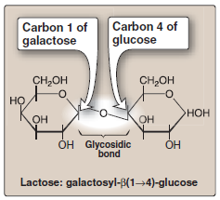
Joining of Monosaccharides
Monosaccharides can be joined to form disaccharides,
oligosaccharides, and polysaccharides.
The bonds that link sugars are called glycosidic bonds. These are formed by enzymes known as glycosyltransferases that use nucleotide sugars such as UDP-glucose as substrates.
Naming glycosidic bonds: Glycosidic bonds between sugars are named according to the numbers of the connected carbons, and with regard to the position of the anomeric hydroxyl group of the sugar involved in the bond.
If this anomeric hydroxyl is in the α configuration, the linkage is an α-bond. If it is in the β configuration, the linkage is a β-bond.
Lactose, for example, is synthesized by forming a glycosidic bond between carbon 1 of β-galactose and carbon 4 of glucose. The linkage is, therefore, a β(1→4) glycosidic bond .

Slide 23
Glycosidic Bonds

Slide 24
Disaccharides
Two Joined Monosaccharides, examples:
    Sucrose: Glucose + Fructose
    Maltose: Glucose + Glucose
    Lactose: Glucose + Galactose

Slide 25
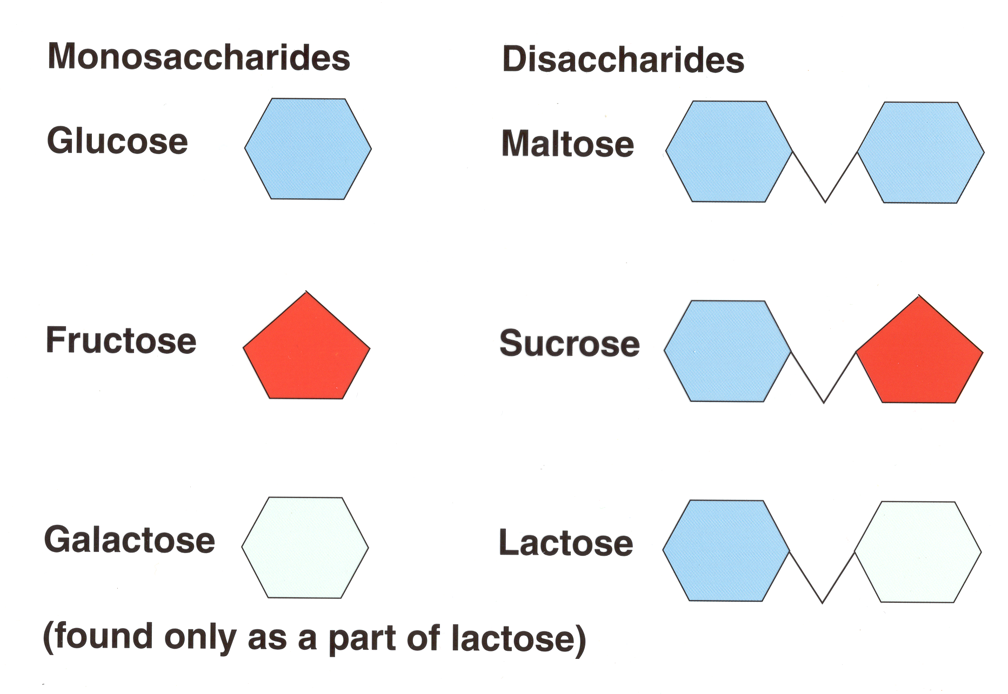
The Most Important Disaccharides
2 glucose molecules
glucose + fructose
glucose +galactose

Slide 26
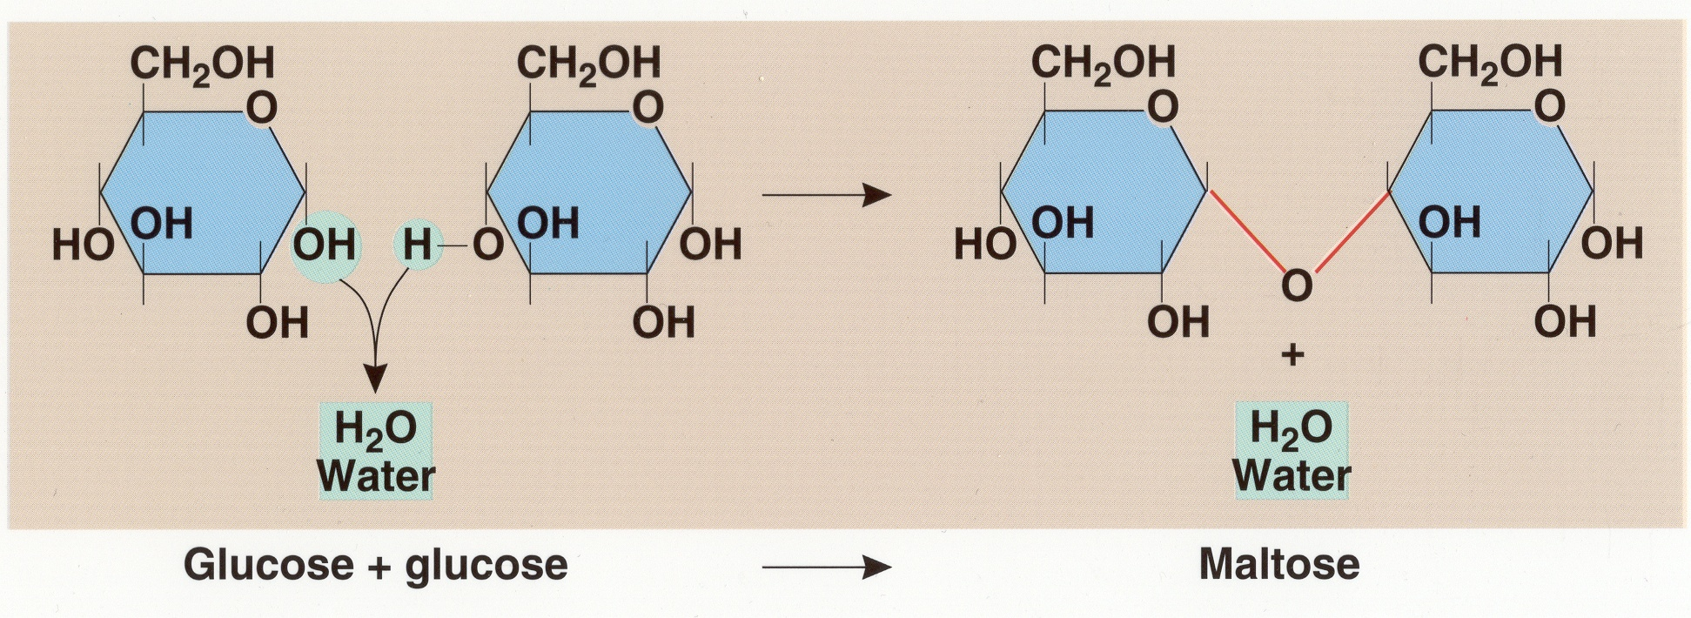

Slide 27
Oligosaccharides
Composed of:
  Three to ten monosaccharide units.
  E.g. Fructooligosaccharides

Slide 28
Polysaccharides
Larger than ten monosaccharide units.
Can reach many thousands of units.
Examples:
  Glycogen
  Starch
  Fibres ( Cellulose)

Slide 29
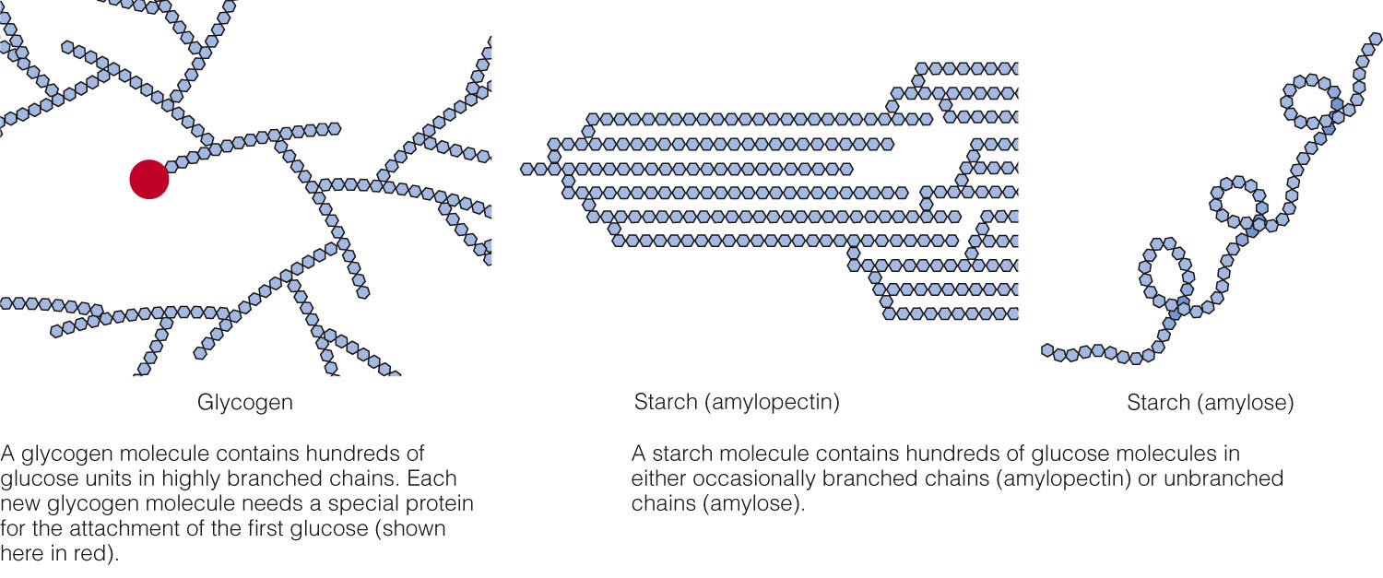
Fig. 4-8, p. 101
Notes:
Figure 4.8: Glycogen and Starch Molecules Compared (Small Segments).
These units would have to be magnified millions of times to appear at the size shown in this figure. For details of the chemical structures, see Appendix C.

Slide 30
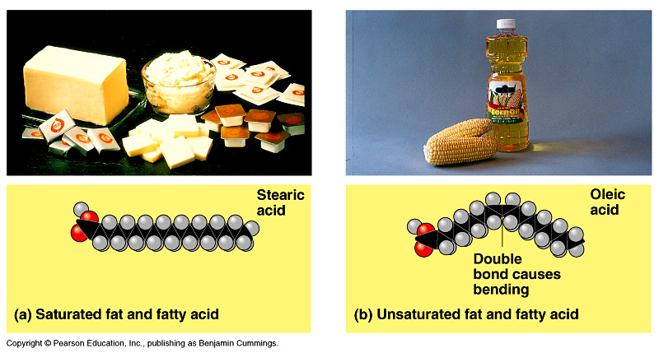
Lipids of
Physiologic Significance
Dr. Shaimaa Munther

Slide 31
Lipids
Lipids are a heterogeneous group of compounds including fats, oils, steroids, waxes, and related compounds, that are insoluble in water, but soluble in an organic solvent (e.g., ether, benzene, acetone, chloroform)
“lipid” composed mainly from C, H, O
• The main feature, in all lipids, is the large number of carbon-hydrogen bonds which makes them non-polar.

Slide 32
Function of Lipids
1. Energy Stores
Triglycerides act as energy reserves. The majority of triglycerides are stored in adipose tissue, in adipocytes (fat cells)
2. Sources of energy
Fatty acids are released from triglycerides are broken down in the mitochondria and used in the production of energy.
3. Insulation
Subcutaneous adipose tissue is important in the maintenance of body temperature
3. Absorption
Phospholipids help to emulsify fats and increase absorption of fats and fat-soluble nutrients (e.g. sterols, vitamins)
4. Local hormones
Membrane phospholipids can be converted into hormone-like substances called ‘eicosanoids’ which control smooth muscle contraction, blood clotting and immune cell stimulation

Slide 33
Function of Lipids
5. Structural element of cell membrane
Phospholipids
6. Metobolic Functions:
Cholesterol is metabolised to:
•Sex Hormones - reproduction
•Corticosteroids – stress response
•Mineralcorticoids – blood pressure regulation
7. Bile Acids – digestive health
8. Vitamin D ( the immune modulater ) with other fat-soluble vitamins and essential fatty acids are contained in the fat of natural foods
Notes:
•Extremely important for brain health
•Cell Communication
–Inositol phospholipids translate extracellular signals into intracellular ones
–Sphingolipids are involved in cell recognition and cell signalling cascades involved in apoptosis, proliferation, inflammation and differentiation

Slide 34
Lipids Classification
Lipids can be classified into:
1. Simple lipids: Esters of fatty acids with various alcohols.
1. Fats.
2. Waxes.
2. Complex lipids: Esters of fatty acids containing groups in addition to an alcohol and a fatty acid.
1. Phospholipids.
2. Glycolipids (glycosphingolipids).
3. Other complex lipids:
1. Sulfolipids
2. Amino lipids.
3. Lipoproteins.
4. Precursor and derived lipids:
These include fatty acids, glycerol, steroids, other alcohols, fatty aldehydes, ketone bodies , hydrocarbons, lipid-soluble vitamins, and hormones.
Note : Because they are uncharged, acylglycerols (glycerides), cholesterol, and cholesteryl esters are termed neutral lipids.

Slide 35
Classification Scheme
Lipids
Simple
Wax esters
Triacylglycerol
Complex
Derived
Fatty acids
Sterols
Diglycerides
monoglycerides
Phospholipids
Glycolipids
1.Cerebrosides
2.Gangliosides
Glycerophospholipids
1.Phosphatidylcholine (PC)
2.Phosphatidylethanolamine (PE)
3.Phosphatidylinositol (PI)
Sphingolipids
1.Ceramides
2.Sphingomyelin

Slide 36
Biological Classification Of Lipids
Based on there Biological functions Lipids can be classified into:
Storage Lipids:
The principle stored form of energy example : Triglycerols
Structural Lipids:
The major structural elements of biological Membranes example: Phospholipids and its derivatives

Slide 37
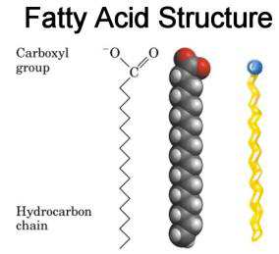
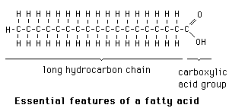
Fatty Acids
Common building block for most lipids
Long-chain carboxylic acids
Made up of carbon, hydrogen, oxygen
– Mostly carbon & hydrogen atoms
– Usually have an even number of carbons
Fatty acids occur in the body mainly as esters in natural fats and oils, but are found in the unesterified form as free fatty acids, a transport form in the plasma.

Slide 38
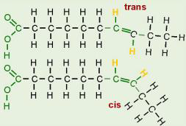
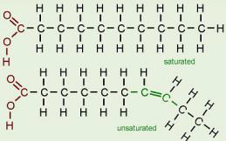
Fatty Acid Characteristics
A fatty acid may be characterized as saturated, unsaturated, monounsaturated, polyunsaturated or trans fatty acid.
This is determined by its chemical bonds and structure

Slide 39
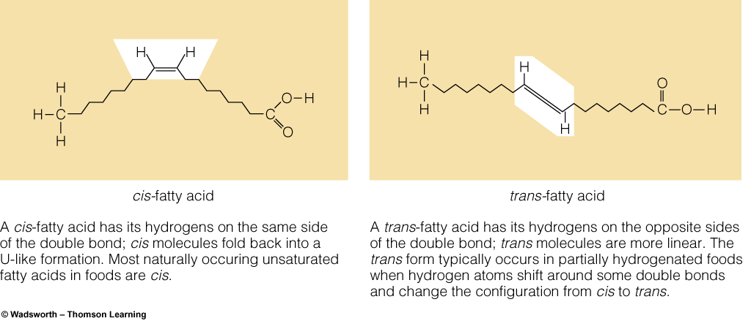
Cis- and Trans-Fatty Acids Compared

Slide 40
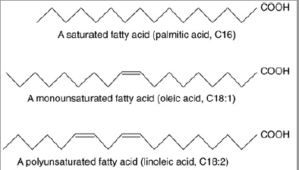
Fatty acids may occur as saturated , monounsaturated or polyunsaturated

Slide 41
Essential fatty acids
Two fatty acids are dietary essentials in humans because of our inability to synthesize them:
  linoleic acid, which is the precursor of ω-6 arachidonic acid, the substrate for prostaglandin synthesis
  α-linolenic acid, the precursor of other ω-3 fatty acids important for growth and development.
Plants provide us with the essential fatty acids. [Note: Arachidonic acid becomes essential if linoleic acid is deficient in the diet.]

Slide 42
Storage Lipids
Storage Lipids include fats and oils, and wax.
Fats and oils:
  Are Esters of fatty acids with glycerol, composed of 3 fatty acids each in ester linkage with a single glycerol (Triacylglycerols)
  Oils are fats in the liquid state
Waxes:
  Are esters of long-chain(C14-C36) saturated and unsaturated fatty acids with long chain (C16-C30) monohydric alcohols

Slide 43
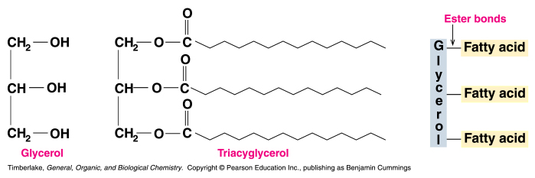
Triglycerols
Triglycerol (Triglyceride) is an ester of glycerol with three fatty acids.
Its also called neutral fat.
They are stored in adipocytes in animals
A mammal contains 5% to 25% or more of its body weight as lipids, 90% are TAG
TAGs are non polar, hydrophobic molecules, essentially insoluble in water

Slide 44
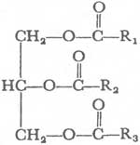
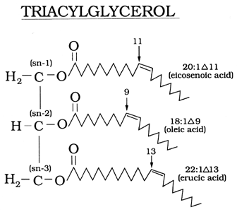
Structure of Triacylglyceride

Slide 45
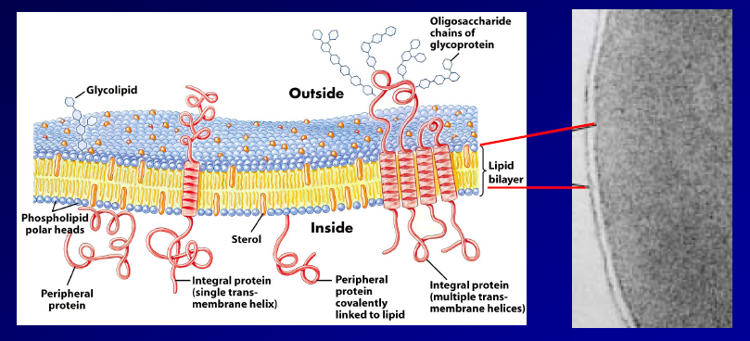
Lipids as structural elements

Slide 46
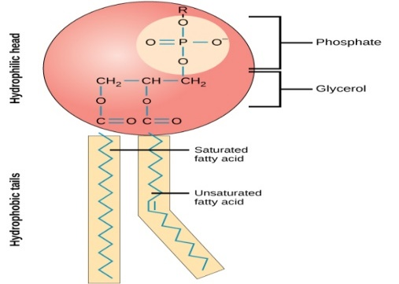
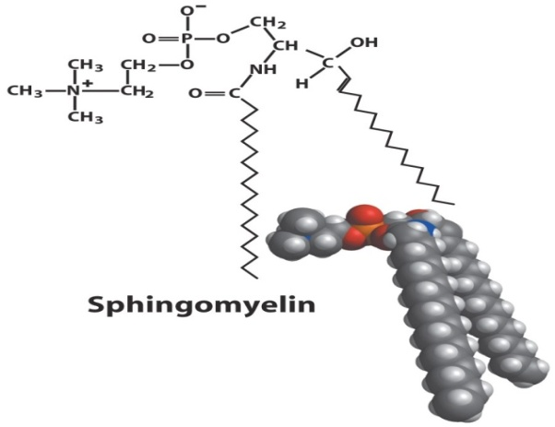

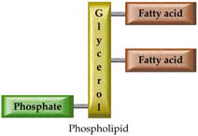
1- Phospholipids
Phospholipids includes glycerophospholipids & Sphingolipids

Slide 47
A- Glycerophospholipids
Glycerophospholipids formed from 2 Fatty Acids and a phosphate group esterified with glycerol
Act as ‘biological detergents’ and stabilizers
Mainly present with cell membrane
Each glycerophospholipid includes:
  A polar region:
    Glycerol
    Carbonyl O of fatty acids,
    Pi
    The polar head group (X)
  A non-polar region:
    The hydrocarbon tails of fatty acids (R1, R2).

Slide 48
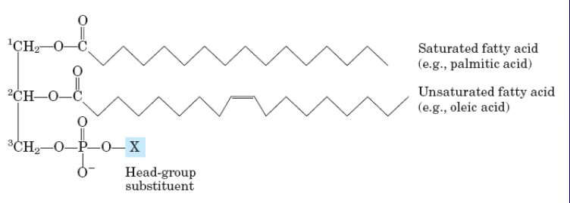
General structure of Glycerophospholipid
The type of fatty acid that connects to L-glycerol phosphate 3 Phosphate are specific for different organisms, different tissues of the same organisms, and different glycerophospholipids in the same cells and tissues.

Slide 49
B - Sphingolipids
Sphingolipids are derivatives of the lipid sphingosine, which has a long hydrocarbon tail, and a polar domain that includes an amino group.
Sphingosine may be reversibly phosphorylated to produce the signal molecule sphingosine-1-phosphate.
Other derivatives of sphingosine are commonly found as constituents of biological membranesand nerveous system e.g. Ceramide & Sphingomyelin

Slide 50
2- Glycolipids
Glycolipids are widely distributed in every tissue of the body, particularly in nervous tissue such as brain.
The major glycolipids found in animal tissues are glycosphingolipids e.g. cerebroside & gangliosides
Cerebroside is a sphingolipid (ceramide) with a monosaccharide such as glucose or galactose as polar head group.
Ganglioside is a ceramide with a polar head group that is a complex oligosaccharide, including the acidic sugar derivative sialic acid ( neuraminic acid)

Slide 51
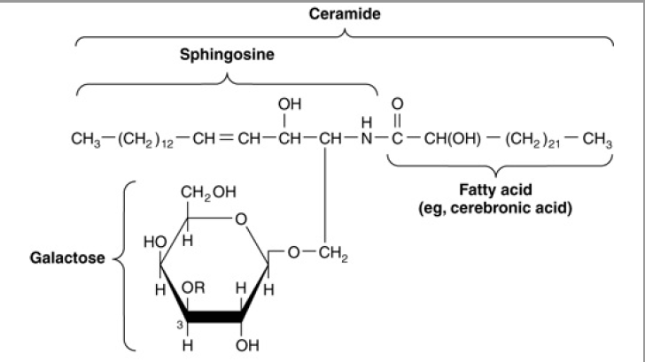
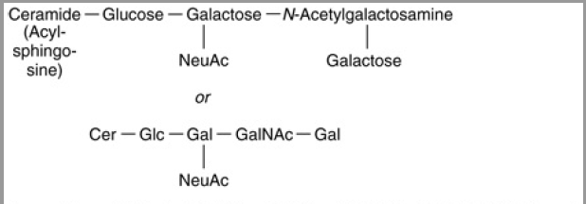
Cerebroside
Ganglioside

Slide 52
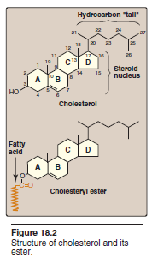
Cholesterol a Type of Sterol Lipids
Cholesterol is an essential component of cell membranes modulating their fluidity, and, in specialized tissues, cholesterol is a precursor of bile acids, steroid hormones, and vitamin D.
Cholesterol is a very hydrophobic compound. It consists of four fused hydrocarbon rings (A-D) called the “steroid nucleus”), and it has an eight-carbon, branched hydrocarbon chain attached to carbon 17 of the D ring. Ring A has a hydroxyl group at carbon 3, and ring B has a double bond between carbon 5 and carbon 6.
Found only in animals

Slide 53
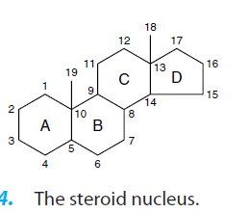

Slide 54


