Slide 1

Electronic
Professor Ehssan Al-Bermany
Asst.lecture Israa Hussein
1st semester

Slide 2
Chapter One: Semiconductor Material
Lecture 1

Slide 3
Electronics
Electronics is the branch of physics that deals with:
the emission and effects of electrons
the use of electronic devices, i.e.,
Science of the motion of charges in a gas, vacuum or semiconductor.
An electronic building blocks packaged in a discrete form with two or more connecting leads or metallic pads.
Components are connected together to create an electronic circuit with a particular function, e.g.: an amplifier radio receiver or oscillator. Active components are sometimes called devices.
Composed of subsystems or electronic circuits, which may include amplifiers signal sources, power supplies etc…, e.g.: Laptop, DVD players, iPod, mobile phonex, PDA (Personal Digital Assistant).

Slide 4
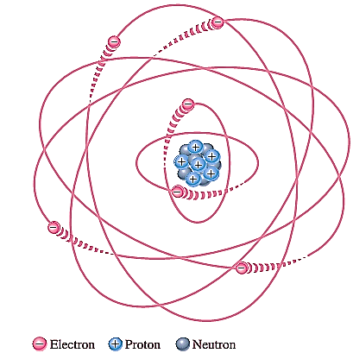


  Atomic structure
All matters on earth made of atoms (made up of elements or combination of elements); all atoms consist of electrons, protons and neutrons except normal hydrogen, which does not have a neutron.
An atom is the smallest particle of an element that retains the characteristics of that element.
According to Bohr, atoms have a planetary orbits structure that consists of a central nucleus, surround by orbiting electrons (Figure 1). Nucleus contains protons and neutrons, similar to the way planets orbit the sun in our solar system.
Each type of atom has a certain number of electrons and protons that distinguishes it from atoms of other elements.
Each electron has its own orbit that corresponds to different energy levels.
In an atom, orbits are grouped into energy bands known as shells. Each shell has a fixed maximum number of electrons at allowed energy levels. The maximum number of electrons
that can exist in each shell can be calculated as,
Ne=2n2 where n is the number of the shell.
Figure (1)

Slide 5
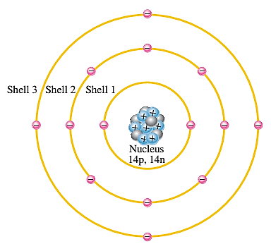
Electrons that are in orbits farther from the nucleus have higher energy and are less tightly bound to the atom than those closer to the nucleus.
Electrons with the highest energy exist in the outermost shell of an atom and are relatively loosely bound to the atom.
This outermost shell is known as the valence shell and electrons in this shell are called valence electrons.
Valence electrons contribute to chemical reactions and bonding within the structure of a material and determine its electrical properties.
Maximum number of valence electron is 8.
An atom is stable if it has 8 valence electrons.
The number of valence electrons determines the ability of material to conduct current.
Figure 2: Illustration of the Bohr model of the silicon atom.
© Prof E. Al-Bermany, Department of Physics, University of Babylon.

Slide 6
  Materials Classification (Insulators, Conductors, and Semiconductor)
  In terms of their electrical properties, materials can be classified into three groups: conductors, semiconductors, and insulators.
  Insulators: An insulator is a material that does not conduct electrical current under normal conditions.
  Valence electrons are tightly bound to the atoms; therefore, there are very few free electrons in an insulator.
  Energy gap in an insulator is very wide (≥ 6 eV). Valence electron requires a large electric field to gain enough energy to jump into conduction band.
  Examples of insulators are rubber, plastics, glass, mica, and quartz.

Slide 7
Conductors: A conductor is a material that easily conducts electrical current. Most metals are good conductors.
The best conductors are (with one valence electron) e.g.: copper (Cu), silver (Ag), gold (Au), and aluminum (Al), which are characterized by atoms with only one valence electron very loosely bound to the atom.
In a conductor, the valence band and the conductor band overlaps
(≤ 0.01 eV). Only a little energy or voltage is needed for the electron to jump into conduction band.
Semiconductors: A semiconductor is a material that is between conductors and insulators in its ability to conduct electrical current. A semiconductor in its pure (intrinsic) state is neither a good conductor nor a good insulator. Single-element semiconductors are silicon (Si), germanium (Ge), antimony (Sb), arsenic (As), astatine (At), boron (B), polonium (Po) and tellurium (Te), these semiconductor characterized by atoms with four valence electrons. Compound semiconductors such as gallium arsenide, indium phosphide, gallium nitride, silicon carbide and silicon germanium are also commonly used. Silicon is the most commonly used semiconductor.

Slide 8
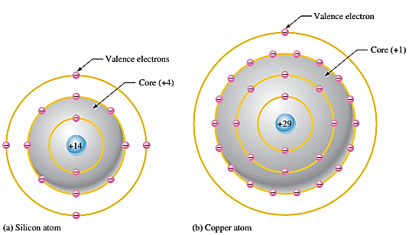
Silicon is a semiconductor and Copper is a conductor. Bohr diagrams of the silicon atom and the Copper atom are shown in following Figure 3.
A Silicon atom has 4 electrons in its valence ring. This makes it a semiconductor.
A Copper atom has only 1 electron in its valence ring. This makes it good conductor.
Figure 3: Diagrams of the silicon and copper atoms.

Slide 9
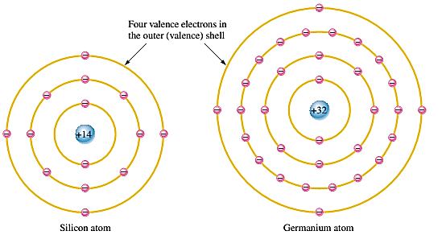
    Silicon and Germanium
The atomic structures of silicon and germanium are compared in Figure 4,
Both silicon and germanium have the characteristic four valence electrons.
The valence electrons in germanium are in the fourth shell while those in silicon are in the third shell, closer to the nucleus.
This means that the germanium valence electrons are at higher energy levels than those in silicon.
Therefore, require a smaller amount of additional energy to escape from the atom. This property makes germanium more unstable at high temperatures and results in excessive reverse current. This is why silicon is a more widely used semiconductive material.
Figure 4

