Slide 1

Electronic
Prof. Dr. Ehssan Al-Bermany
Asst.lect Israa Hussein
1st semester

Slide 2
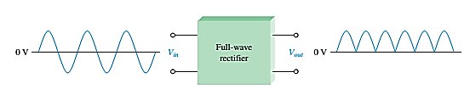
    Full wave rectifiers
Although half-wave rectifiers have some applications, the full-wave rectifier is the most commonly used type in dc power supplies.
A full-wave rectifier allows unidirectional (one-way) current through the load during the entire of the input cycle.
Whereas, a half-wave rectifier allows current through the load only during one-half of the cycle.
The output voltage have twice the input frequency.
VAVG = 2VP/π= VAVG is approximately 63.7 % of Vp
Figure 14

Slide 3
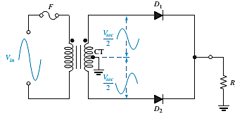
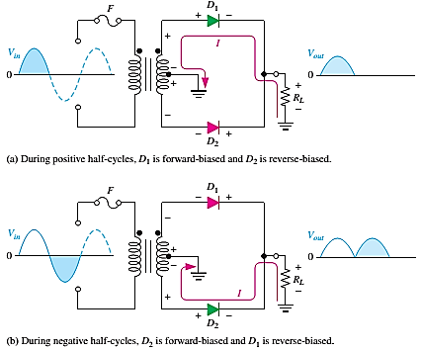
    Center-Tapped Full-Wave Rectifier Operation
A center-tapped rectifier is used two diodes that connected to the secondary of a center-tapped transformer, as shown in Figure 14.
Figure 16: Basic operation of a center-tapped full-wave rectifier.

Slide 4
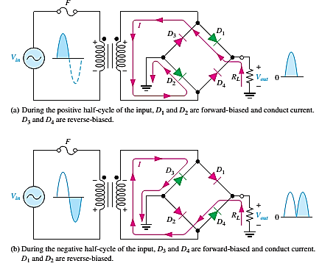
    The Bridge Full-wave rectifiers
The Bridge Full-Wave rectifier uses four diodes connected across the entire secondary as shown in Figure 16

Slide 5
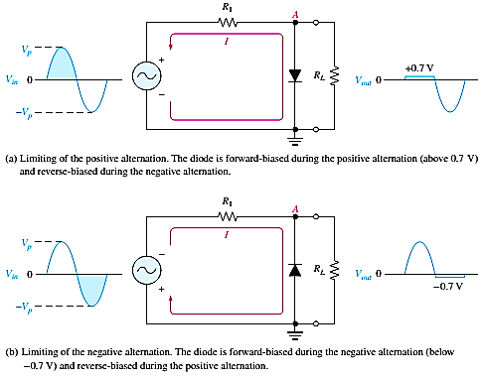
    Diode Limiters
Diode circuits, called limiters or clippers, are used to clip off portions of signal voltages above or below certain levels.
Point A is limited to +0.7V when the input voltage exceeds this value (Figure 18(a)).
If the diode is turned around, as in Figure 18(b), the negative part of the input voltage is clipped off. When the diode is forward-biased during the negative part of the input voltage, point A is held at -0.7V by the diode drop.
Figure 18: Examples of diode
limiters (clippers).

Slide 6
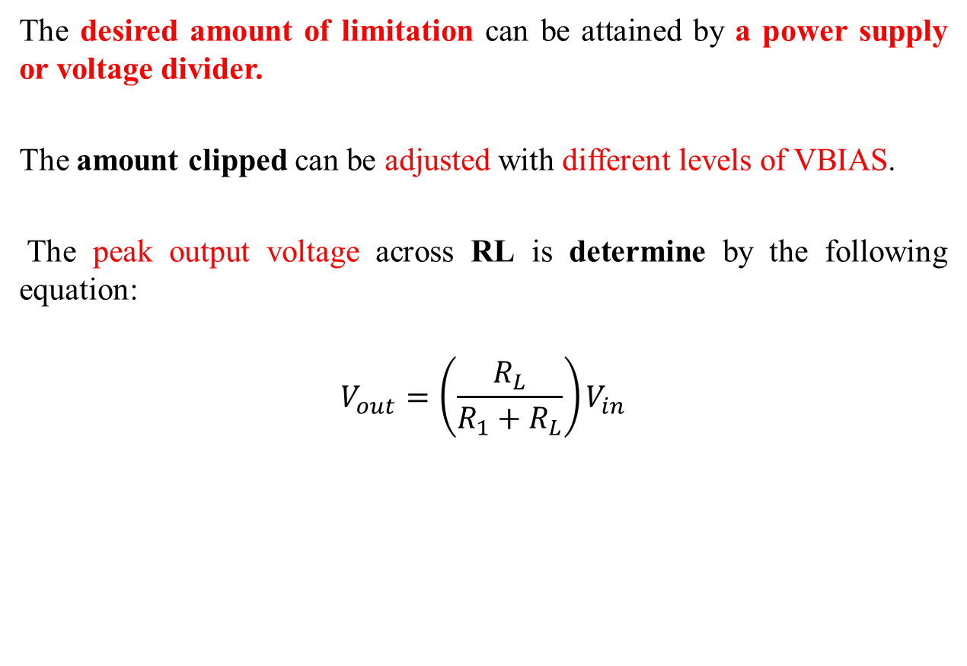
The desired amount of limitation can be attained by a power supply or voltage divider.
The amount clipped can be adjusted with different levels of VBIAS.
The peak output voltage across RL is determine by the following equation:
$$V_{out}=\left(\frac{R_{L}}{R_{1}+R_{L}}\right)V_{in}$$

Slide 7
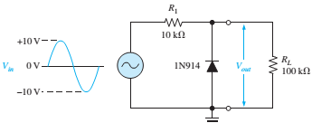

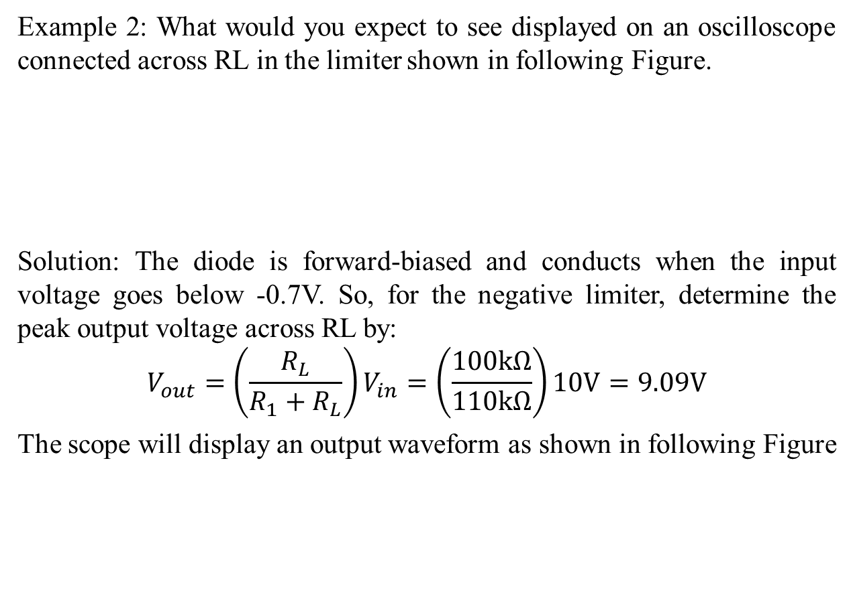
Example 2: What would you expect to see displayed on an oscilloscope connected across RL in the limiter shown in following Figure.
Solution: The diode is forward-biased and conducts when the input voltage goes below -0.7V. So, for the negative limiter, determine the peak output voltage across RL by:
$$V_{out}=\left(\frac{R_{L}}{R_{1}+R_{L}}\right)V_{in}=\left(\frac{100kΩ}{110kΩ}\right)10V=9.09V$$
The scope will display an output waveform as shown in following Figure

Slide 8
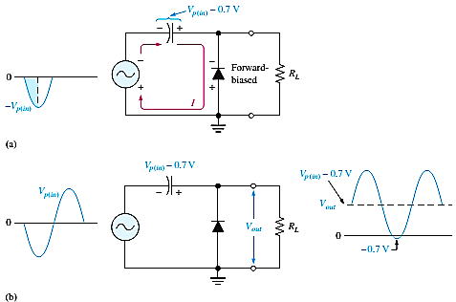
Diode Clampers
Another type of diode circuit, called a clamper, is used to add or restore a dc level to an electrical signal.
The capacitor charges to the peak of the supply minus the diode drop. Once charged the capacitor acts like a battery in series with the input voltage.
The AC voltage will “ride” along with the DC voltage. The polarity arrangement of the diode determines whether the DC voltage is negative or positive.

Slide 9
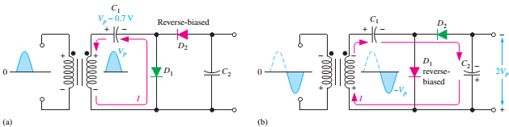
Voltage Multiplier
Voltage multipliers use clamping action to increase peak rectified voltages without the necessity of increasing the transformer’s voltage rating.
Multiplication factors of two, three, and four are common. Voltage multipliers are used in high-voltage, low-current applications such as cathode-ray tubes (CRTs) and particle accelerators.
In the Figure 20 a half-wave voltage doubler, a voltage doubler is a voltage multiplier with a multiplication factor of two.
Once C1 and C2 charges to the peak voltage, it is act like two batteries in series, effectively doubling the voltage output. The current capacity for voltage multipliers is low.

Slide 10
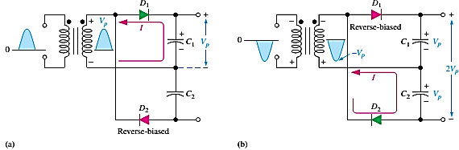
The full-wave voltage doubler arrangement of diodes and capacitors takes advantage of both positive and negative peaks to charge the capacitors giving it more current capacity.
Voltage triplers and quadruplers utilize three and four diode-capacitor arrangements, respectively.

Slide 11
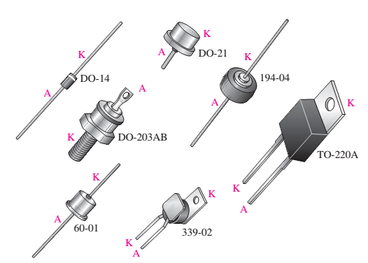
Typical diode packages with terminal identification. The letter K is used for cathode to avoid confusion with certain electrical quantities that are represented by C. Case type numbers are indicated for each diode.

