Slide 1
Chapter 7
General Human Anatomy & Physiology
The Urinary System
Dr. Zainab Hayder Alkufaishi
M.B.Ch.B F.I.C.M.S. Path.
2nd Year
Medical Intelligent System
1st Semester 2023-2024

Slide 2

Functions of the Urinary System
1.Elimination of waste products
  Nitrogenous wastes
  Toxins
  Drugs

Slide 3
Functions of the Urinary System
2. Regulate aspects of homeostasis
  Water balance
  Electrolytes
  Acid-base balance in the blood
  Blood pressure
  Red blood cell production
  Activation of vitamin D

Slide 4

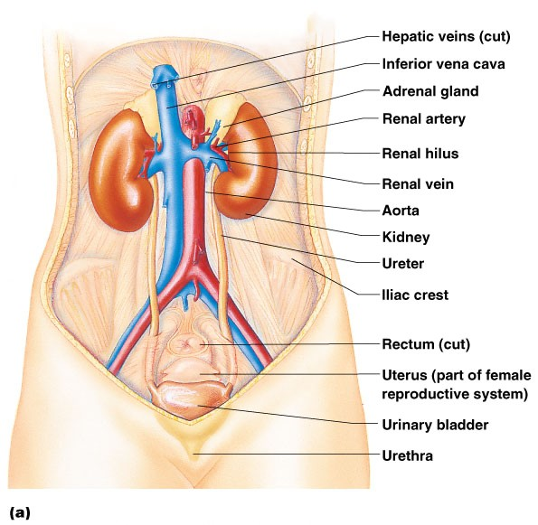
Organs of the Urinary system
Kidneys
Ureters
Urinary bladder
Urethra

Slide 5

Location of the Kidneys
Against the dorsal body wall
At the level of T₁₂ to L₃
The right kidney is slightly lower than the left
Attached to ureters, renal blood vessels, and nerves at renal hilus
Atop each kidney is an adrenal gland

Slide 6

Coverings of the Kidneys
Renal capsule
  Surrounds each kidney
Adipose capsule
  Surrounds the kidney
  Provides protection to the kidney
  Helps keep the kidney in its correct location

Slide 7

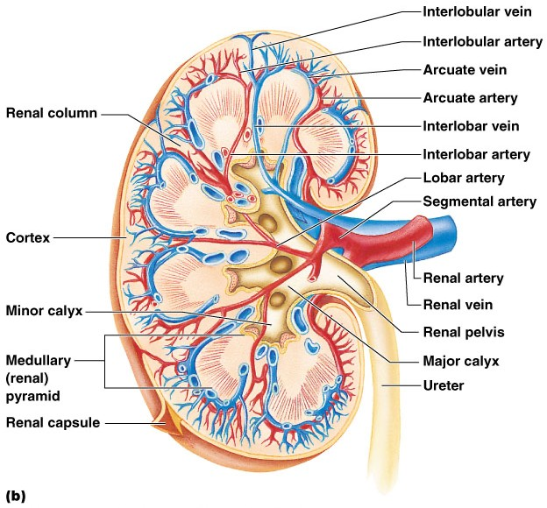
Regions of the Kidney
Renal cortex – outer region
Renal medulla – inside the cortex
Renal pelvis – inner collecting tube

Slide 8

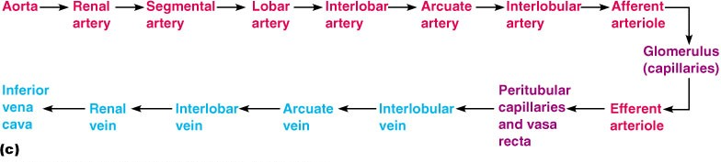
Blood Flow in the Kidneys

Slide 9

Nephrons
The structural and functional units of the kidneys
Responsible for forming urine
Main structures of the nephrons
  Glomerulus
  Renal tubule

Slide 10

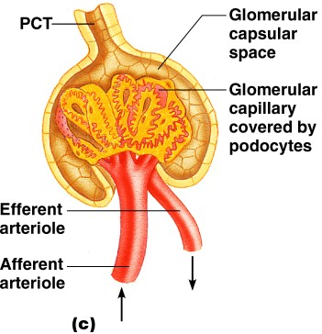
Glomerulus
A specialized capillary bed
Attached to arterioles on both sides (maintains high pressure)
  Large afferent arteriole
  Narrow efferent arteriole

Slide 11

Glomerulus
The glomerulus sits within a glomerular capsule (the first part of the renal tubule)

Slide 12

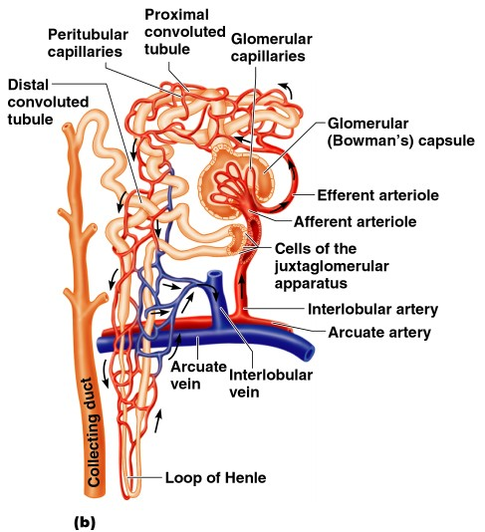
Renal Tubule
Glomerular (Bowman’s) capsule
Proximal convoluted tubule
Loop of Henle
Distal convoluted tubule

Slide 13

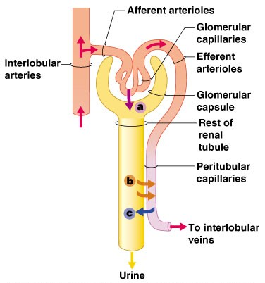
Urine Formation Processes
Filtration
Reabsorption
Secretion

Slide 14

Filtration
Nonselective passive process
Water and solutes smaller than proteins are forced through capillary walls
Blood cells cannot pass out to the capillaries
Filtrate is collected in the glomerular capsule and leaves via the renal tubule

Slide 15

Reabsorption
The peritubular capillaries reabsorb several materials
  Some water
  Glucose
  Amino acids
  Ions
Some reabsorption is passive, most is active
Most reabsorption occurs in the proximal convoluted tubule

Slide 16

Materials Not Reabsorbed
Nitrogenous waste products
  Urea
  Uric acid
  Creatinine
Excess water

Slide 17

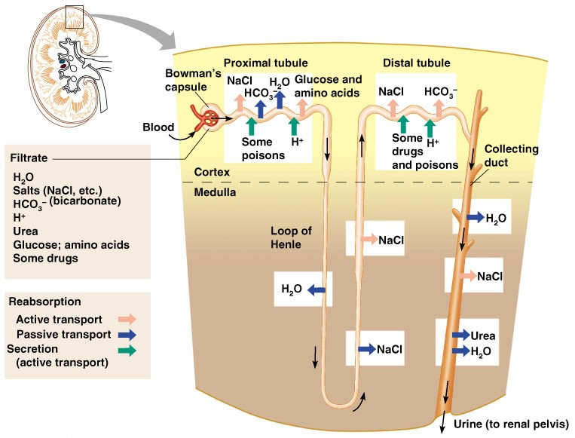
Formation of Urine

Slide 18


Characteristics of Urine Used for Medical Diagnosis
Colored somewhat yellow due to the pigment urochrome (from the destruction of hemoglobin) and solutes
Sterile
Slightly aromatic
Normal pH of around 6 (varies 4.5-8)
Specific gravity of 1.001 to 1.035

Slide 19

Ureters
Slender tubes attaching the kidney to the bladder
  Continuous with the renal pelvis
  Enter the posterior aspect of the bladder
Runs behind the peritoneum
Peristalsis aids gravity in urine transport

Slide 20

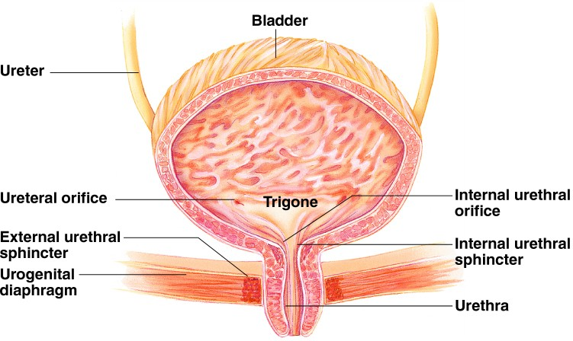
Urinary Bladder
Smooth, collapsible, muscular sac
Temporarily stores urine

Slide 21
Urinary Bladder
Trigone – three openings
  Two from the ureters
  One to the urethrea

Slide 22

Urinary Bladder Wall
Three layers of smooth muscle (detrusor muscle)
Mucosa made of transitional epithelium
Walls are thick and folded in an empty bladder
Bladder can expand significantly without increasing internal pressure

Slide 23

Urethra
Thin-walled tube that carries urine from the bladder to the outside of the body by peristalsis
Release of urine is controlled by two sphincters
  Internal urethral sphincter (involuntary)
  External urethral sphincter (voluntary)

Slide 24

Urethra Gender Differences
Length
  Females – 3–4 cm (1 inch)
  Males – 20 cm (8 inches)
Location
  Females – along wall of the vagina
  Males – through the prostate and penis

Slide 25
Urethra Gender Differences
Function
  Females – only carries urine
  Males – carries urine and is a passageway for sperm cells

Slide 26

Micturition (Voiding)
Both sphincter muscles must open to allow voiding
  The internal urethral sphincter is relaxed after stretching of the bladder
  Activation is from an impulse sent to the spinal cord and then back via the pelvic splanchnic nerves
  The external urethral sphincter must be voluntarily relaxed

Slide 27

Maintaining Water Balance
Normal amount of water in the human body
  Young adult females – 50%
  Young adult males – 60%
  Babies – 75%
  Old age – 45%
Water is necessary for many body functions and levels must be maintained

Slide 28
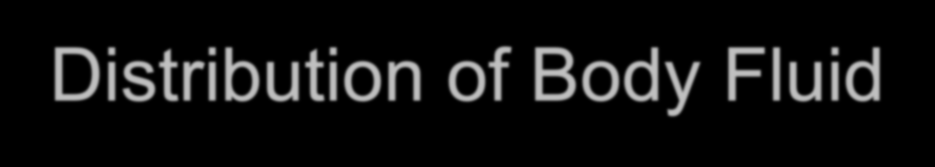
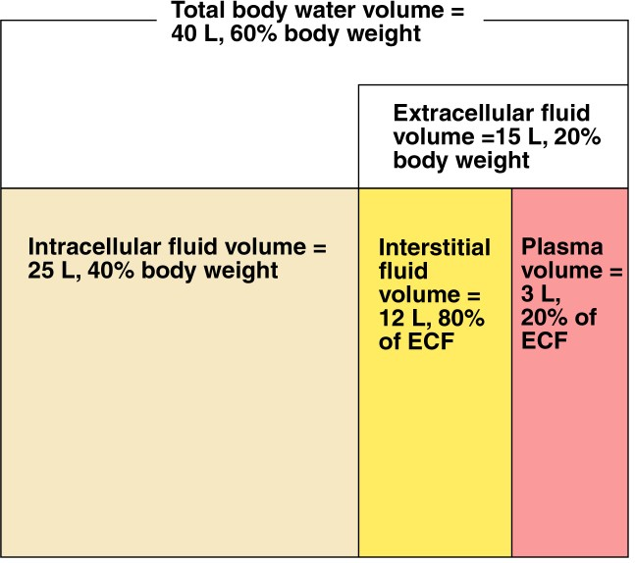
Distribution of Body Fluid
Intracellular fluid (inside cells)
Extracellular fluid (outside cells)
  Interstitial fluid
  Blood plasma

Slide 29
Maintaining Water Balance
Water intake must equal water output
Sources for water intake
  Ingested foods and fluids
  Water produced from metabolic processes
Sources for water output
  Vaporization out of the lungs
  Lost in perspiration
  Leaves the body in the feces
  Urine production

Slide 30
Maintaining Water Balance
Dilute urine is produced if water intake is excessive
Less urine (concentrated) is produced if large amounts of water are lost
Proper concentrations of various electrolytes must be present

Slide 31

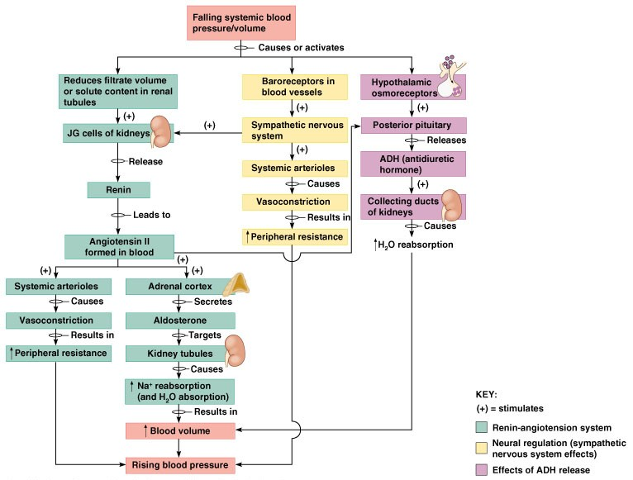
Maintaining Water/Electrolyte Balance

Slide 32


Developmental Aspects of the Urinary System
Functional kidneys are developed by the third month
Urinary system of a newborn
  Bladder is small
  Urine cannot be concentrated

Slide 33
Developmental Aspects of the Urinary System
Control of the voluntary urethral sphincter does not start until age 18 months
Urinary infections are the only common problems before old age

Slide 34

Aging and the Urinary System
There is a progressive decline in urinary function
The bladder shrinks with aging
Urinary retention is common in males

Slide 35


