Slide 1
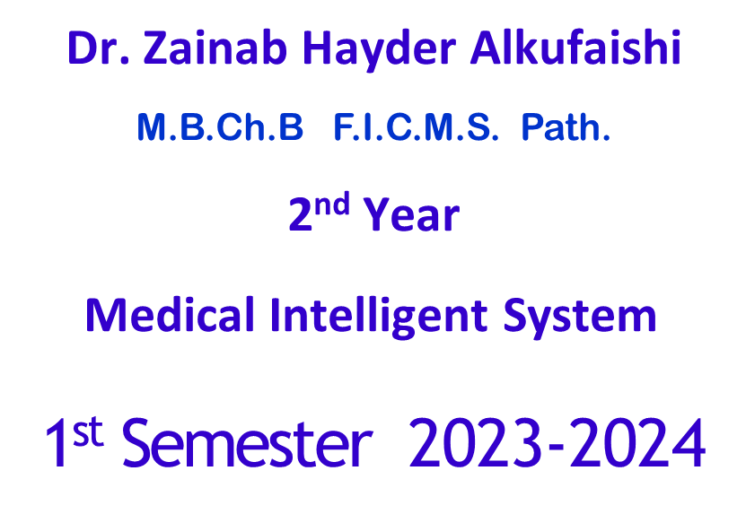
Chapter 5
Blood
General Human Anatomy & Physiology

Slide 2
Blood
The only fluid tissue in the human body
Classified as a connective tissue
  Living cells = formed elements
  Non-living matrix = plasma

Slide 3
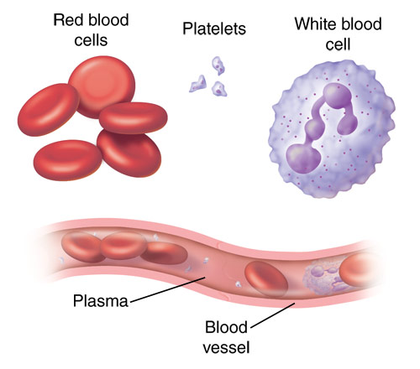

Slide 4
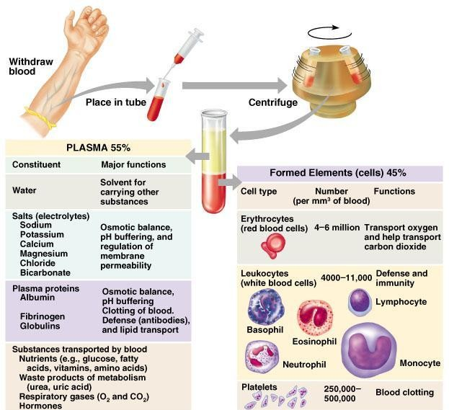
Blood

Slide 5
Physical Characteristics of Blood
Color range
  Oxygen-rich blood is scarlet red
  Oxygen-poor blood is dull red
pH must remain between 7.35–7.45
Blood temperature is slightly higher than body temperature

Slide 6
Blood Plasma
Composed of approximately 90 percent water
Includes many dissolved substances
  Nutrients
  Salts (metal ions)
  Respiratory gases
  Hormones
  Proteins
  Waste products

Slide 7
Plasma Proteins
Albumin – regulates osmotic pressure
Clotting proteins – help to stem blood loss when a blood vessel is injured
Antibodies – help protect the body from antigens

Slide 8
Formed Elements
Erythrocytes = red blood cells
Leukocytes = white blood cells
Platelets = cell fragments

Slide 9
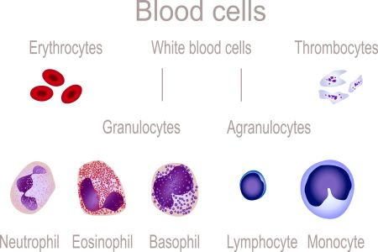

Slide 10
Erythrocytes (Red Blood Cells)
The main function is to carry oxygen
Anatomy of circulating erythrocytes
  Biconcave disks
  Essentially bags of hemoglobin
  Anucleate (no nucleus)
  Contain very few organelles

Slide 11
Hemoglobin
Iron-containing protein
Binds strongly, but reversibly, to oxygen
Each hemoglobin molecule has four oxygen binding sites

Slide 12
Leukocytes (White Blood Cells)
Crucial in the body’s defense against disease
These are complete cells, with a nucleus and organelles
Able to move into and out of blood vessels)
Can move by ameboid motion
Can respond to chemicals released by damaged tissues

Slide 13
Leukocyte Levels in the Blood
Normal levels are between 4,000 and 11,000 cells per millimeter
Abnormal leukocyte levels
  Leukocytosis
    Above 11,000 leukocytes/ml
    Generally indicates an infection
  Leukopenia
    Abnormally low leukocyte level
    Commonly caused by certain drugs

Slide 14
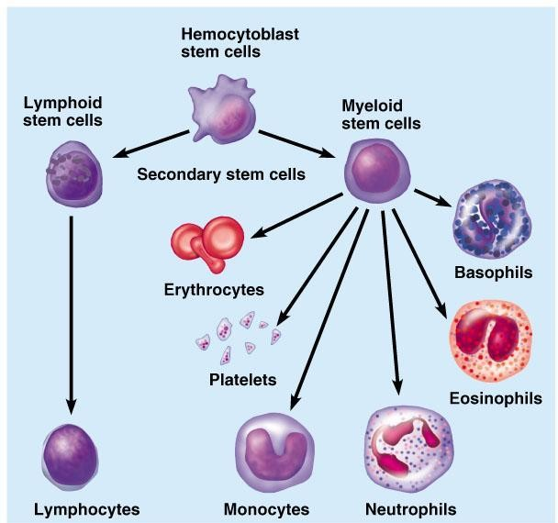
Types of Leukocytes
Granulocytes
  Granules in their cytoplasm can be stained
  Include neutrophils, eosinophils, and basophils

Slide 15
Types of Leukocytes
Agranulocytes
  Lack visible cytoplasmic granules
  Include lymphocytes and monocytes

Slide 16
Agranulocytes
Lymphocytes
  Nucleus fills most of the cell
  Play an important role in the immune response
Monocytes
  Largest of the white blood cells
  Function as macrophages
  Important in fighting chronic infection

Slide 17
Platelets
Derived from ruptured multinucleate cells (megakaryocytes)
Needed for the clotting process
Normal platelet count = 300,000/mm³

Slide 18
Hematopoiesis
Blood cell formation
Occurs in red bone marrow
All blood cells are derived from a common stem cell (hemocytoblast)
Hemocytoblast differentiation
  Lymphoid stem cell produces lymphocytes
  Myeloid stem cell produces other formed elements

Slide 19
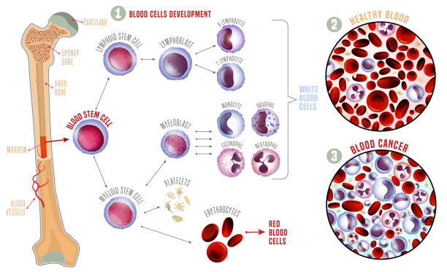

Slide 20
Fate of Erythrocytes
Unable to divide, grow, or synthesize proteins
Wear out in 100 to 120 days
When worn out, are eliminated by phagocytes in the spleen or liver
Lost cells are replaced by division of hemocytoblasts

Slide 21
Control of Erythrocyte Production
Rate is controlled by a hormone (erythropoietin)
Kidneys produce most erythropoietin as a response to reduced oxygen levels in the blood
Homeostasis is maintained by negative feedback from blood oxygen levels

Slide 22
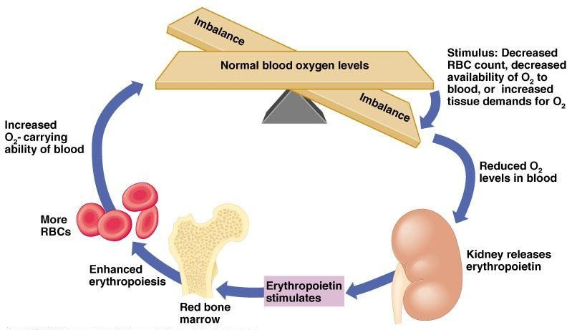
Control of Erythrocyte Production
Figure 10.5

Slide 23
Hemostasis
Stoppage of blood flow
Result of a break in a blood vessel
Hemostasis involves three phases
  Platelet plug formation
  Vascular spasms
  Coagulation

Slide 24
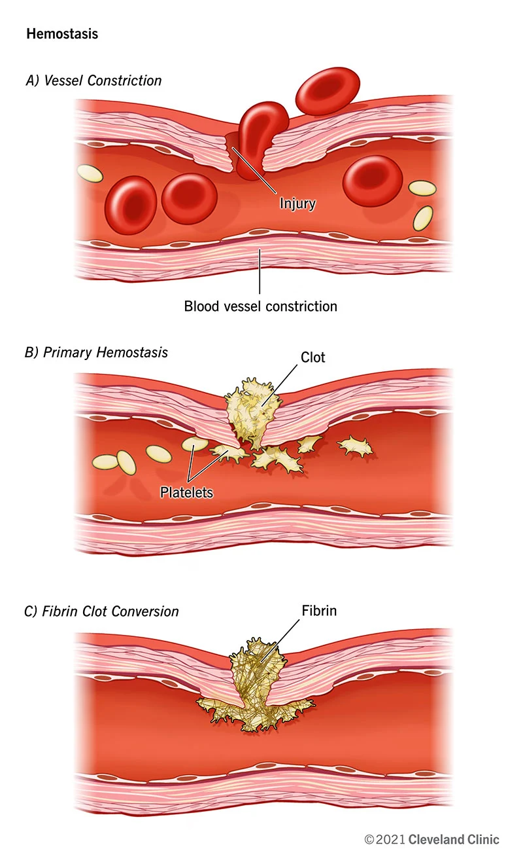

Slide 25
Blood Groups and Transfusions
Large losses of blood have serious consequences
  Loss of 15 to 30 percent causes weakness
  Loss of over 30 percent causes shock, which can be fatal
Transfusions are the only way to replace blood quickly
Transfused blood must be of the same blood group

Slide 26
Human Blood Groups
There are over 30 common red blood cell antigens
The most vigorous transfusion reactions are caused by ABO and Rh blood group antigens

Slide 27
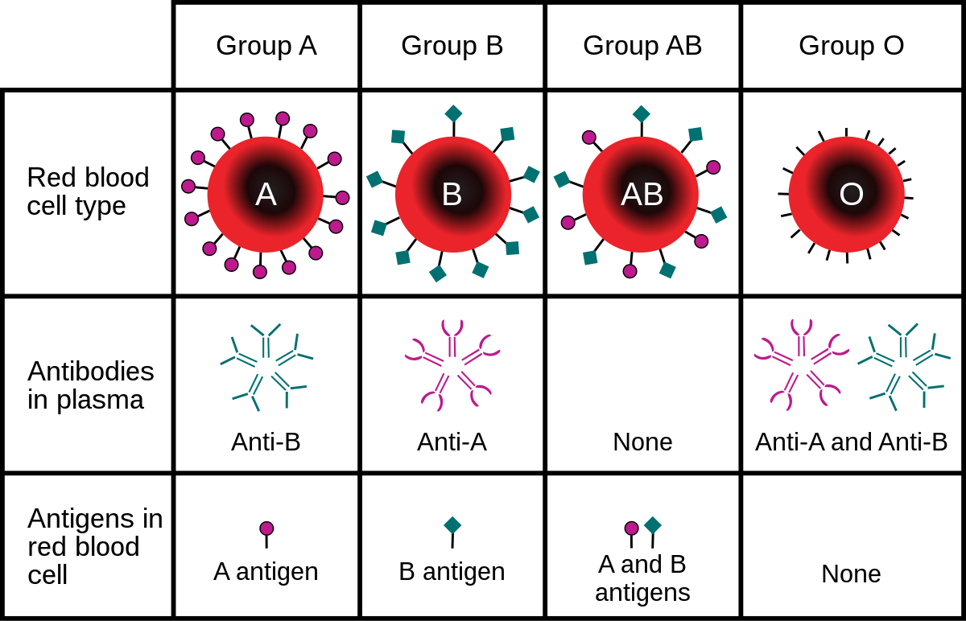

Slide 28
ABO Blood Groups
Based on the presence or absence of two antigens
  Type A
  Type B
The lack of these antigens is called type O

Slide 29
ABO Blood Groups
The presence of both A and B is called type AB
The presence of either A or B is called types A and B, respectively

Slide 30
Rh Blood Groups
Named because of the presence or absence of one of eight Rh antigens (agglutinogen D)
Most Americans are Rh⁺
Problems can occur in mixing Rh⁺ blood into a body with Rh– blood

Slide 31
Rh Dangers During Pregnancy
Danger is only when the mother is Rh– and the father is Rh⁺, and the child inherits the Rh⁺ factor

Slide 32
Rh Dangers During Pregnancy
The mismatch of an Rh– mother carrying an Rh⁺ baby can cause problems for the unborn child
  The first pregnancy usually proceeds without problems
  The immune system is sensitized after the first pregnancy
  In a second pregnancy, the mother’s immune system produces antibodies to attack the Rh⁺ blood (hemolytic disease of the newborn)

Slide 33


