Slide 1


Artificial Intelligence
College of Engineering & Technology
Computer Techniques Engineering Department
Artificial Intelligence – Stage 3
Lecture 4
Solving Problems by Searching

Slide 2
Uninformed Search Strategies (Blind Search)
The term blind means that the strategies have no additional information about states beyond that provided in the problem detention.
All they can do is generate successors and distinguish a goal stat from non-goal state.
All Search Strategies are Distinguished by the order in with nodes are expanded

Slide 3
Uninformed Search Strategies (Blind Search)
Breadth-First Search
Uniform Cost Search
Depth-First Search
Depth limited search
Iterative deepening depth first search.
Biodirectional search

Slide 4
1- Breadth-First Search
It is simple strategy in which root node is expanded first.
Successors of the root are expanded next.
Then their successors, and so on.
All the nodes are expanded at a given depth in the search tree before and nodes at the next level are expanded.

Slide 5
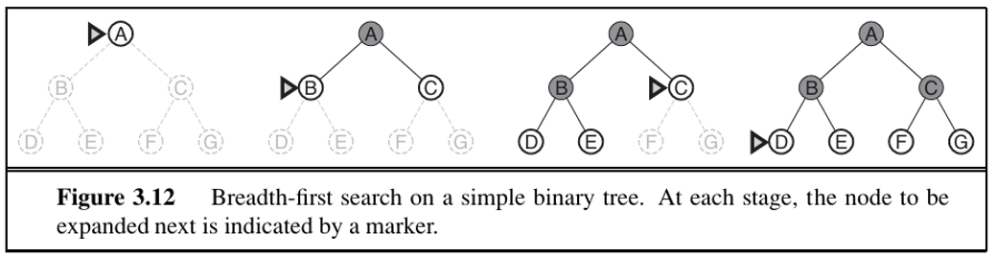
Breadth-First Search

Slide 6
Breadth-First Search
In breadth-first search algorithm the shallowest node is chosen for expansion.
This is achieved very simply by using FIFO queue
New nodes which are always deeper than their parent go to the back of the queue.

Slide 7
Breadth-First Search Performance
Breadth-first search is complete
Breadth-first is optimal if the path cost is a nondecreasing function.
TIME and MEMORY

Slide 8
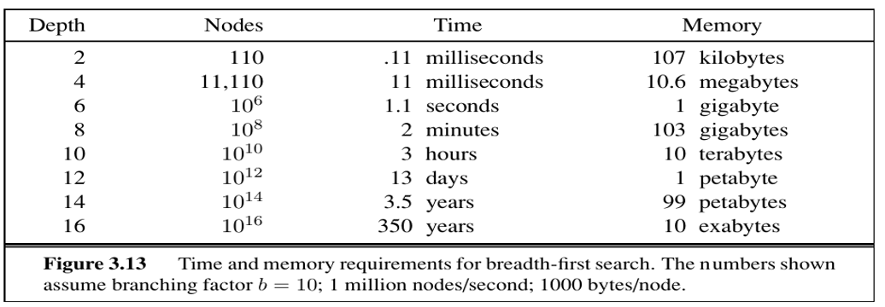
Breadth-First Search Performance
TIME and MEMORY

Slide 9
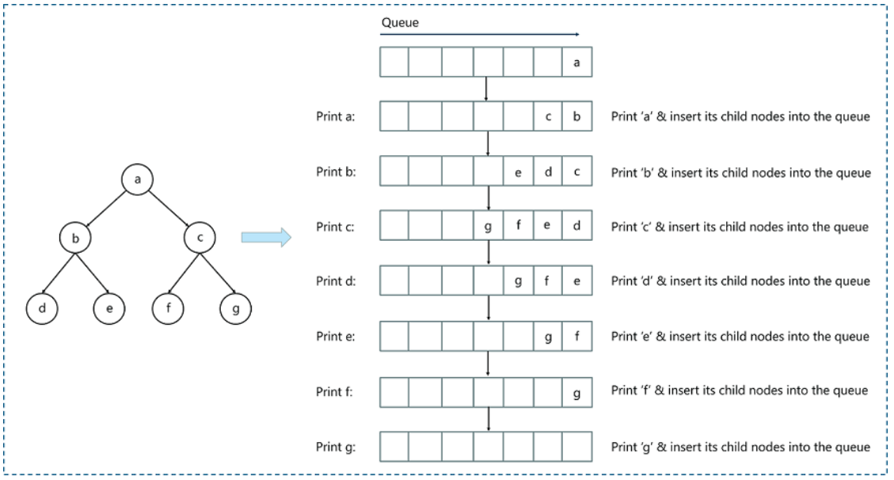
Breadth-First Search Examples

Slide 10
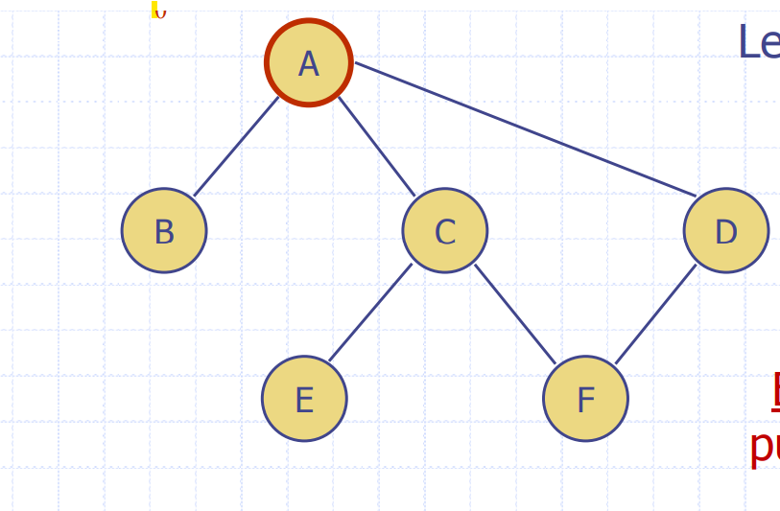
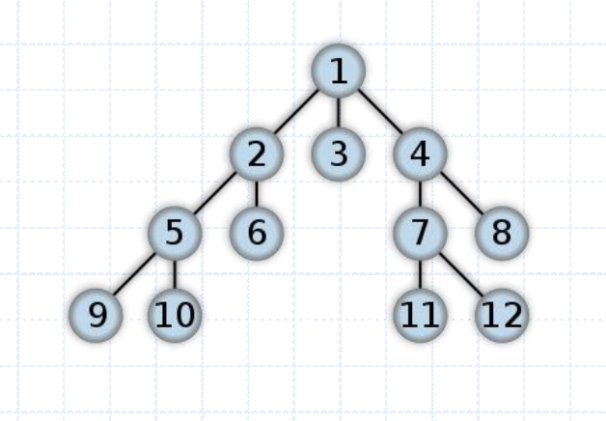
Breadth-First Search Examples

Slide 11
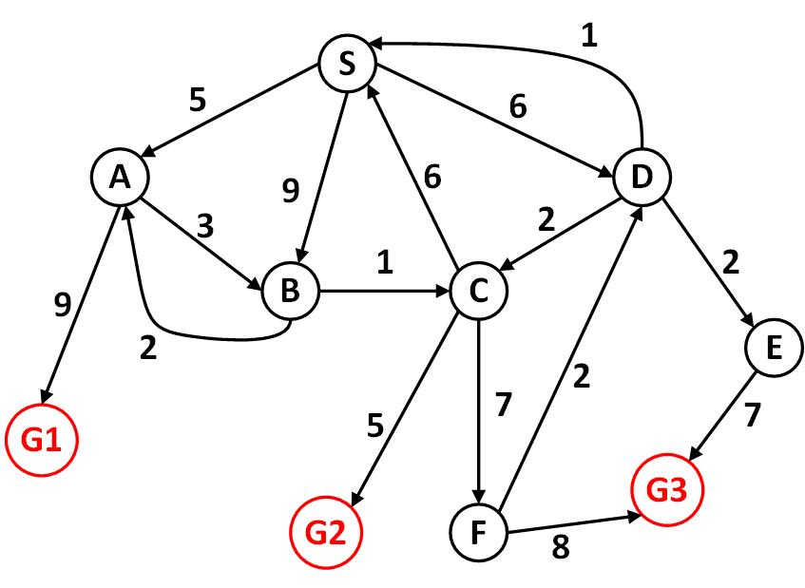
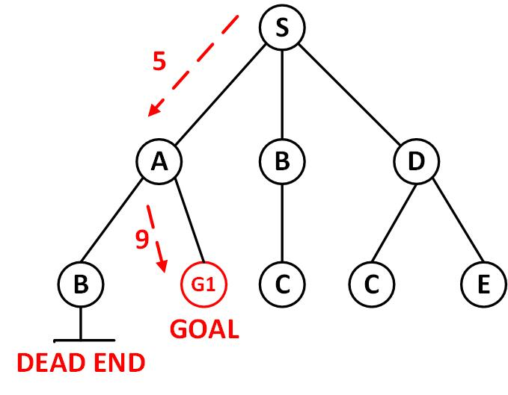
Breadth-First Search Examples
Visited: S, A, B, D

Slide 12
2-Uniform-cost search
Breadth-first always expands the shallowest unexpanded node.
Breadth-first is optimal because the step cost are equal.
By a simple extension, we can find an algorithm that is optimal with any step-cost function.
Uniform-cost search expands the node n with the lowest path cost g(n).

Slide 13
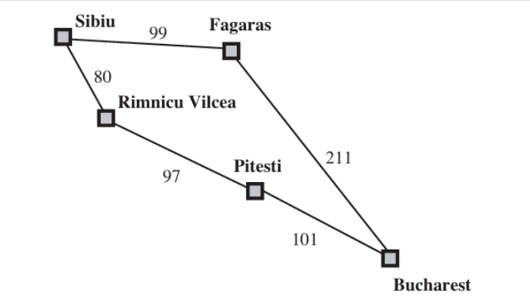
Uniform-cost search
The figure explains the problem to get from Sibiu to Bucharest.
The successors of Sibiu are Rimnicu Vilcea and Fagaras.
With cost 80 and 99, respectively.
The least cost nod Rmnicu Vilcea is expanded.
Next, adding Pitest with cost 80+97 = 177.
The least cost now is Fagaras (99 < 177) so it is expanded.
Adding Bucharest with cost 99 + 211 = 310
A goal node has been generated, BUT THE ALGORITHM KEEP SEARCHING.
Expanding Pitesti and adding a second path to Bucharest with a cost 80 + 97 + 101 = 278.
The algorithm check the new path is better than the old one (cost 278 < 310) and the solution is returned

Slide 14
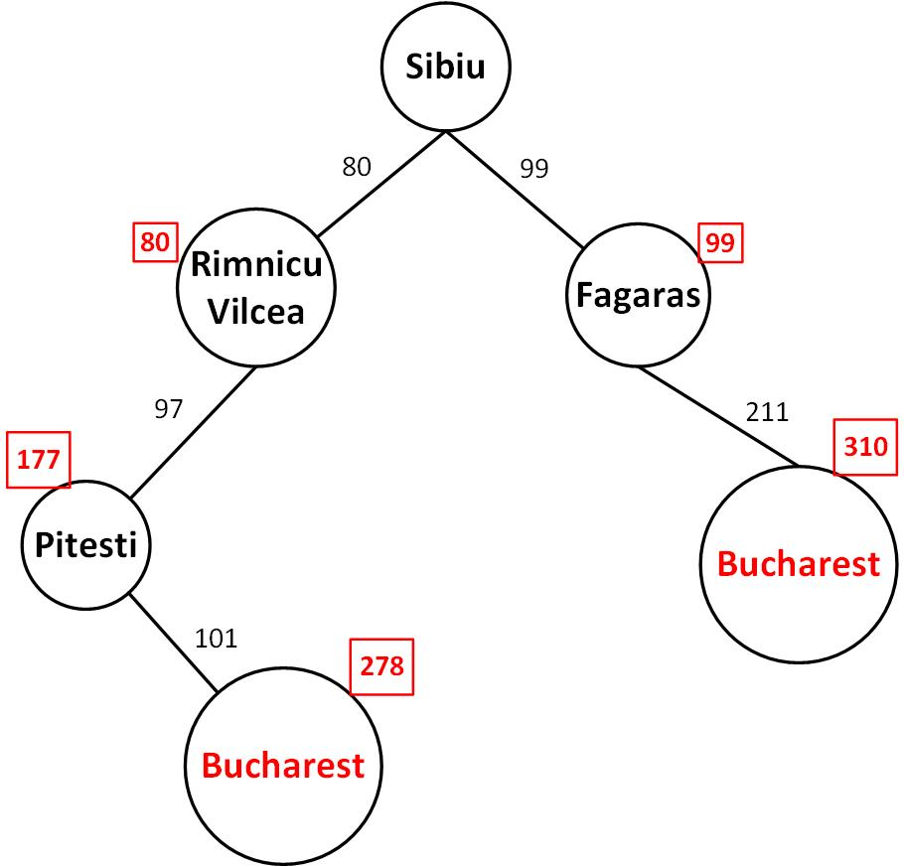
Uniform-cost search

Slide 15
Uniform-cost search Example

Slide 16
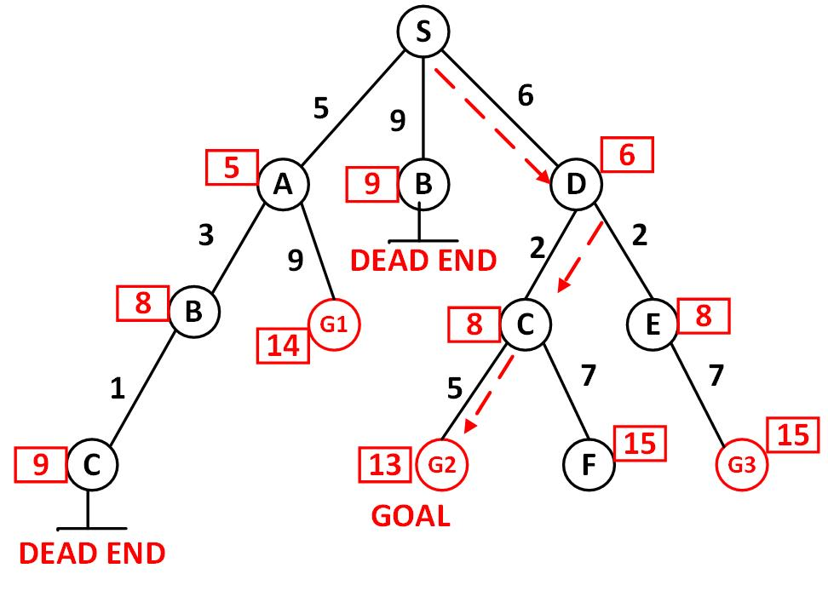
Uniform-cost search Example
Visited: S, A, D, B, C, E

Slide 17
3-Depth-first search
It always expands the deepest node in the current frontier of the search tree.
The search proceeds immediately to the deepest level of the search tree.
If the node has no successors, it dropped frontier and the search backs up
Depth first search uses LIFO queue.
LIFO means that the most recently generated node is chosen for expansion.

Slide 18
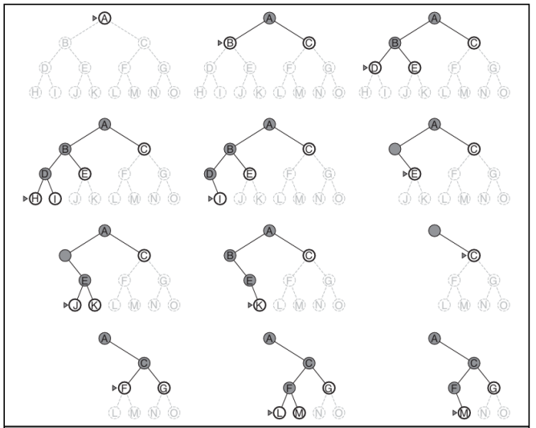
Depth-first search

Slide 19
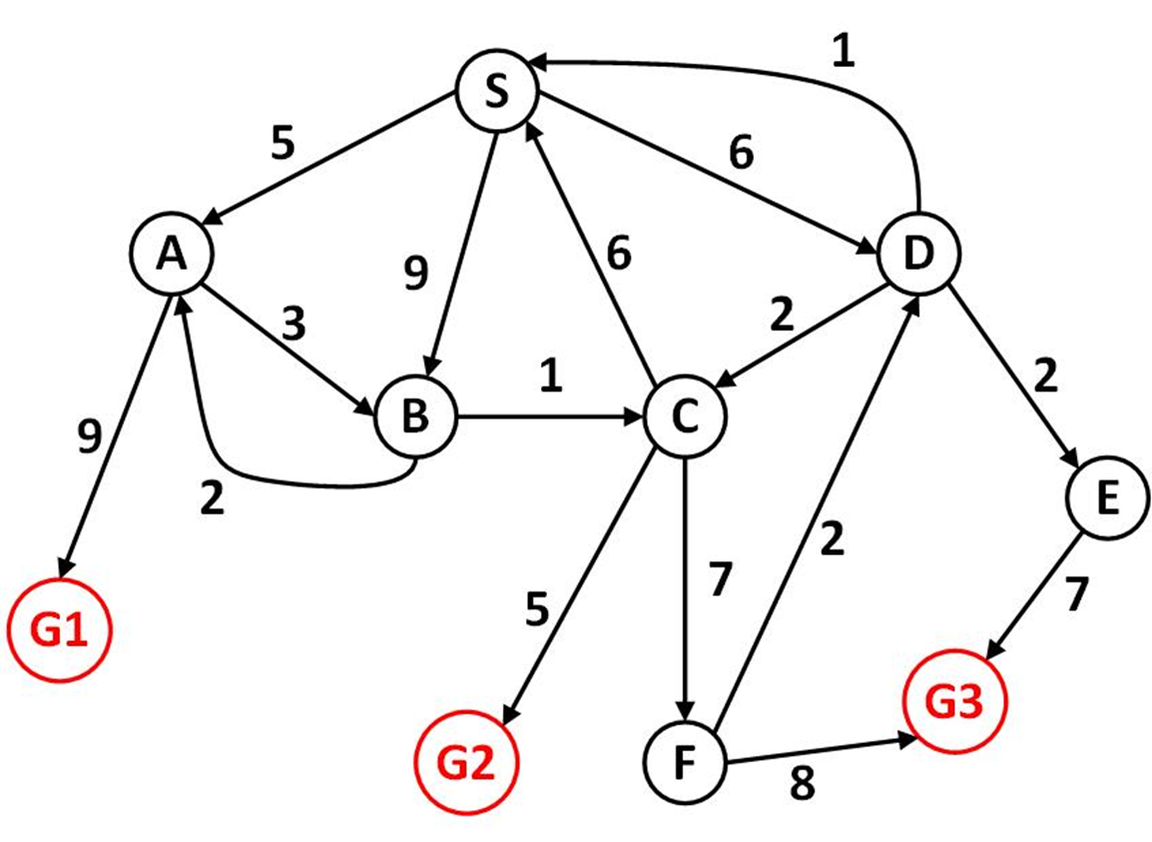
Depth-first search

Slide 20
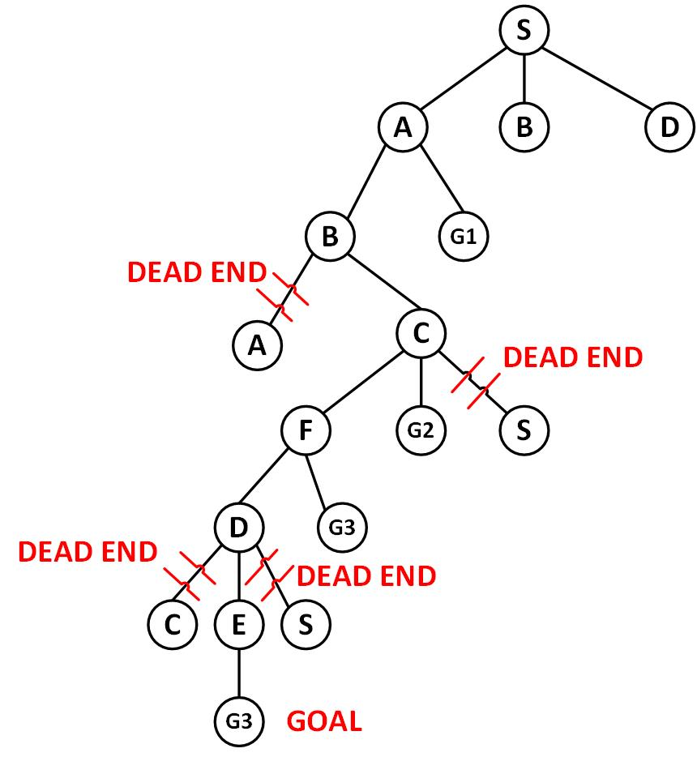
Depth-first search

Slide 21
4-Depth-limited search
To overcome the drawbacks of depth-first search
The depth-first search is predetermined with depth L
Nodes at depth L treated as if they have no successors
This approach is called depth-limited search.
This approach solve some problem , but also introduce an additional source of incompleteness.
L can be specified based on previous knowledge of the problem.

Slide 22
5-Iterative deepening depth-first search
It is general strategy often used in combination with depth first search.
It gradually increasing the limit, first 0, then 1, then 2 and so on.
Until a goal is found.
It combine the benefits of depth-first and breadth-first search.
Like depth-first memory requirements are modest.
Like breadth-first it is complete and optimal when path cost is a nondecreasing function.

Slide 23
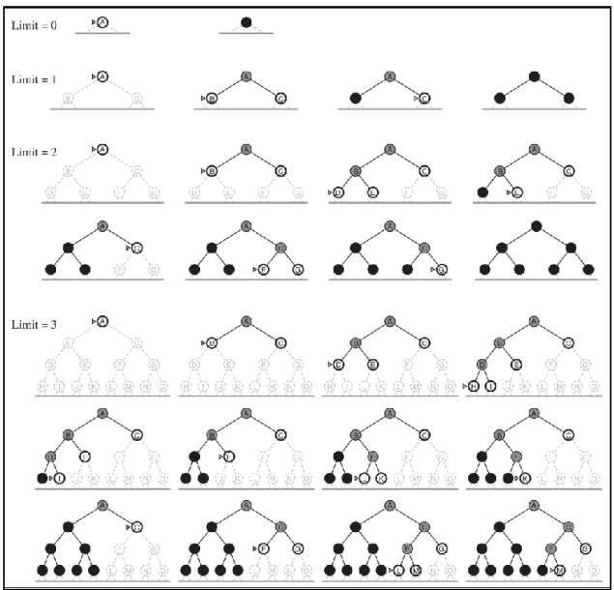
5-Iterative deepening depth-first search

Slide 24
6-Bidirectional Search
Run to simultaneous searches.
One forward from the initial state.
The other backward from the goal.
Hoping the two searches meet in the middle.
It implemented by replacing the goal test with a check to see whether the frontiers of the two searches intersect.

Slide 25
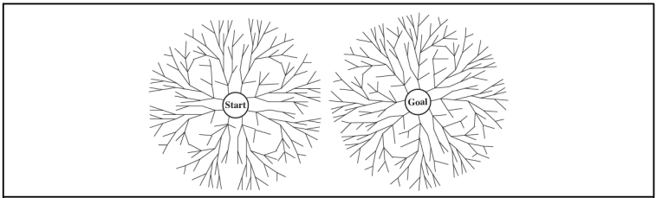
6-Bidirectional Search

Slide 26
Thanks for Your Attention

