Slide 1
CEREBRO VASCULAR ACCEDANT (CVA)
Dr.Zaid Al-Nasrawi
Trauma and Orthopedics surgery

Slide 2
CEREBRO VASCULAR ACCEDANT (CVA)
Neurological deficit of cerebrovascular cause that persists beyond 24 hours .
Transient ischemic attack (TIA), which is a related syndrome of stroke symptoms that resolve completely within 24 hours.

Slide 3
CLASSIFICATION
Ischemic stroke
Caused by interruption of the blood supply to the brain
About 85%
Hemorrhagic stroke
hemorrhagic strokes result from the rupture of a blood vessel or an abnormal vascular structure
About 15%
The main risk factor for stroke is high blood pressure. Other risk factors include tobacco smoking, obesity, high blood cholesterol, diabetes mellitus, a previous TIA, end-stage kidney disease, and atrial fibrillation

Slide 4
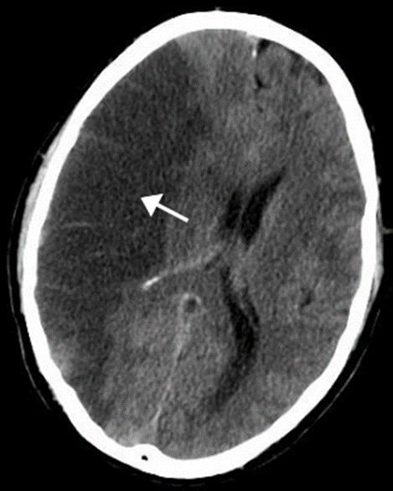
Ischemic stroke
In an ischemic stroke, blood supply to part of the brain is decreased, leading to dysfunction of the brain tissue in that area. There are four reasons why this might happen:
Thrombosis (obstruction of a blood vessel by a blood clot forming locally).
Embolism (obstruction due to an embolus from elsewhere in the body).
Systemic hypoperfusion (general decrease in blood supply, e.g., in shock)
Cerebral venous sinus thrombosis.

Slide 5
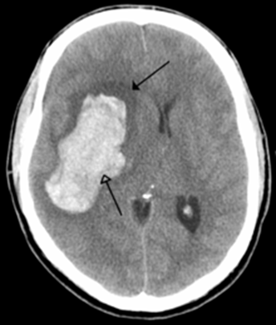
Hemorrhagic Stroke
There are two main types of hemorrhagic stroke:
Intracerebral hemorrhage, which is basically bleeding within the brain itself (when an artery in the brain bursts, flooding the surrounding tissue with blood),
Subarachnoid hemorrhage, which is basically bleeding that occurs outside of the brain tissue but still within the skull, and precisely between the arachnoid mater and pia mater.
Hemorrhagic strokes may occur on the background of alterations to the blood vessels in the brain, such as cerebral AV malformation and an intracranial aneurysm, which can cause intraparenchymal or subarachnoid hemorrhage

Slide 6
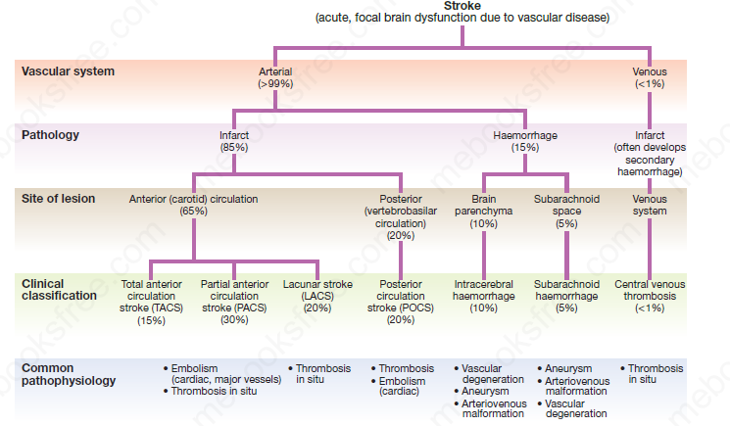

Slide 7
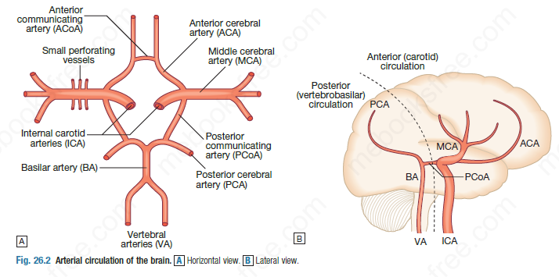

Slide 8
Neuroimaging
Computed tomography (CT) scanning is the mainstay of emergency stroke imaging. It allows the rapid identification of intracerebral bleeding and stroke ‘mimics’ (i.e. pathologies other than stroke that have similar presentations), such as tumours.
Magnetic resonance imaging (MRI) is used when there is diagnostic uncertainty or delayed presentation, and when more information on brain structure and function is required .Contraindications to MRI include cardiac pacemakers and claustrophobia on entering the scanner.
CT angiography (CTA) and CT perfusion are now being used to characterize the cerebral circulation and areas of ischaemia better .

Slide 9
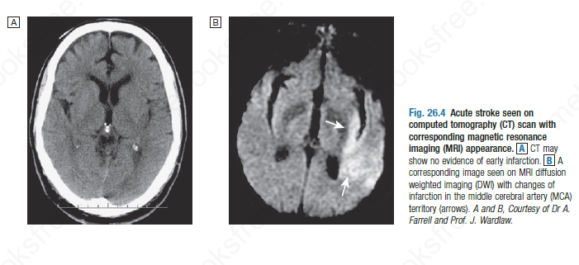

Slide 10
Vascular imaging
Various techniques are used to obtain images of extracranial and intracranial blood vessels .
The least invasive is ultrasound (Doppler or duplex scanning), which is used to image the carotid and the vertebral arteries in the neck.
Can provided the degree of arterial stenosis and the presence of ulcerated plaques.

Slide 11
Blood flow in the intracerebral vessels can be examined using transcranial Doppler.
Blood flow can also be detected by specialised sequences in MR angiography (MRA) or CTA but the anatomical resolution is still not as good as that of intra-arterial angiography, which outlines blood vessels by the injection of radio-opaque contrast intravenously or intra-arterially.
Because of the significant risk of complications, intra-arterial contrast angiography is reserved for use when non-invasive methods have provided a contradictory picture or incomplete information, or when it is necessary to image the intracranial circulation in detail, e.g. to delineate a saccular aneurysm, an arteriovenous malformation or vasculitis.

Slide 12
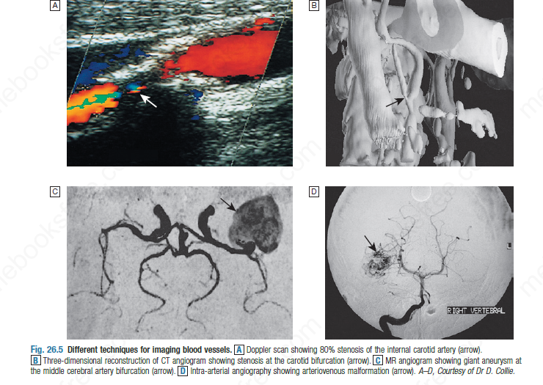

Slide 13
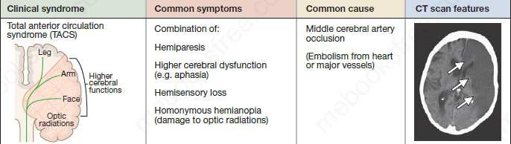

Slide 14
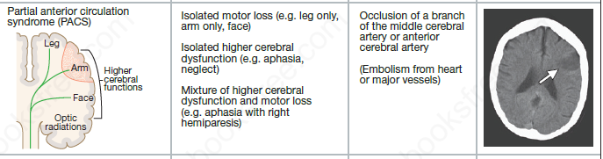

Slide 15
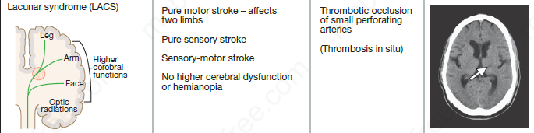

Slide 16
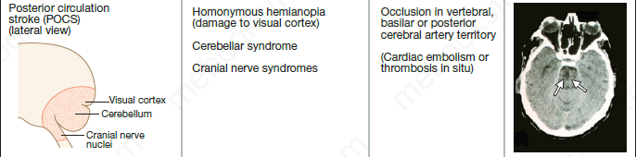

Slide 17
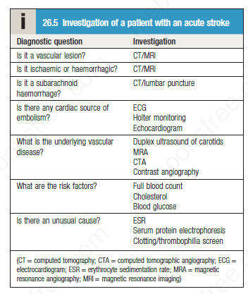
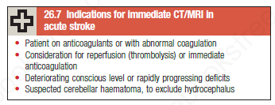

Slide 18
For detecting chronic hemorrhages, MRI scan is more sensitive.
For the assessment of stable stroke, nuclear medicine scans SPECT and PET/CT may be helpful. SPECT documents cerebral blood flow and PET with FDG isotope the metabolic activity of the neurons.
CT scans may not detect an ischemic stroke, especially if it is small, of recent onset, or in the brainstem or cerebellum areas. A CT scan is to rule out bleeding.

Slide 19
Management
Stroke unit
Ideally, people who have had a stroke are admitted to a "stroke unit", a ward or dedicated area in a hospital staffed by nurses and therapists with experience in stroke treatment.
Nursing care is fundamental in maintaining skin care, feeding, hydration, positioning, and monitoring vital signs such as temperature, pulse, and blood pressure.

Slide 20
Rehabilitation
Stroke rehabilitation is the process by which those with disabling strokes undergo treatment to help them return to normal life as much as possible by regaining and relearning the skills of everyday living
Medication
Antiplatelet and statin in ischemic stroke, antibiotics in case of infection, treatment of the underlying cause with control of DM,HT.

