Slide 1


ICU
L7
Anesthesia Technologist
BCS. Anesthesia. and IC
diploma. Community health
Karrar Nader AL-Taie
Anesthesia Technologist
BCS. Anesthesia. and IC
diploma. Community health
Muneer Salman Hasan

Slide 2
Special complications in the ICU
Acute respiratory distress syndrome (ARDS):
Pneumothorax:
DVT
stress ulcer

Slide 3
Acute Respiratory Distress Syndrome (ARDS):
It is a state of acute diffuse alveolar damage characterized by increased capillary permeability, pulmonary edema and refractory hypoxia due to right to left shunting.
Timing: within 1 week of a known clinical insult or new worsening respiratory symptoms.
chest imaging: bilateral opacities- not fully explained by effusion, lobar/lung collapse, or nodules

Slide 4
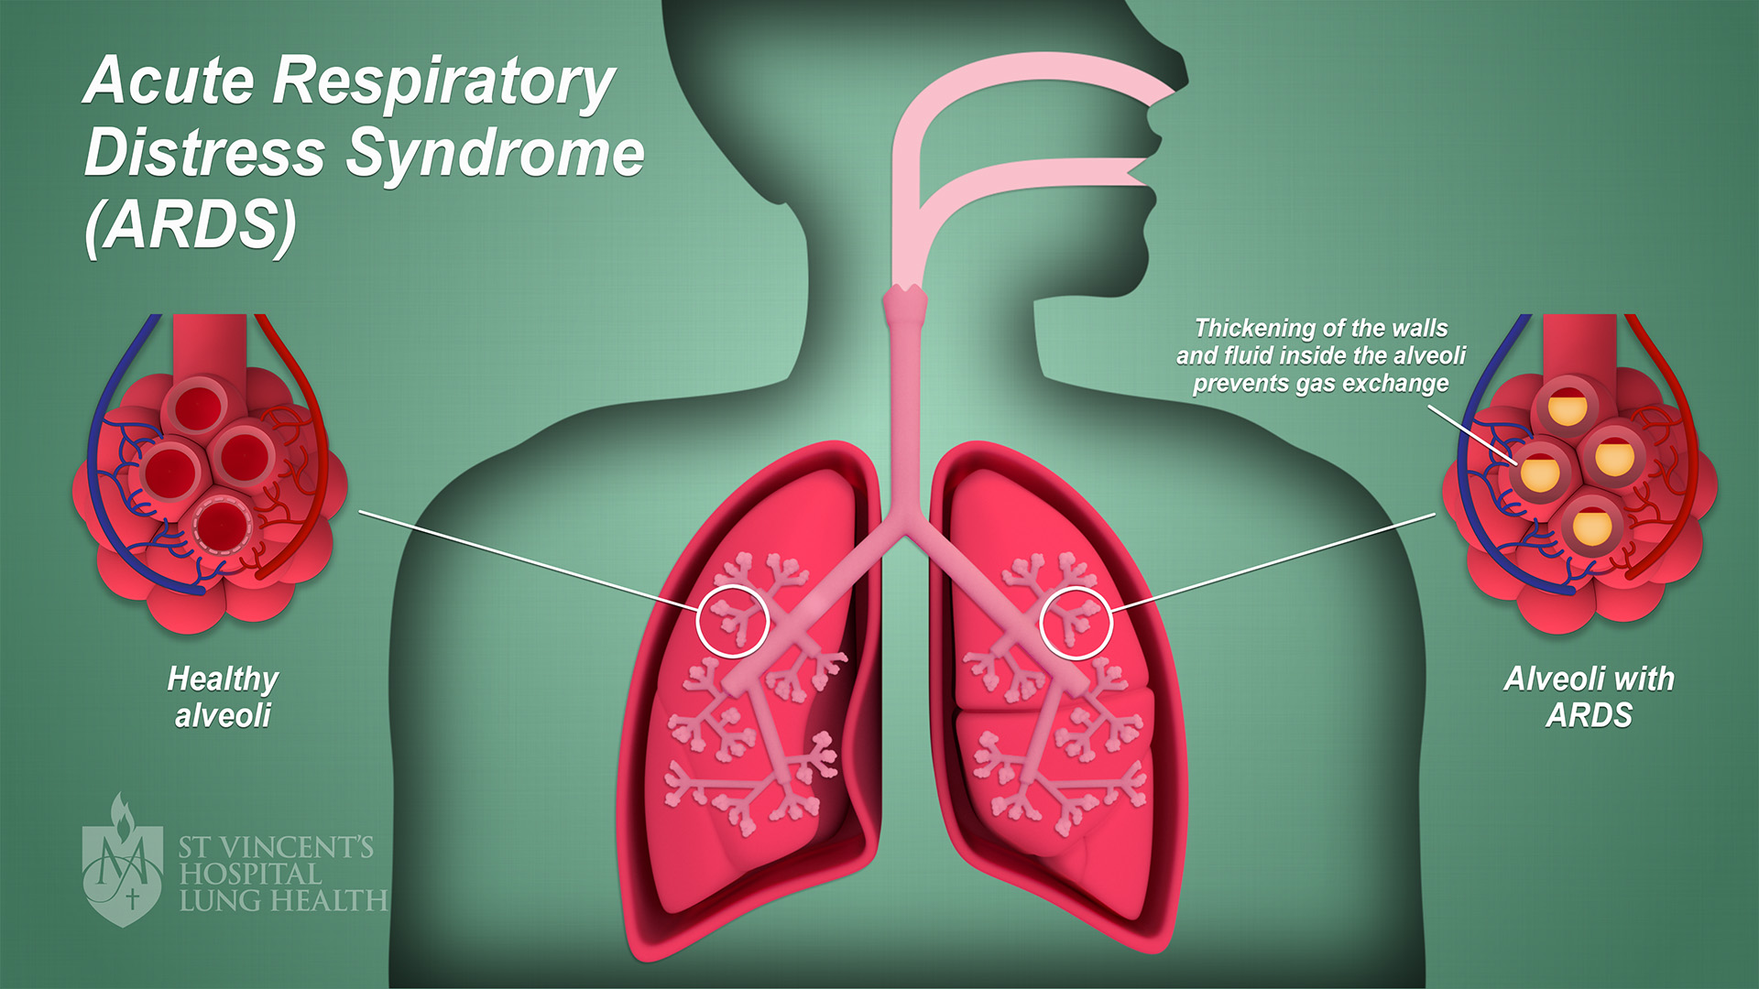

Slide 5
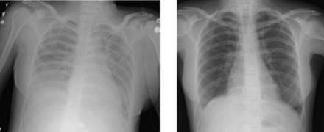

Slide 6
diagnosis
Oxygenation
PaO2/FiO2 200-300 with PEEP or CPAP > 5 cmH2O (mild ARDS)
PaO2/FiO2 100-200 with PEEP or CPAP > 5 cmH2O (moderate ARDS)
PaO2/FiO2 < 100 with PEEP or CPAP > 5 cmH2O (sever ARDS)

Slide 7
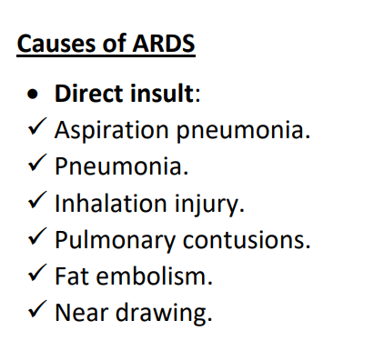
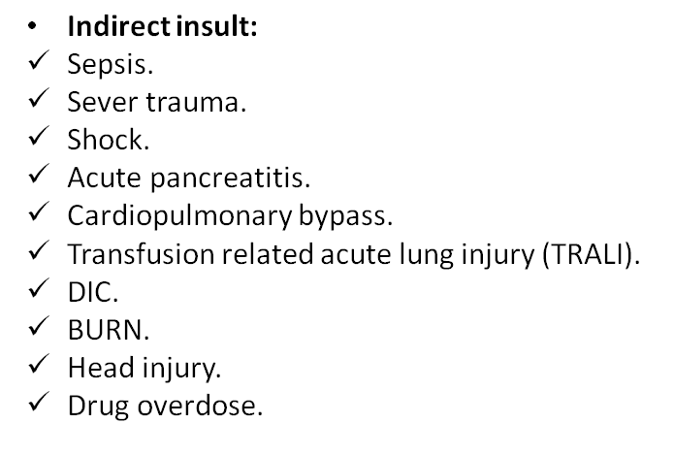

Slide 8
ARDS-problems and concerns:
Strain (stretch) due to over distension of compliant alveoli leading to volutrauma.
High inspiratory pressure (Pplat) leading to barotrauma.
Release of inflammatory mediators from lung leading to biotrauma.
Shear stress due to complete closure and re-opening of noncompliant alveoli (atelectrauma).

Slide 9
Differential diagnosis
Cardiogenic pulmonary edema.
Diffuse pneumonia.
Alveolar hemorrhage.
Acute interstitial pneumonitis.
Toxin injury (radiation pneumonitis).

Slide 10
Management of ARDS
General principles and supportive care:
Early recognition and treatment of underlying cause.
Minimizing procedures and their complications.
Venous thromboembolism and stress ulcer prophylaxis.
Lung protective ventilation protocol
Limit tidal volume to 6ml/kg.
Limit peak pressure to 35cmH2O.
Accept PaO2 (55-60 mmHg) and SaO2 > 90%.
Accept higher than normal PaCO2 level (45-55mmHg).
Use higher level of PEEP to improve alveolar recruitment.
Use longer inspiratory time.
Use ventilator mode which allow and support spontaneous respiratory effort.
Paralysis with neuromuscular blockade within first 48 hr.

Slide 11
Complications
The mortality rate for ARDS is 35-40% within the first 2 weeks of illness and complications of management are common and include:
Barotrauma
nosocomial pneumonia
DVT
catheter related infections
stress ulcer

Slide 12
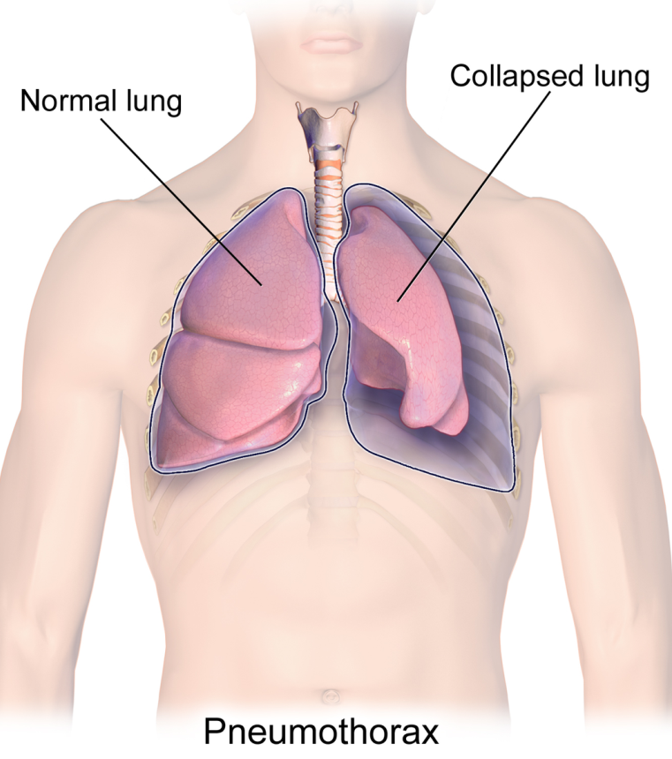
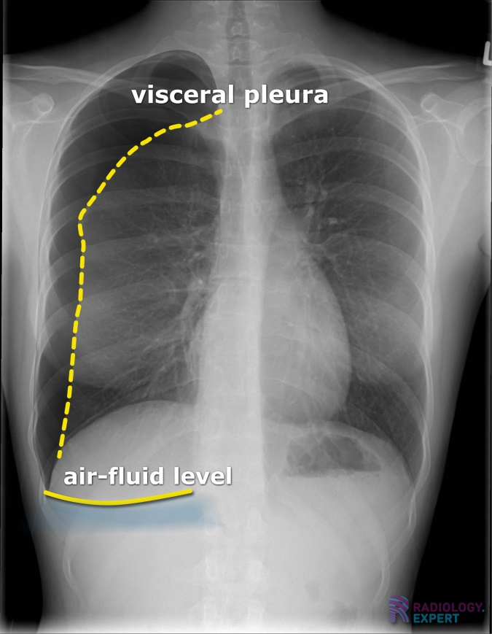
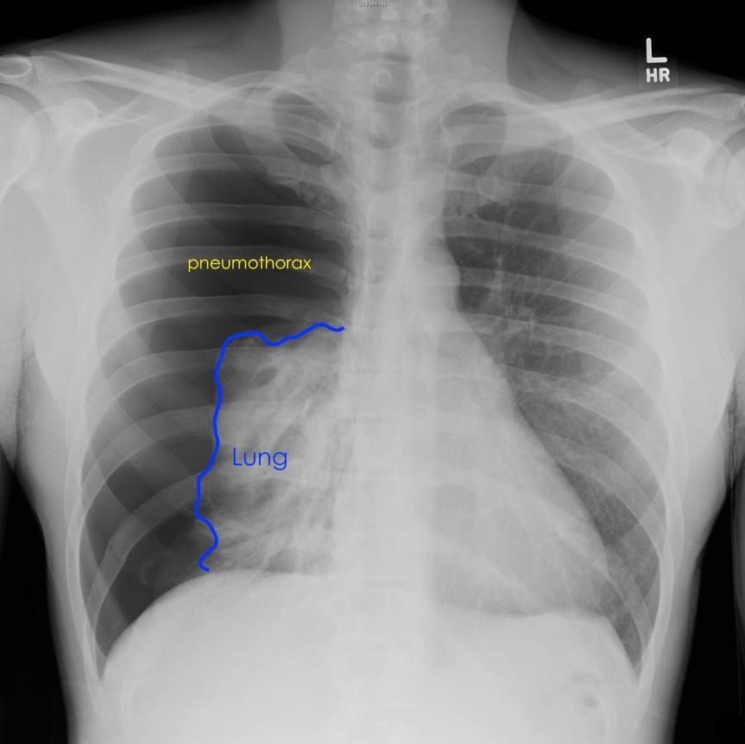
Pneumothorax
Means air in pleural space, air can enter from the outside (injury penetrated the chest wall) or air can enter from inside (if the lung is torn or ruptured)

Slide 13
Types of pneumothorax
Spontaneous: This refers to a condition in which the lung collapses with no apparent injury or trauma (pulmonary blebs, COPD emphysematous bullae, lung tumor and infective or infiltrative lung disease) Cigarette smokers also at great risk of spontaneous pneumothorax.
Traumatic pneumothorax: Result from direct trauma to the chest wall from either blunt or penetrated trauma (mostly thoracentesis then central line and pulmonary artery cath.)
Tension pneumothorax: Occur when the pleural pressure is positive throughout respiratory cycle (ball valve mechanism) Injury to pleura creates a tissue flap that open on inspiration and close on expiration.

Slide 14
Clinical features of pneumothorax
Sharp, stabbing chest pain that worsens on breathing, pain radiates to the shoulder
A dry hacking cough may occur because of irritation of the diaphragm.
Decrease breath sounds on affected side
Hyper resonance on percussion on affected side.
Tracheal deviation to other side.
Cyanosis.
Hypotension
Marked tachycardia.
Profuse diaphoresis.

Slide 15
Diagnosis
CXR
CT scan
Ultrasonography
Treatment
Small pneumothorax: resolve over days to weeks, O2 supplement with observation.
Spontaneous pneumothorax: Asymptomatic: follow up with serial CXR Symptomatic: chest tube Recurrent: CT to evaluate need for thoracotomy.
Tension pneumothorax: Immediate needle decompression by inserting a large bore needle (14-16 gauge) into 2nd intercostal space in midclavicular line, then tube thoracotomy should be done immediately.

Slide 16


