Slide 1


ICU
L7
Anesthesia Technologist
BCS. Anesthesia. and IC
diploma. Community health
Karrar Nader AL-Taie
Anesthesia Technologist
BCS. Anesthesia. and IC
diploma. Community health
Muneer Salman Hasan

Slide 2
Electrolyte disturbance

Slide 3
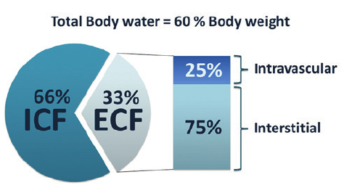
Introduction .
Body fluid:- Approximately 60% of adult weight is composed of fluid
Factors that influence the amount of body fluids
- Age : Younger people have a high percentage of body fluid than do older people
-Gender:- Men have proportionally more body fluid than do women Body fat
- Obese people have less fluid than thin people
Body fluid is located in two compartments -40% in intracellular , 20% extracellular
1. The intracellular fluid:
- Approximately two-thirds of body fluid is in intracellular fluid compartment
2. The Extracellular fluid - Approximately one-third of body fluid is extracellular.
Extracellular fluid has two main subdivision
1 Intravascular
2. Extravascular (interstitial space)
-Note / Body fluid normally shift between two compartments in order to maintain an equilibrium

Slide 4
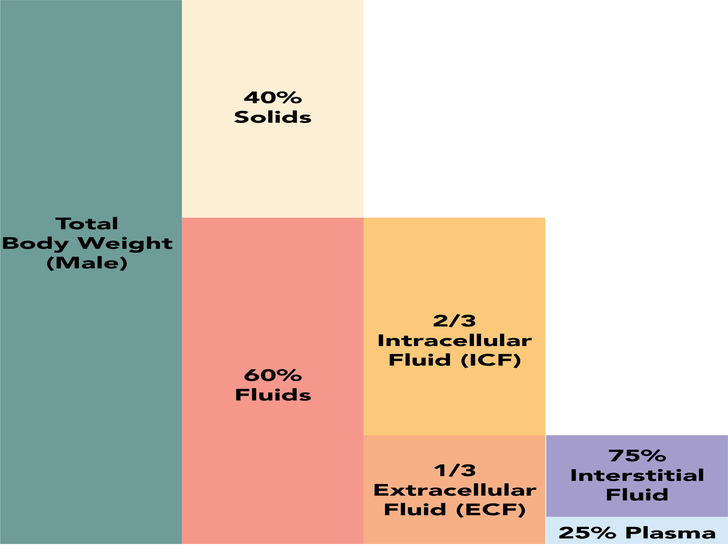

Slide 5
normal input = output
-hydration fluid over load =↑ input ----↓ output
-dehydration fluid loss=↓input -----↑output
Routes of fluid loses
-kidneys (1-2L)
-skin (600 ML )
-lung INSP & EXP.
-Gastrointestinal ( 100 – 200 ML )
Laboratory tests evaluation
• Blood Urea Nitrogen (BUN)
• Creatinine
• Hematocrit Electrolytes

Slide 6
Na (135-145) Normal rang
Sodium deficit (hyponatremia)
. Definition ↓ na 135 .
Contributing factors .
Renal disease .
Gain water via administration of fluids .
Excessive water supplements (tube feeding) .
Compulsive water drinking (psychogenic polydipsia) .
Signs and symptoms / Anorexia, Nausea, vomiting, headache, lethargy. confusion, muscle cramps. Poor elastic skin turgor, dry mouth hypotension.(common ) .
Diagnostic Evaluation/ Serum electrolyte .
medical management .
Sodium replacement (mouth, NG tube, Intravenous)
.Water restriction .
Intake and output (1&0) and daily weight .
Monitor serum sodium closely .
Encourage fluids and foods with high sodium content

Slide 7
Sodium Excess (Hypernatremia)
-Definition . Na ↑ 145
contributing factors .
Loss of water (watery diarrhea) and gain of sodium (drowning)
Fluid deprivation in an unconscious patient
Diabetes insipidus
Heat stroke
. Signs and symptoms /Dry mouth, thirsty,, restlessness, fatigue, general weakness, disorientation, hallucination, and brain damage, ↑BP
Diagnostic Evaluation / Serum electrolyte .
medical management .
Isotonic non-saline solution .
Monitor the changes in behavior .
Intake and output (1&0) and daily Weight .
Monitor serum sodium .
Offering fluid at regular time for diabetes insipidus

Slide 8
Potassium (3.5-5.5)
Potassium deficit (Hypokalemia)
Definition K ↓ 3.5
Contributing factors .
Vomiting and diarrhea .
Gastric suction .
Uses of diuretics .
Decrease dietary intake .
Signs and symptoms Fatigue, anorexia, nausea, vomiting, muscle weakness, leg cramps, paresthesia, cardiac dysrhythmias (Flattened T waves, prominent of U waves and ST depression)
Diagnostic Evaluation ECG, serum electrolyte. .
medical management
-Oral or IV replacement therapy
-Monitor ECG for change
-Dietary supplement
- Intake and output (1&0)
- Monitor serum potassium closely

Slide 9
Potassium Excess (hyperkalemia)
Definition K ↑ 5.5
Contributing factors .
Renal Failure (decrease renal excretion) .
Rapid intravenous administration of potassium (treatment of hypokalemia) .
Hemolytic anemia (Excessive destruction of RBC)
Medications (heparin, captopril, etc...)
Signs and symptoms Fatigue, anorexia, nausea, vomiting, muscle weakness cardiac dysrhythmias (Tall tented T waves and ST depression)
Diagnostic Evaluation -ECG - serum electrolyte .
medical management .
Administration of regular insulin and dextrose .
Peritoneal or hemodialysis .
Monitor ECG for changes .
Intake and output (I&O) .
Monitor serum potassium

Slide 10
Calcium ca (8.5-10.5) ca deficit (Hypocalcemia)
-Definition Ca ↓ 8.5
- Contributing factors .
Hypoparathyroidism .
Surgical removal of parathyroid gland .
Vitamin D deficiency .
Pancreatitis
Signs and symptoms .Positive Trousseau's Sign. . Positive Chvostek's Sign .Tetany .Numbness and tingling of fingers and toes Diagnostic Evaluation Serum ca .
medical management .
Administration of calcium gluconate .
Vitamin D therapy .
Seizure precautions .Intake and output (1&0) .
Monitor serum calcium closely

Slide 11
Calcium Excess (Hypercalcemia)
. Definition ↑ 10.5 .
Contributing factors
-Hyperparathyroidism .
- Over use of calcium supplement |
-Vitamin D excess signs and symptoms
-Renal colic -Renal calculi .
-Hypercalcemia crisis
Signs and symptoms : stomach upset, nausea, vomiting and constipation. Bones and musclesbone pain and muscle weakness
Diagnostic Evaluation Serum ca
medical management .
- Treat the underlying cause
-Increase fluid intake .
- Normal saline IV administration
-Calcitonin (IM or S.C. hypocalcemia)
-Corticosteroids (decrease shifting of calcium

Slide 12


