Slide 1


ICU
L3
Anesthesia Technologist
BCS. Anesthesia. and IC
diploma. Community health
Karrar Nader AL-Taie
Anesthesia Technologist
BCS. Anesthesia. and IC
diploma. Community health
Muneer Salman Hasan

Slide 2
Artificial Ventilation
Part 1

Slide 3
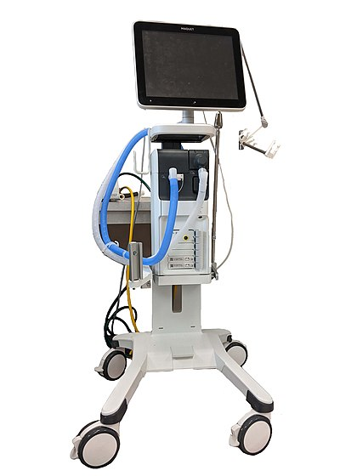
Artificial Ventilation
Mechanical ventilation helps move air into and out of the lungs, with the main goal of helping the delivery of oxygen and removal of carbon dioxide.
Mechanical ventilation is used for many reasons, including to protect the airway due to mechanical or neurologic cause, to ensure adequate oxygenation, or to remove excess carbon dioxide from the lungs.

Slide 4
Type of mechanical ventilation
There are two primary types of mechanical ventilation:
negative pressure ventilation (NPV)
positive pressure ventilation (PPV)

Slide 5
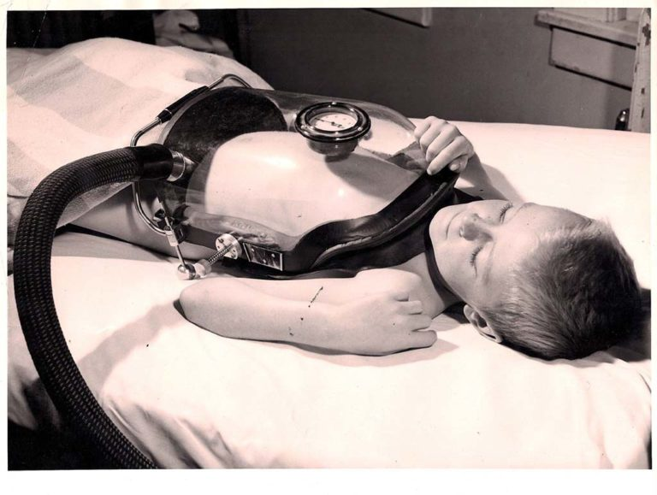
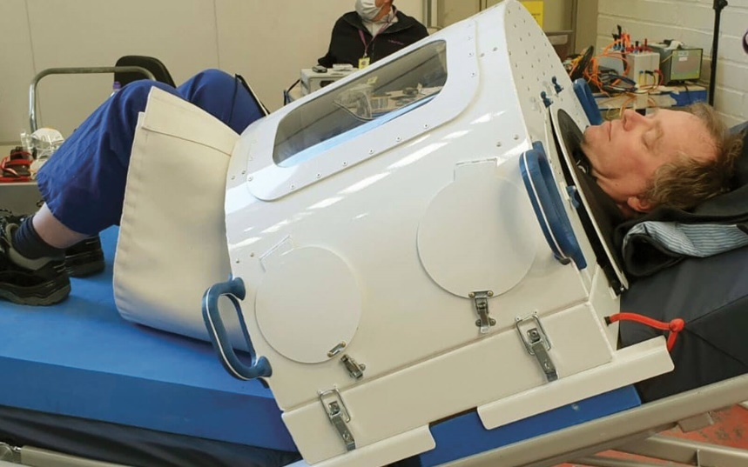
negative pressure ventilation (NPV)
provides intermittent non-invasive ventilatory assistance for patients with advanced chronic obstructive lung disease. Upper airway obstruction during sleep . And poliomyelitis ventilation

Slide 6
positive pressure ventilation (PPV)
Delivery gas to the patient under positive pressure during the inspiratory phase
Tow types of PPV
1-Non Invasive positive Mechanical Ventilation ((NIPMV))
2-Invasive positive Mechanical Ventilation ((IPMV))

Slide 7
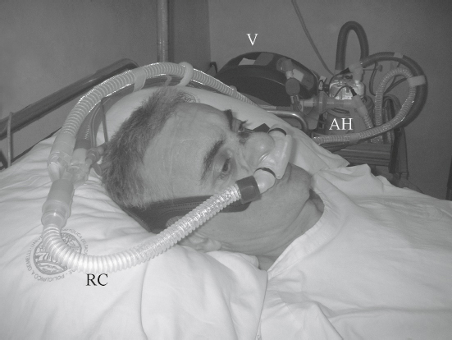
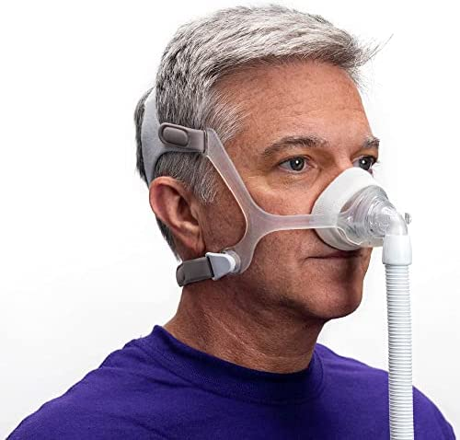
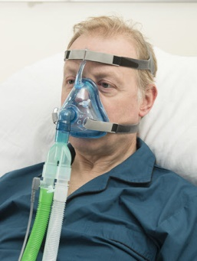
Non Invasive positive Mechanical Ventilation NIPMV
mechanical support in which positive pressure delivers a mixture of air and oxygen throughout the respiratory tree via a noninvasive interface. delivery of positive pressure ventilation through a noninvasive interface
(eg, nasal mask, oronasal mask, or nasal plugs) is applied throughout the respiratory cycle of a spontaneously breathing

Slide 8
Continuous positive airway pressure (CPAP)
CPAP is the most effective treatment for moderate to severe obstructive sleep apnea OSA, mild/moderate ARDS and COPD . in which the mild pressure from the CPAP prevents the airway from collapsing or becoming blocked . Recently it has been used in patients with covid - 19

Slide 9
Characterise CPAP
Improve oxygenation by increasing FRC and recruiting collapsed alveoli
It provides certain positive airway pressure throughout all phases of spontaneous ventilation
It is similar to breathing with your head stuck out of a moving car
CPAP » PEEP
an appropriate CPAP pressure is
between 5 __ 15 cmH2O, with an average of 10 cmH2O

Slide 10
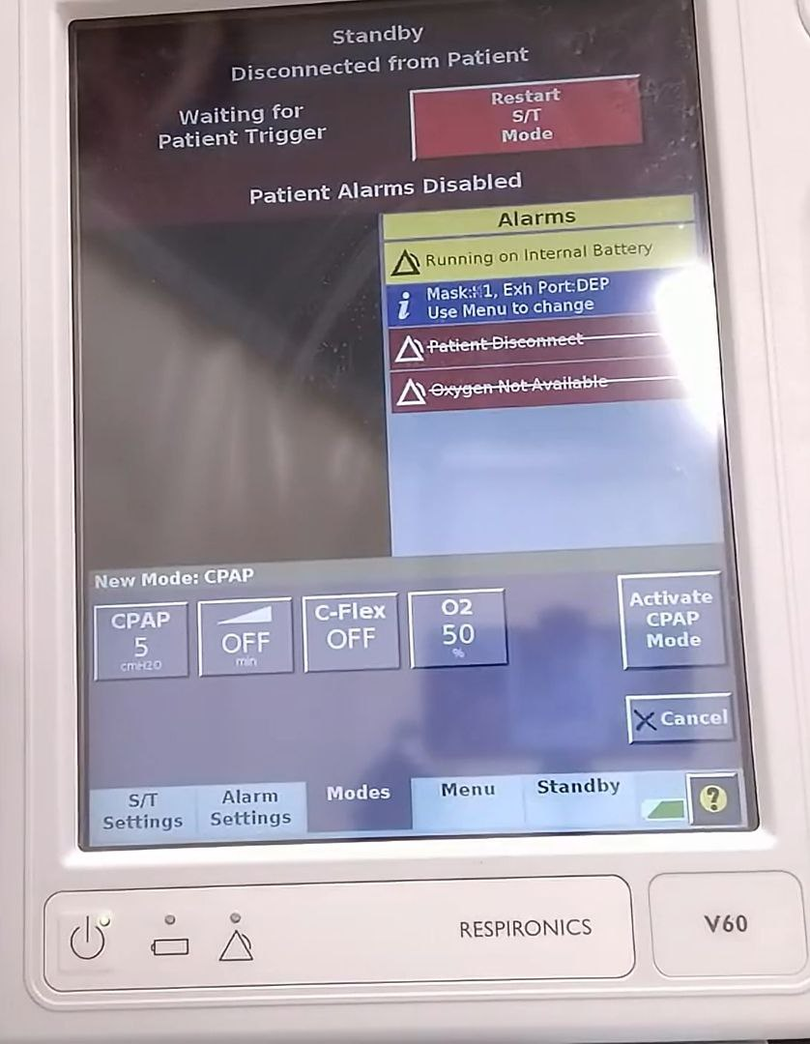

Slide 11
advantage of CPAP
CPAP reduces preload and afterload. Hence it is a very effective for treatment of pulmonary oedema.
It keeps your airways open while you sleep so you can receive the oxygen you need for optimal function.

Slide 12
disadvantage of CPAP
discomfort and difficulty falling asleep, especially in the beginning.
a feeling of claustrophobia or anxiety.
nasal congestion.
dry mouth.
nosebleeds.
skin irritation or sores where the mask touches the face.
a feeling of being bloated with air.

Slide 13
BIPAP
Non invasive form of mechanical ventilation provided by means of nasal mask or nasal prongs or full face mask . The system allows to select tow levels of positive pressure support
An inspiratory pressure support level (referred to as IPAP)
An expiratory pressure called EPAP (PEEP/CPAP level)
pressure support = IPAP – EPAP
pressure support = 5 __ 10 cmH2O

Slide 14
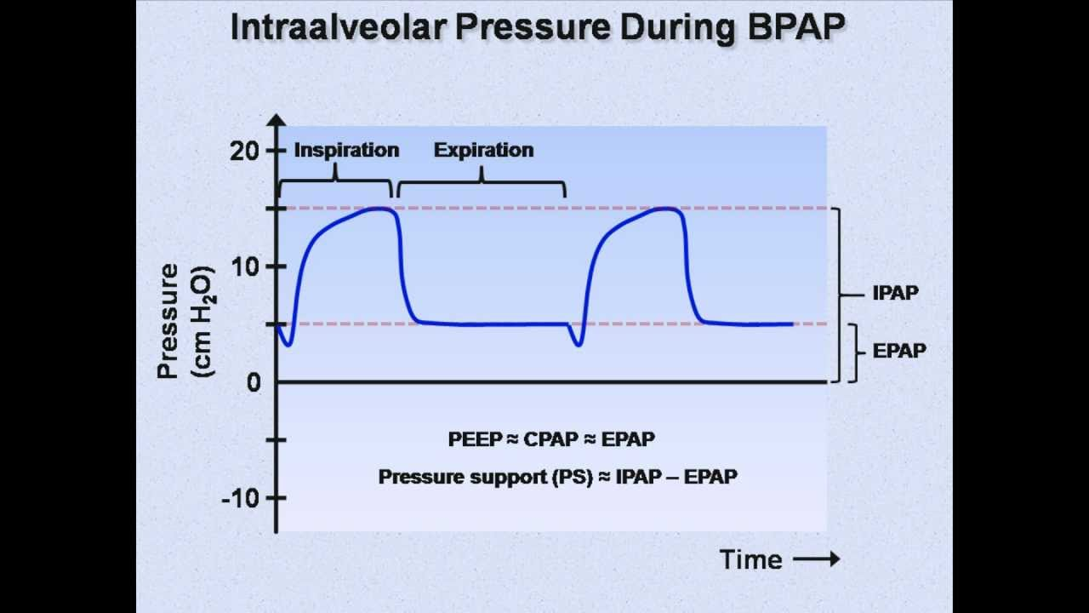

Slide 15
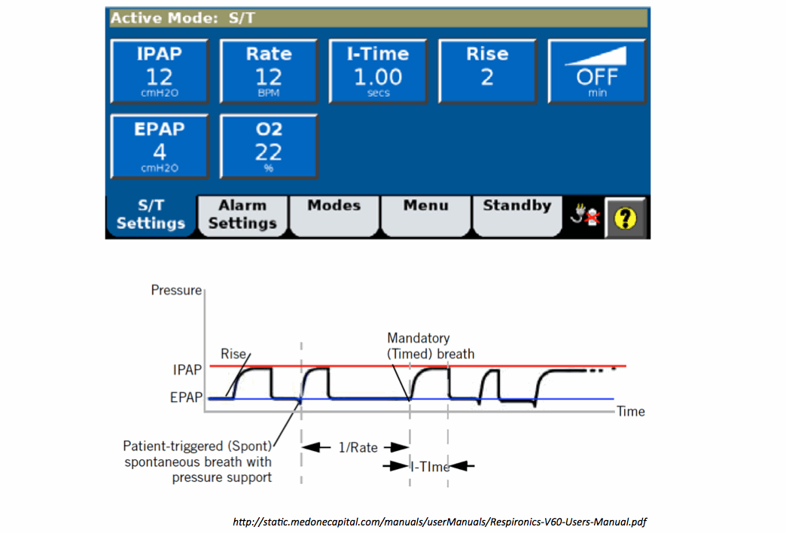

Slide 16
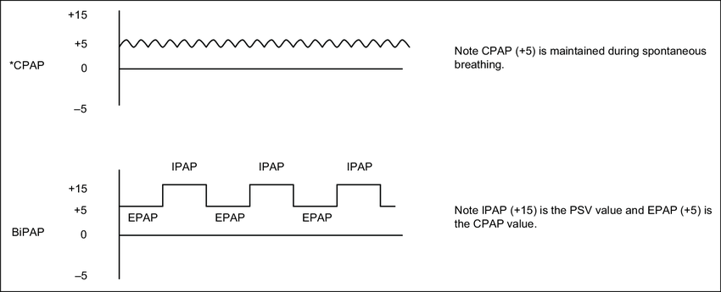

Slide 17
Advantage of BIPAP
BiPAP delivers higher air pressure when you breathe than CPAP
delivers the same amount of pressure at all times. So the BiPAP makes it easier to breathe out than the CPAP

Slide 18
disadvantage of BIPAP
discomfort and difficulty falling asleep, especially in the beginning.
a feeling of claustrophobia or anxiety.
nasal congestion.
dry mouth.
nosebleeds.
skin irritation or sores where the mask touches the face.
a feeling of being bloated with air.

Slide 19


