Slide 1


ICU
L5-2
Anesthesia Technologist
BCS. Anesthesia. and IC
diploma. Community health
Karrar Nader AL-Taie
Anesthesia Technologist
BCS. Anesthesia. and IC
diploma. Community health
Muneer Salman Hasan

Slide 2
CPR
Advanced Life Support
(ALS)

Slide 3
Shockable rhythms
one of advance life support equipment that we use in CPR that is depend on ECG reading to the heart rhythm
Shockable rhythms
1-Ventricular Fibrillation
2-ventricular tachycardia
nonshockable rhythms
1-pulseless electrical activity (PEA)
2- asystole

Slide 4
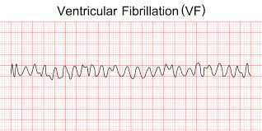
Ventricular fibrillation
Ventricular fibrillation is a type of irregular heart rhythm (arrhythmia). During ventricular fibrillation, the lower heart chambers contract in a very rapid and uncoordinated manner. As a result, the heart doesn't pump blood to the rest of the body

Slide 5
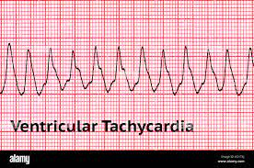
Ventricular tachycardia (VT or V-tach)
a type of abnormal heart rhythm, or arrhythmia. It occurs when the lower chamber of the heart beats too fast to pump well and the body doesn't receive enough oxygenated blood

Slide 6
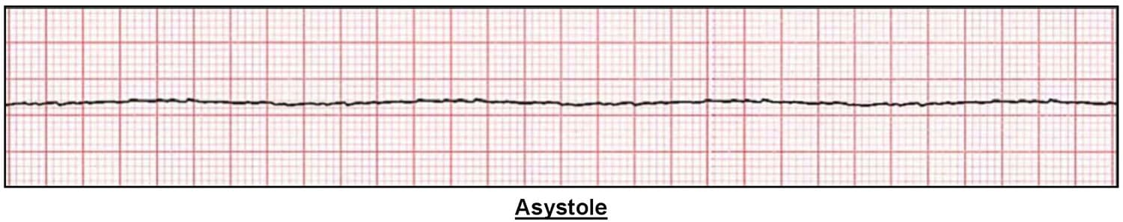
Asystole
Asystole is the most serious form of cardiac arrest and is usually irreversible. Also referred to as cardiac flatline, asystole is the state of total cessation (stop) of electrical activity from the heart, which means no tissue contraction from the heart muscle and therefore no blood flow to the rest of the body.

Slide 7
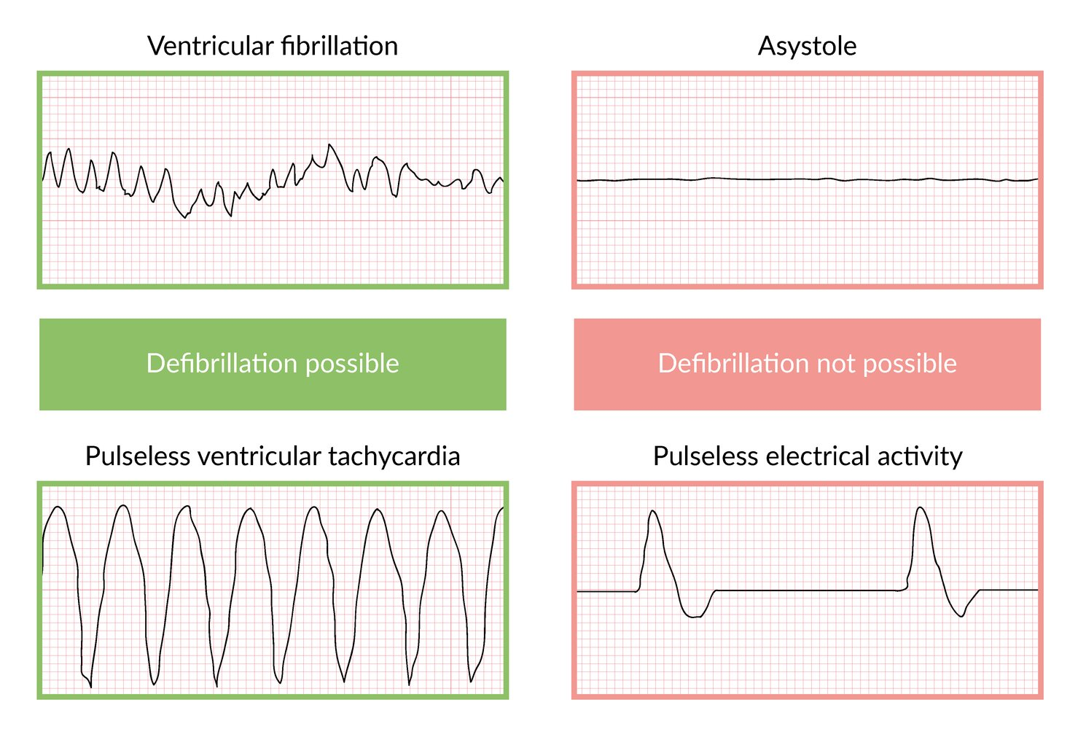
Pulseless Electrical Activity
PEA/ can lead to cardiac arrest. The difference is that with PEA, your heart still has some detectable electrical activity. With asystole, there's no electrical activity to detect

Slide 9
CPR Quality
1-Push hard at lest 2 inch 5 cm and fast 100-120/min and allow complete chest recoil
2- Minimize interruptions in compressions
3- Avoid excessive ventilation.
4-Change compressor every 2 minutes, or sooner if fatigued.
5-If no advanced airway 30:2 compression-ventilation ratio
6-Quantitative waveform capnography
-if ET-CO2, is low or decreasing reassess CPR quality

Slide 10
Shock Energy for Defibrillation
Biphasic: Manufacturer recommendation (eg, initial dose of 120-200 J if unknown use maximum available Second and subsequent doses should be equivalent, and higher doses may be considered.
Monophasic:360 J

Slide 11
Drug Therapy
Epinephrine IV/IO dose: 1 mg every 3-5 minutes
Amiodarone IV/IO dose: First dose: 300 mg bolus
-Second dose: 150mg
Lidocaine IV/IO dose: First dose: 1-1.5 mg/kg.
-Second dose:0.5-0.75mg/kg.

Slide 12
Advanced Airway
Endotracheal intubation or supraglottic advanced airway
wave form capnogram or capnometry to confirm and monitor ET tube replesment
Once advanced airway in place give 1 breath every 6 seconds (10 breaths/min) with continuous chest compressions

Slide 13
Return of Spontaneous Circulation (ROSC)
1- Pulse and blood pressure
2-Abrupt sustained increase in PETCO, (typically >40 mm Hg)
3- Spontaneous arterial pressure waves with intra-arterial monitoring

Slide 14
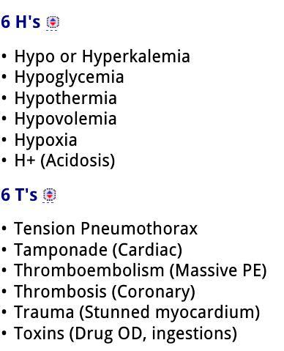
Reversible Causes

Slide 15
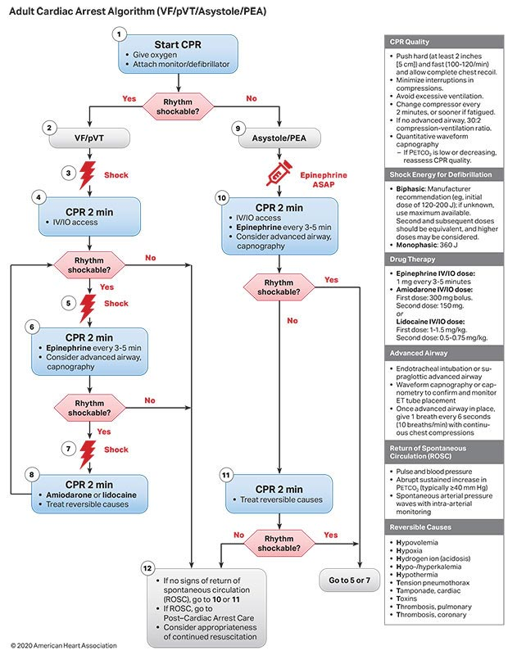

Slide 16
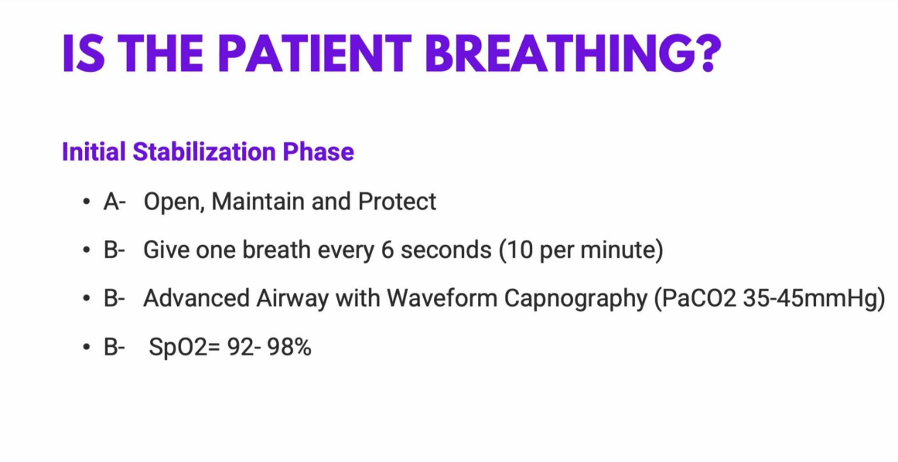

Slide 17
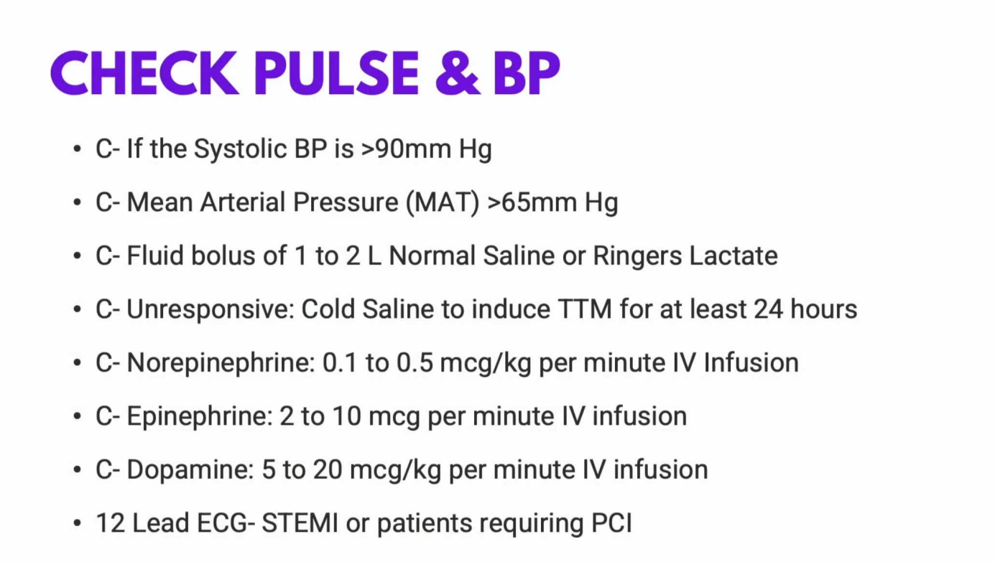

Slide 18
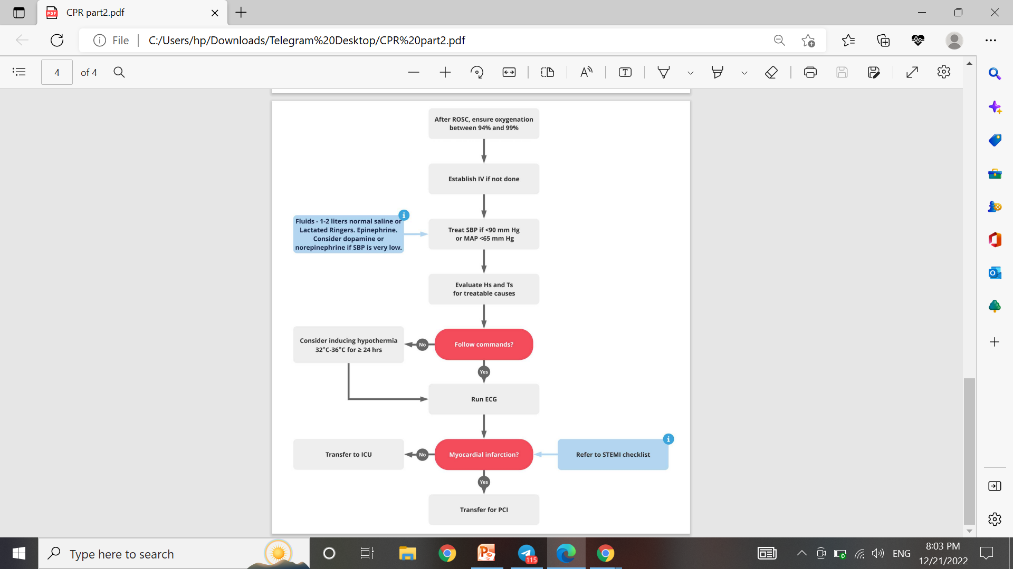

Slide 19


