Slide 1


ICU
L2
Anesthesia Technologist
BCS. Anesthesia. and IC
diploma. Community health
Karrar Nader AL-Taie
Anesthesia Technologist
BCS. Anesthesia. and IC
diploma. Community health
Muneer Salman Hasan

Slide 2
oxygen delivery system
oxygen delivery system is a device used to administer, regulate, and supplement oxygen to a subject to increase the arterial oxygenation. In general, the system entrains oxygen and air to prepare a fixed concentration required for administration

Slide 3
FiO2: is the concentration of oxygen in the gas mixture .normally there is oxygen in the air at 21%
SpO2 :Oxygen saturation measures the percentage of oxyhemoglobin (oxygen-bound hemoglobin) in the blood, and it is represented as arterial oxygen saturation
PaO2 : the oxygen pressure in arterial blood. The PaO2 reflects how well oxygen is able to move from the lungs to the blood
dead space : in the average adult, approximately 150 mL of the air that is inhaled with each breath never reaches the alveoli. It fills the nose, mouth, larynx, trachea, bronchi, and bronchioles, a volume known as the “dead space.” This air is not available for gas mixing and exchange

Slide 4
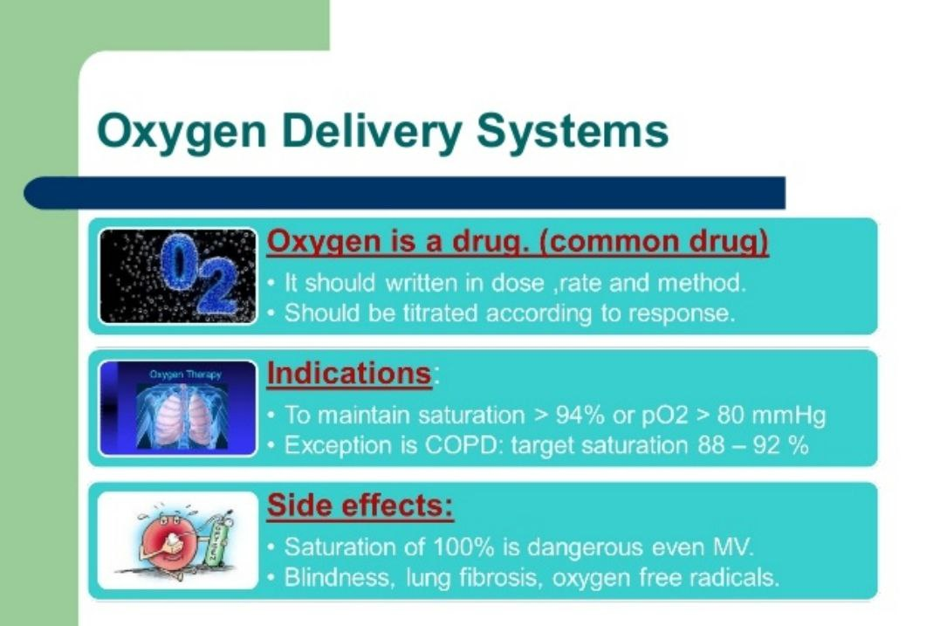

Slide 5
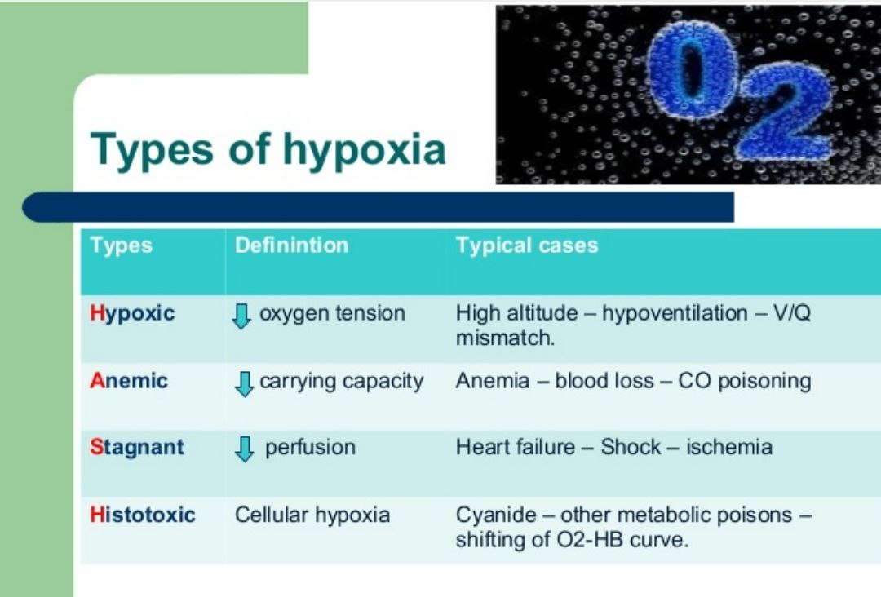
Hypoxia :Hypoxia is low levels of oxygen in the body tissues. It causes symptoms like confusion, restlessness, difficulty breathing,

Slide 6
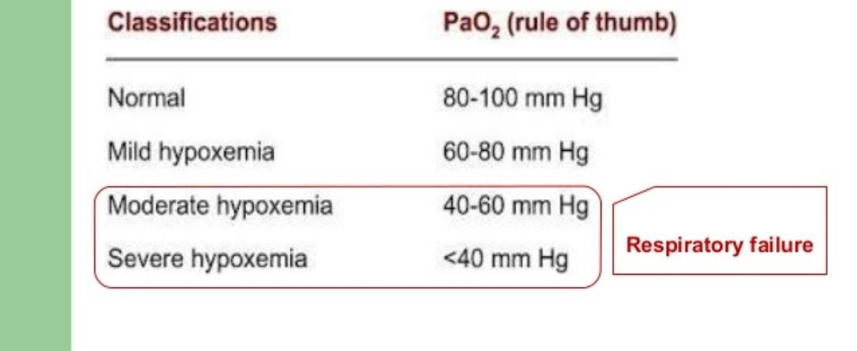
Hypoxemia is a low level of oxygen in the blood. It starts in blood vessels (( arteries)). Hypoxemia It's a sign of a problem in breathing or blood flow

Slide 7
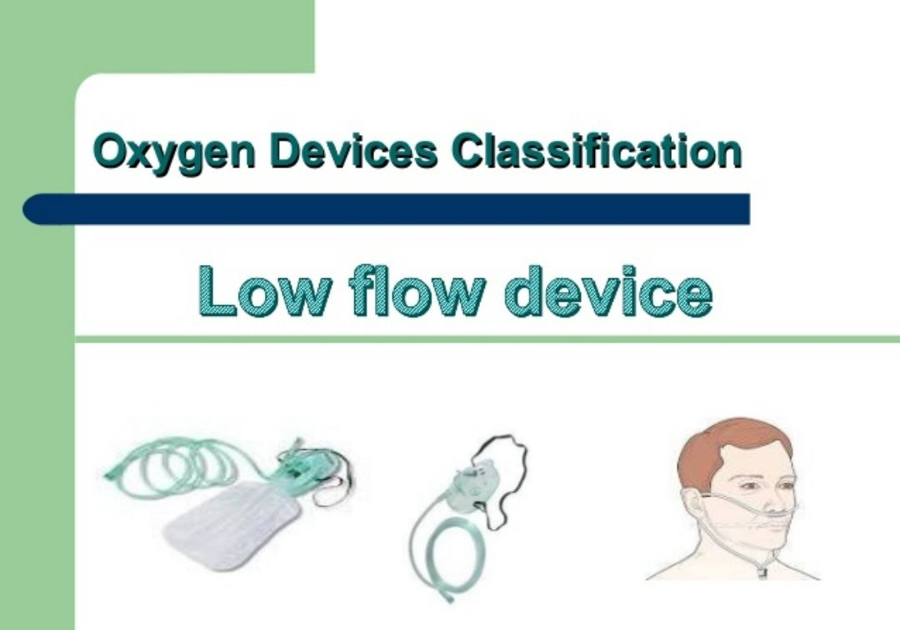

Slide 8
nasal cannula / nasal prongs
A nasal cannula is a medical device to provide supplemental oxygen therapy to people who have lower oxygen levels. There are two types of nasal cannulas: low flow and high flow. The device has two prongs and sits below the nose

Slide 9
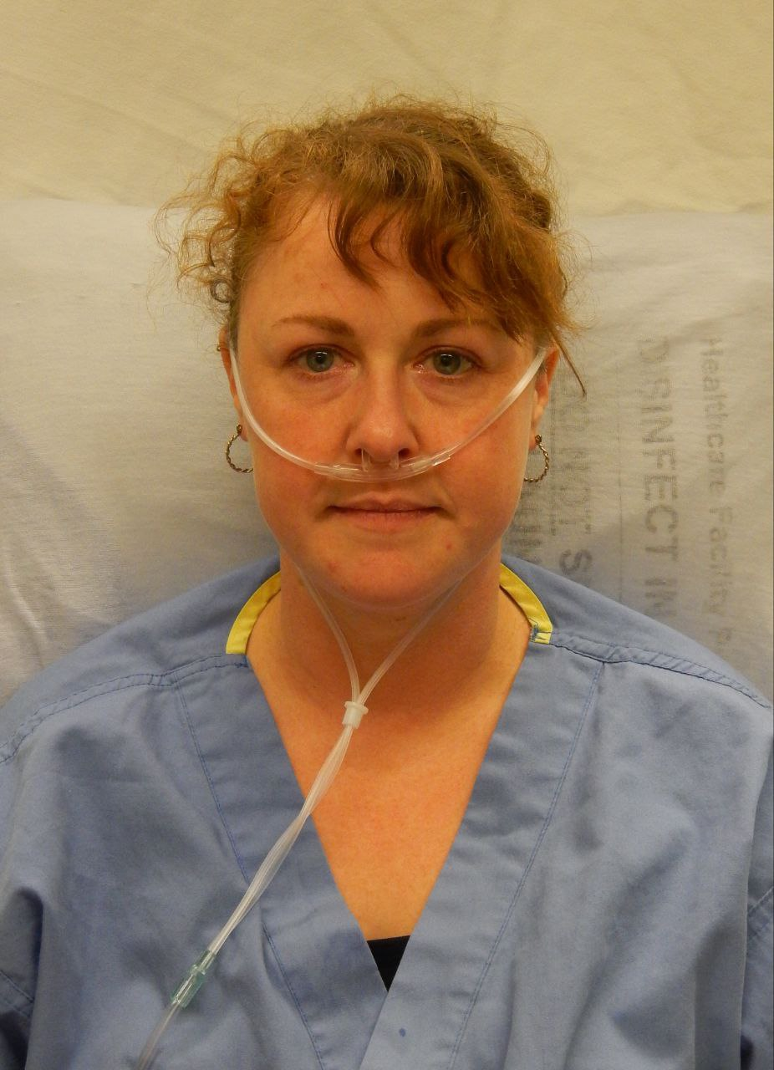
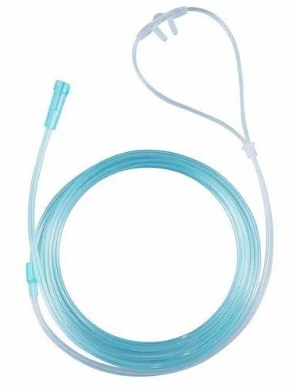

Slide 10
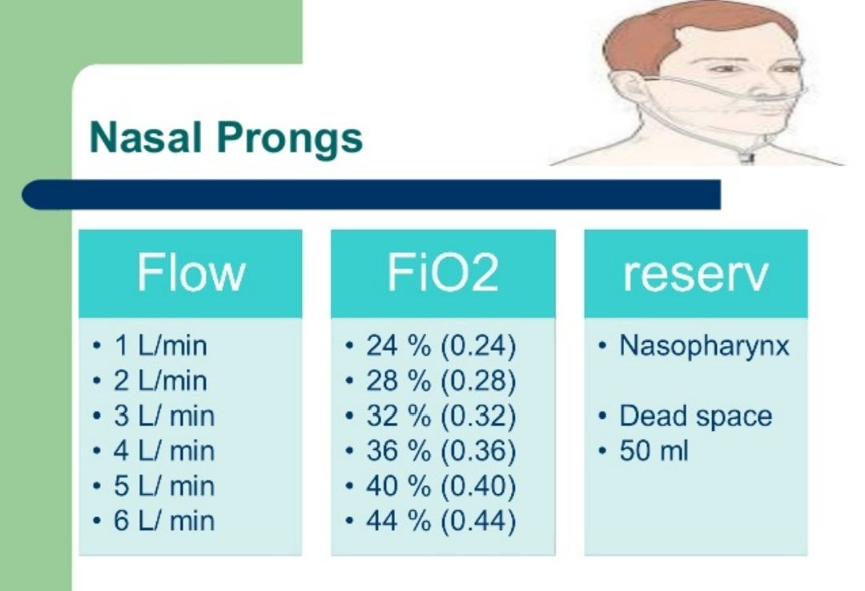

Slide 11
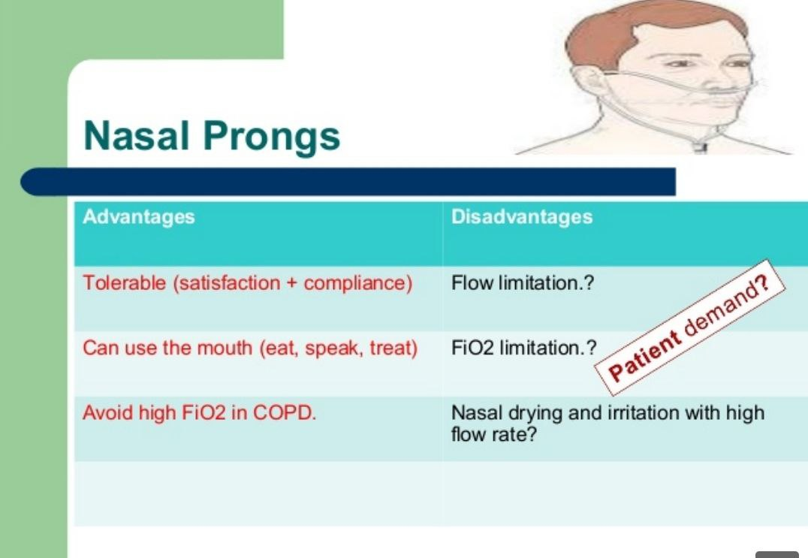

Slide 12
The simple face mask (SFM)
is a basic disposable mask, made of clear plastic, to provide oxygen therapy for patients who are experiencing conditions such as chest pain (possible heart attacks), dizziness, and minor hemorrhages

Slide 13
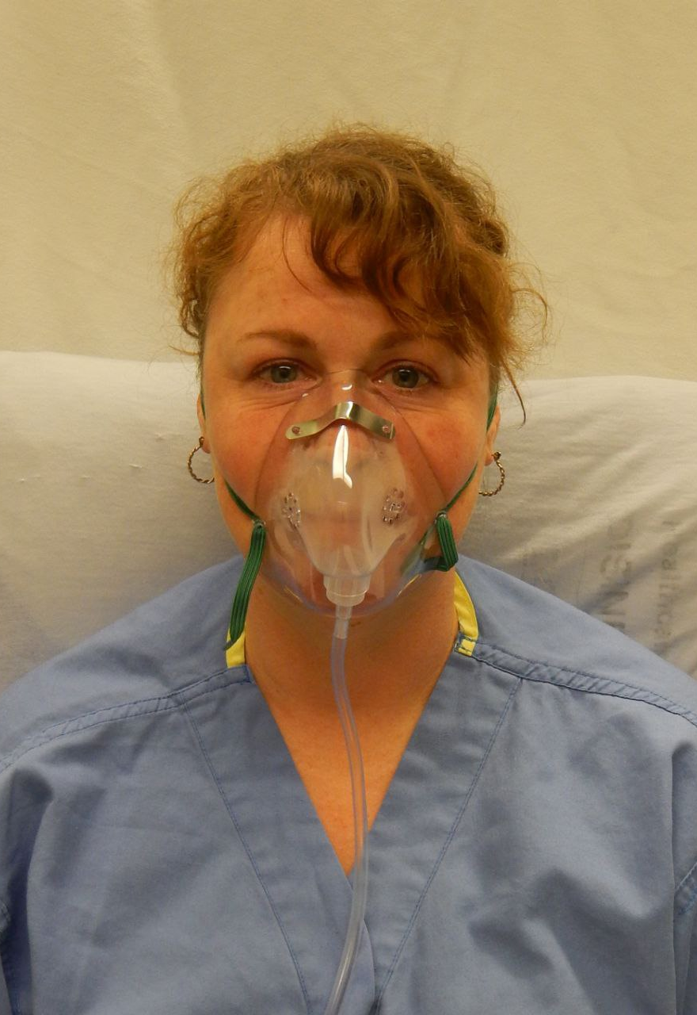
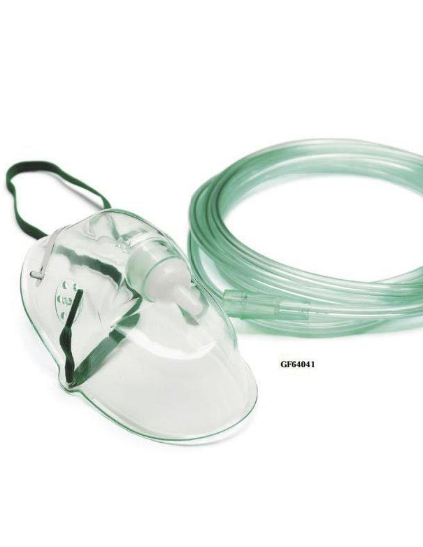

Slide 14
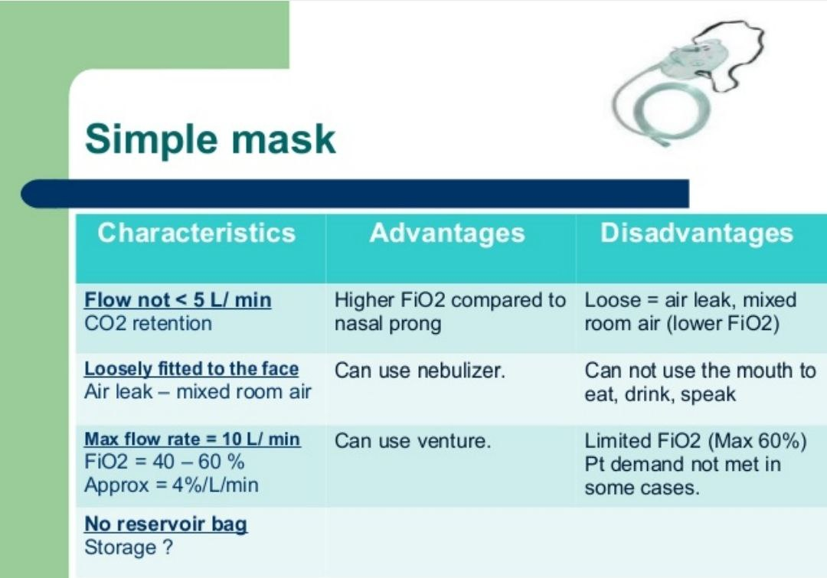

Slide 15
non-rebreather mask
is a special medical device that helps provide you with oxygen in emergencies. These masks help people who can still breathe on their own but need a lot of extra oxygen. Non-rebreather masks are used to treat several conditions

Slide 16
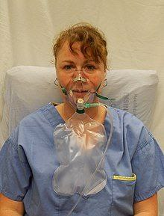
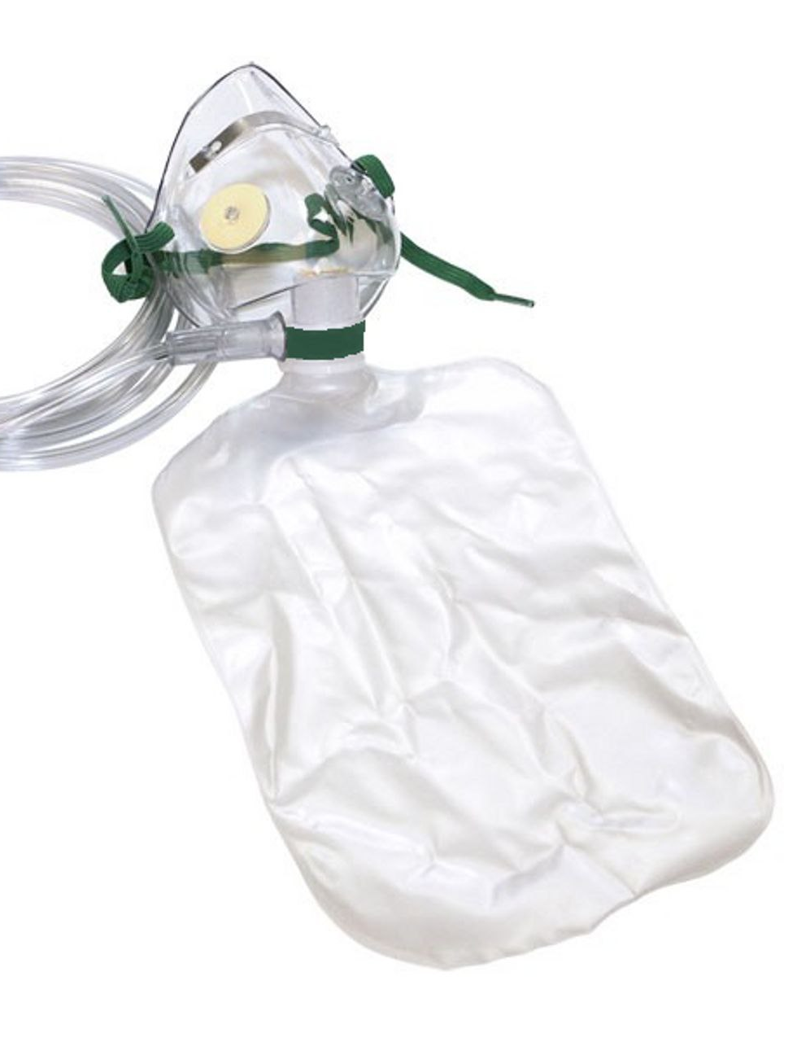

Slide 17
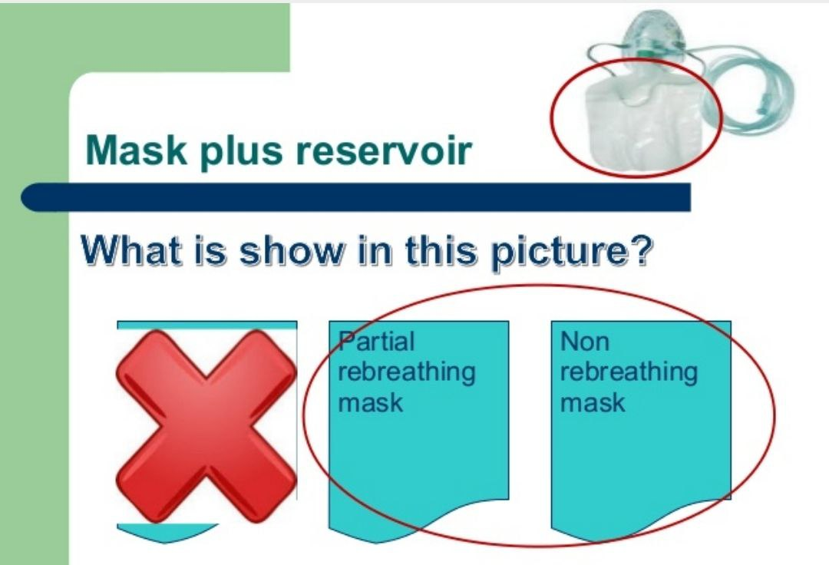

Slide 18
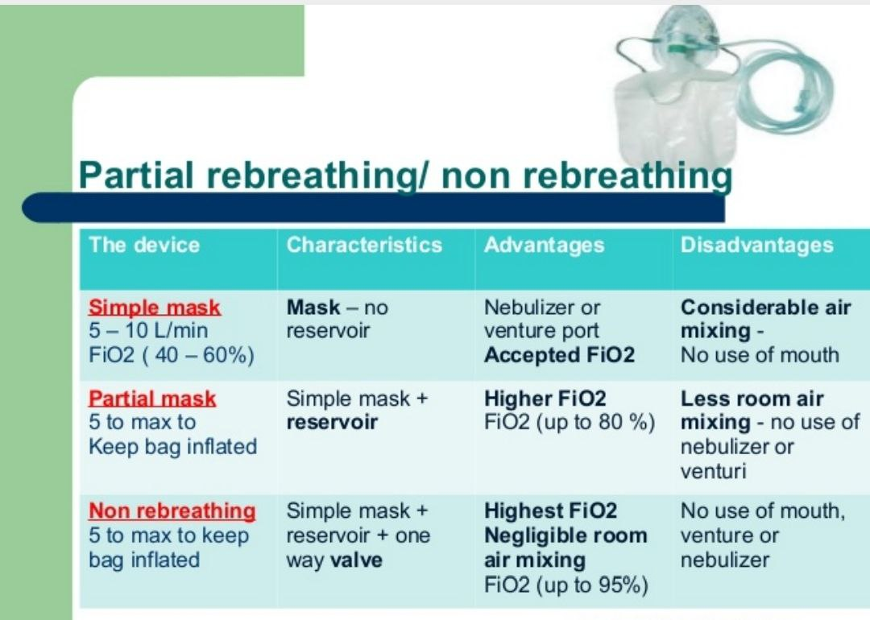

Slide 19
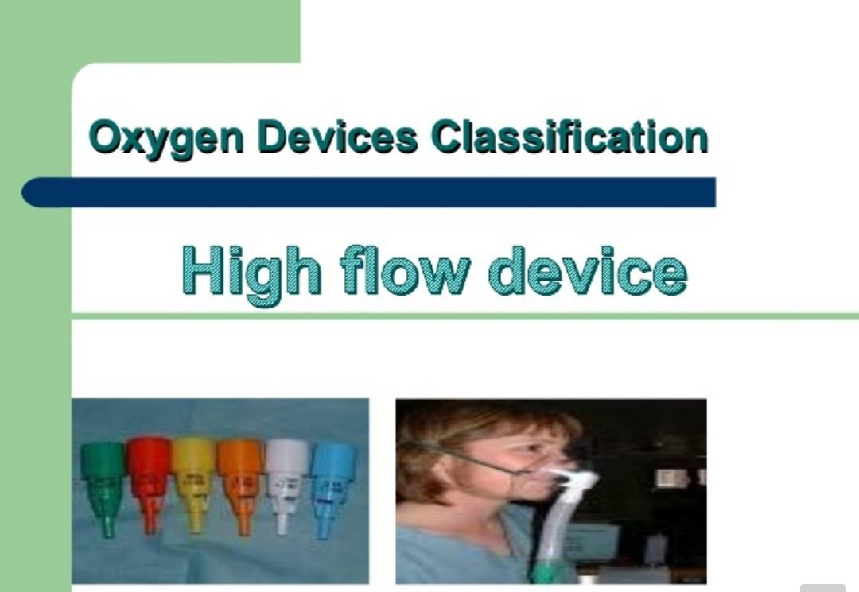

Slide 20
The Venturi mask
is a medical device to deliver a known oxygen concentration to patients on controlled oxygen therapy. The mask was invented by Moran Campbell at McMaster University Medical School as a replacement for intermittent oxygen treatment

Slide 21
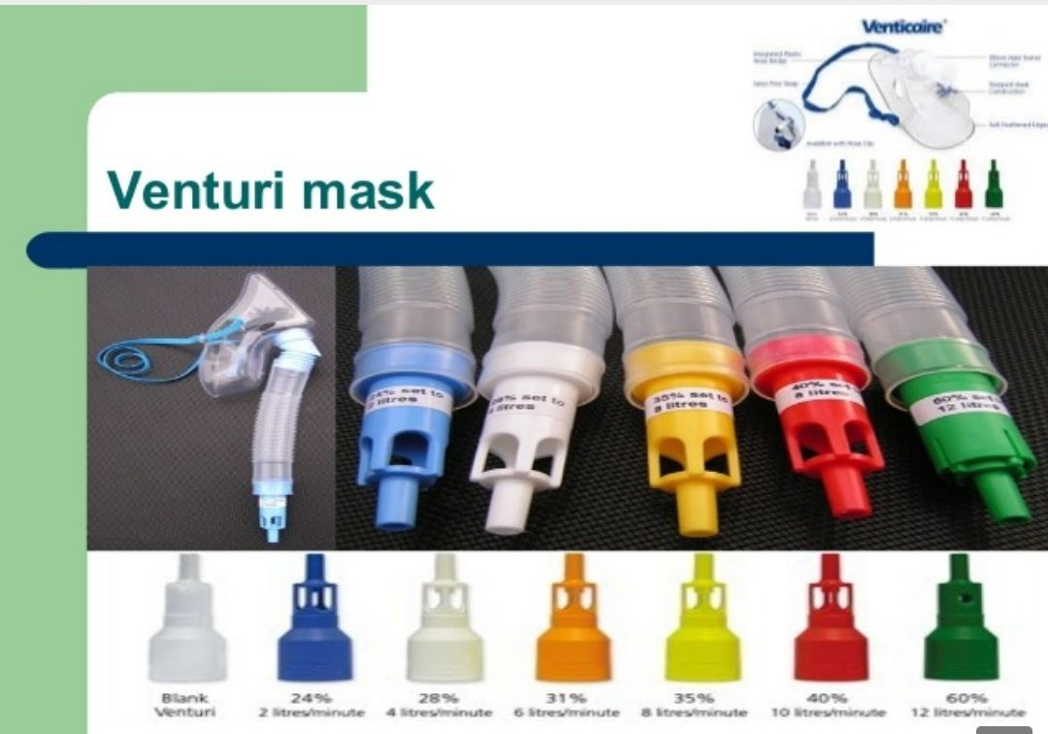

Slide 22
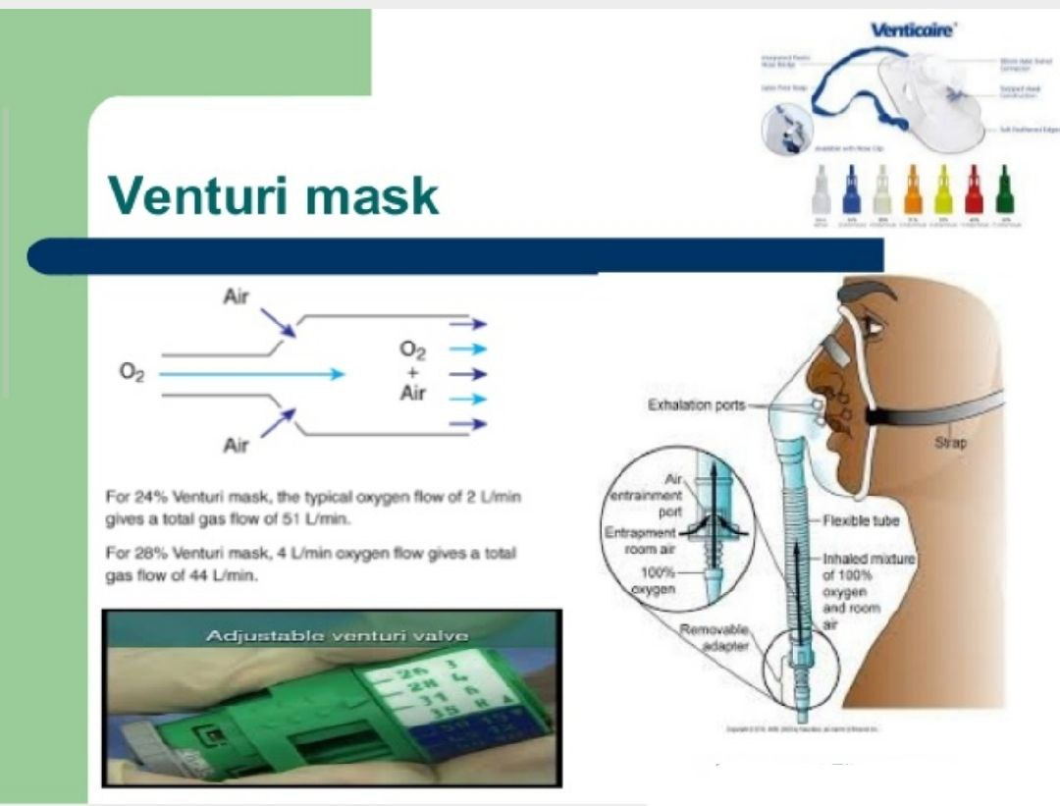

Slide 23
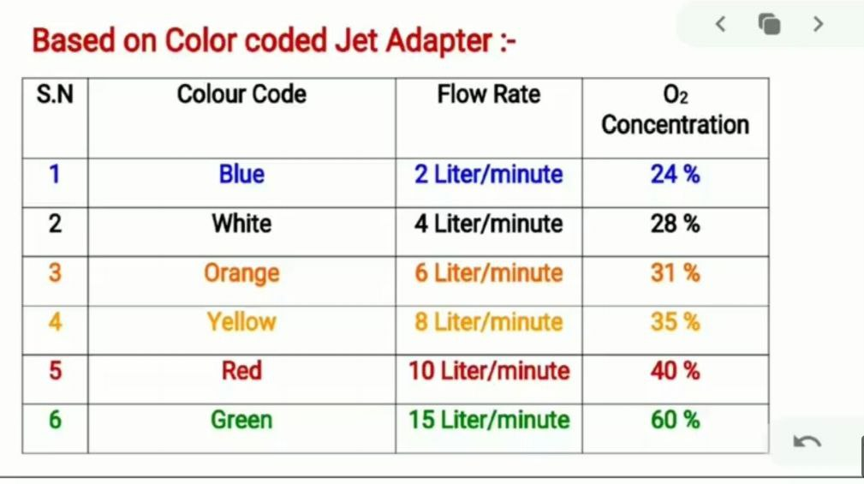

Slide 24
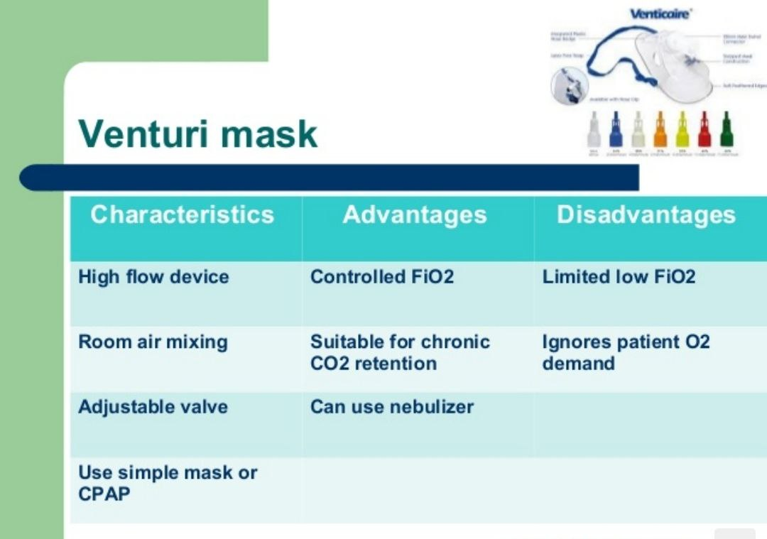

Slide 25
AMBU-bag
Bag Valve Mask (AMBU-bag). Used for manual ventilation of the patient in case of a respiratory emergency

Slide 26
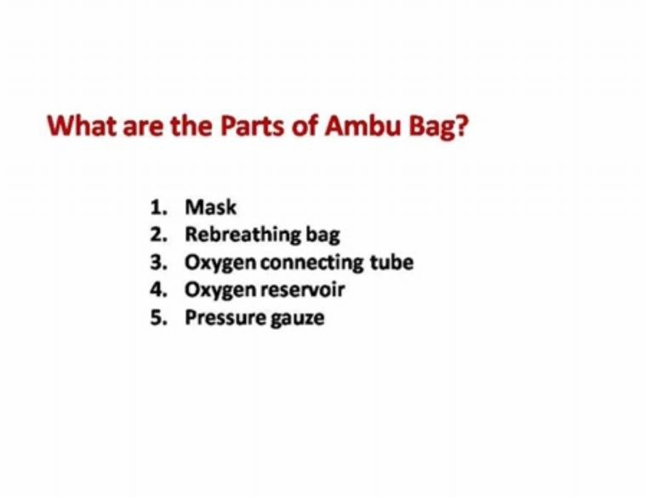

Slide 27
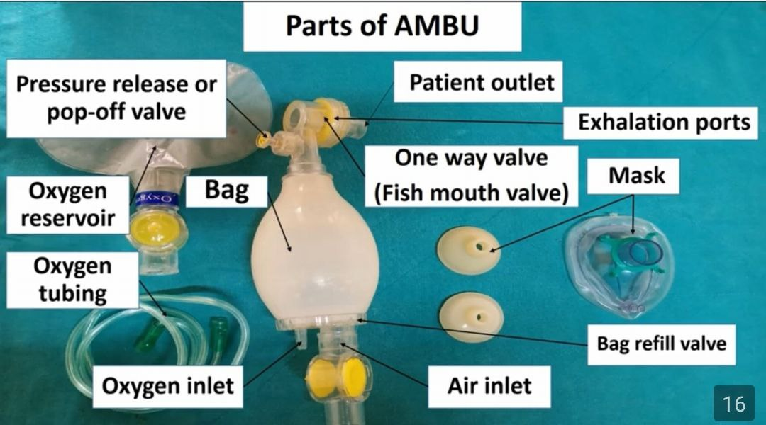

Slide 28
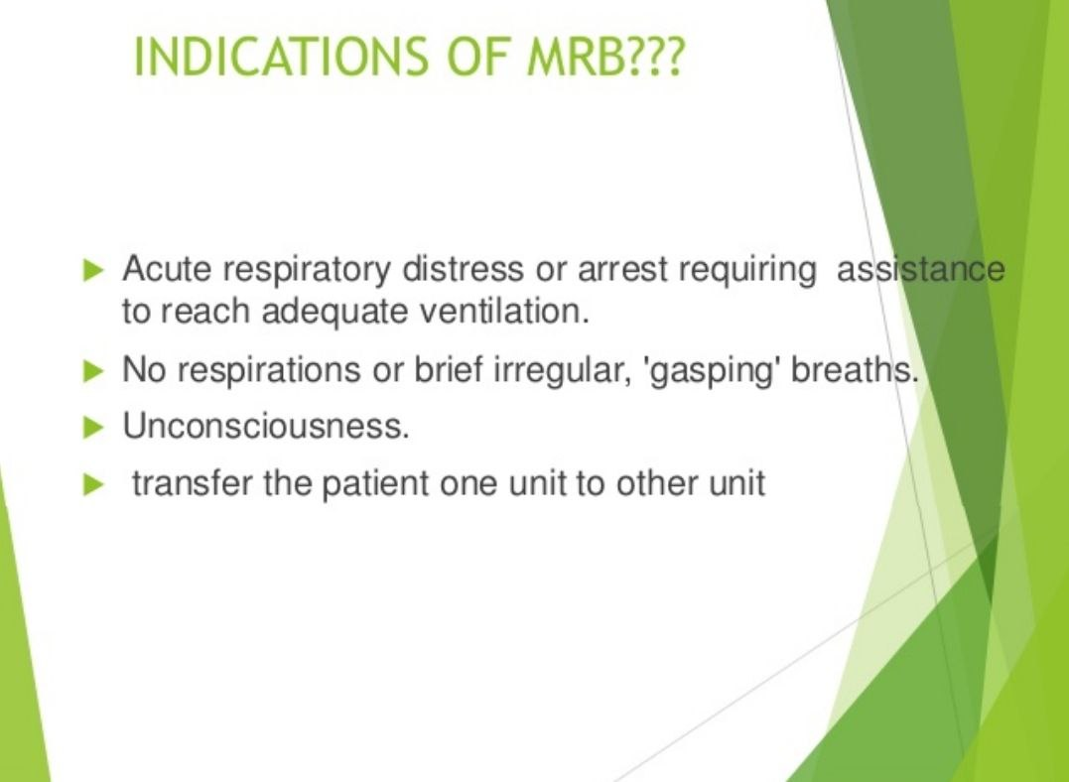

Slide 29
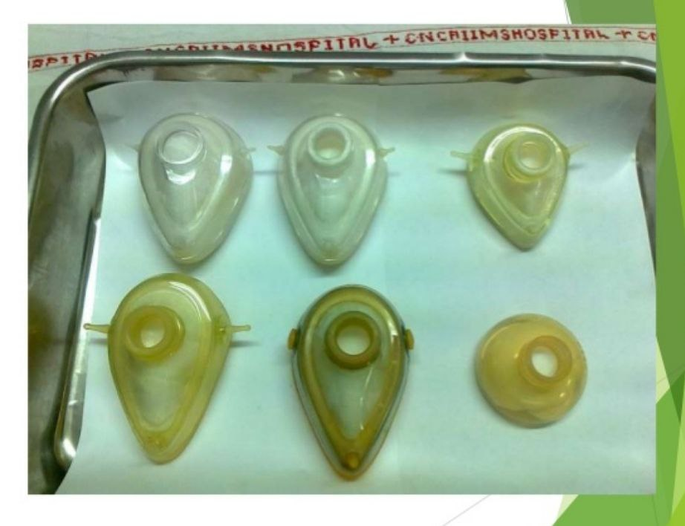

Slide 30
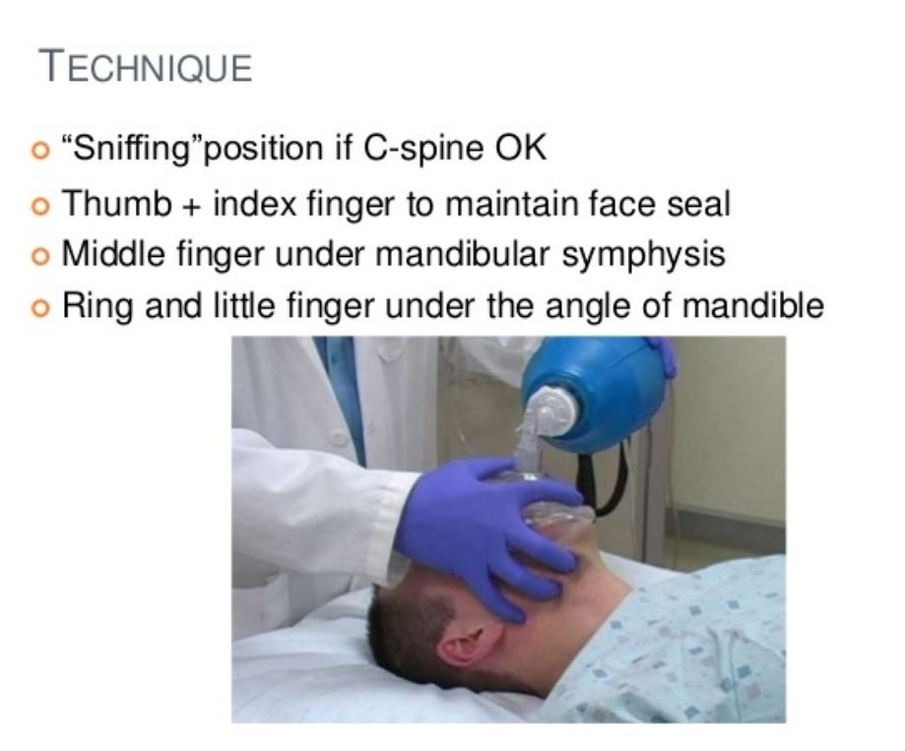

Slide 31
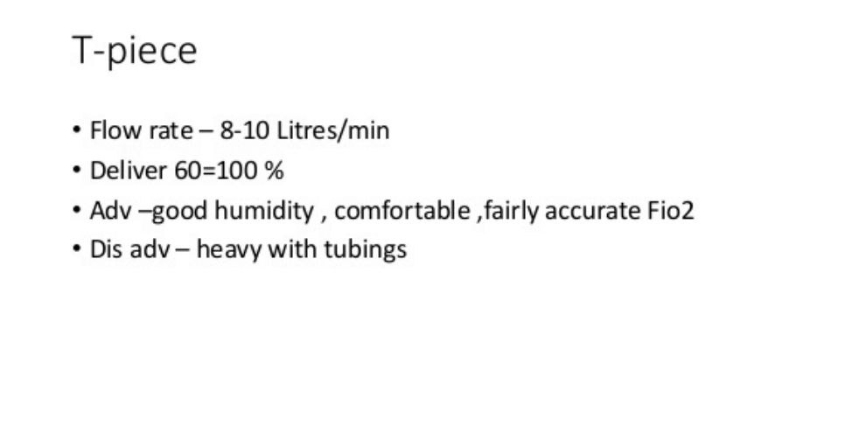

Slide 32
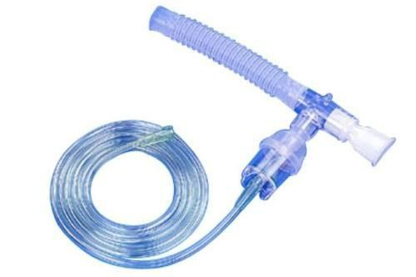

Slide 33
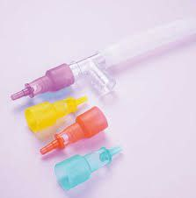

Slide 34


