Slide 1


ICU
L6
Anesthesia Technologist
BCS. Anesthesia. and IC
diploma. Community health
Karrar Nader AL-Taie
Anesthesia Technologist
BCS. Anesthesia. and IC
diploma. Community health
Muneer Salman Hasan

Slide 2
Clinical monitoring in ICU

Slide 3
Clinical monitoring in ICU
Intensive care unit (ICU) equipment includes: 1- patient monitoring
2- respiratory and cardiac support
3- pain management
4- emergency resuscitation devices, and other life support equipments.

Slide 4
PATIENT MONITORING EQUIPMENTS
1- Arterial line.
2-Blood pressure device (sphygmomanometer)
3- Blood pressure monitor
4-Electrocardiograph(ECG or EKG machine)
5- Electroencephalograph(EEG machine)
6- Intracranial pressure monitor
7- Pulse Oximeter
8- Glucometer.

Slide 5
LIFE SUPPORT AND EMERGENCY RESUSCITATION DEVICES:
1- Mechanical Ventilator
2- Laryngoscope
3- Airways
4- Infusion pump
5- Crash cart(Resuscitation cart)
6- Intra-aortic balloon pump
7- Continuous positive airway pressure machine (CPAP)
8- Defibrillator

Slide 6
Noninvasive Hemodynamic Monitoring
1-Noninvasive BP
2- Heart Rate, pulses
3- Mental Status
4- Skin Temperature
5- Capillary Refill
6- Urine Output

Slide 7
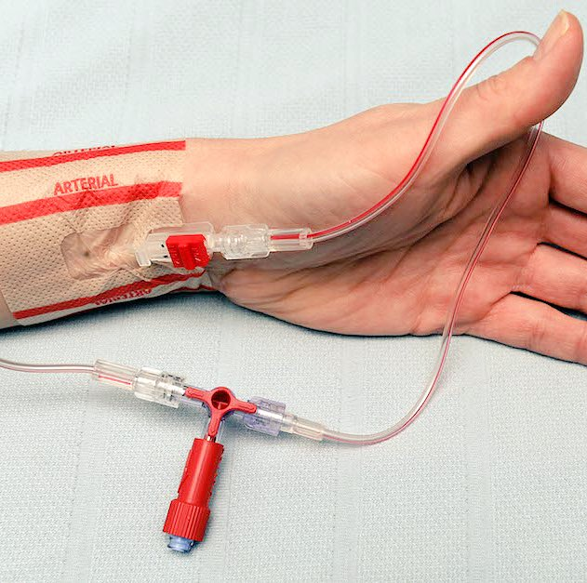
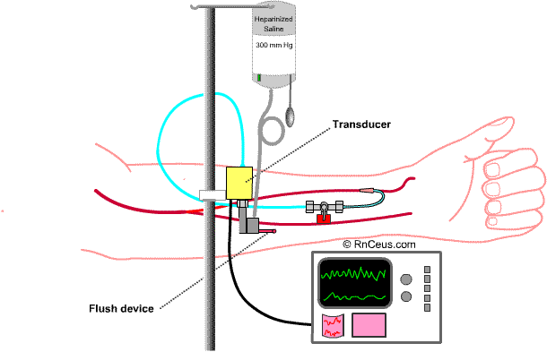
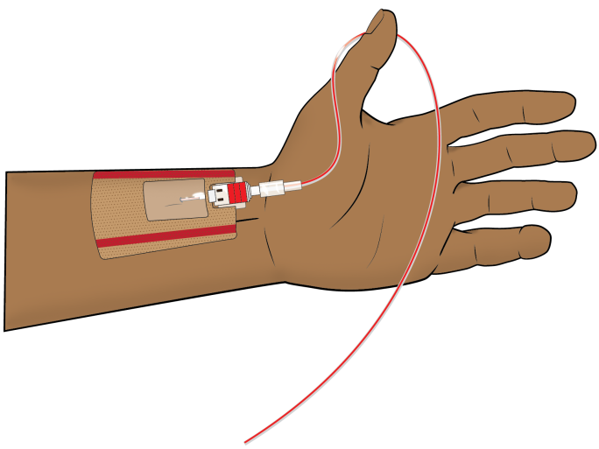
ARTERIAL LINE
ARTERIAL LINE DEFINITION: It is the method of direct continuous monitoring of systemic arterial pressure by inserting a catheter into peripheral artery either in arm or in leg.

Slide 8
Patients may require an arterial line for:
1.Monitoring continuous blood pressure especially in patients with hemodynamic instability.
2. When vasoactive medications are needed and the responses to such medications require continuous blood pressure monitoring.
3. For patients who require frequent blood sampling.

Slide 9
Complications Associated With
Arterial Lines
1-hemorrhage
2-air Emboli
3-infection
4- altered skin integrity
5- impaired circulation

Slide 10
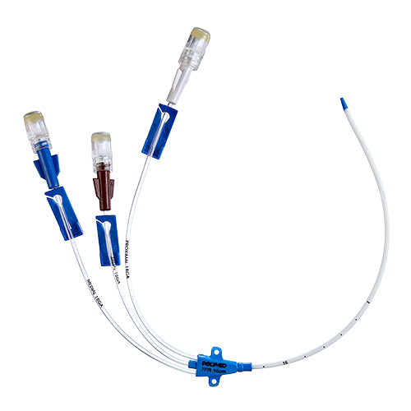
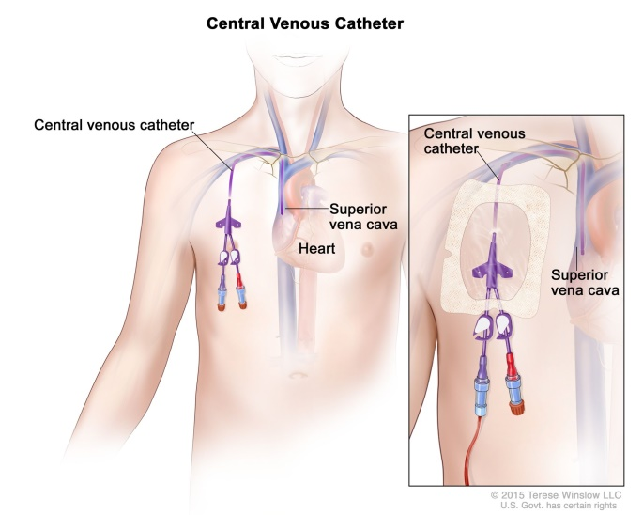
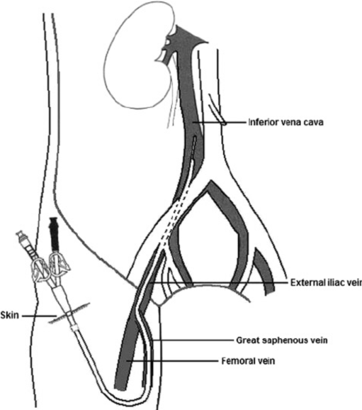
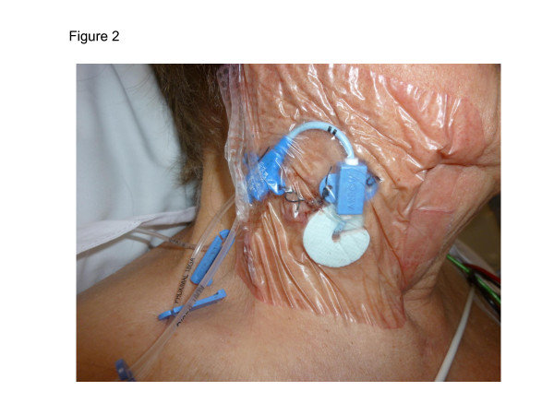
Central I.V catheters
A central venous catheter is a special IV line that is inserted into a large vein in the body. Several veins are used for including those located in the central venous catheters
Shoulder (subclavian vein)
Neck (jugular vein)
Groin ( femoral vein)

Slide 11
Purposes of central vein I.V catheter
when the patient either does not have adequate veins in the arms or needs special medications and/or nutrition that cannot be given through the smaller arm veins.
Serve as a guide of fluid balance in critically ill patients.
Determine the function of the right side of the heart.

Slide 12
Nurses role in patient with central I.V lines
1. Monitor for the signs of complications.
2. Assess for patency of the CVP line.
3. Sterile dressing should be done to prevent infection( CVP care per the hospital protocol)
4. The length of the indwelling catheter should be recorded and regularly monitored.
5. Follow strict aseptic technique when handling CVC.

Slide 13
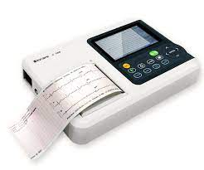
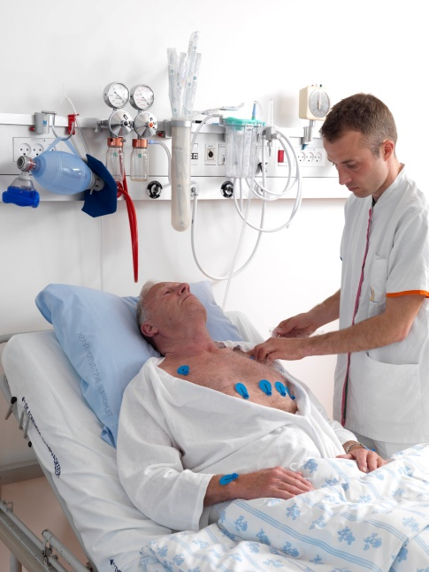
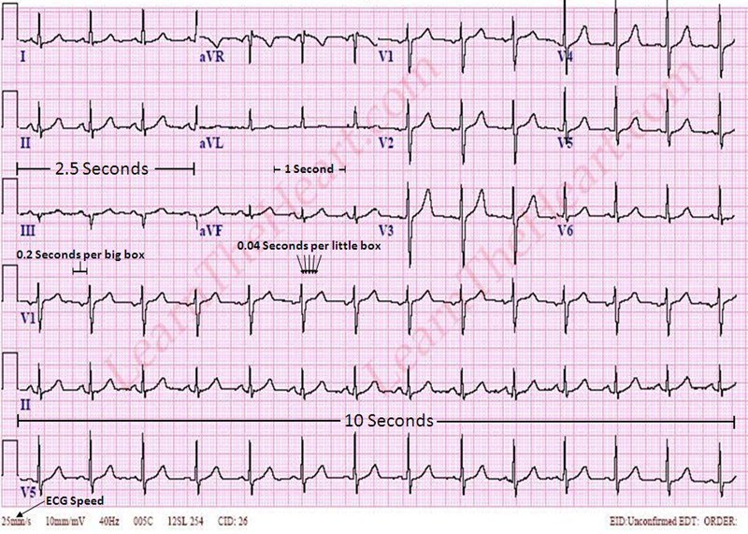
Electrocardiographic (ECG)
Electrocardiographic (ECG) monitoring is routinely used in hospitals for patients with a wide range of cardiac and non-cardiac diagnoses.
Besides simple monitoring of heart rate and detection of life-threatening arrhythmias, the goals of ECG monitoring include detection of myocardial ischaemia, diagnosis of complex arrhythmia, and identification of a prolonged QT interval.

Slide 14
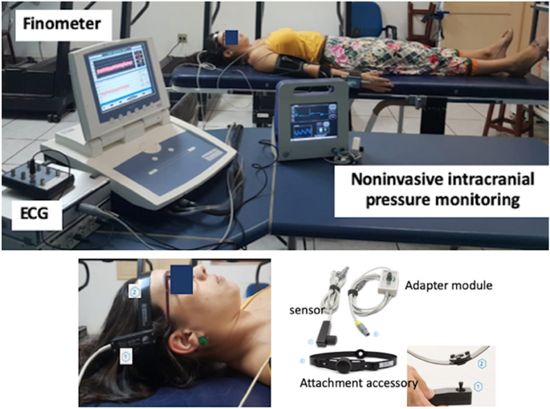
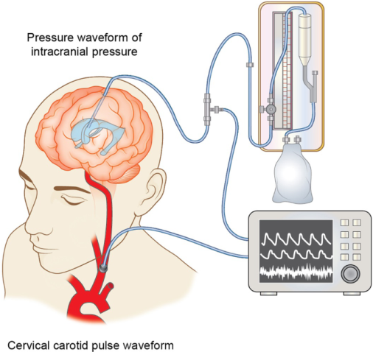
Intracranial pressure (ICP) monitor
Patients with brain injury of any etiology are at risk for developing increased intracranial pressure.
Acute intracranial hypertension is a medical emergency requiring immediate intervention to prevent permanent damage to the brain
Intracranial pressure (ICP) data from electronic monitoring equipment are usually calculated and recorded hourly in the clinical chart by trained nurses.

Slide 15
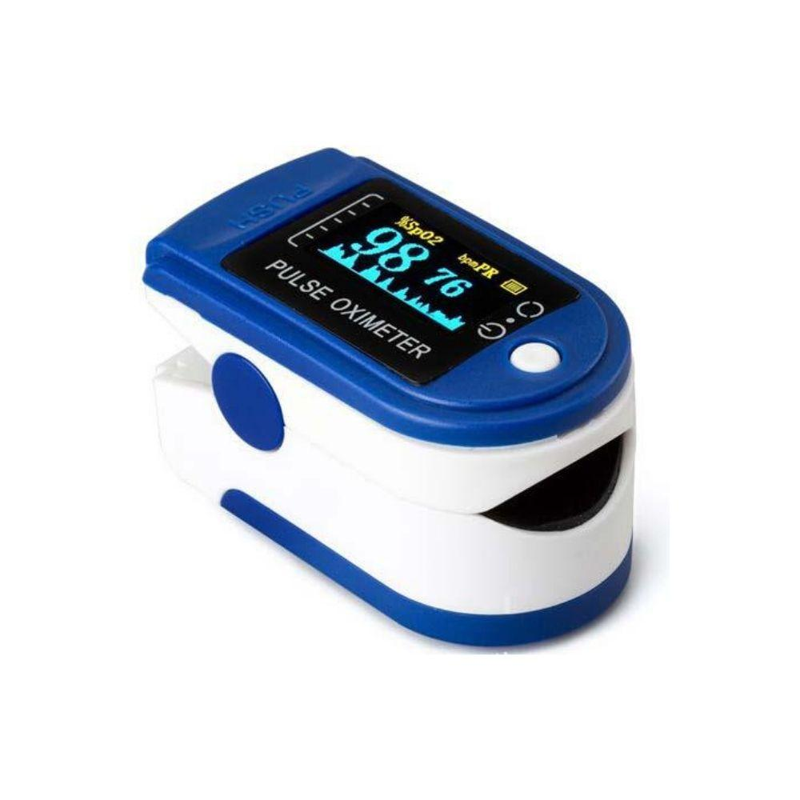
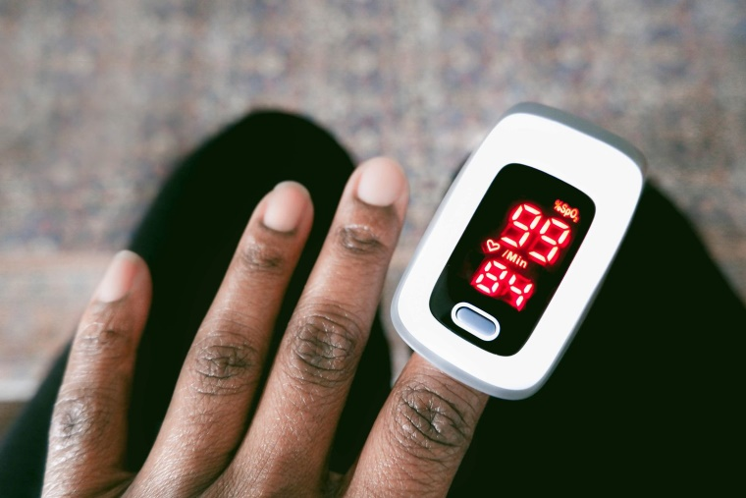
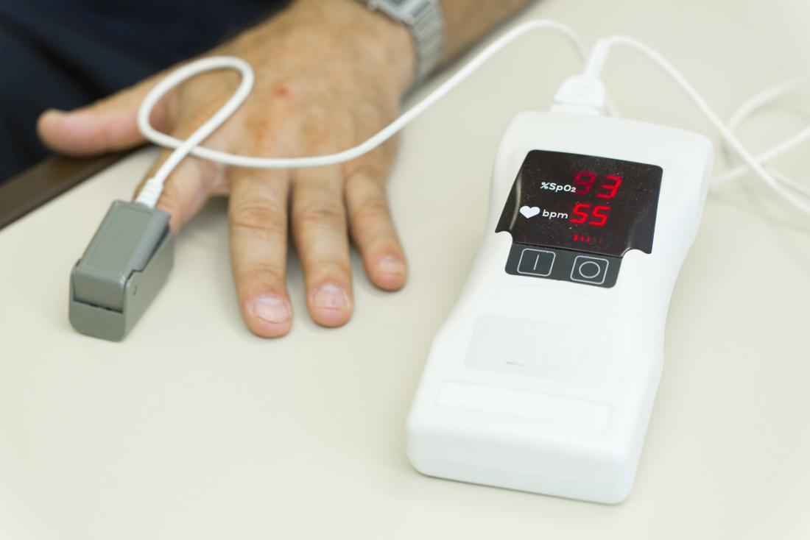
Pulse Oximetery
Pulse oximetry is universally used for monitoring patients in the critical care setting.
A pulse oximter is the device that measures and displays the oxygen arterial saturation and heart rate .

Slide 16
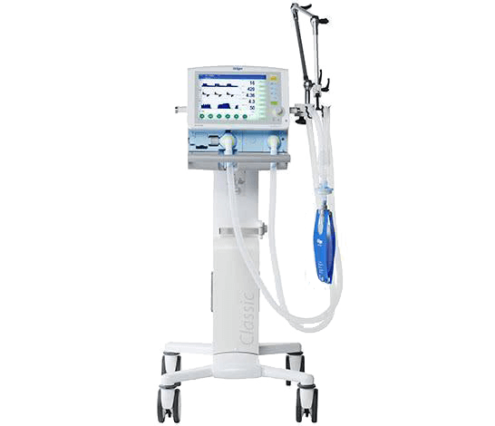
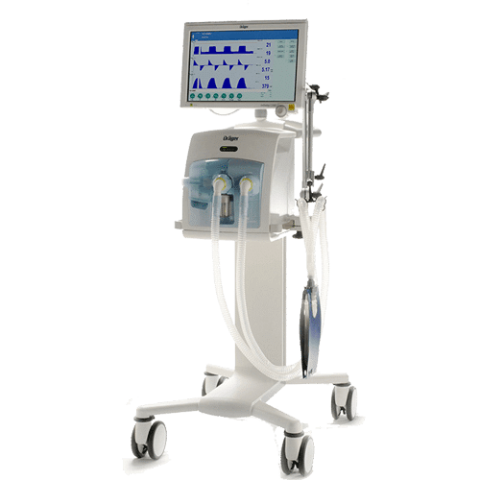
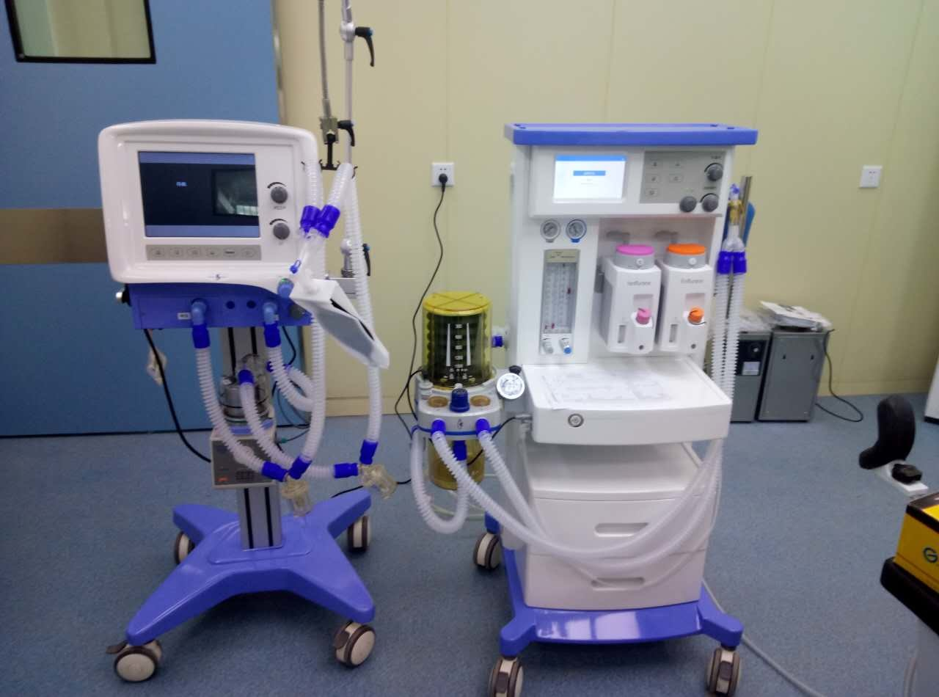
Mechanical ventilatilator
Mechanical ventilation may be required for a variety of reasons, including the need to control the patient's respirations during surgery or during treatment of severe head injury, to oxygenate the blood when the patient's ventilatory efforts are inadequate, and to rest the respiratory muscles.

Slide 17
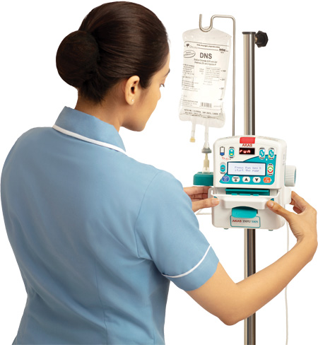
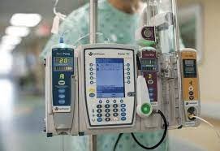
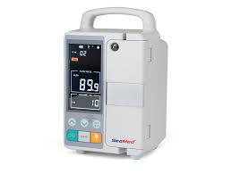
INFUSION PUMPS
An external infusion pump is a medical device used to deliver medications & fluids into a patient's body in a controlled manner.
Infusion pumps may be capable of delivering medications & fluids in large or small amounts, and may be used to deliver nutrients or medications-such insulin or other hormones, antibiotics, chemotherapy drugs, and pain relievers.

Slide 18
Nurses role in patient with I.V infusion pump
1-Using aseptic technique and universal precautions, iv infusion
2- should be set. Monitor the pump and patient frequently to ensure correct operation.
3- Keep the pump plugged in when possible to ensure that the battery is fully charged at all times.
4- Set the flow rate as prescribed calculating the amount of fluid.
5-Observe for the signs of infiltration or other complications such as thrombophlebitis.
6-Fluid or electrolyte overload and embolism before administration.

Slide 19
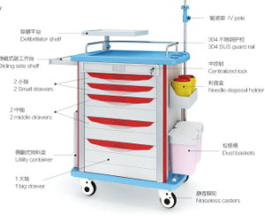
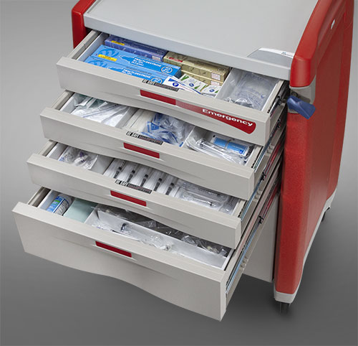
Resuscitation Cart (Crash Cart)
The Resuscitation cart contains all of the equipment and medications needed for advanced life support and CPR (cardiopulmonary resuscitation).

Slide 20
CONTENTS RESUSCITATION CART (CRASH CART)
- Monitor/defibrillators, suction devices, and bag valve mask s (BVMs) of different sizes.
- Advanced cardiac life support (ACLS) drugs such as
1. Epinephrine
2. Atropine
3. Amiodarone
4. Lidocaine
5. sodium bicarbonate
6. Dopamine and vasopressin.

Slide 21
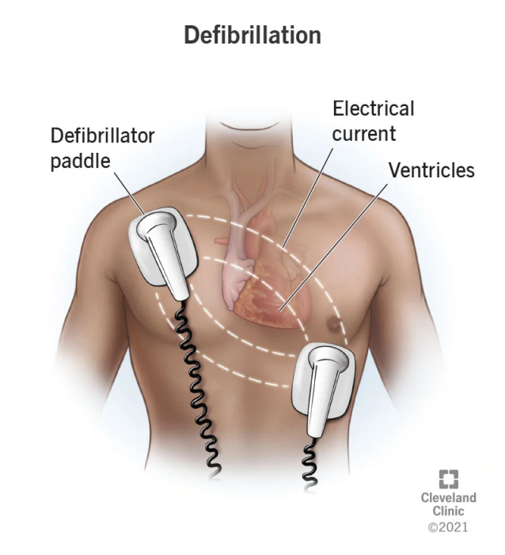
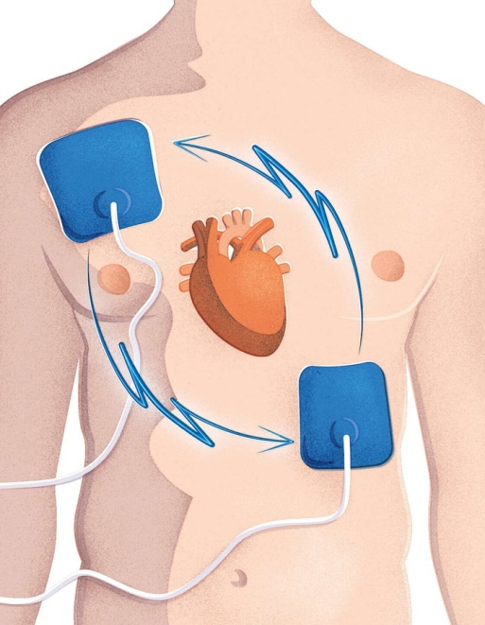
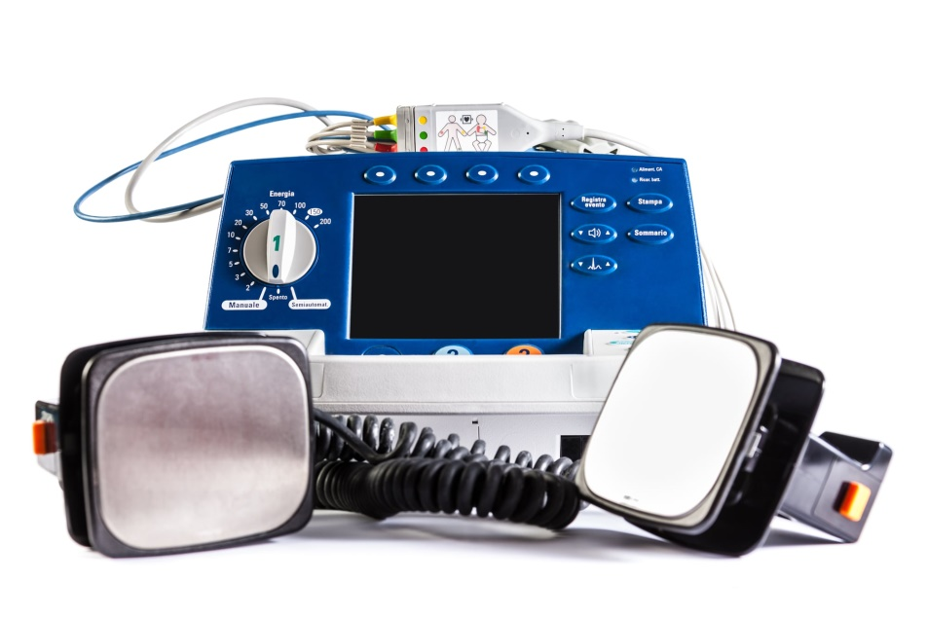
DEFIBRILLATOR
A defibrillator is a device that is designed to pass electrical current through a patient’s heart. The passing of electrical current through the heart is called defibrillation. A defibrillation is done through pads placed on the patient’s chest.

Slide 22
Purpose of DEFIBRILLATOR
A defibrillation is used to restore a patient's heart rhythm to normal. Abnormal heart rhythms may be treated with medications while other rhythms need to be treated with defibrillation.
Life threatening heart rhythms need defibrillation immediately while other heart rhythms may be defibrillated in a scheduled fashion.
Defibrillation may be done using the manual defibrillator or the automatic external defibrillator

