Slide 1


Artificial Intelligence
College of Engineering & Technology
Computer Techniques Engineering Department
Artificial Intelligence – Stage 3
Lecture 5
Solving Problems by Searching

Slide 2
Informed Search Strategies (Heuristic Search)
The informed (heuristic) search strategy uses problem specific knowledge beyond the definition of the problem to find solutions more efficiently.
Heuristic functions are the most common form in which additional knowledge of the problem is imparted to the search algorithm.
Greedy best-first search
A* search

Slide 3
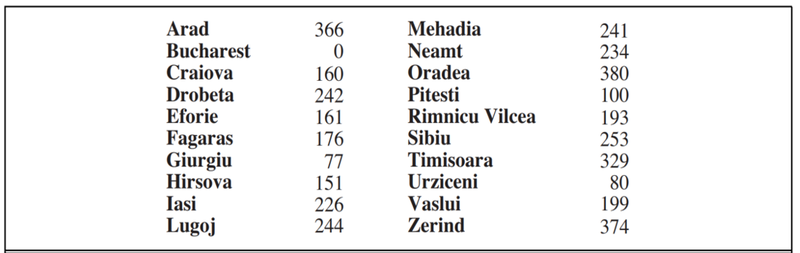
Greedy best-first Search
Greedy best-first search tries to expand the node that is closest to the goal.
It evaluates nodes by using heuristic function h(n).
For the route-finding problem in Romania ( Straight-line distance ) heuristic which we call hSLD.

Slide 4
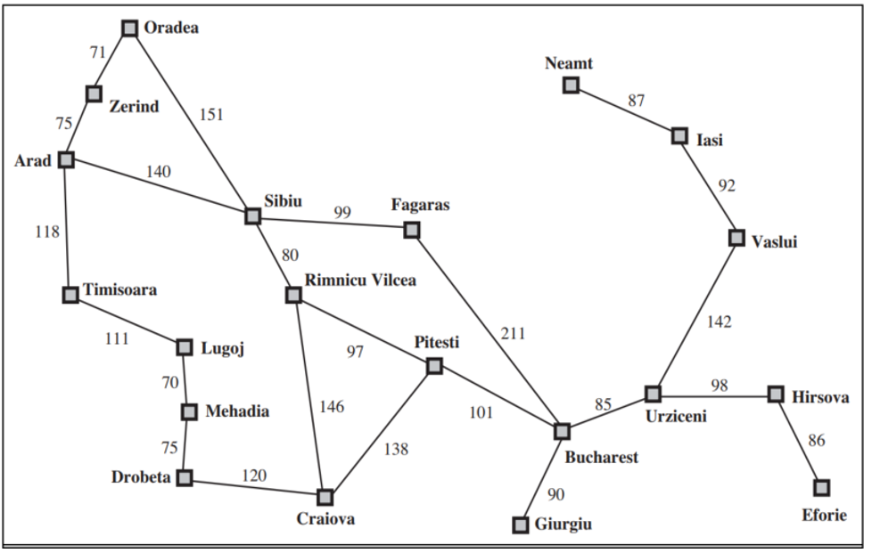
Greedy best-first Search
hSLD(In(Arad)) = 366 which cannot be computed from the problem description.

Slide 5
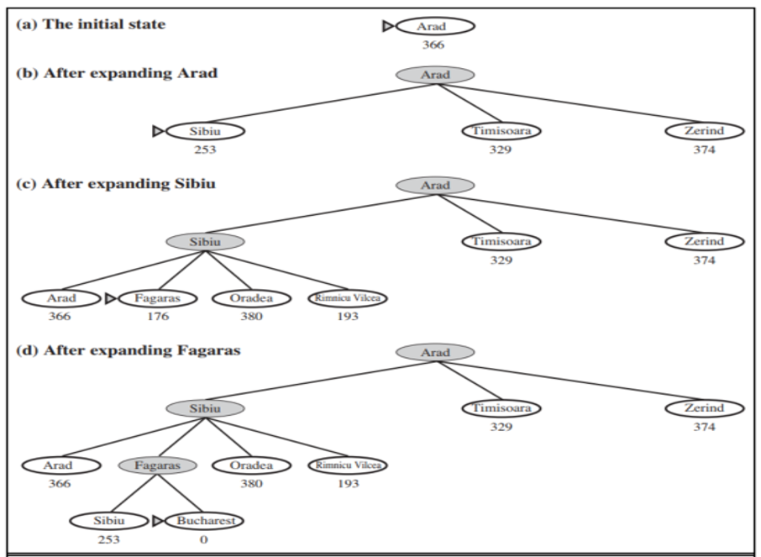
Greedy best-first Search
Figure below shows the progress of greedy best search using hSLD to find a path from Arad to Bucharest.

Slide 6

Greedy best-first Search
The first node to expanded from Arad will be Sibiu because is closer to Bucharest than either Zerind or Timisoara. The next node to expanded will be Fagaras because it is closest. Fagaras in turn generates Bucharest, which is the goal.
The search cost is minimal. It is not optimal
The path via Sibiu and Fagaras to Bucharest is 32 kilometers longer that the path through Rimnicu Vilcea and Pitesti.

Slide 7
Greedy best-first Search
This show why the algorithm is called greedy at each step it tries to get as close to the goal as it can.
Greedy best-first tree search is also incomplete.
Consider the problem of getting from Iasi to Fagaras.
The heuristic suggests that Neamt be expanded first because it is closest fo Fagaras, but it is a dead end.
The solution is to go first to Vaslui a step that is actually farther from the goal according the heuristic and then to continue to Urziceni, Bucharest, and Fagaras.
The algorithm will never find this solution, however, because expanding Neamt puts Iasi back inot the frontier, Iasi is closer to Fagaras than Vaslui is, and so Iasi will be expanded again, leading to an infinite loop.

Slide 8
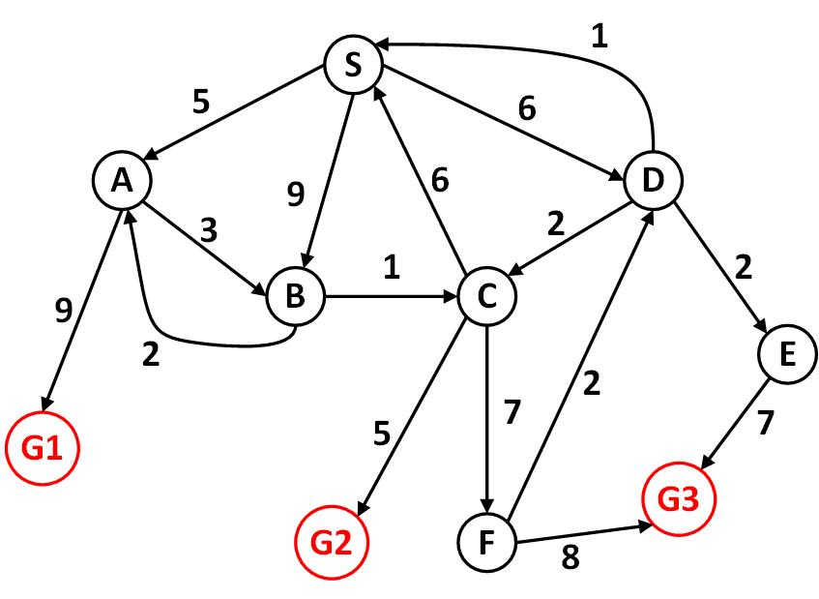
Greedy best-first Search
Find the path from S to a goal nod using Greedy best-first search and the give domain knowledge.
Cost to Goal Node
S | 5
A | 7
B | 3
C | 4
D | 6
E | 5
F | 6
G1,G2,G3 | 0

Slide 9
A* Search
A* search evaluates nodes by combining g(n), the cost to reach the node, and h(n), the cost to get from the node to the goal:
f(n) = g(n) + h(n)
since g(n) gives the path cost from the start node to node n, and h(n) is the estimated cost of the cheapest path from n to the goal, we have
f(n) = estimate cost of the cheapest solution through n.
A* search is both complete and optimal.

Slide 10
A* Search
The following figure explain how to travel from Arad to Bucharest using A* algorithm.

Slide 11
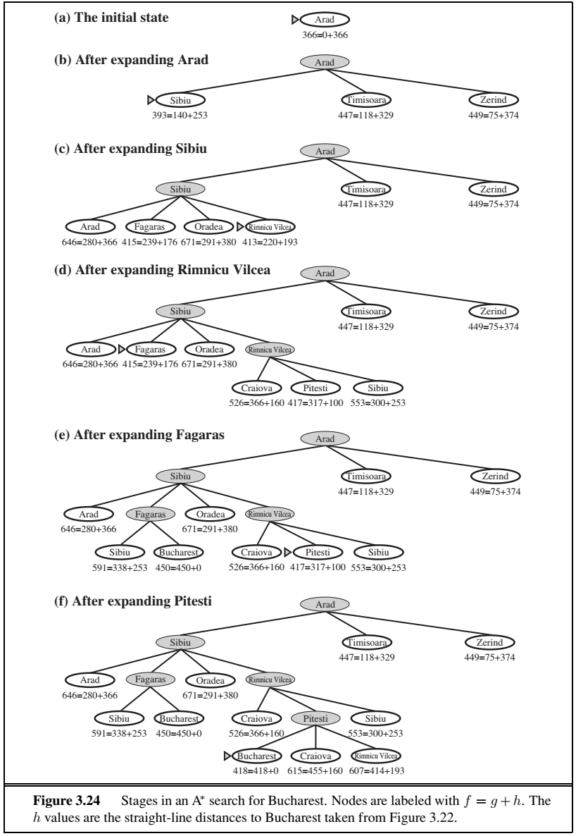
A* Search

Slide 12
A* Search
Find the path from S to a goal nod using A* search and the give domain knowledge.
Cost to Goal Node
S | 5
A | 7
B | 3
C | 4
D | 6
E | 5
F | 6
G1,G2,G3 | 0

Slide 13
Thanks for Your Attention

