Slide 1

Chapter 1
The Human Body: An Orientation
General Human Anatomy & Physiology
Dr. Zainab Hayder Alkufaishi
M.B.Ch.B F.I.C.M.S. Path.
2nd Year
Medical Intelligent System
₁st
Semester 2023-2024-

Slide 2
The Human Body – An Orientation
Anatomy – study of the structure and shape of the body and its parts
Physiology – study of how the body and its parts work or function

Slide 3
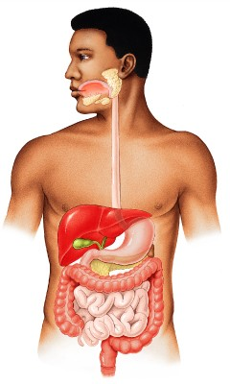
Anatomy – Levels of Study
Gross Anatomy
  Large structures
  Easily observable

Slide 4
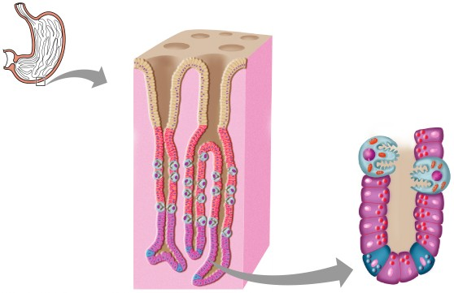
Anatomy – Levels of Study
Microscopic Anatomy
  Very small structures
  Can only be viewed with a microscope

Slide 5
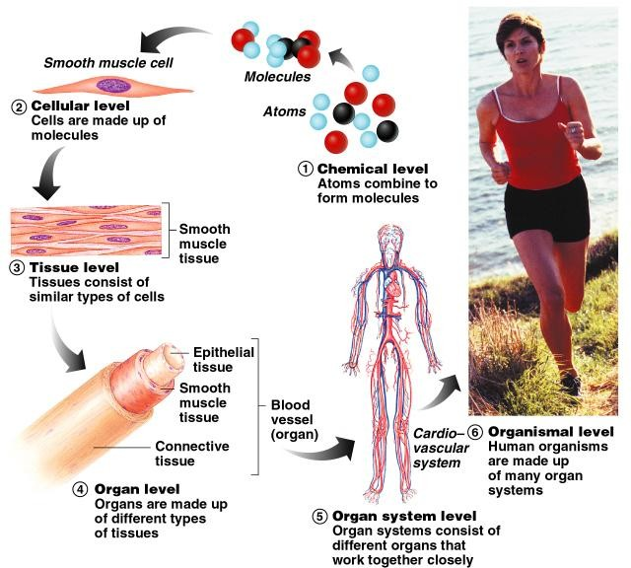
Levels of Structural Organization

Slide 6
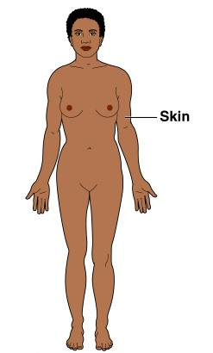
Organ System Overview
Integumentary
  Forms the external body covering
  Protects deeper tissue from injury and drying out
  Synthesizes vitamin D
  Location of cutaneous nerve receptors

Slide 7
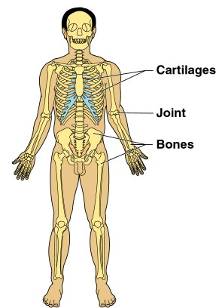
Organ System Overview
Skeletal
  Protects and supports body organs
  Provides muscle attachment for movement
  Site of blood cell formation
  Stores minerals

Slide 8
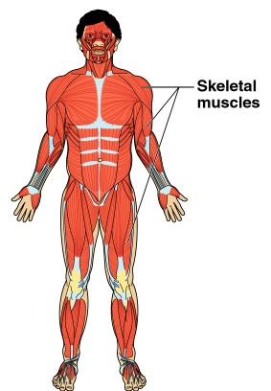
Organ System Overview
Muscular
  Allows locomotion
  Maintains posture
  Produces heat

Slide 9
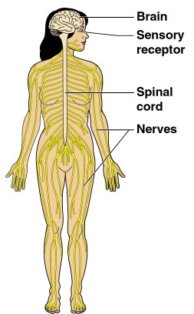
Organ System Overview
Nervous
  Fast-acting control system
  Responds to internal and external change
  Activates muscles and glands

Slide 10
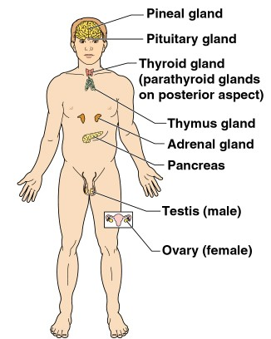
Organ System Overview
Endocrine
  Secretes regulatory hormones
    Growth
    Reproduction
    Metabolism

Slide 11
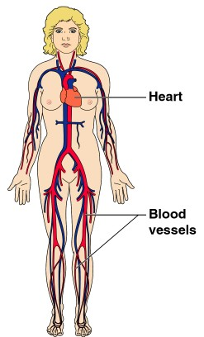
Organ System Overview
Cardiovascular
  Transports materials in body via blood pumped by heart
    Oxygen
    Carbon dioxide
    Nutrients
    Wastes

Slide 12
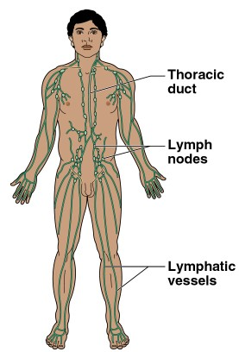
Organ System Overview
Lymphatic
  Returns fluids to blood vessels
  Disposes of debris
  Involved in immunity- destroys bacteria and tumor cells

Slide 13
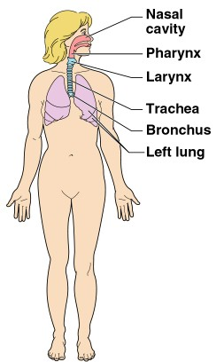
Organ System Overview
Respiratory
  Keeps blood supplied with oxygen
  Removes carbon dioxide

Slide 14
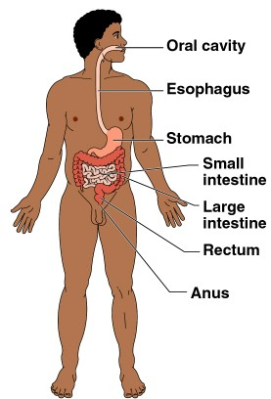
Organ System Overview
Digestive
  Breaks down food
  Allows for nutrient absorption into blood
  Eliminates indigestible material

Slide 15
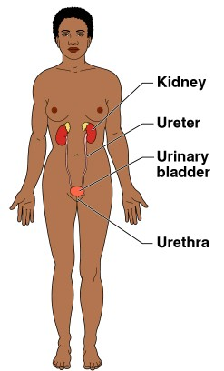
Organ System Overview
Urinary
  Eliminates nitrogenous wastes
  Maintains acid – base balance
  Regulation of materials
    Water
    Electrolytes

Slide 16
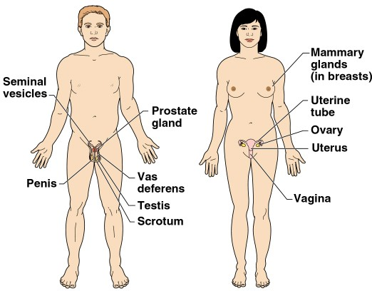
Organ System Overview
Reproductive
  Production of offspring

Slide 17
Necessary Life Functions
Maintain Boundaries- keeps the body’s internal environment
distinct from the external environment- the skin and membranes
Movement
  Locomotion
  Movement of substances
Responsiveness
  Ability to sense changes and react
Digestion
  Break-down and delivery of nutrients

Slide 18
Necessary Life Functions
Metabolism – all chemical reactions within the body
  Production of energy
  Making body structures
Excretion
  Elimination of waste from metabolic reactions

Slide 19
Necessary Life Functions
Reproduction
  Production of future generation
  Provides new cells for growth and repair
Growth
  Increasing of cell size and number

Slide 20
Survival Needs
Nutrients
  Chemicals for energy and cell building
  Includes carbohydrates, proteins, lipids, vitamins, and minerals
Oxygen
  Required for chemical reactions

Slide 21
Survival Needs
Water
  60–80% of body weight
  Provides for metabolic reaction
Stable body temperature
Atmospheric pressure must be appropriate

Slide 22
Homeostasis
Maintenance of a stable internal environment = a dynamic state of equilibrium
Homeostasis must be maintained for normal body functioning and to sustain life
Homeostatic imbalance – a disturbance in homeostasis resulting in disease

Slide 23
Maintaining Homeostasis
The body communicates through neural and hormonal control systems
  Receptor
    Responds to changes in the environment (stimuli)
    Sends information to control center

Slide 24
Maintaining Homeostasis
Control center
  Determines set point
  Analyzes information
  Determines appropriate response
Effector
  Provides a means for response to the stimulus

Slide 25
Homeostasis
Stable operating conditions in the internal environment
Three components interact
STIIgULUs (input into the system)
RECEPFOR
(e.g., free nerve ending in the skin)
INTEGRATOR
(such as
the brain)
EVER
(amuscle
or a gland)
RESPONSE
(system's output}
*----,
The response to the stimulus leads to change The change is “fed back” to the receptor. In negative feedback, the response of the system cancels or counteracts the effect of the original stimulus.

Slide 26
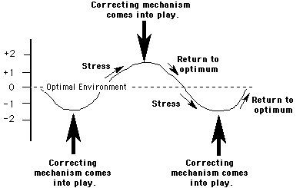
Feedback Mechanisms
Negative feedback
  Includes most homeostatic control mechanisms
  Shuts off the original stimulus, or reduces its intensity
  Works like a
household thermostat

Slide 27
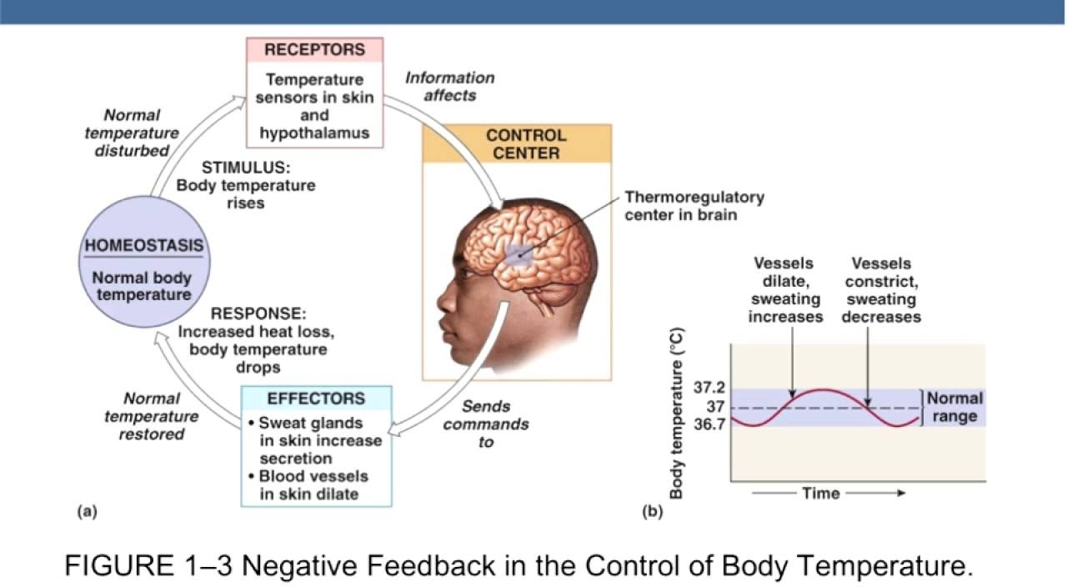

Slide 28
Feedback Mechanisms
Positive feedback
  Increases the original stimulus to push the variable farther
  In the body this only occurs in blood clotting and birth of a baby

Slide 29
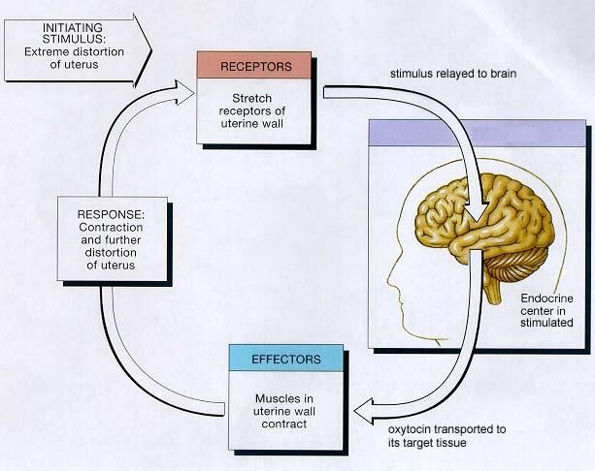

Slide 30
The Language of Anatomy
Special terminology is used to prevent misunderstanding
Exact terms are used for:
  Position
  Direction
  Regions
  Structures

Slide 31
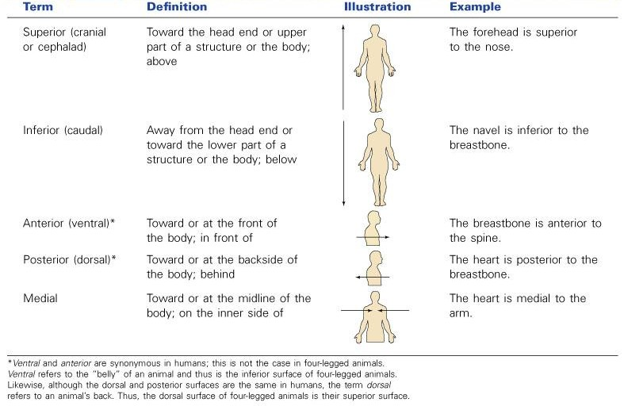
Orientation and Directional Terms
Table 1.1

Slide 32
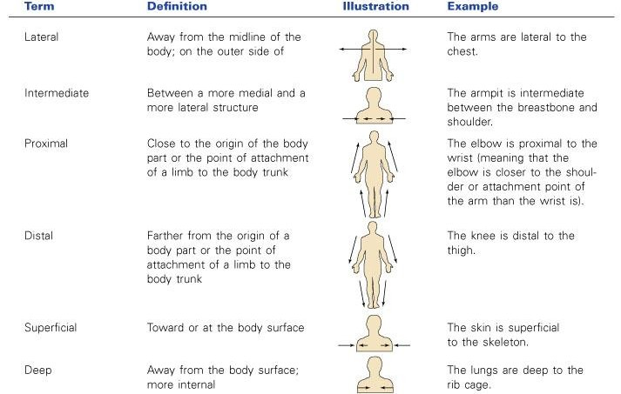
Orientation and Directional Terms

Slide 33
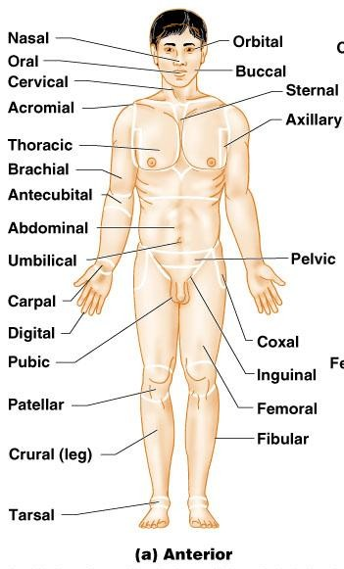
Body Landmarks
Anterior

Slide 34
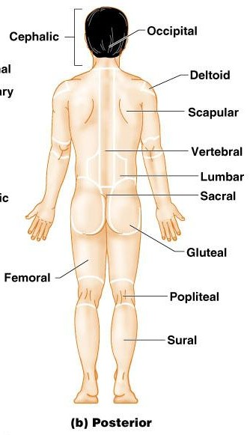
Body Landmarks
Posterior

Slide 35
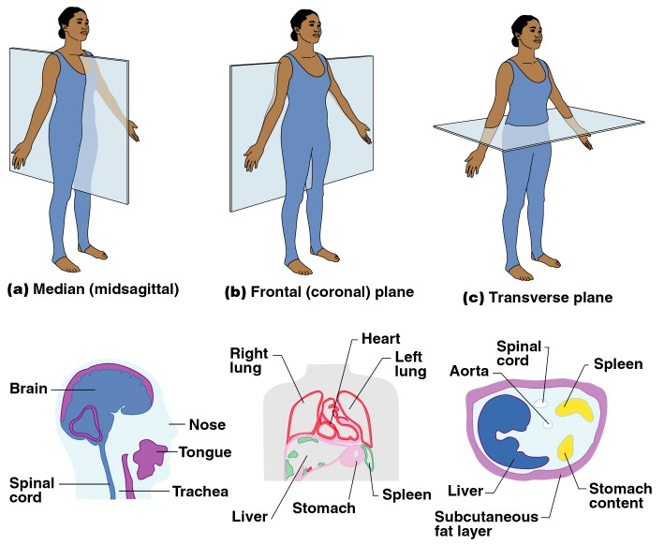
Body Planes

Slide 36
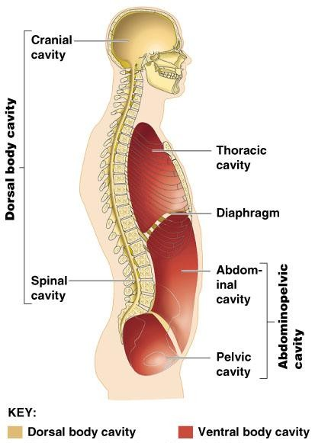
Body Cavities

Slide 37
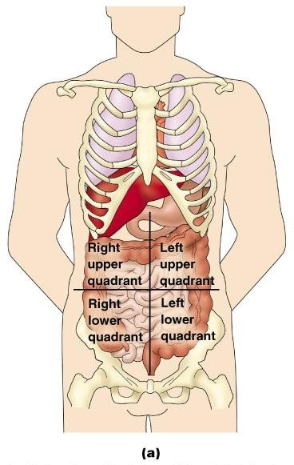
Abdominopelvic Quadrants

Slide 38
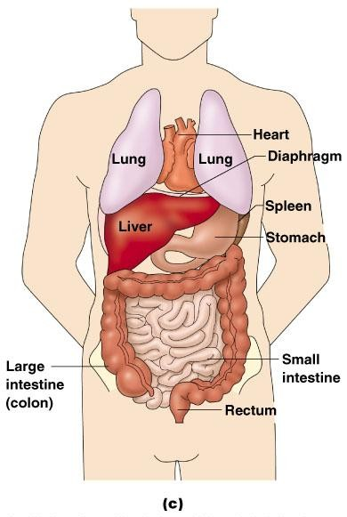
Abdominopelvic Major Organs

Slide 39
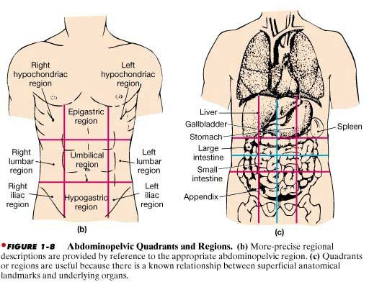

Slide 40


Slide 41


