Slide 1

General Human Anatomy & Physiology
Chapter 2
Cells and Tissues
Dr. Zainab Hayder Alkufaishi
M.B.Ch.B F.I.C.M.S. Path.
2nd Year
Medical Intelligent System
t
1st Semester 2023-2024

Slide 2
Learning Objectives
Describe how cells are organized into tissues, and identify the intercellular junctions in tissues.
List and describe cell organelles and their function.
Explain cell division stages and DNA replication
List the four major tissue types in the body.
Compare and contrast the cellular components, structures, fibers, and extracellular matrix in each type of connective tissue.
Distinguish among the three types of muscle tissue.
Describe the general characteristics and functions of nervous tissue.

Slide 3
Cells and Tissues
Carry out all chemical activities needed to sustain life
Cells are the building blocks of all living things
Tissues are groups of cells that are similar in structure and function

Slide 4
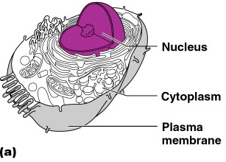
Anatomy of the Cell
Cells are not all the same
All cells share general structures
Cells are organized into three main regions
  Nucleus
  Cytoplasm
  Plasma membrane

Slide 5
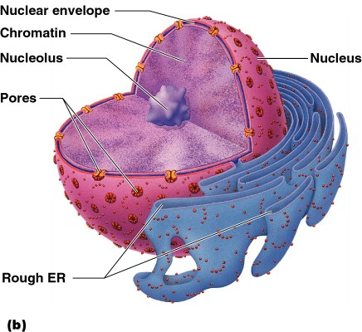
The Nucleus
Control center of the cell
  Contains genetic material (DNA)
Three regions
  Nuclear membrane
  Nucleolus
  Chromatin

Slide 6
Nuclear Membrane
Barrier of nucleus
Consists of a double phospholipid membrane
Contain nuclear pores that allow for exchange of material with the rest of the cell

Slide 7
Nucleoli
Nucleus contains one or more nucleoli
Sites of ribosome production
  Ribosomes then migrate to the cytoplasm through nuclear pores

Slide 8
Chromatin
Composed of DNA and protein
Scattered throughout the nucleus
Chromatin condenses to form chromosomes when the cell divides

Slide 9
Plasma Membrane
Barrier for cell contents
Double phospholipid layer
  Hydrophilic heads
  Hydrophobic tails
Other materials in plasma membrane
  Protein
  Cholesterol
  Glycoproteins

Slide 10
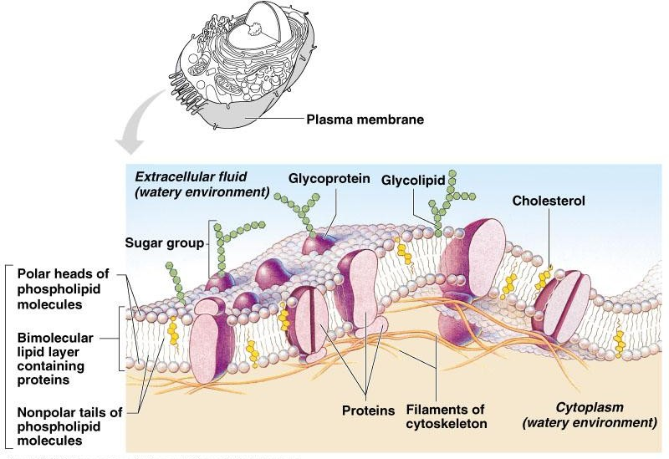
Plasma Membrane

Slide 11
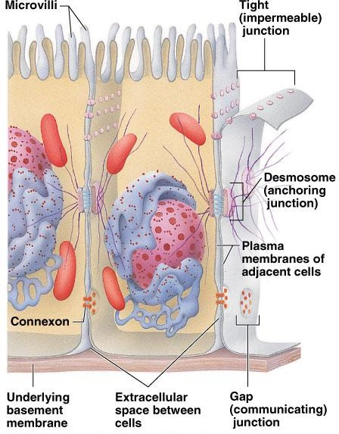
Plasma Membrane Specializations
Microvilli
  Finger-like projections that increase surface area for absorption

Slide 12
Plasma Membrane Specializations
Membrane junctions
  Tight junctions
  Desmosomes
  Gap junctions

Slide 13
Cytoplasm
Material outside the nucleus and inside the plasma membrane
  Cytosol
    Fluid that suspends other elements
  Organelles
    Metabolic machinery of the cell
  Inclusions
    Non-functioning units

Slide 14
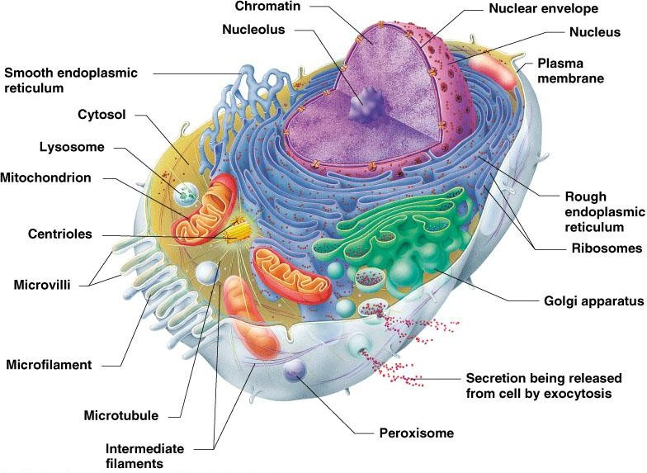
Cytoplasmic Organelles
Figure 3.4

Slide 15
Cytoplasmic Organelles
Ribosomes
  Made of protein and RNA
  Sites of protein synthesis
  Found at two locations
    Free in the cytoplasm
    Attached to rough endoplasmic reticulum

Slide 16
Cytoplasmic Organelles
Endoplasmic reticulum (ER)
  Fluid-filled tubules for carrying substances
  Two types of ER
    Rough Endoplasmic Reticulum
      Studded with ribosomes
      Site where building materials of cellular membrane are formed
    Smooth Endoplasmic Reticulum
      Functions in cholesterol synthesis and breakdown, fat metabolism, and detoxification of drugs

Slide 17
Cytoplasmic Organelles
Golgi apparatus
  Modifies and packages proteins
  Produces different types of packages
    Secretory vesicles
    Cell membrane components
    Lysosomes

Slide 18
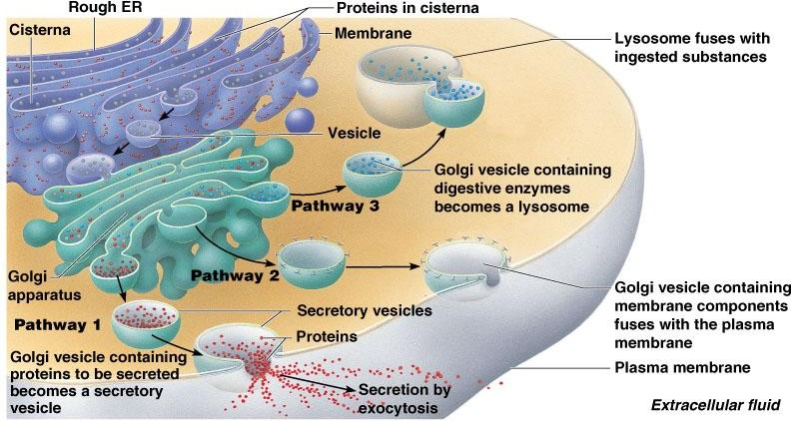
Cytoplasmic Organelles
Figure 3.5

Slide 19
Cytoplasmic Organelles
Lysosomes
  Contain enzymes that digest nonusable materials within the cell

Slide 20
Cytoplasmic Organelles
Mitochondria
  “Powerhouses” of the cell
  Change shape continuously
  Carry out reactions where oxygen is used to break down food
  Provides ATP for cellular energy

Slide 21
Cytoplasmic Organelles
Cytoskeleton
  Network of protein structures that extend throughout the cytoplasm
  Provides the cell with an internal framework

Slide 22
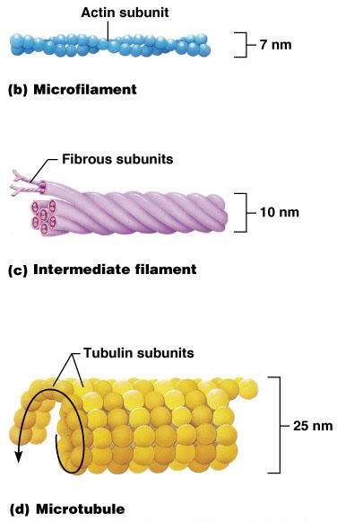
Cytoplasmic Organelles
Cytoskeleton
  Three different types
    Microfilaments
    Intermediate filaments
    Microtubules
Figure 3.6

Slide 23
Cellular Projections
Not found in all cells
Used for movement
  Cilia moves materials across the cell surface
  Flagellum propels the cell

Slide 24
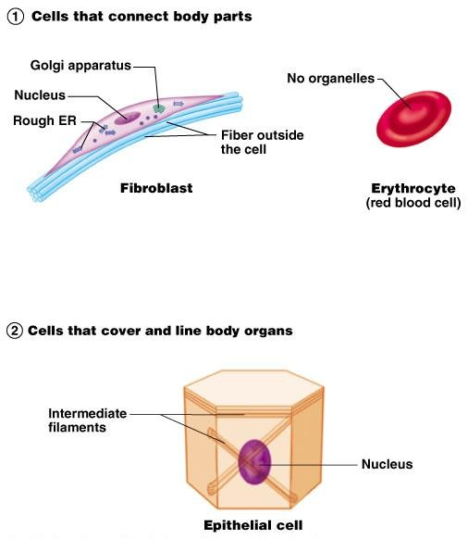
Cell Diversity

Slide 25
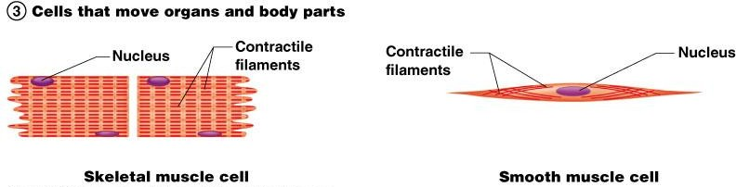
Cell Diversity

Slide 26
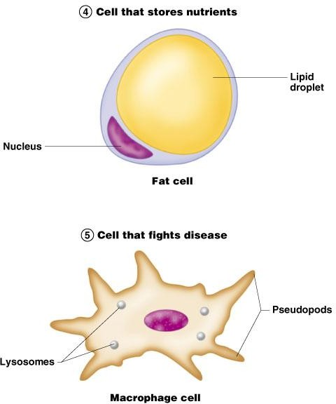
Cell Diversity
Figure 3.7; 4, 5

Slide 27
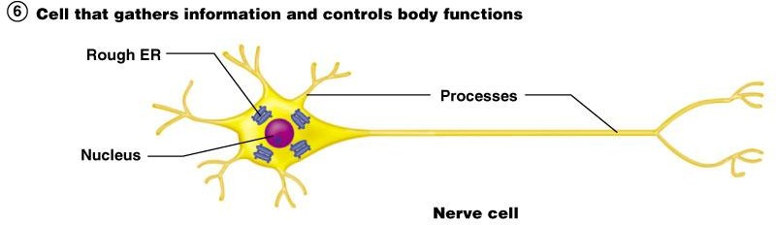
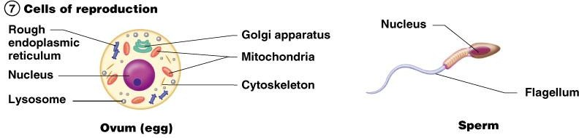
Cell Diversity
Figure 3.7; 6, 7

Slide 28
Cellular Physiology: Membrane Transport
Membrane Transport – movement of substance into and out of the cell
Transport is by two basic methods
  Passive transport
    No energy is required
  Active transport
    The cell must provide metabolic energy

Slide 29
Solutions and Transport
Intracellular fluid – nucleoplasm and cytosol
Interstitial fluid – fluid on the exterior of the cell

Slide 30
Selective Permeability
The plasma membrane allows some materials to pass while excluding others
This permeability includes movement into and out of the cell

Slide 31
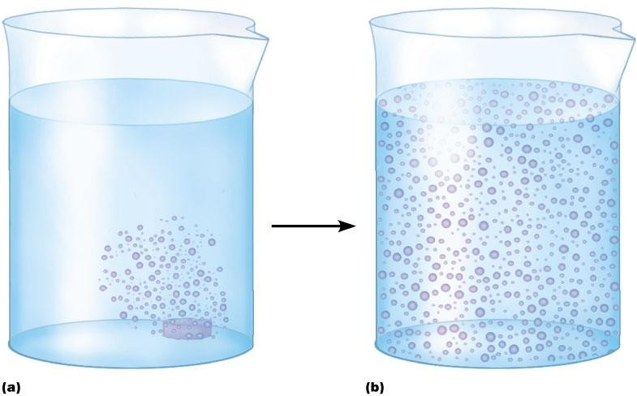
Passive Transport Processes
Diffusion
  Particles tend to distribute themselves evenly within a solution
  Movement is from high concentration to low concentration, or down a concentration gradient
Figure 3.8

Slide 32
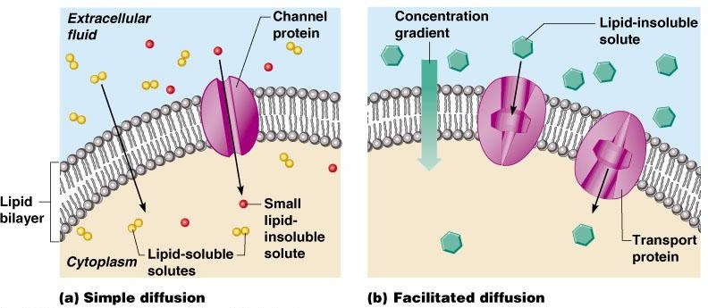
Diffusion through the Plasma Membrane

Slide 33
Active Transport Processes
Transport substances that are unable to pass by diffusion
  They may be too large
  They may not be able to dissolve in the fat core of the membrane
  They may have to move against a concentration gradient
Two common forms of active transport
  Solute pumping
  Bulk transport

Slide 34
Active Transport Processes
Solute pumping
  Amino acids, some sugars and ions are transported by solute pumps
  ATP energizes protein carriers, and in most cases, moves substances against concentration gradients

Slide 35
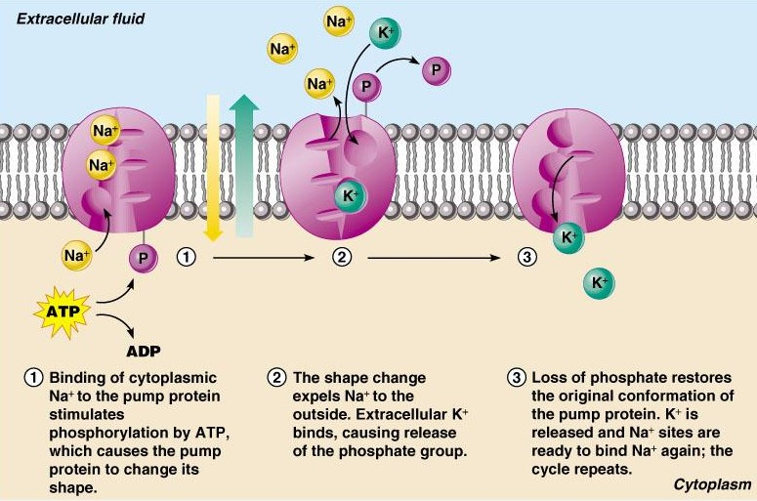
Active Transport Processes
Figure 3.10

Slide 36
Active Transport Processes
Bulk transport
  Exocytosis
    Moves materials out of the cell
    Material is carried in a membranous vesicle
    Vesicle migrates to plasma membrane
    Vesicle combines with plasma membrane
    Material is emptied to the outside

Slide 37
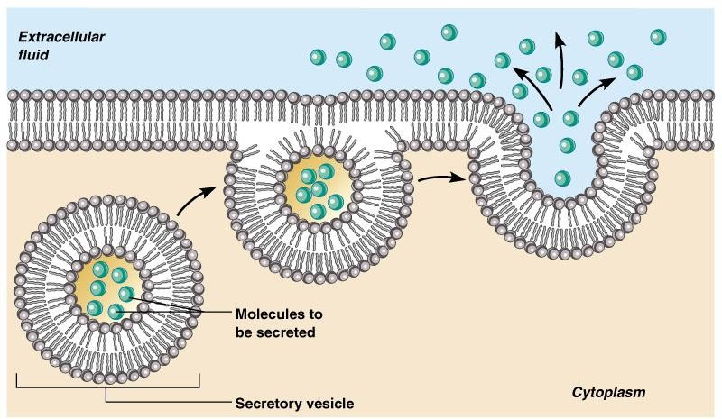
Active Transport Processes
Figure 3.11

Slide 38
Active Transport Processes
Bulk transport
  Endocytosis
    Extracellular substances are engulfed by being enclosed in a membranous vescicle
  Types of endocytosis
    Phagocytosis – cell eating
    Pinocytosis – cell drinking

Slide 39
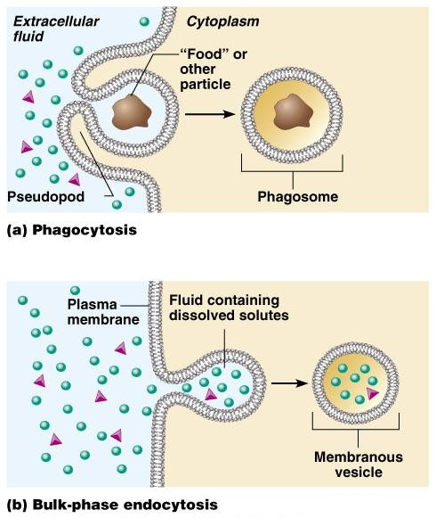
Active Transport Processes

Slide 40
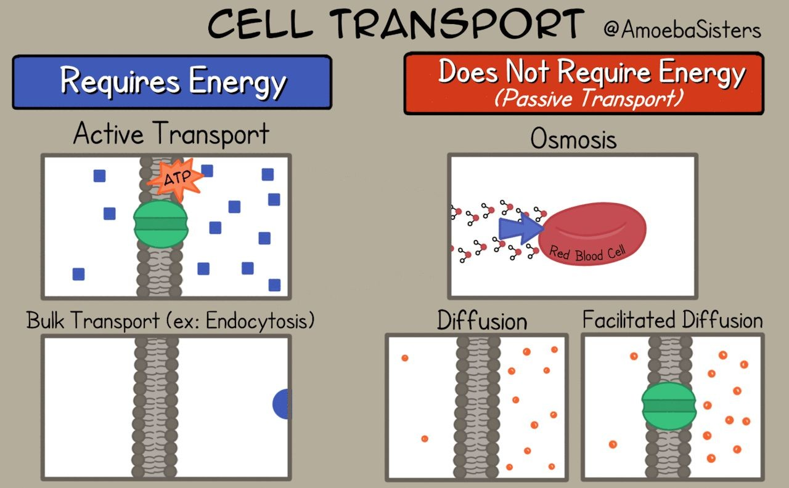

Slide 41
Cell Life Cycle
Cells have two major periods
  Interphase
    Cell grows
    Cell carries on metabolic processes
  Cell division
    Cell replicates itself
    Function is to produce more cells for growth and repair processes

Slide 42
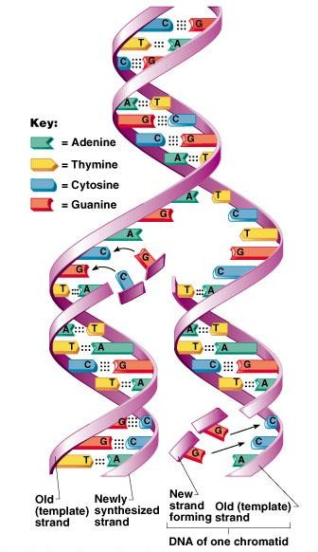
DNA Replication
Genetic material duplicated and readies a cell for division into two cells
Occurs toward the end of interphase
DNA uncoils and each side serves as a template
Figure 3.13

Slide 43
Events of Cell Division
Mitosis
  Division of the nucleus
  Results in the formation of two daughter nuclei
Cytokinesis
  Division of the cytoplasm
  Begins when mitosis is near completion
  Results in the formation of two daughter cells

Slide 44
Stages of Mitosis
Interphase
  No cell division occurs
  The cell carries out normal metabolic activity and growth
Prophase
  First part of cell division
  Centromeres migrate to the poles

Slide 45
Stages of Mitosis
Metaphase
  Spindle from centromeres are attached to chromosomes that are aligned in the center of the cell

Slide 46
Stages of Mitosis
Anaphase
  Daughter chromosomes are pulled toward the poles
  The cell begins to elongate
Telophase
  Daughter nuclei begin forming
  A cleavage furrow (for cell division) begins to form

Slide 47
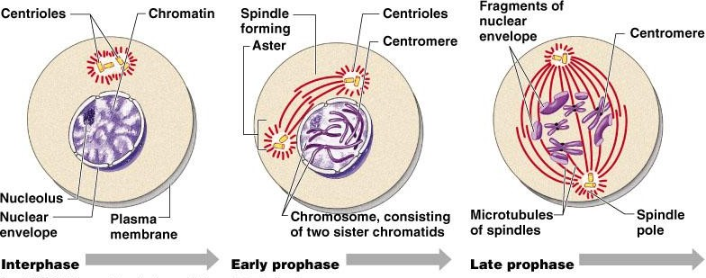
Stages of Mitosis
Figure 3.14; 1

Slide 48
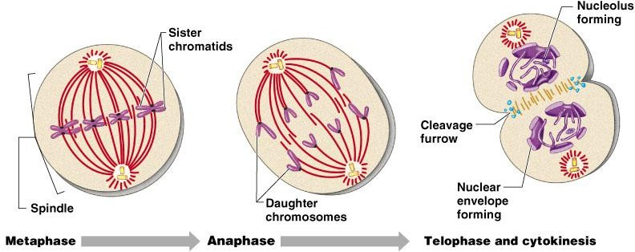
Stages of Mitosis
Figure 3.14; 2

Slide 49
Protein Synthesis
Gene – DNA segment that carries a blueprint for building one protein
Proteins have many functions
  Building materials for cells
  Act as enzymes (biological catalysts)
RNA is essential for protein synthesis

Slide 50
Protein Synthesis
Gene – DNA segment that carries a blueprint for building one protein
Proteins have many functions
  Building materials for cells
  Act as enzymes (biological catalysts)
RNA is essential for protein synthesis

Slide 51
Role of RNA
Transfer RNA (tRNA)
  Transfers appropriate amino acids to the ribosome for building the protein
Ribosomal RNA (rRNA)
  Helps form the ribosomes where proteins are built
Messanger RN
  Carries the instructions for building a protein from the nucleus to the ribosome

Slide 52
Transcription and Translation
Transcription
  Transfer of information from DNA’s base sequence to the complimentary base sequence of mRNA
Translation
  Base sequence of nucleic acid is translated to an amino acid sequence
  Amino acids are the building blocks of proteins

Slide 53
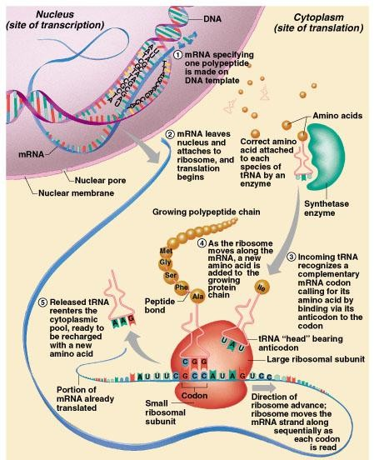
Protein Synthesis

Slide 54
Epithelium Characteristics
Cells fit closely together
Tissue layer always has one free surface
The lower surface is bound by a basement membrane
Avascular (have no blood supply)
Regenerate easily if well nourished

Slide 55
Body Tissues
Cells are specialized for particular functions
Tissues
  Groups of cells with similar structure and function
  Four primary types
    Epithelium
    Connective tissue
    Nervous tissue
    Muscle

Slide 56
Epithelial Tissues
Found in different areas
  Body coverings
  Body linings
  Glandular tissue
Functions
  Protection
  Absorption
  Filtration
  Secretion

Slide 57
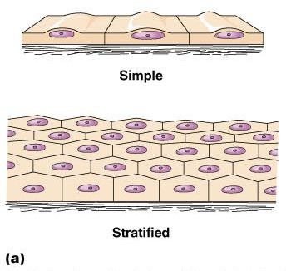
Classification of Epithelium
Number of cell layers
  Simple – one layer
  Stratified – more than one layer
Figure 3.16a

Slide 58
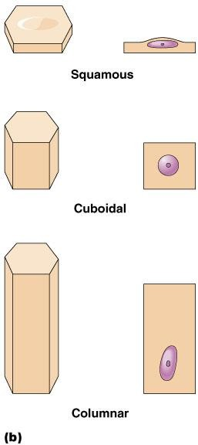
Classification of Epithelium
Shape of cells
  Squamous – flattened
  Cuboidal – cube-shaped
  Columnar – column-like
Figure 3.16b

Slide 59
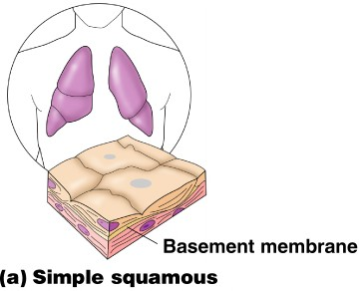
Simple Epithelium
Simple squamous
  Single layer of flat cells
  Usually forms membranes
    Lines body cavities
    Lines lungs and capillaries
Figure 3.17a

Slide 60
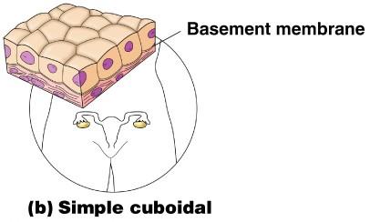
Simple Epithelium
Simple cuboidal
  Single layer of cube-like cells
  Common in glands and their ducts
  Forms walls
of kidney tubules
  Covers the ovaries
Figure 3.17b

Slide 61
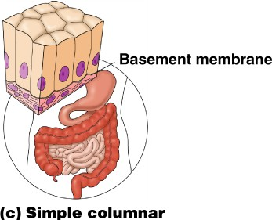
Simple Epithelium
Simple columnar
  Single layer of tall cells
  Often includes goblet cells, which produce mucus
  Lines digestive tract
Figure 3.17c

Slide 62
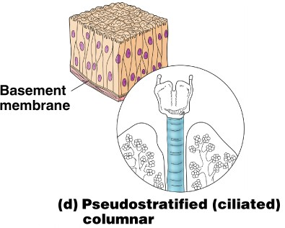
Simple Epithelium
Pseudostratified
  Single layer, but some cells are shorter than others
  Often looks like a double cell layer
  Sometimes ciliated, such as in the respiratory tract
  May function in absorption or secretion
Figure 3.17d

Slide 63
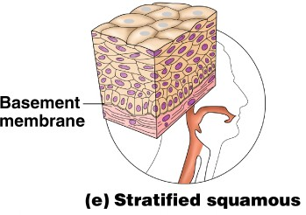
Stratified Epithelium
Stratified squamous
  Cells at the free edge are flattened
  Found as a protective covering where friction is common
  Locations
    Skin
    Mouth
    Esophagus
Figure 3.17e

Slide 64
Stratified Epithelium
Stratified cuboidal
  Two layers of cuboidal cells
Stratified columnar
  Surface cells are columnar, cells underneath vary in size and shape
Stratified cuboidal and columnar
  Rare in human body
  Found mainly in ducts of large glands

Slide 65
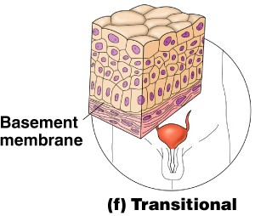
Stratified Epithelium
Transitional epithelium
  Shape of cells depends upon the amount of stretching
  Lines organs of the urinary system
Figure 3.17f

Slide 66
Glandular Epithelium
Gland – one or more cells that secretes a particular product
Two major gland types
  Endocrine gland
    Ductless
    Secretions are hormones
  Exocrine gland
    Empty through ducts to the epithelial surface
    Include sweat and oil glands

Slide 67
Connective Tissue
Found everywhere in the body
Includes the most abundant and widely distributed tissues
Functions
  Binds body tissues together
  Supports the body
  Provides protection

Slide 68
Connective Tissue Characteristics
Variations in blood supply
  Some tissue types are well vascularized
  Some have poor blood supply or are avascular
Extracellular matrix
  Non-living material that surrounds living cells

Slide 69
Extracellular Matrix
Two main elements
  Ground substance – mostly water along with adhesion proteins and polysaccharide molecules
  Fibers
    Produced by the cells
    Three types
      Collagen fibers
      Elastic fibers
      Reticular fibers
Copyright © 2003 Pearson Education, Inc. publishing as Benjamin Cummings
Slide 3.55

Slide 70
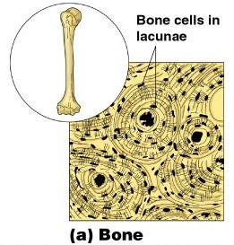
Connective Tissue Types
Bone (osseous tissue)
  Composed of:
    Bone cells in lacunae (cavities)
    Hard matrix of calcium salts
    Large numbers of collagen fibers
  Used to protect and
support the body
Figure 3.18a

Slide 71
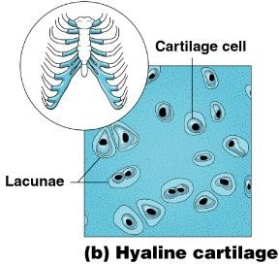
Connective Tissue Types
Hyaline cartilage
  Most common cartilage
  Composed of:
    Abundant collagen fibers
    Rubbery matrix
  Entire fetal skeleton is hyaline cartilage
Figure 3.18b

Slide 72
Connective Tissue Types
Elastic cartilage
  Provides elasticity
  Example: supports the external ear

Slide 73
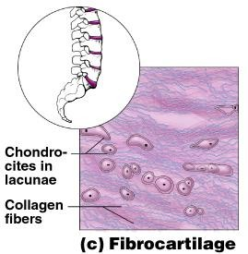
Connective Tissue Types
Fibrocartilage
  Highly compressible
  Example: forms cushion-like discs between vertebrae
Figure 3.18c

Slide 74
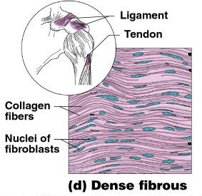
Connective Tissue Types
Dense connective tissue
  Main matrix element is collagen fibers
  Cells are fibroblasts
  Examples
    Tendon – attach muscle to bone
    Ligaments – attach bone to bone
Figure 3.18d

Slide 75
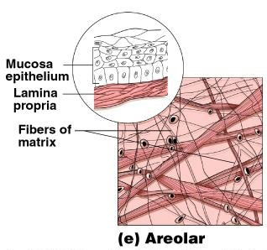
Connective Tissue Types
Areolar connective tissue
  Most widely distributed connective tissue
  Soft, pliable tissue
  Contains all fiber types
  Can soak up excess
fluid
Figure 3.18e

Slide 76
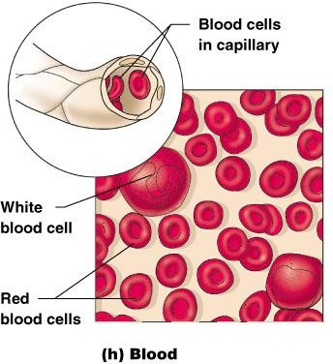
Connective Tissue Types
Blood
  Blood cells surrounded by fluid matrix
  Fibers are visible during clotting
  Functions as the transport vehicle for materials
Figure 3.18h

Slide 77
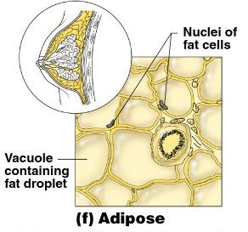
Connective Tissue Types
Adipose tissue
  Matrix is an areolar tissue in which fat globules predominate
  Many cells contain large lipid deposits
  Functions
    Insulates the body
    Protects some organs
    Serves as a site of fuel storage
Figure 3.18f

Slide 78
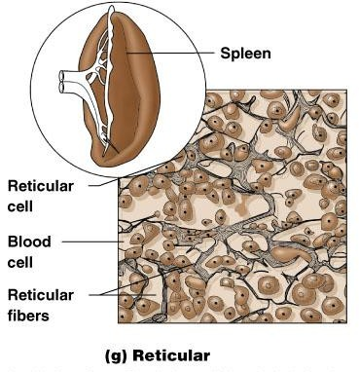
Connective Tissue Types
Reticular connective tissue
  Delicate network of interwoven fibers
  Forms stroma (internal supporting network) of lymphoid organs
    Lymph nodes
    Spleen
    Bone marrow
Figure 3.18g

Slide 79
Muscle Tissue
Function is to produce movement
Three types
  Skeletal muscle
  Cardiac muscle
  Smooth muscle

Slide 80
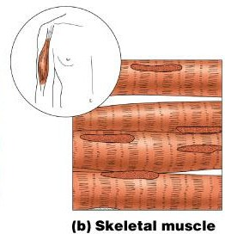
Muscle Tissue Types
Skeletal muscle
  Can be controlled voluntarily
  Cells attach to connective tissue
  Cells are striated
  Cells have more than one nucleus
Figure 3.19b

Slide 81
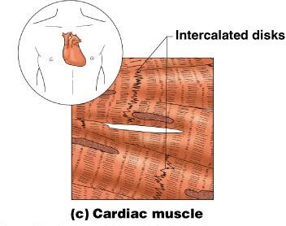
Muscle Tissue Types
Cardiac muscle
  Found only in the heart
  Function is to pump blood (involuntary)
  Cells attached to other cardiac muscle cells at intercalated disks
  Cells are striated
  One nucleus per cell
Figure 3.19c

Slide 82
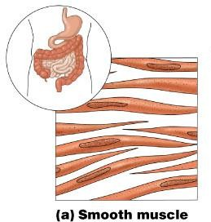
Muscle Tissue Types
Smooth muscle
  Involuntary muscle
  Surrounds hollow organs
  Attached to other smooth muscle cells
  No visible striations
  One nucleus per cell
Figure 3.19a

Slide 83
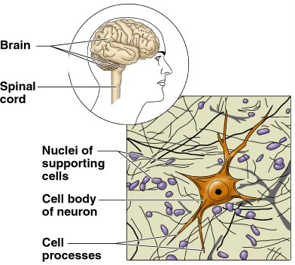
Nervous Tissue
Neurons and nerve support cells
Function is to send impulses to other areas of the body
  Irritability
Conductivity
Figure 3.20

Slide 84


