Slide 1
Radiographic anatomy of the femur
Dr Zaid Saad Madhi
Trauma and orthopedics surgery

Slide 2
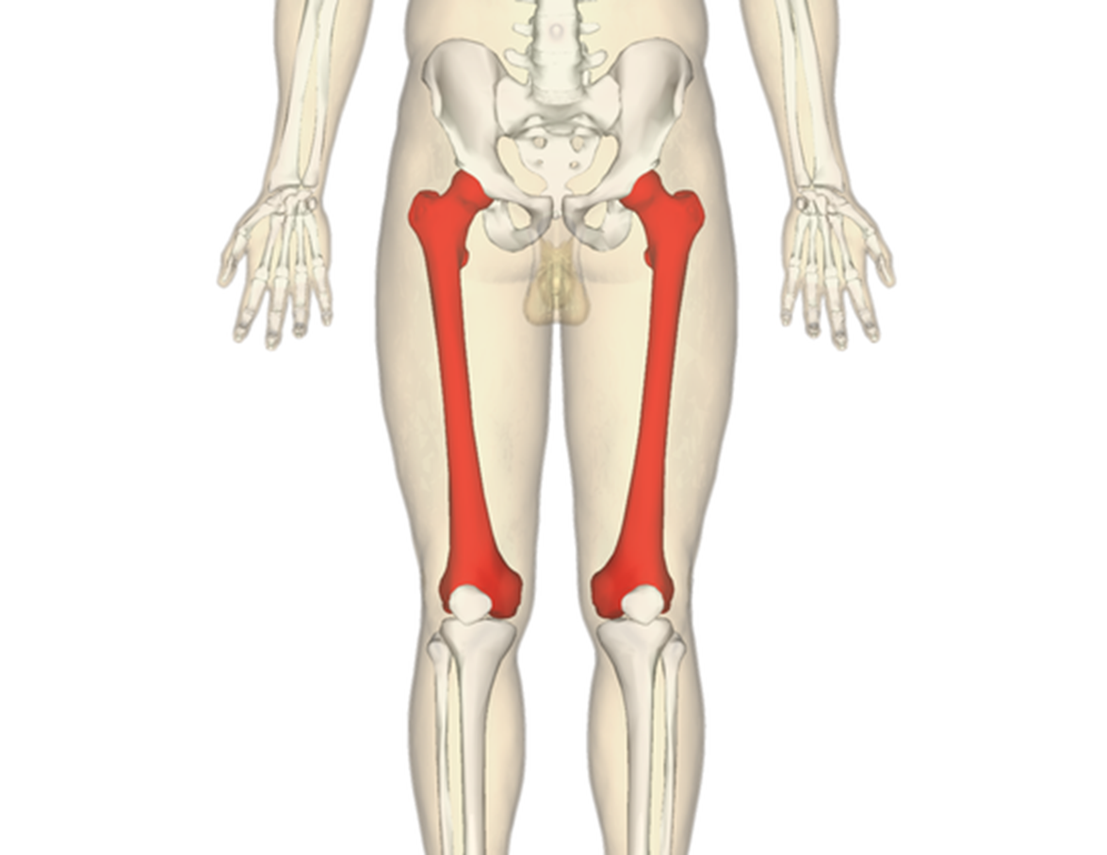
The femur
The femur is the longest and the strongest bone of the body.
It has a head, neck, shaft and an expanded lower end.
The head is more than half of a sphere and is directed upwards, medially and forwards.
The head of the femur articulates with the acetabulum of the pelvis to create the hip joint.
It is intra-articular and covered with cartilage apart from a central pit called the fovea, where the ligamentum teres is attached

Slide 3
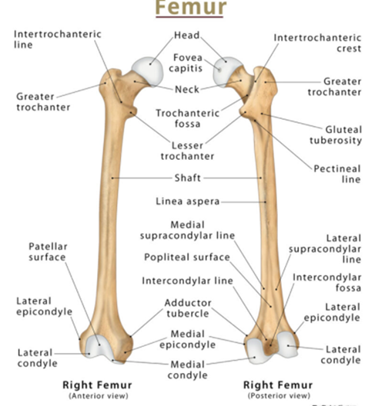
The neck of the femur is about 5 cm long and forms an angle of 125° in females to 130° in males with the shaft.
It is also anteverted, that is, it is directed anteriorly at an angle of about 10° with the sagittal plane.
The lower end of the femur is expanded into two prominent condyles united anteriorly as the patellar surface, but separated posteriorly by a deep intercondylar notch.
The most prominent parts of each condyle are called the medial and lateral epicondyles.

Slide 4
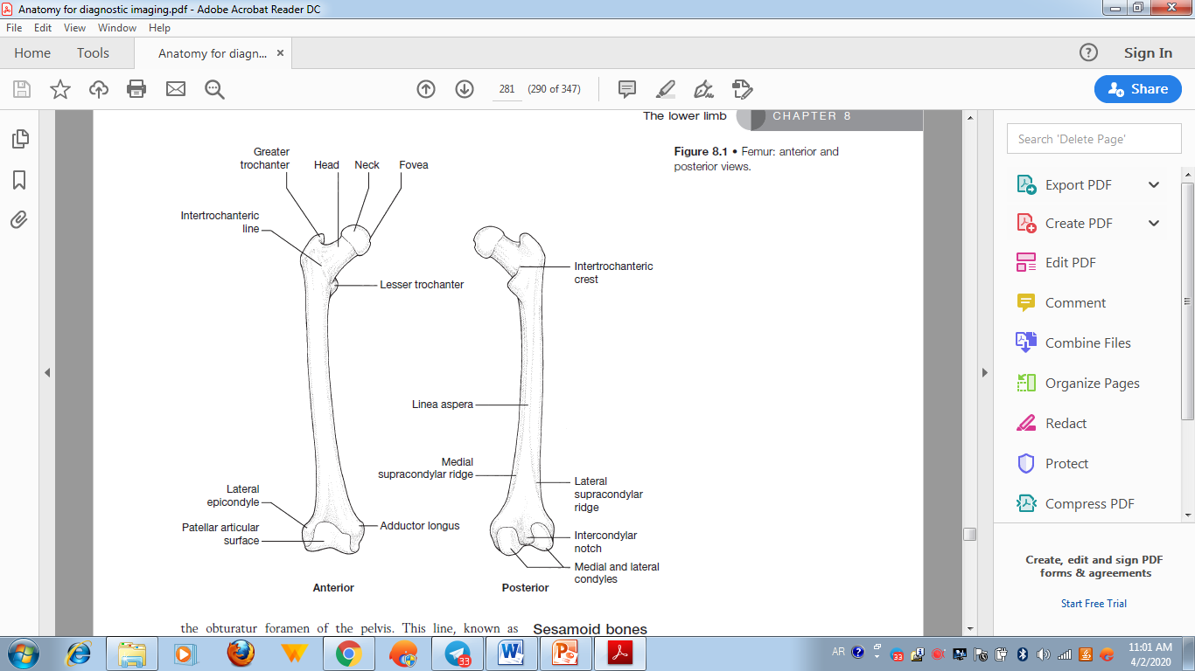

Slide 5
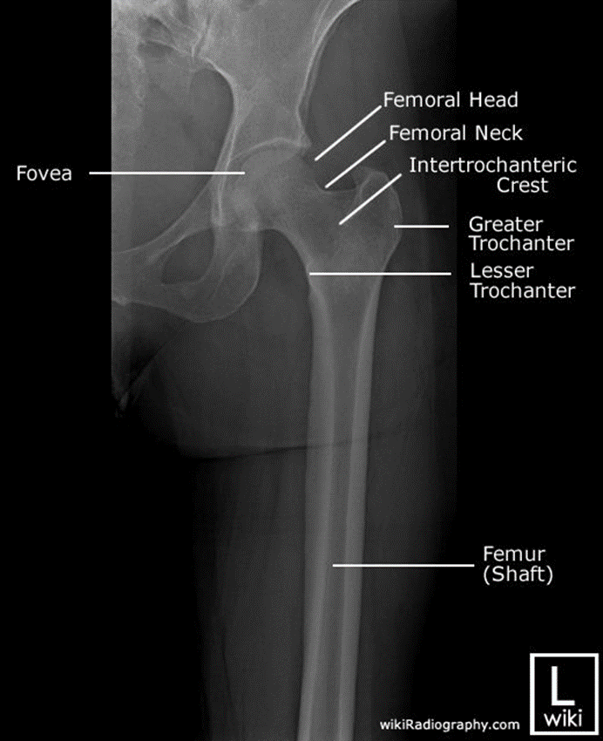
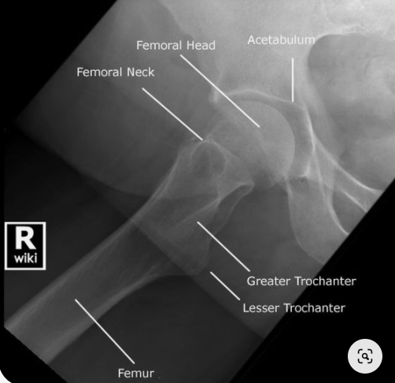
AP and Lateral view of the femur

Slide 6
Developmental dysplasia of the hip (DDH)
Previously known as congenital dislocation of the hip (CDH).
Now DDH because it comprises a spectrum of disorders ranging from acetabular dysplasia without dislocation to instability ( dislocation or subluxation), the unstable hip could be reduced but it is dislocatable or it is dislocated which is either reducible or irreducible.

Slide 7
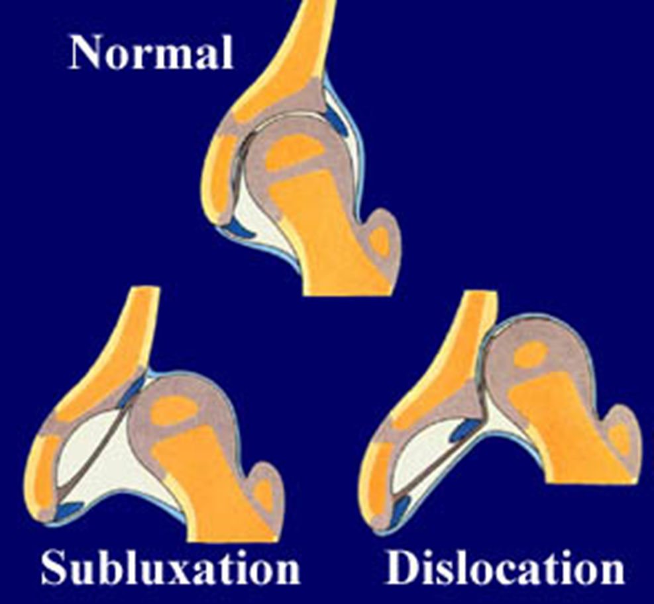

Slide 8
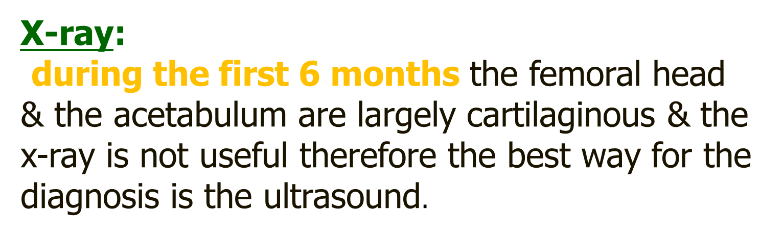

Slide 9
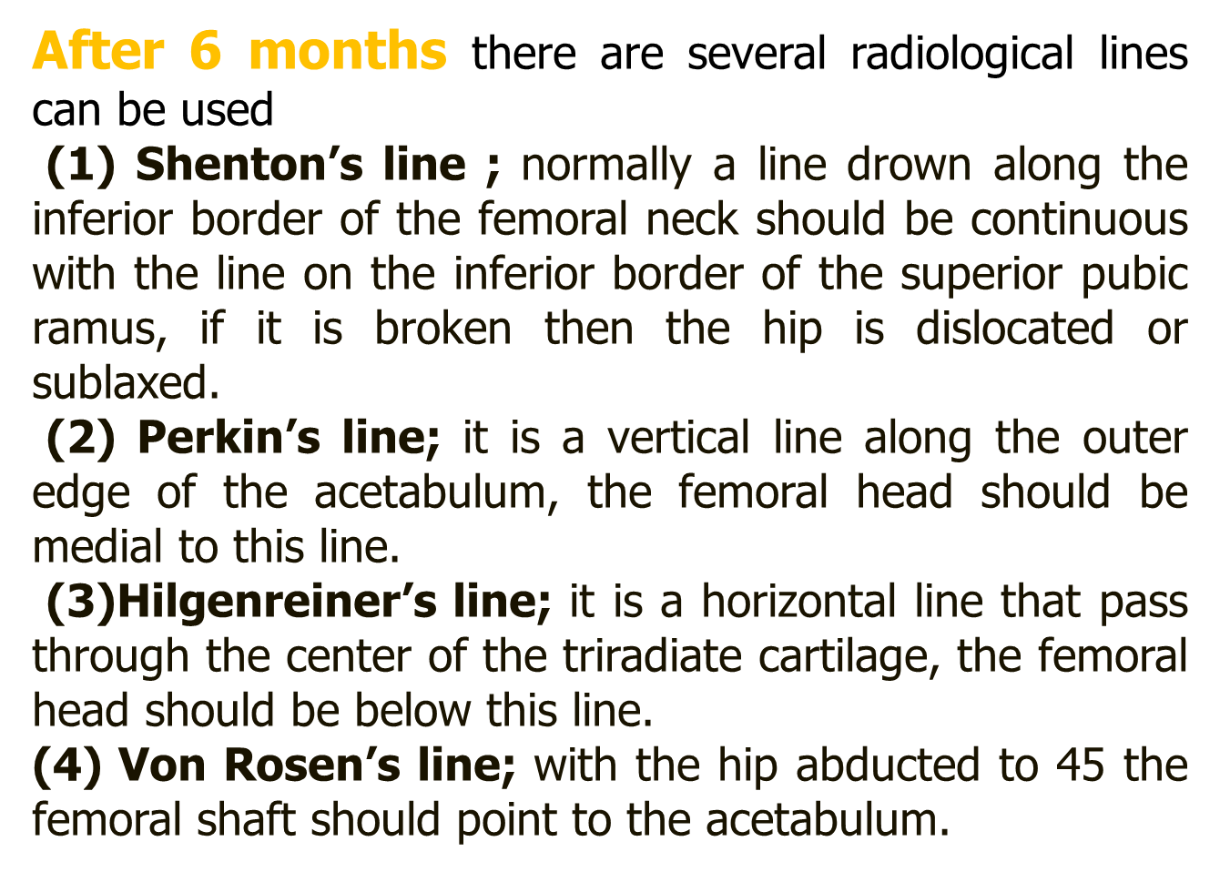

Slide 10
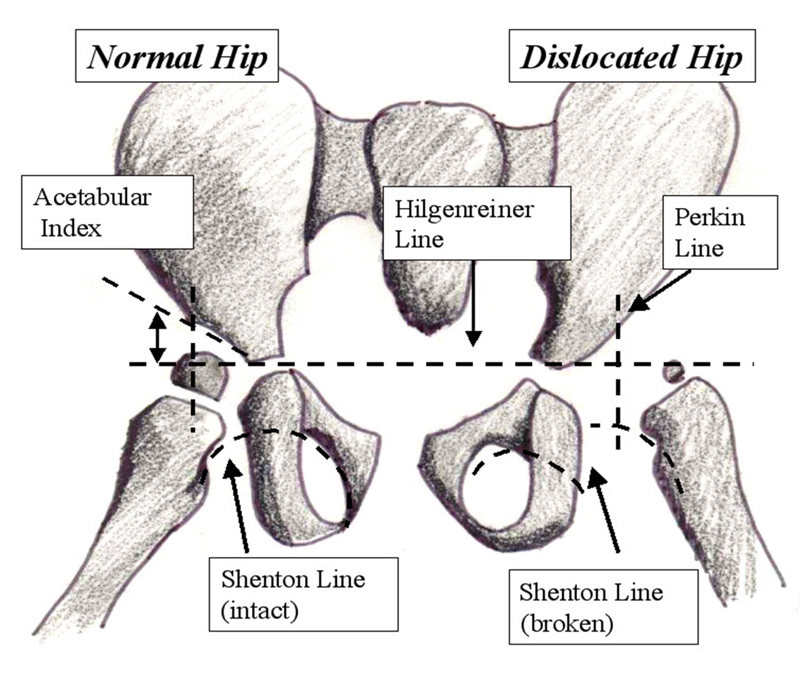

Slide 11
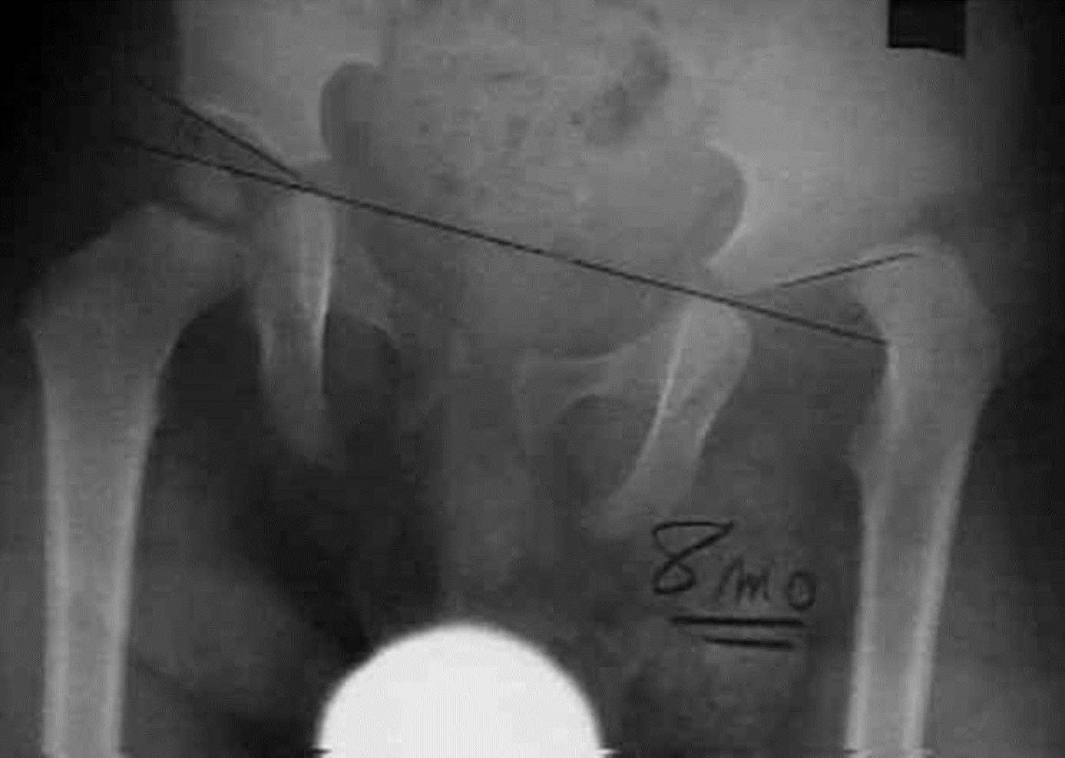

Slide 12
Ossification of the femur
The primary center in the shaft appears in the seventh fetal week
A secondary center is present in the lower femur at birth (this is a reliable indicator that the fetus is full term) and another appears in the head between 6 months and 1 year of age
Secondary centers appear in the greater trochanter at 4 years and in the lesser trochanter at 8 years of age
All fuse at 18 – 20 years of age

Slide 13
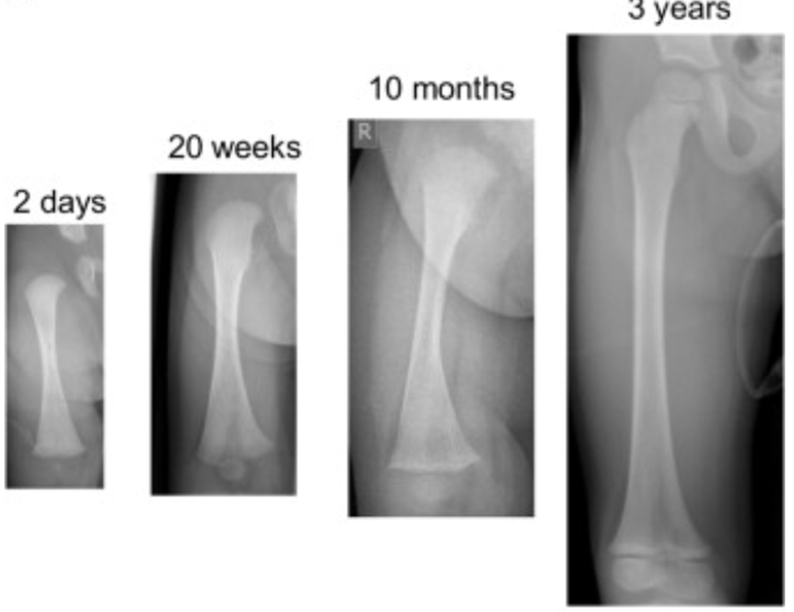
Ossification of the femur
The primary center in the shaft appears in the seventh fetal week
A secondary center is present in the lower femur at birth (this is a reliable indicator that the fetus is full term) and another appears in the head between 6 months and 1 year of age
Secondary centers appear in the greater trochanter at 4 years and in the lesser trochanter at 8 years of age
All fuse at 18 – 20 years of age

Slide 14
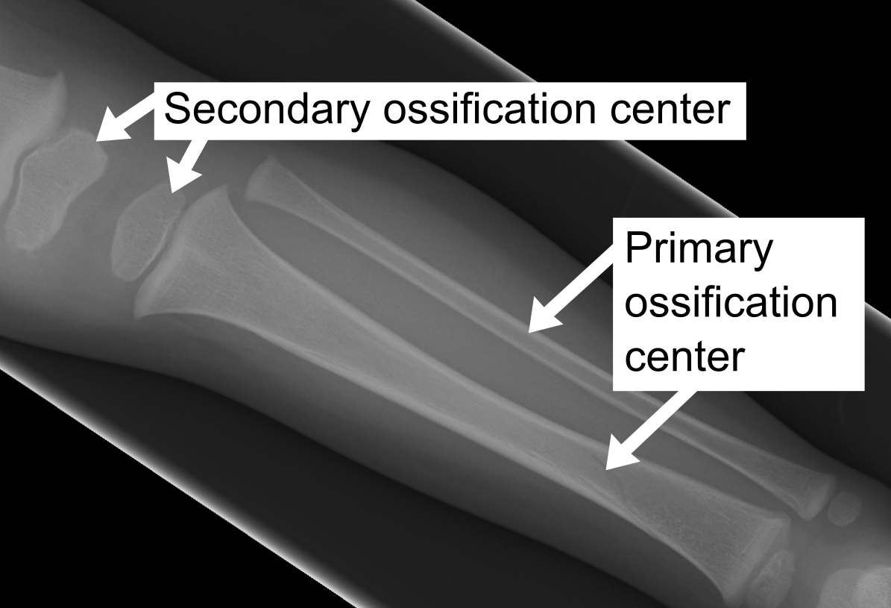

Slide 15


Slide 16
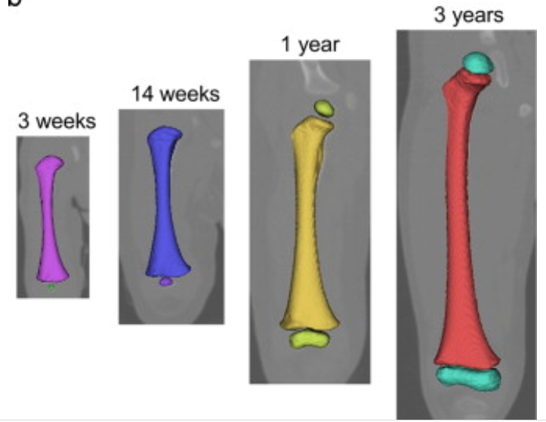

Slide 17
Muscle of the femur
gluteus medius
gluteus minimus
piriformis
obturator internus
gemelli
obturator externus
quadratus femoris
vastus lateralis
iliopsoas

Slide 18
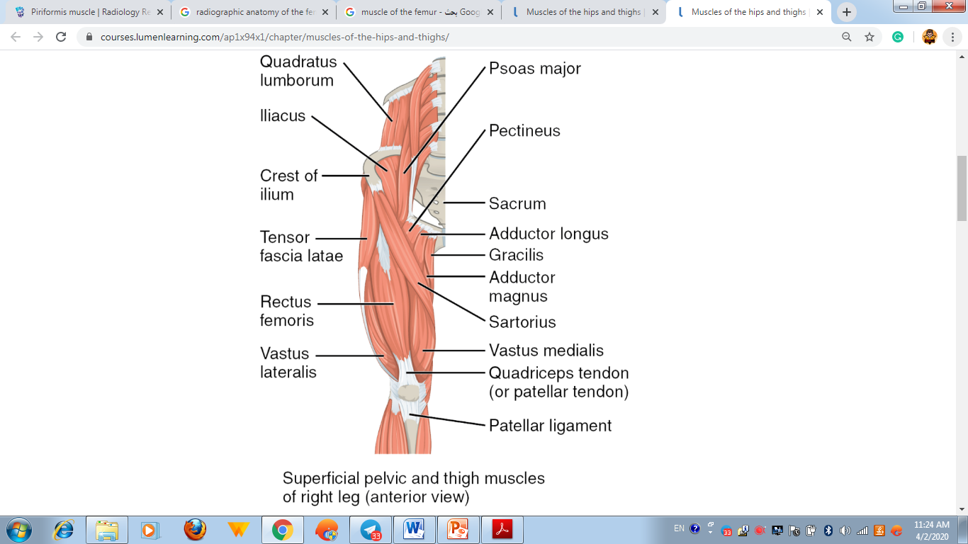

Slide 19
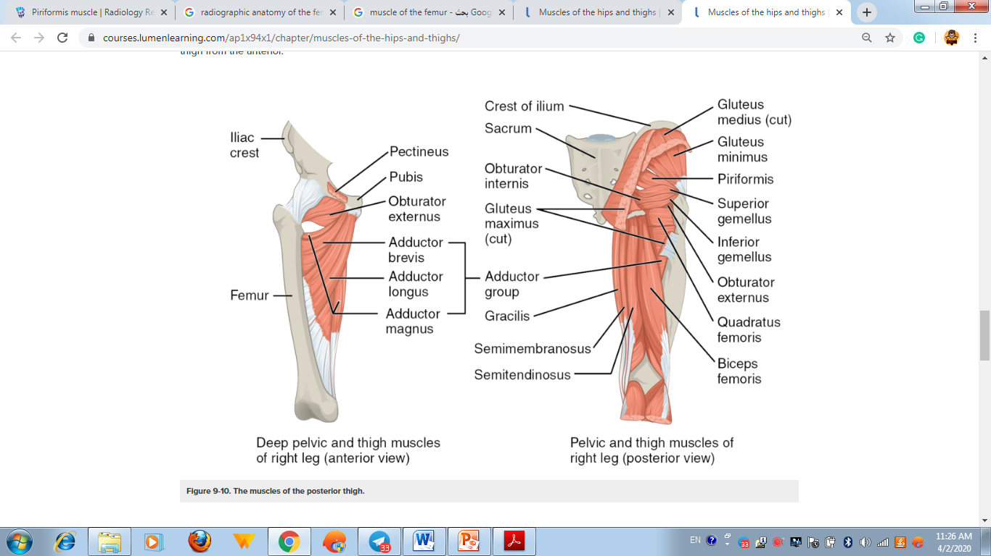

Slide 20
Fracture of the femur
Femoral neck fracture
Femoral neck fractures are a subset of proximal femoral fractures. The femoral neck is the weakest part of the femur.
Since disruption of blood supply to the femoral head is dependent on the type of fracture and causes significant morbidity, the diagnosis and classification of these fractures is important.
There are three types:
Subcapital: femoral head/neck junction
Transcervical: midportion of femoral neck
Basicervical: base of femoral neck

Slide 21
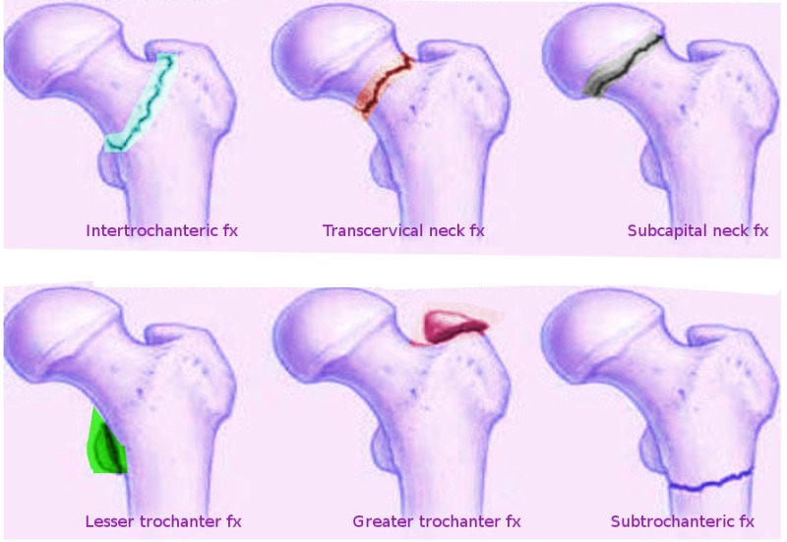

Slide 22
