Slide 1
The Ankle Joint
Dr.Zaid saad Al-Nasrawi
Trauma and Orthopedics surgery

Slide 2
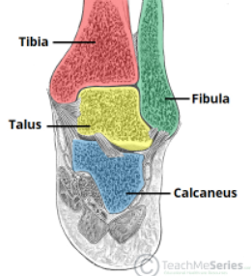
Anatomy of the Ankle Joint
The ankle joint is a synovial hinge joint
Articular surfaces:
the lower tibia and the inner surface of the medial malleolus.
the medial surface of the lateral malleolus of the fibula.
the trochlear surface of the head of the talus

Slide 3
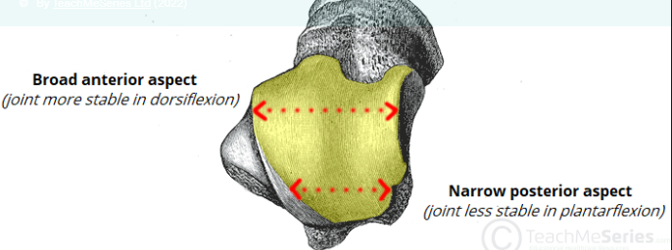
The articular surface of the talus is broader anteriorly than posteriorly This makes the ankle more stable in dorsiflexion (i e standing) and more mobile in plantar flexion
Capsule This is attached to the margins of the articular surfaces, except where it extends distally to the neck of the talus
Synovium This lines the capsule and frequently passes up between the lower ends of the tibia and the fibula

Slide 4
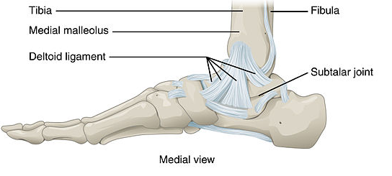
Ligaments
The capsule of the ankle joint is thickened with ligaments medially and laterally but is weak anteriorly and posteriorly
The deltoid ligament is a triangular ligament on the medial aspect of the ankle It is attached to the apex of the medial malleolus and inferiorly to the medial aspect of the talus, the sustentaculum tali of the calcaneus and the tuberosity of the navicular

Slide 5
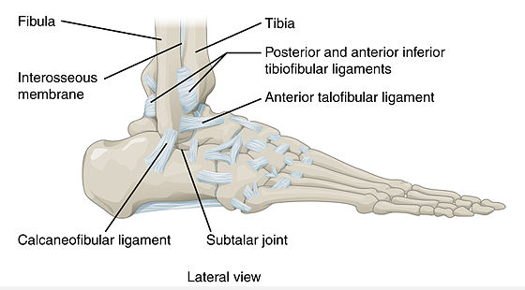
Laterally, the ankle is strengthened by three ligaments:
the posterior talofibular ligament , which passes medially from the lowest part of the malleolar fossa of the fibula to the posterior process of the talus.
the calcaneofibular ligament , which passes from the apex of the lateral malleolus to the calcaneus.
the anterior talofibular ligament , which passes anteromedially from the lateral malleolus to the lateral aspect of the neck of the talus

Slide 6
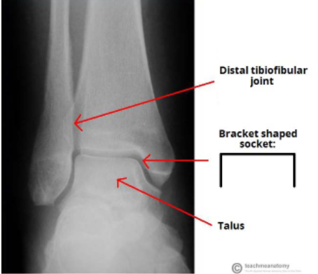
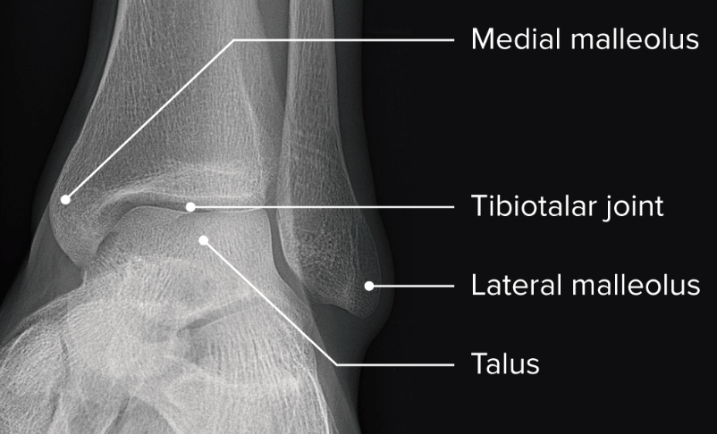
Radiological features of the ankle joint

Slide 7
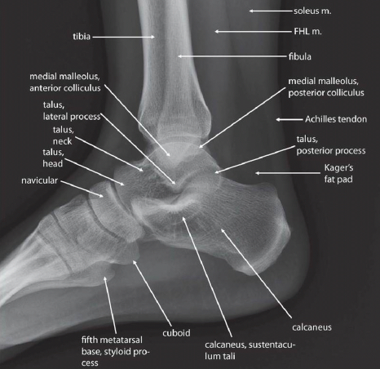
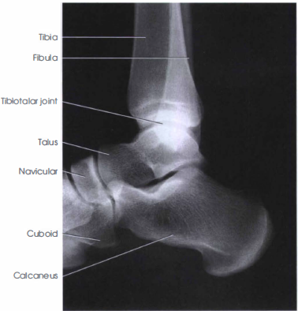

Slide 8
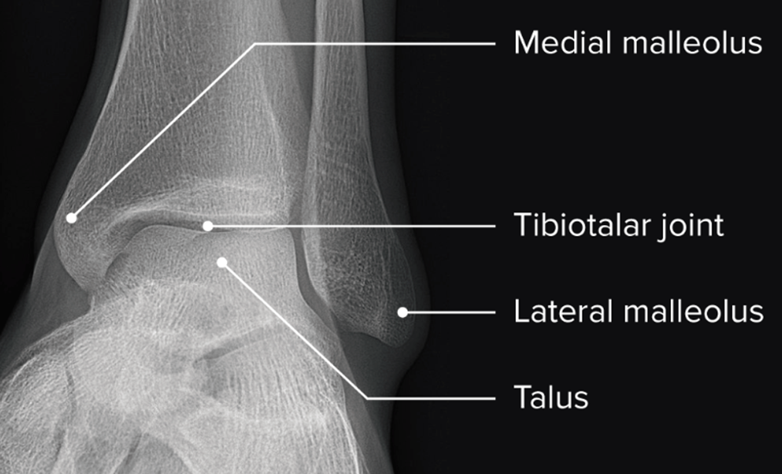
Plain radiographs of Ankle joint
On AP radiographs
The tibiotalar surfaces are seen to be parallel to each other and perpendicular to the shaft of the tibia.
The articular surfaces of the malleoli on each side are symmetrical about a line through the shaft of the tibia, each making an equal angle with the inferior surface of the tibia

Slide 9
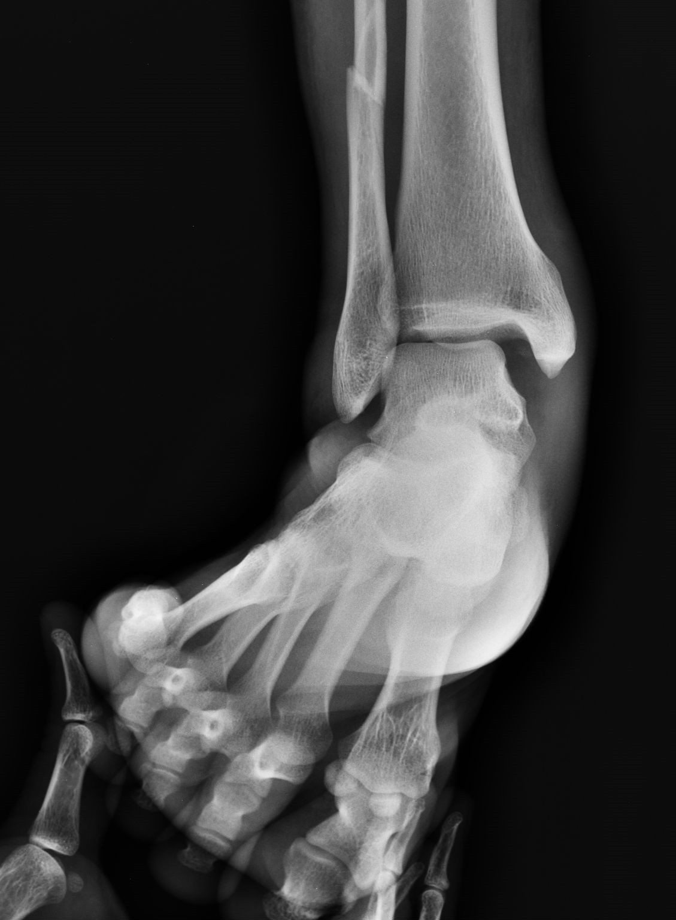
X ray on Stress View
The medial and lateral ligaments of the ankle joint are not visible on plain radiographs.
Stress views Where the distance between the medial malleolus and the talus is increased ,this means disruption of the deltoid ligament. Where there is increased distance between the lateral malleolus and the talus without bony injury this is due to disruption of the lateral ligaments.

Slide 10
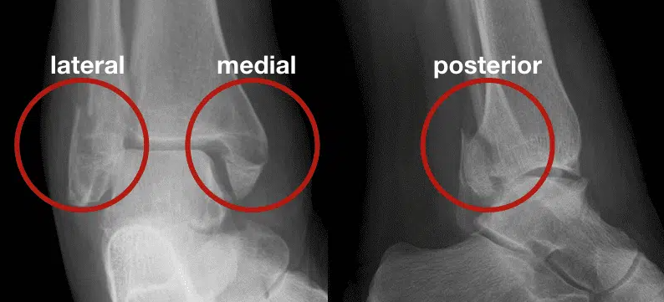
Trimalleolar fracture
The term trimalleolar fracture is sometimes used, although there are only two malleoli The third ‘ malleolus ’ is the posterior lip of the tibial articular surface

Slide 11
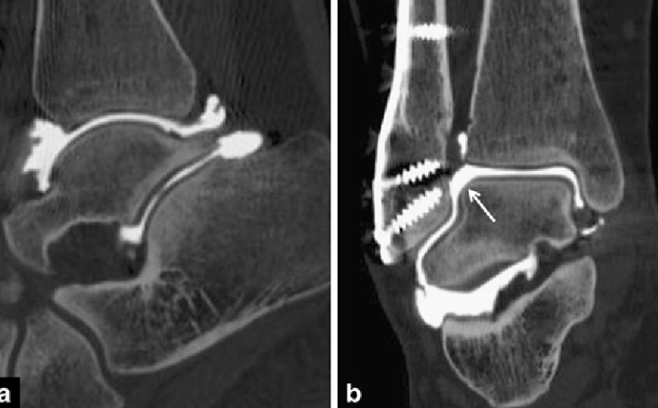
Arthrography
The synovial cavity is outlined by injection of contrast and the integrity of the medial and lateral ligaments can be assessed The normal articular surfaces are seen to be smooth and parallel
Computed tomography
This can be combined with arthrography to assess the bony components of the ankle joint
Direct coronal and axial images are routinely acquired in slices 2 mm thick

Slide 12
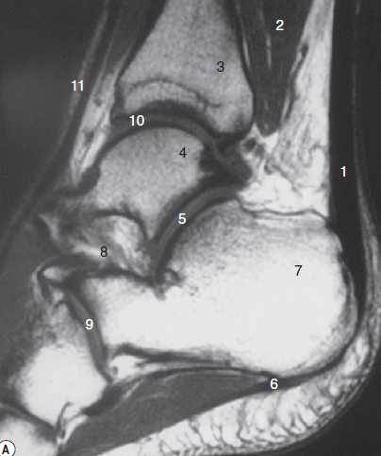
Magnetic resonance imaging
This technique is particularly useful for soft tissues, especially ligaments and tendons.
The Achilles tendon can be seen inserting into the posterior aspect of the calcaneus, separated from the posterior surface of the tibia by a fat pad
The cartilaginous surface of the articulating bones can be visualized directly.

Slide 13
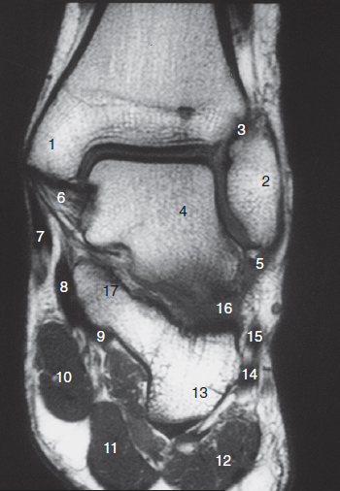
The ankle ligaments
There are four major ligamentous stabilizers in the foot and ankle:
the lateral collateral ligament.
the medial collateral ligament (the deltoid ligament).
the syndesmotic complex and
the interosseous ligament (talocalcaneal ligament) in the sinus tarsi

Slide 14
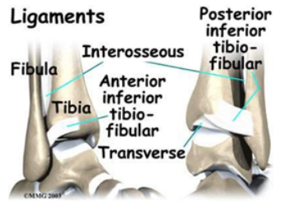
The syndesmosis.
Syndesmosis is the term used to describe the three stabilizing components of the inferior tibiofi bular articulation: the anterior and posterior tibiofi bular ligaments (ATIF, PTIF) and the interosseous membrane Injury to the syndesmosis is extremely uncommon in the absence of a fracture
Injury to the syndesmosis usually involves rupture to the anterior tibiofi bular ligament and spares the posterior.

Slide 15
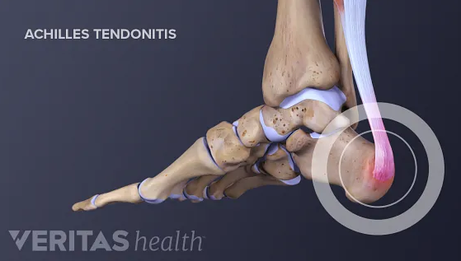
The Achilles tendon
Formed by merging of the gastrocnemius and soleus tendons, the Achilles tendon extends inferiorly to insert on the dorsal margin of the calcaneus It is readily visualized on both ultrasound and MRI in the sagittal plane

