Slide 1
Diffusion – Lecture 2
Assist. Proff. Dr. eng. Alaa D. Jawad AL-Bayati

Slide 2
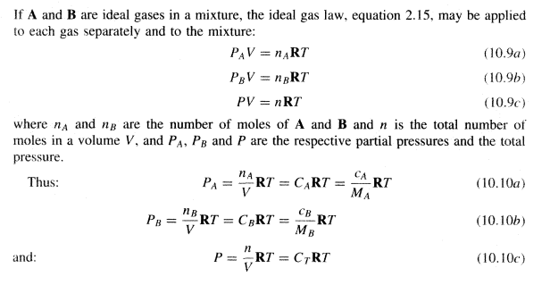
DIFFUSION IN BINARY GAS MIXTURES
Properties of binary mixtures:

Slide 3
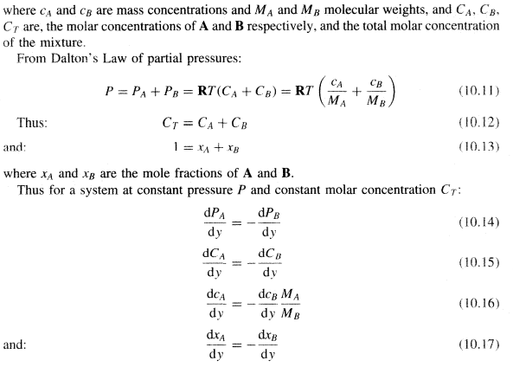

Slide 4
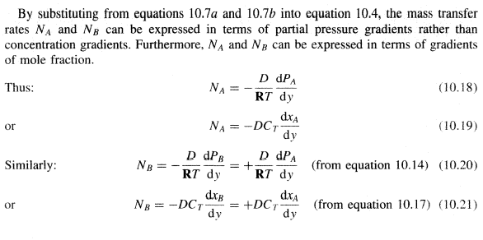

Slide 5
Equimolecular counter diffusion
When the mass transfer rates of the two components are equal and opposite the process is said to be one of equimolecular counter diffusion. Such a process occurs in the case of the box with a movable partition, referred to in Section 10.1. It occurs also in a distillation column when the molar latent heats of the two components are the same. At any point in the column a falling stream of liquid is brought into contact with a rising stream of vapour with which it is not in equilibrium. The less volatile component is transferred from
the vapour to the liquid and the more volatile component is transferred in the opposite direction. If the molar latent heats of the components are equal, the condensation of a given amount of less volatile component releases exactly the amount of latent heat required to volatilise the same molar quantity of the more volatile component. Thus at the interface, and consequently throughout the liquid and vapour phases, equimolecular counterdiffusion is taking place. Under these conditions, the differential forms of equation for NA (10.4, 10.18 and 10.19) may be simply integrated, for constant temperature and pressure, to give respectively:

Slide 6
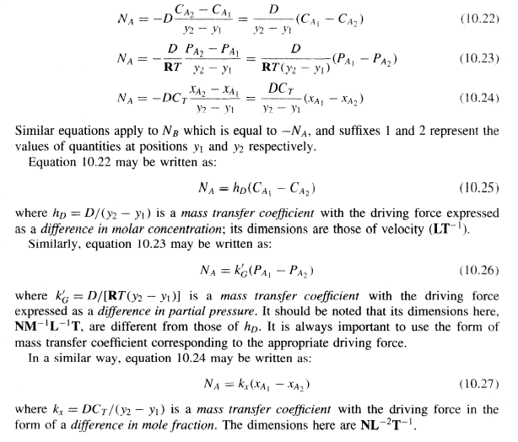

Slide 7
Mass transfer through a stationary second component
In several important processes, one component in a gaseous mixture will be transported relative to a fixed plane, such as a liquid interface, for example, and the other will undergo no net movement. In gas absorption a soluble gas A is transferred to the liquid surface where it dissolves, whereas the insoluble gas B undergoes no net movement with respect to the interface. Similarly, in evaporation from a free surface, the vapour moves away from the surface but the air has no net movement. The mass transfer process therefore differs from that described in Section 10.2.2.

Slide 8
The concept of a stationary component may be envisaged by considering the effect of moving the box, discussed in Section 10.1, in the opposite direction to that in which B is diffusing, at a velocity equal to its diffusion velocity, so that to the external observer B appears to be stationary. The total velocity at which A is transferred will then be increased to its diffusion velocity plus the velocity of the box. For the absorption of a soluble gas A from a mixture with an insoluble gas B, the respective diffusion rates are given by:

Slide 9
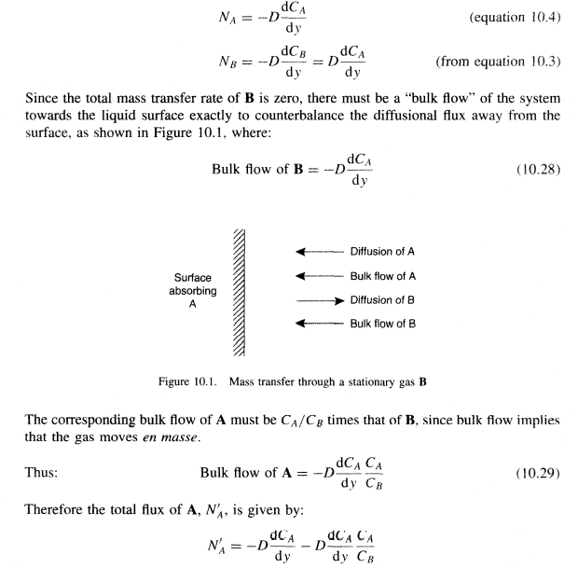

Slide 10
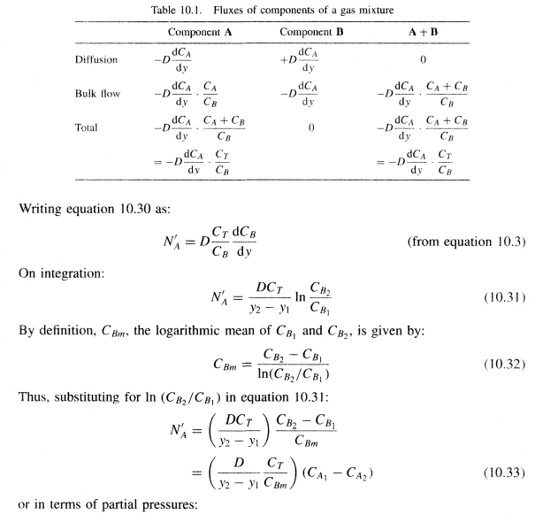
Equation 10.30 is known as Stefan's Law(3) . Thus the bulk flow enhances the mass transfer rate by a factor Cr/Cg, known as the drift factor. The fluxes of the components are given in Table 10.1.

Slide 11
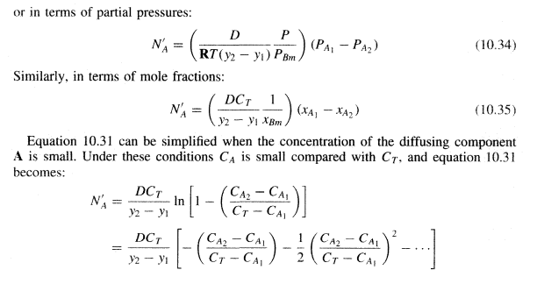

Slide 12
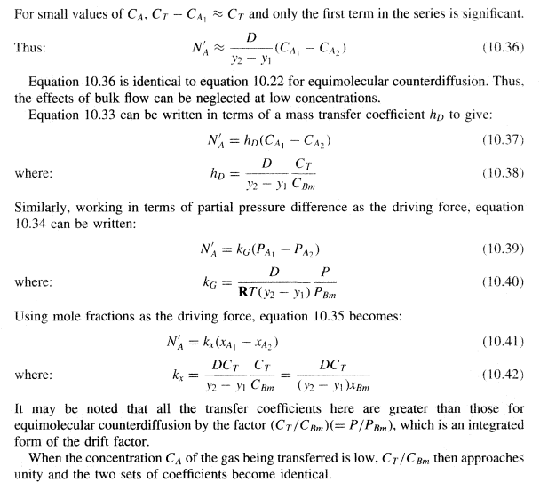

Slide 13
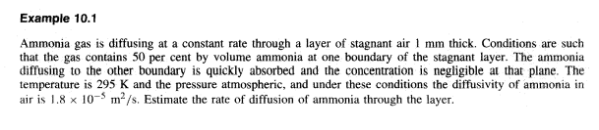
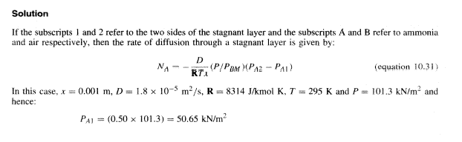

Slide 14
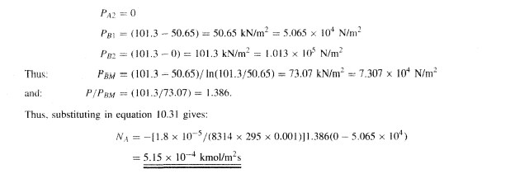

Slide 15


