Slide 1
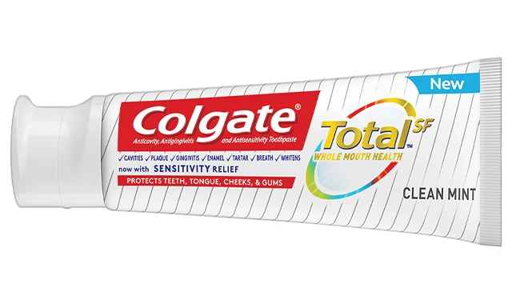
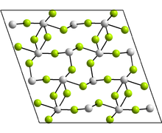
Inorganic Pharmaceutical Chemistry
Lec 6: Dental Products
3rd Stage- College of Pharmacy
SnF₂.

Slide 2
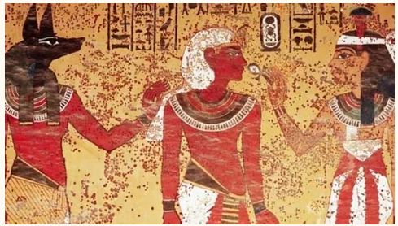
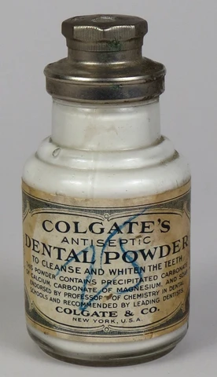
Origins of the Toothpaste Industry
The first record we have of “toothpaste” is from the Ancient Egyptians in around 5000 BC. This was more of a tooth powder that water was added to create the paste. Research shows that this was primarily made of powdered ashes from oxen hooves حافر, myrrh نوع من الصمغ, eggshells, crushed rock salt, and pumice.
Greek and Roman societies that they were adding more abrasives to the mix such as crushed bones and oyster shells and charcoal to improve the taste and breath.
Around 500 BC, in China and India people were using Ginseng, herbal mints, and salt
In 1873 the first smooth, good smelling paste was created by Colgate and sold in tiny glass jars.

Slide 3
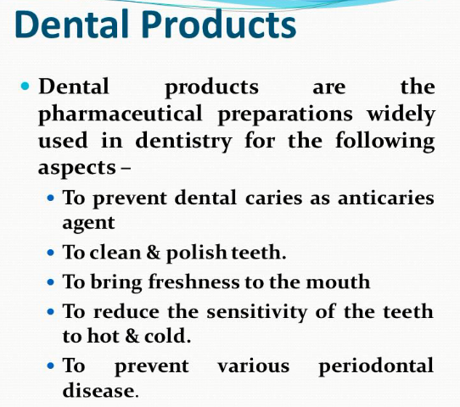

Slide 4
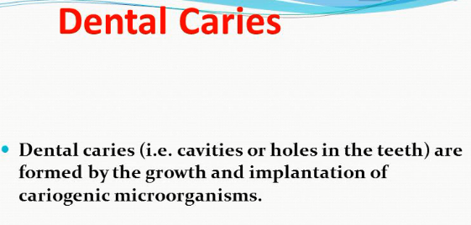

Slide 5
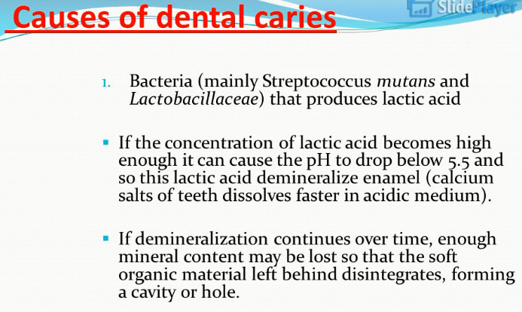

Slide 6
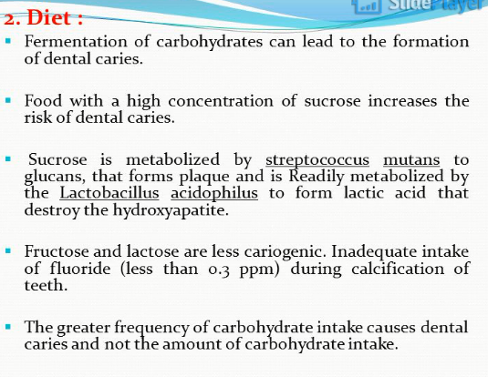

Slide 7
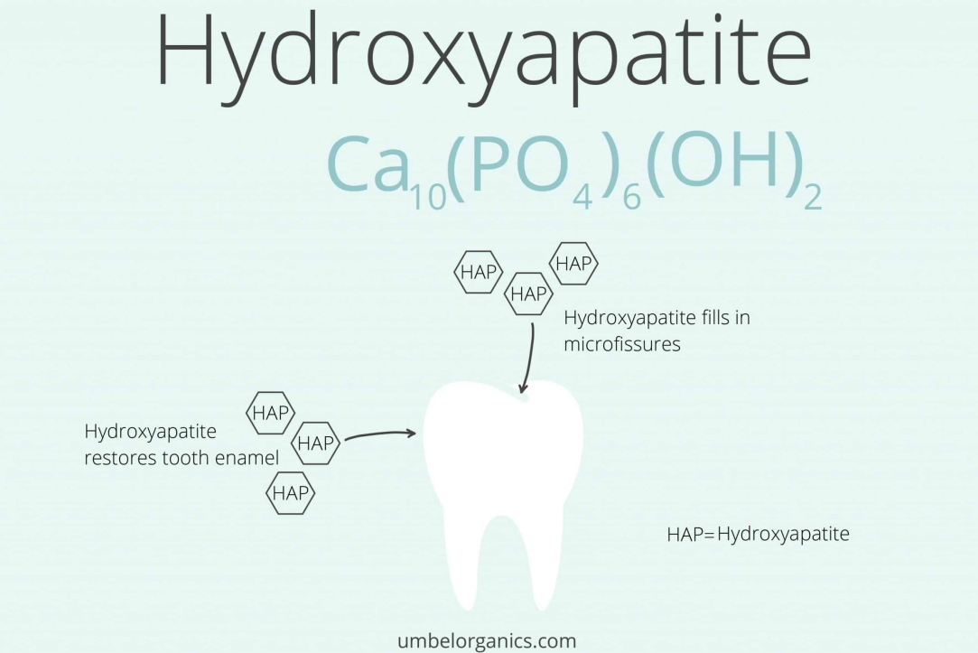
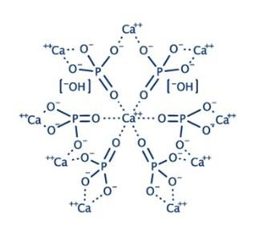
Hydroxyapatite, a calcium phosphate also called is a naturally occurring mineral form of calcium apatite with the formula Ca₅(PO₄)₃, but it is usually written Ca₁₀(PO₄)₆(OH)₂, an essential ingredient of normal bone and teeth

Slide 8
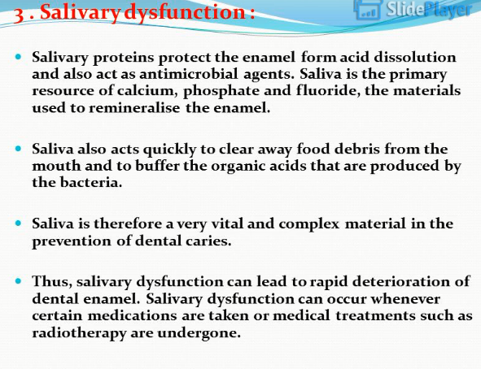

Slide 9
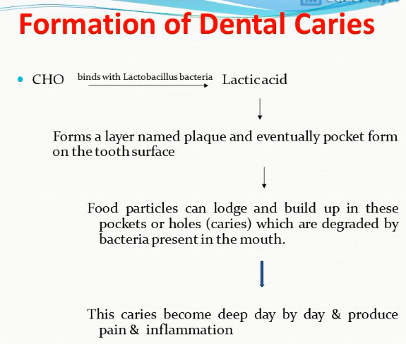

Slide 10
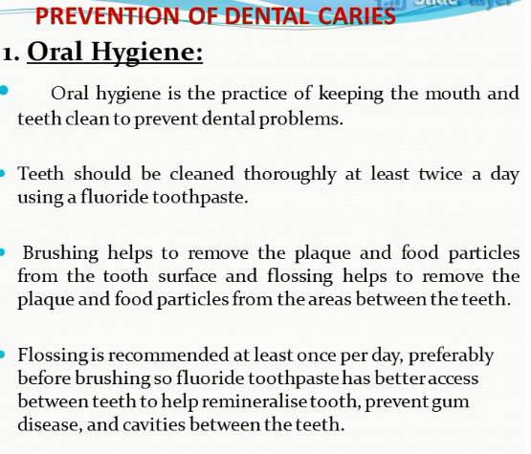

Slide 11
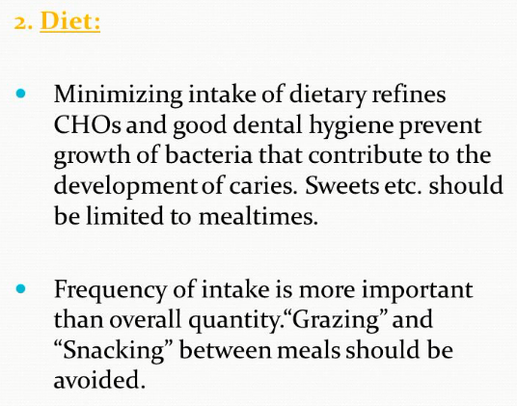

Slide 12
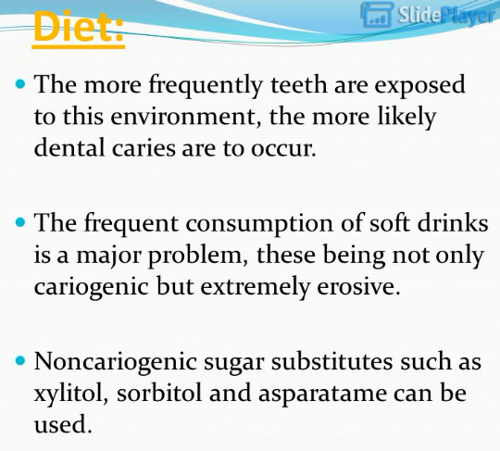

Slide 13
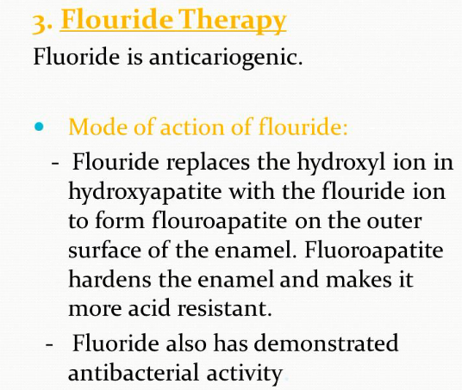

Slide 14
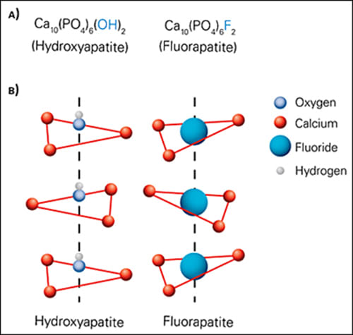
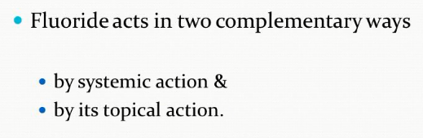

Slide 15
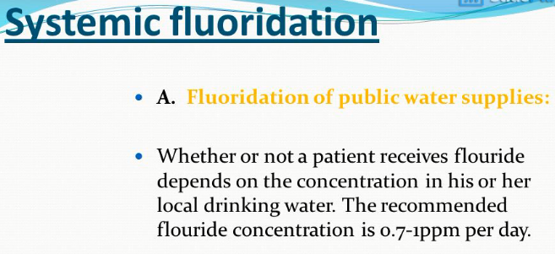

Slide 16
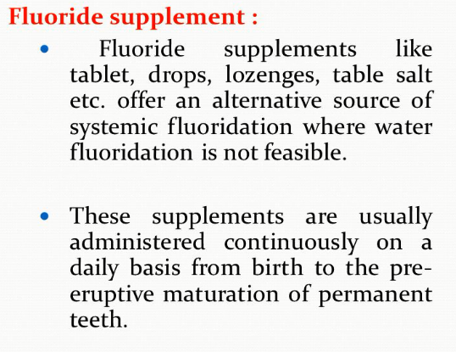

Slide 17
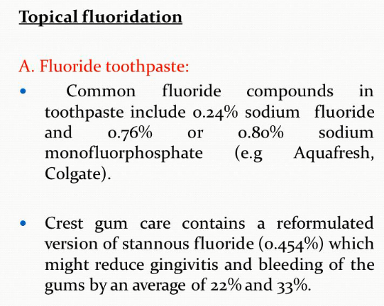
Tin(II) fluoride, commonly referred to commercially as stannous fluoride^{[1][2]} (from Latin stannum, 'tin'), is a chemical compound with the formula SnF₂. It is a colourless solid used as an ingredient in toothpastes.

Slide 18
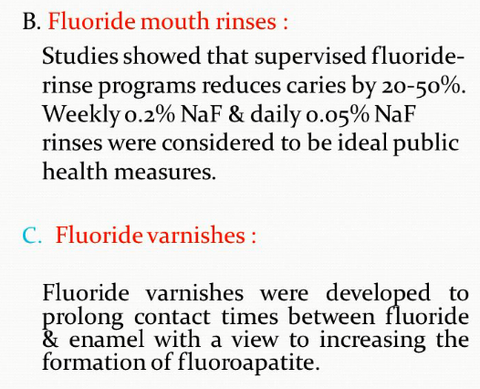

Slide 19
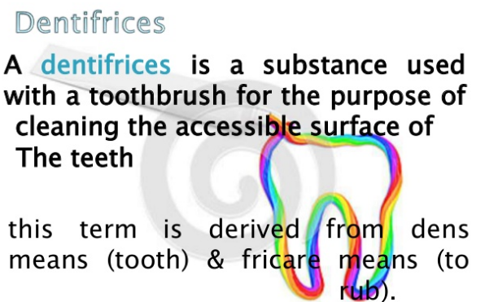

Slide 20
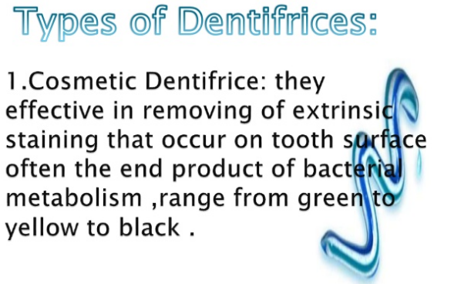
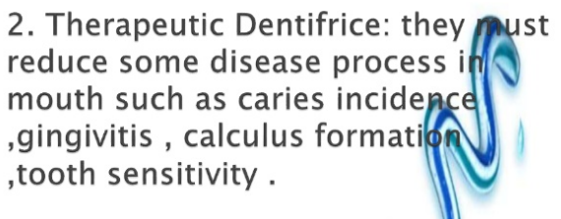

Slide 21
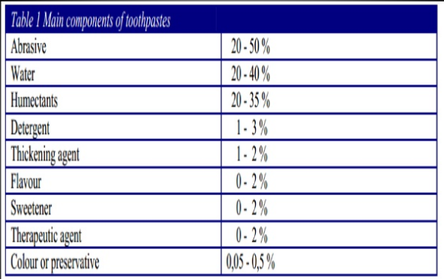

Slide 22
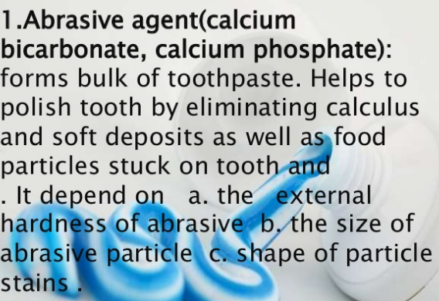

Slide 23
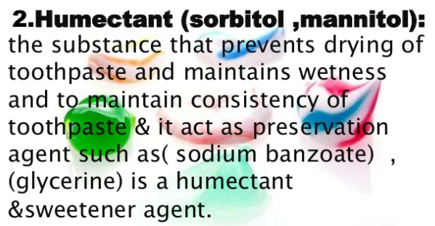

Slide 24
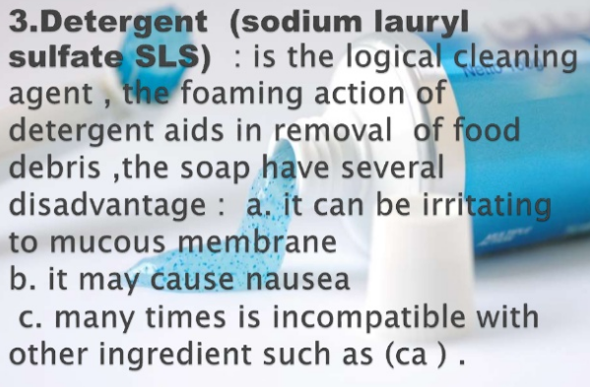

Slide 25
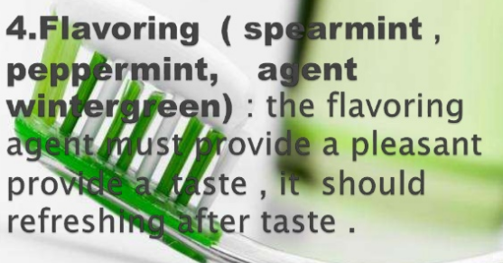
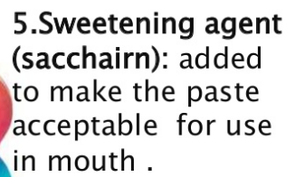
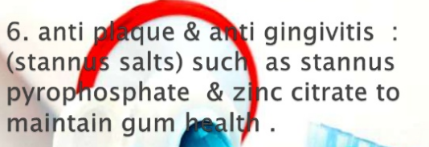

Slide 26
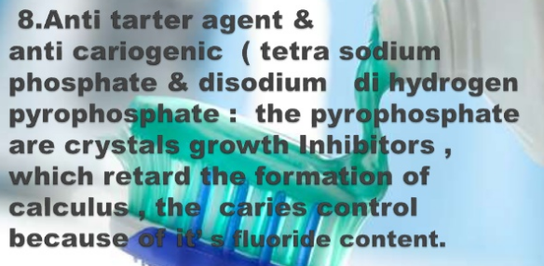
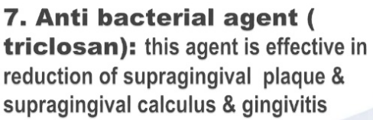
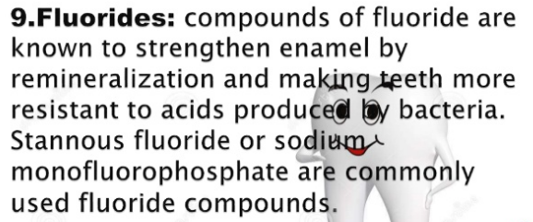

Slide 27
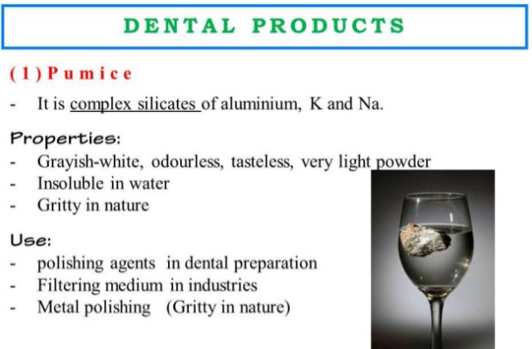

Slide 28

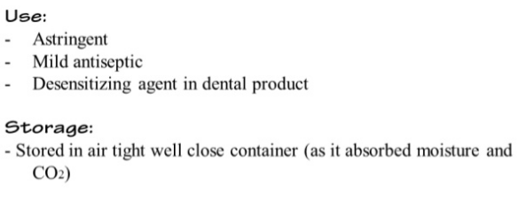

Slide 29
Crest Tooth past components
Stannous Fluoride 0.454% (0.16% W/V Fluoride Ion). Inactive Ingredients: Glycerin, Hydrated Silica, Sodium Hexametaphosphate, Propylene Glycol, PEG-6, Water, Zinc Lactate, Trisodium Phosphate, Flavor, Sodium Lauryl Sulfate, Sodium Gluconate, Carrageenan, Sodium Saccharin, Xanthan Gum
Colgate® Total Original Toothpaste
Glycerin.
Aqua.
Hydrated Silica.
Sodium Lauryl Sulfate.
Arginine.
Aroma.
Cellulose Gum.
Zinc Oxide.
Tetrasodium Pyrophosphate.
Xanthan Gum.
Benzyl Alcohol.
Cocamidopropyl Betaine.
Sodium Fluoride.
Sodium Saccharin.
Phosphoric Acid.
Sucralose.
Biofresh tooth paste
Sorbitol, Aqua, Hydrated Silica, Mentha Piperita Leaf Water*, Aloe Barbadensis Leaf Juice*, Lauryl Glucoside, Xanthan Gum, Aroma, Sodium Fluoride, Sodium Benzoate, Stevia Rebaudiana Extract, Citric Acid, Potassium Sorbate.

