Slide 1
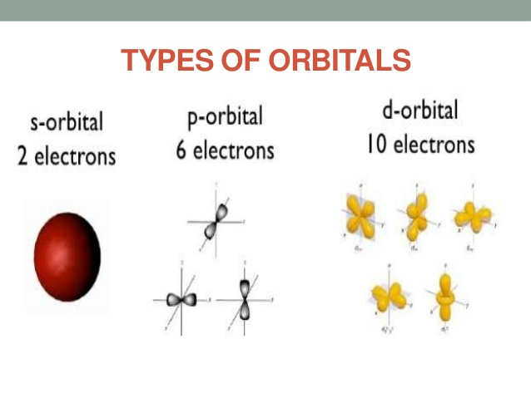
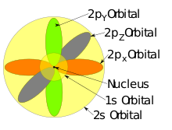
Inorganic Pharmaceutical Chemistry
Pharmaceutical Chemistry
Lecture 1:
Atomic and Molecular
Structure
Third Stage
Semester 1

Slide 2
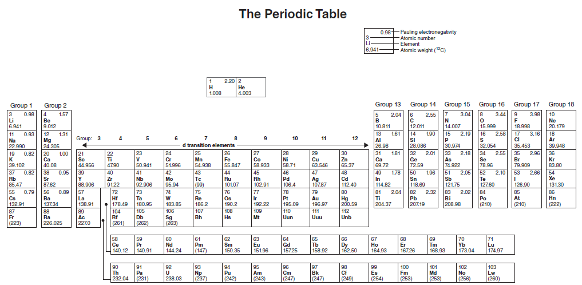
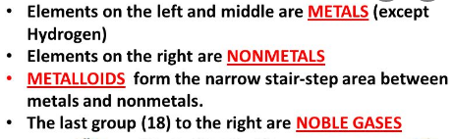

Slide 3
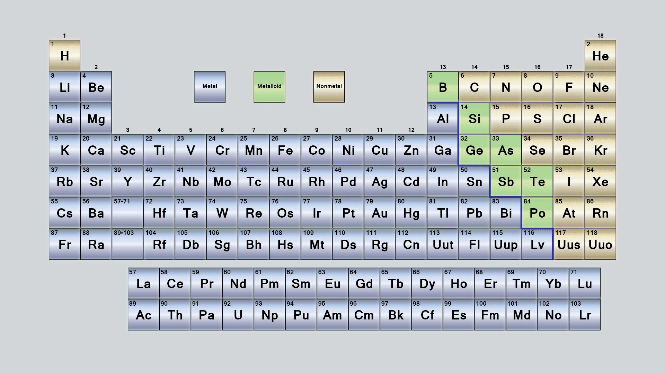
A metalloid is an element that has properties that are intermediate between those of metals and nonmetals. Metalloids can also be called semimetals.

Slide 4
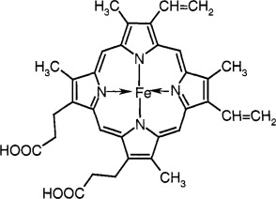
Medicinal inorganic chemistry can be broadly defined as the area of research concerned with metal ions and metal complexes and their clinical applications.
Metals such as arsenic have been used in clinical studies more than 100 years ago, whilst silver, gold and iron have been involved in ‘magic cures’ and other therapeutic applications for more than 5000 years.
Many metal ions play a vital role in living organisms. Metal ions are also involved in a variety of processes within the human body, such as the oxygen transport or the formation of the framework for our bones.
Haemoglobin is an iron-containing metallo-protein which carries oxygen from the lungs to the various tissues around the human body.
Haemoglobin

Slide 5
Calcium (Ca) ions are a vital component of our bones. Elements such as copper (Cu), zinc (Zn) and manganese (Mn) are essential for a variety of catalytic processes
Nevertheless, metals are very often perceived as toxic elements. Very often, the toxicity of a metal in a biological environment depends on the concentration present in the living organism.
Some metal ions are essential for life, but concentrations too high can be highly toxic whilst too low concentrations can lead to deficiency resulting in disturbed biological processes.

Slide 6
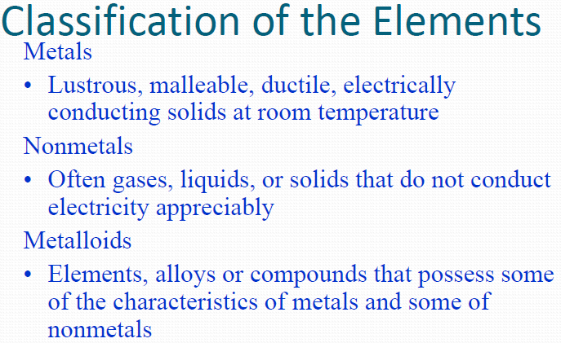
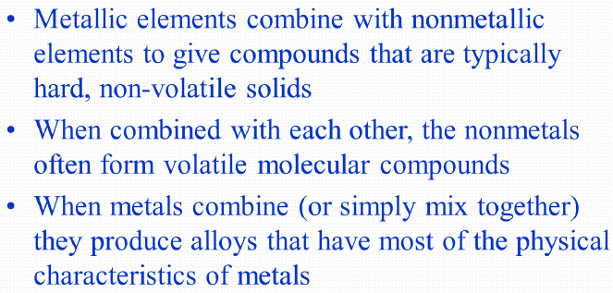

Slide 7
Electronic Structure of Atoms
The fundamental unit of all matter is the atom.
The various chemical and physical properties of matter are determined by its elemental composition.
Elements are composed of like atoms and their isotopes.
Subatomic particle: Any of various units of matter below the size of an atom.
To predict the properties of matter, molecules, or elements, it is important to understand the structure of atoms.

Slide 8
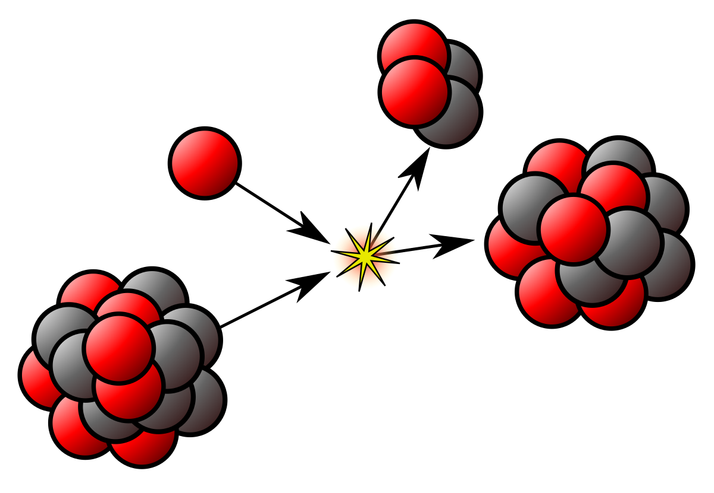
Subatomic Particles:
Atoms are composed of a central nucleus surrounded by electrons which occupy discrete regions of space.
The nucleus is considered to contain two types of stable particles which comprise most of the mass of the atom.
These particles are "held" within the nucleus by various "nuclear forces."

Slide 9
Subatomic Particles:

Slide 10
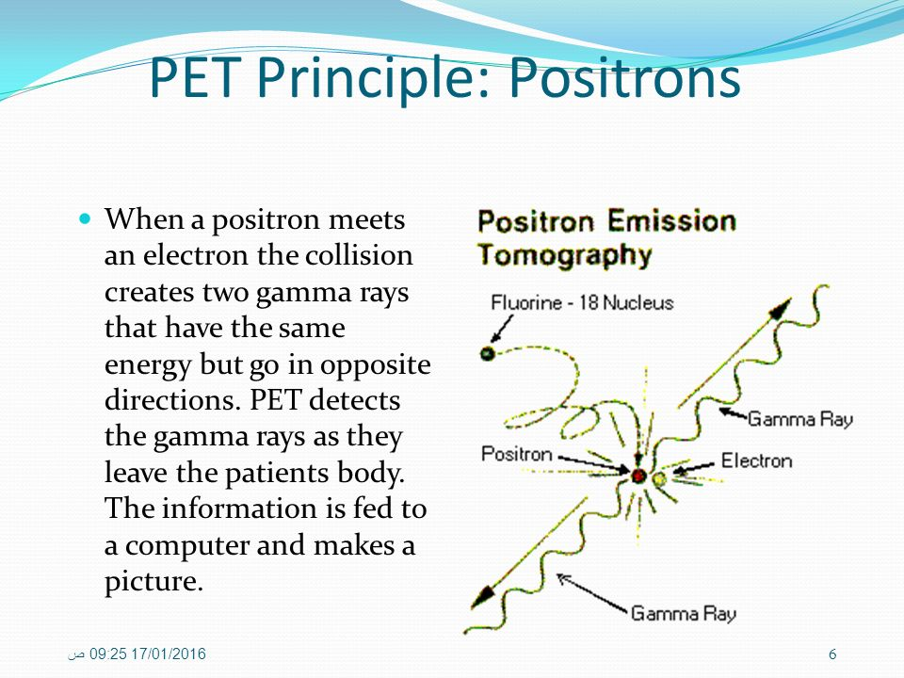
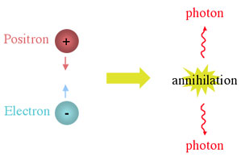
Positron
The positron or antielectron is the antiparticle or the antimatter counterpart of the electron. The positron has an electric charge of +1 e, a spin of 1/2 (the same as the electron), and has the same mass as an electron. When a positron collides with an electron, annihilation occurs.

Slide 11
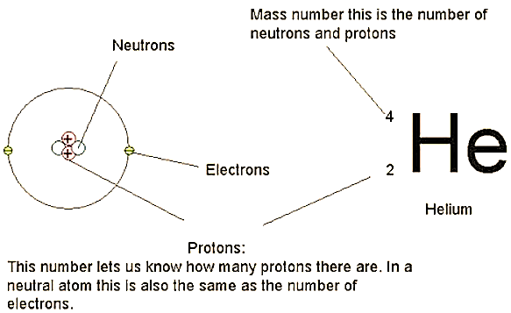
Subatomic Particles:
The sum of the masses of the protons and neutrons accounts for most of the atomic mass “weight” of the element, and the number of protons is equal to the atomic number.

Slide 12
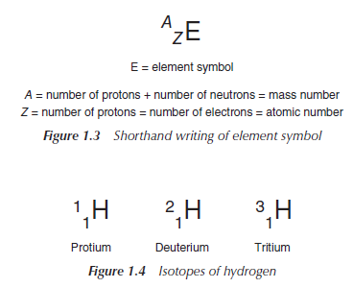
Atoms of the same element can have different numbers of neutrons; the different possible versions of each element are called isotopes. The numbers of protons and electrons are the same for each isotope, as they define the element and its chemical behaviour.
For example, the most common isotope of hydrogen called protium has no neutrons at all. There are two other hydrogen isotopes: deuterium, with one neutron, and tritium, with two neutrons

Slide 13
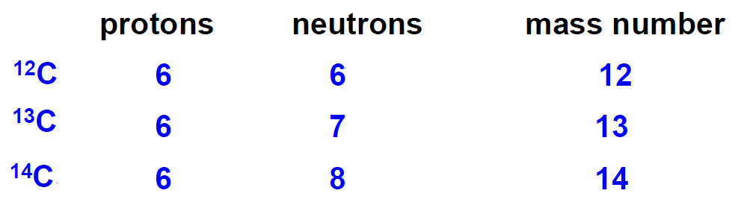
Subatomic Particles:
Isotopic forms of a particular element differ in the number of neutrons, and, therefore, in the atomic mass.
Do isotopes have the same atomic number?

Slide 14
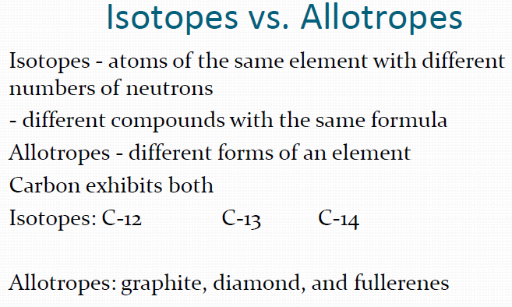
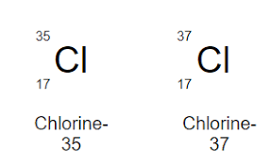
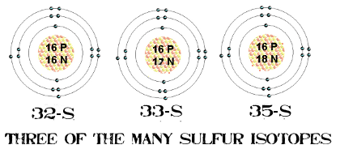


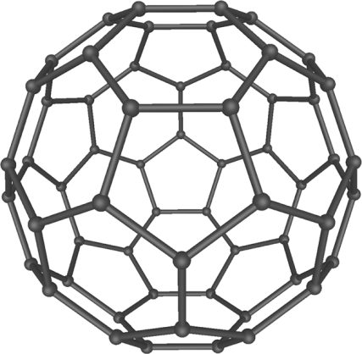

Slide 15
Heisenberg principle:
Also known as Uncertainty principle.
Introduced first in 1927, by the German physicist Werner Heisenberg, it states that the more precisely the position of some particle is determined, the less precisely its momentum [mass. Velocity] can be known, and vice versa. (only for small objects like electrons)
Thus, it is necessary to discuss the "location" of electrons in atoms and molecules in terms of probability.

Slide 16
Atomic Orbitals
Atomic orbitals are defined as discrete volumes of space about the nucleus that the electrons are placed in.
The electrons (contained within the boundaries of these orbitals) are described by a set of four numbers called quantum numbers.
The four quantum numbers set the probability limits within which an electron can be found.
The first three quantum numbers refer to some property of the space or orbital, while the fourth quantum number describes the spin of the electron.

Slide 17
The four quantum numbers
The Principal Quantum Number (n).
The Suborbital Quantum Number (l).
The Magnetic Quantum Number (mℓ).
The Spin Quantum Number (m_{s}).

Slide 18
The Principal Quantum Number (n):
Quantum theory states that electrons in atoms exist in discrete energy levels.
The energy associated with the electron increases as it location farther from the nucleus.
The principal quantum number describes the relative positions of these energy levels and their distance from the nucleus.
The values of this number are integers(اعداد صحيحه) n = 1, 2, 3, ...
When n = 1 the electron is found in the energy level closest to the nucleus.

Slide 19
The Suborbital Quantum Number(l):
Also called the "angular quantum number," can be any value in the range 0 , 1, 2 , ... n - 1.
The secondary quantum number divides the shells into smaller groups of orbitals called sub shells (sublevels).
Usually, a letter code is used to identify (l) to avoid confusion with (n).

Slide 20
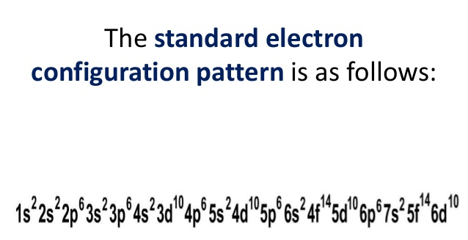
The Suborbital Quantum Number(l):
For example: when n = 1, (l) can only equal 0; meaning that shell n = 1 has only an s orbital (l = 0). when n = 3, (l) can equal 0, 1, or 2; meaning that shell n = 3 has s, p, and d orbitals.
Another example : the sub shell with n=2 and (l)=1 is the 2p subshell; if n=3 and l=0, it is the 3s subshell, and so on.
The following figure shows the shapes of the s, p, and d orbitals.

Slide 21
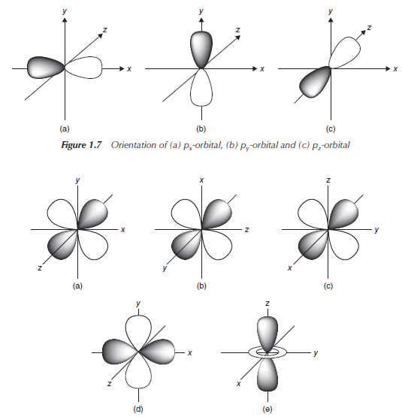
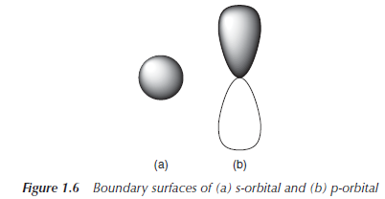
The Suborbital Quantum Number(l):

Slide 22
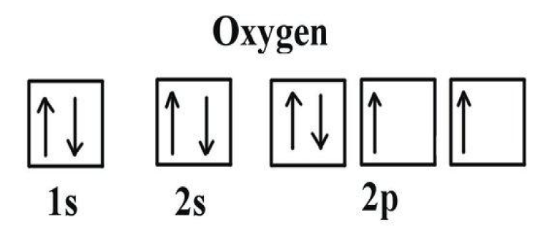
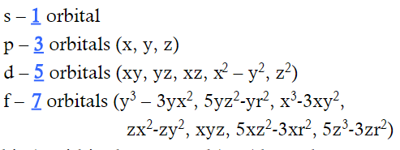
The Magnetic Quantum Number (mℓ):
Basically, this number describes the spatial orientation of the orbital.
The allowed values are restricted by the value of (l) and can be positive or negative integer:
(l) = 0, 1, 2, 3 Where s=0, p=1, d=2, f=3
mℓ = (-3, -2, -1, 0, +1,+2, +3)
s= 0
p= (-1, 0, +1) e.g. mℓ for oxygen = -1
d= (-2, -1, 0, +1,+2)
f= (-3, -2, -1, 0, +1,+2, +3)

Slide 23
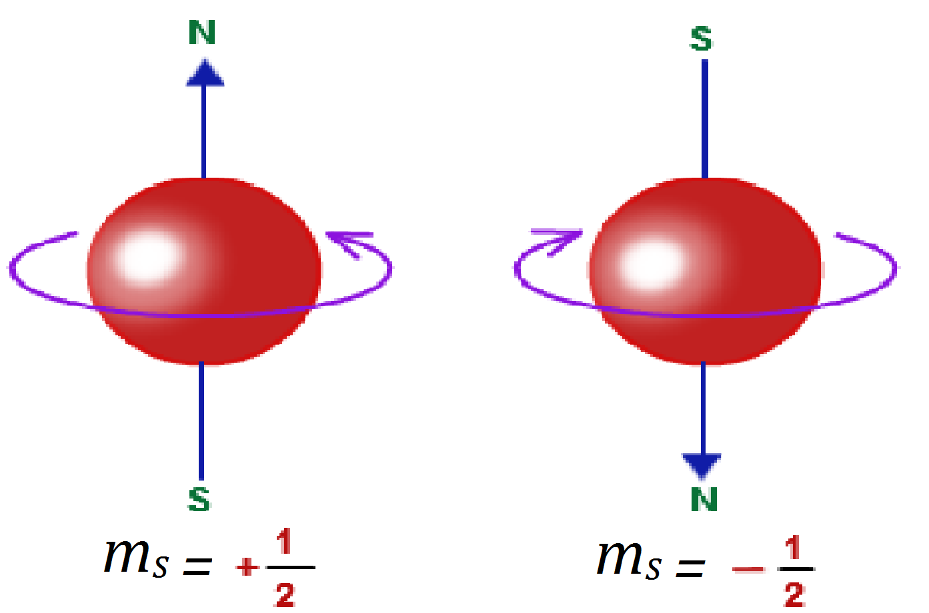
The Spin Quantum Number (m_{s}):
Specifies the orientation of the spin axis of an electron.
The spin quantum number describes the direction the electron is spinning in a magnetic field either clockwise or counter clockwise.
Only two values are allowed: +1/2 or -1/2.
For each subshell, there can be only two electrons, one with a spin of +1/2 and another with a spin of –1/2.

Slide 24
