Slide 1

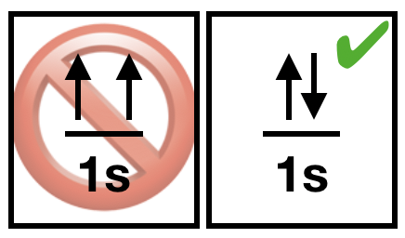
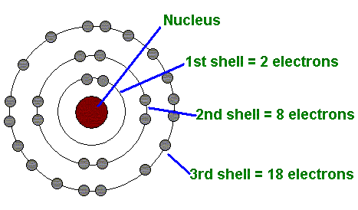
Inorganic Pharmaceutical Chemistry
Lec. 2: Atomic and Molecular structure/ Complexation
Dr. Mohammed Fanokh Al-Jubouri
Lecturer
in Pharmaceutical Chemistry
Third Stage
Semester I

Slide 2
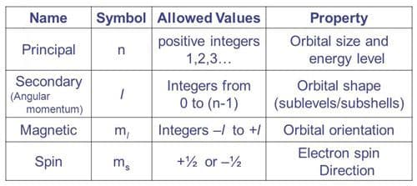
Review-1

Slide 3
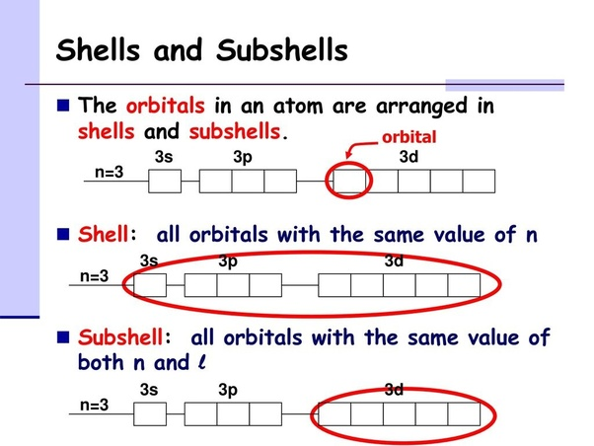
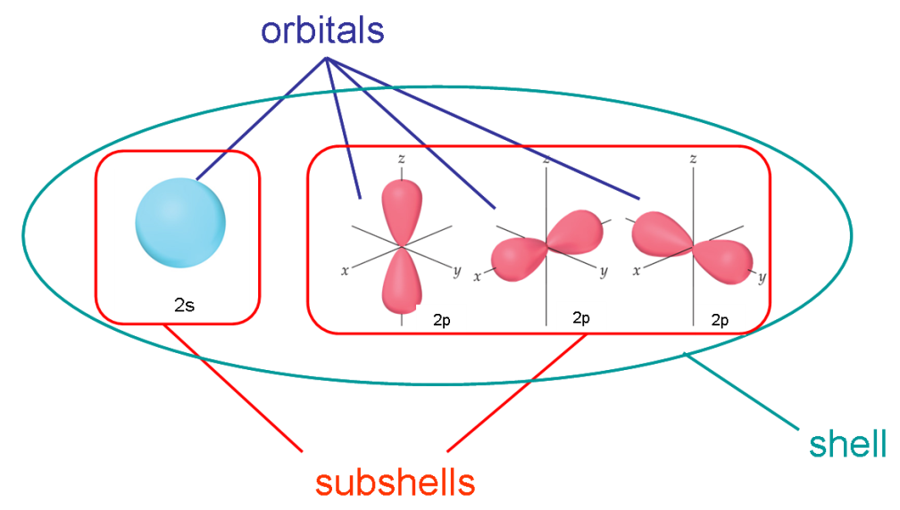
Review-2
The subshells are defined by the quantum number l (l =n−1), which as previously described correspond to the orbital labels s, p, d and f. The number of electrons that can be placed in each subshell can be determined by the following equation: 2(2l +1).
This allows two electrons to be placed in the s subshell
(l=0), six electrons in the p subshell (l =1) and 10 electrons in the d subshell (l=2).

Slide 4
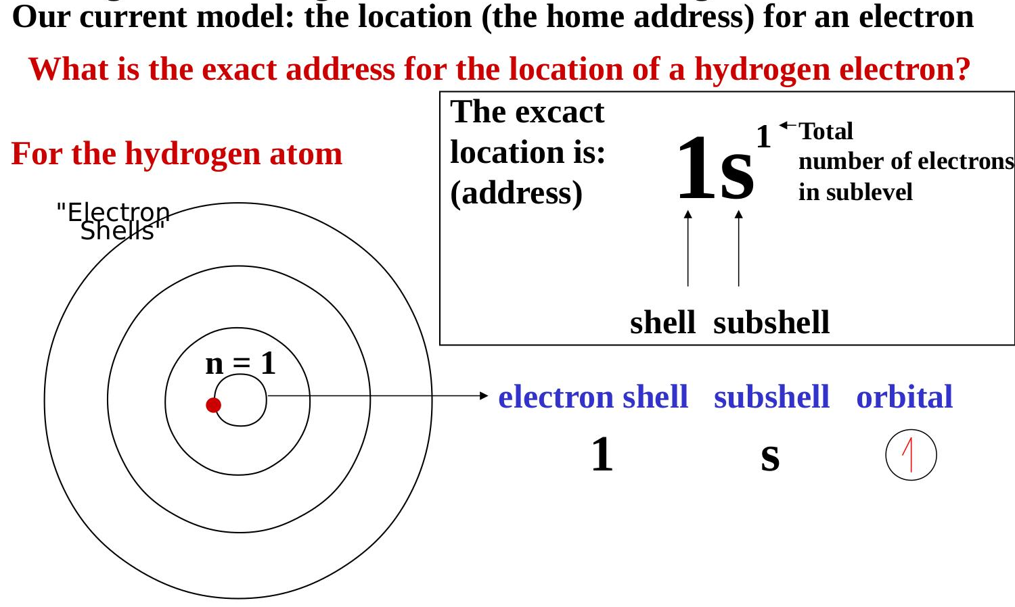
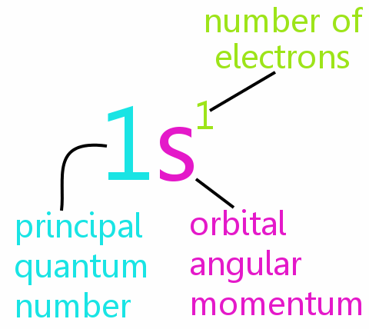
Review-3

Slide 5
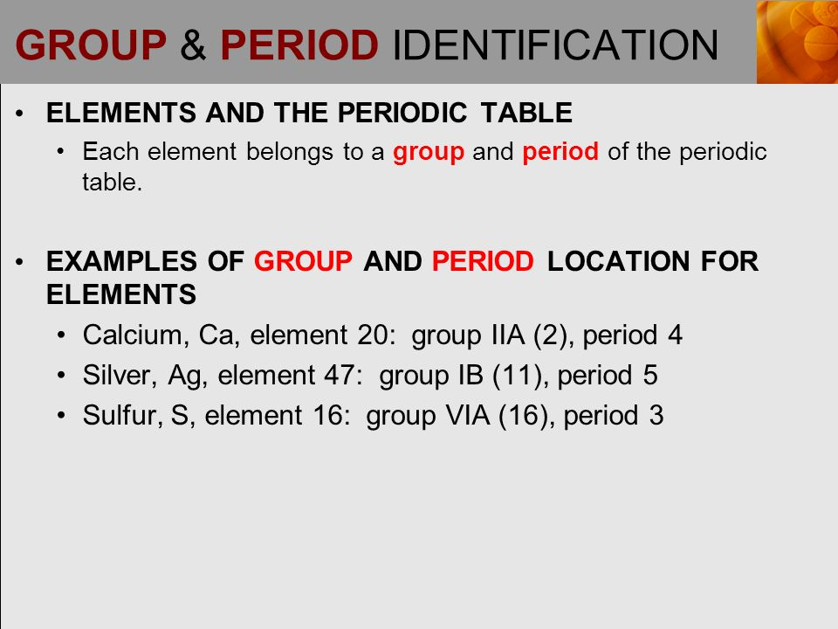

Slide 6
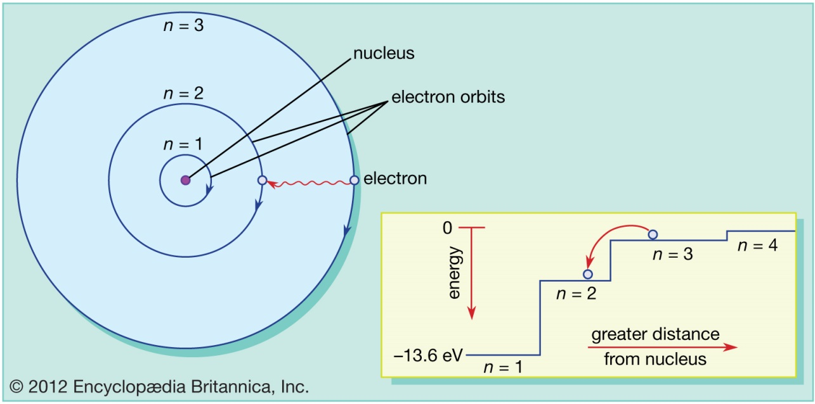

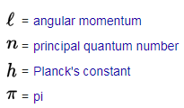
Bohr model of the atom
In the Bohr model of the atom, electrons travel in defined circular orbits around the nucleus. The orbits are labeled by an integer, the quantum number n. Electrons can jump from one orbit to another by emitting or absorbing energy.
The below figure shows an electron jumping from orbit n=3 to orbit n=2, emitting a photon of red light with an energy of 1.89 eV.
Note that, as the value of n increases, the electron is further away from the nucleus. The further away the electron is from the nucleus, the less tightly bound the electron is to the nucleus.

Slide 7
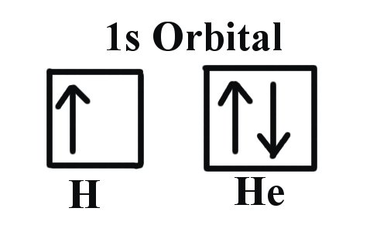
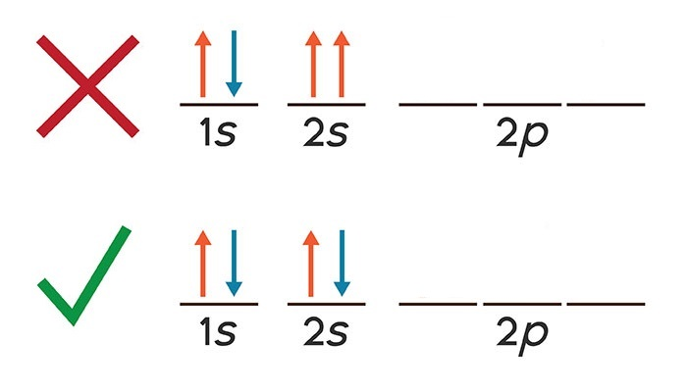
Pauli Exclusion Principle:
Pauli Exclusion Principle states that no two electrons can have the same four quantum numbers within the same atom.
Different direction of spin

Slide 8
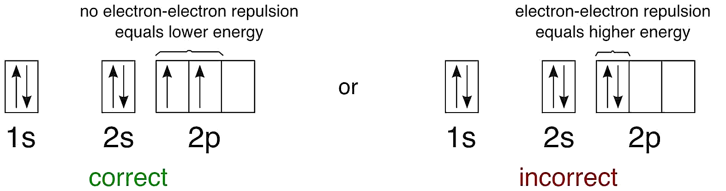
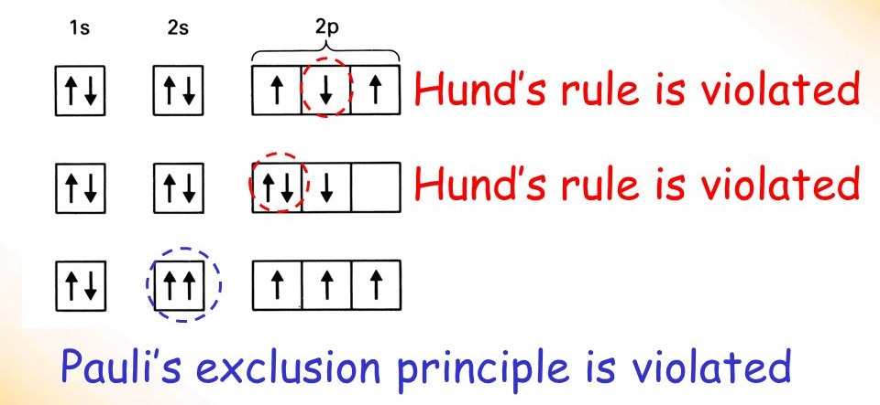
Hund's Rule:
If multiple orbitals have the same energy, one electron goes into each of them before they start to double up.

Slide 9
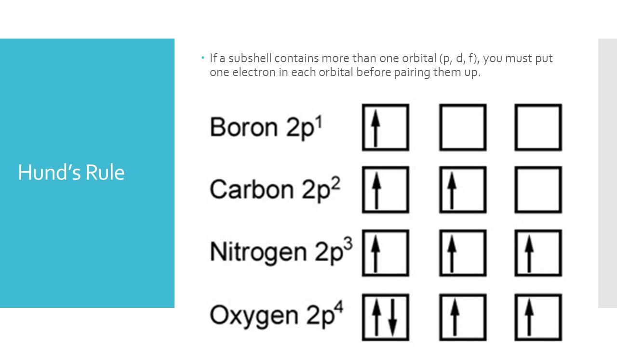

Slide 10
Electron Configurations:
With a knowledge of the quantum description of electrons in orbitals, it is now possible to approach the electronic structures.
The electron configuration is used to describe:
The orbitals of an atom in its ground state, but it can also be used to represent an atom that has ionized into a cation (+) or anion (-).
Many of the physical and chemical properties of elements can be correlated to their unique electron configurations.
The valence electrons, electrons on the outer most shell, become the determining factor for the unique chemistry of the element.

Slide 11
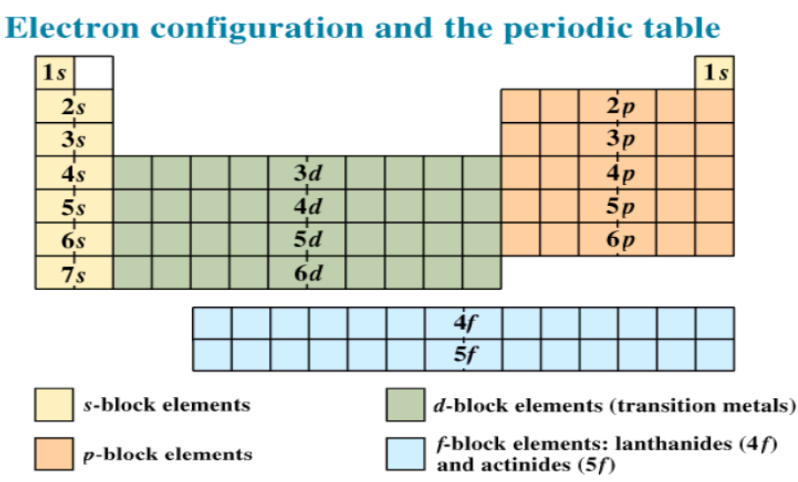
Electron Configurations:
Each orbital can be represented by specific blocks on the periodic table.
The s-block is the region of the Alkali metals including Helium (groups 1 and 2), the p-block are the main group elements from group 13 to 18, the d-block is the Transition metals (groups 3 to 12), and the f-block are the Lanthanides and Actinides series.

Slide 12
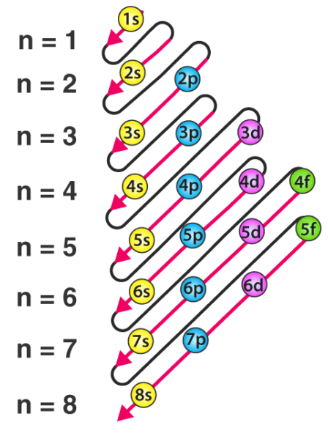
Assigning Electron Orbitals
The electrons in an atom would fill the principal energy levels in order of increasing energy (the electrons are getting farther from the nucleus). The order of levels filled would look like this:
1s, 2s, 2p, 3s, 3p, 4s, 3d, 4p, 5s, 4d, 5p, 6s, 4f, 5d, 6p, 7s, 5f, 6d, and 7p

Slide 13
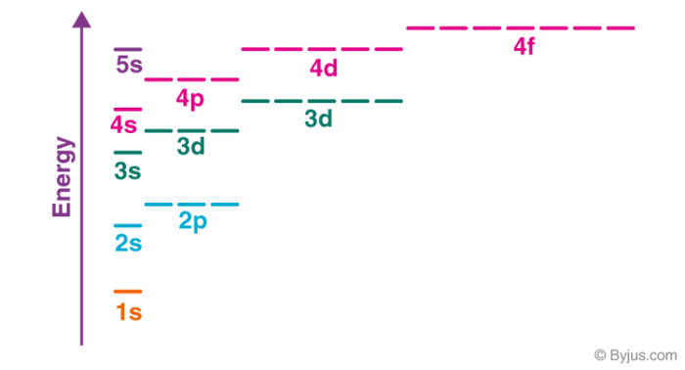
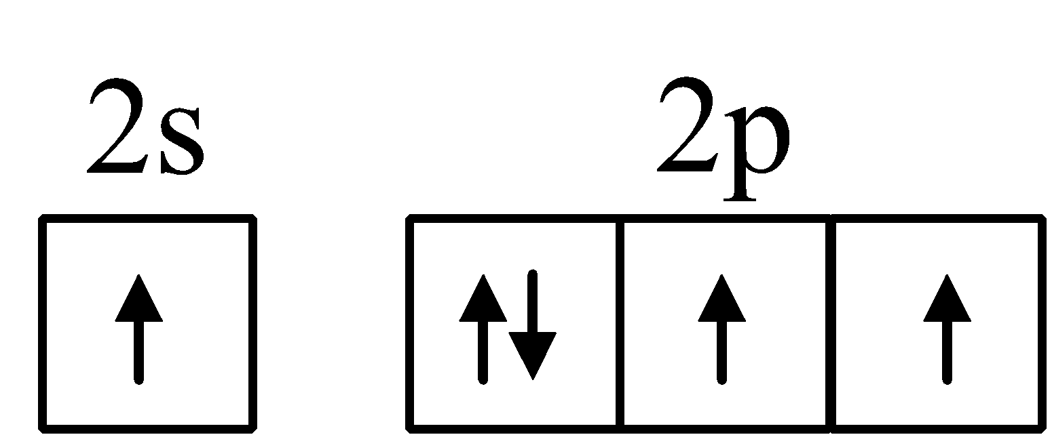
Aufbau Principle: Lazy Tenant Rule
The aufbau principle, from the German Aufbauprinzip (building-up principle), also called the aufbau rule, states that in the ground state of an atom or ion, electrons fill atomic orbitals of the lowest available energy levels before occupying higher levels.
Violated يخالف

Slide 14
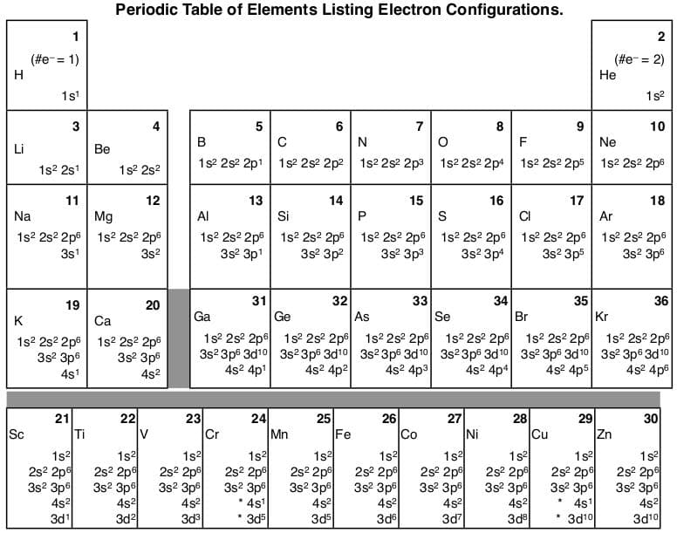

Slide 15
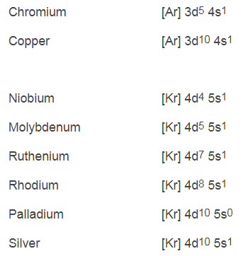
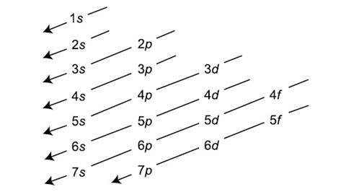
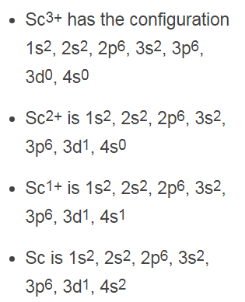
Exception to Aufbau
Aufbau Principle

Slide 16
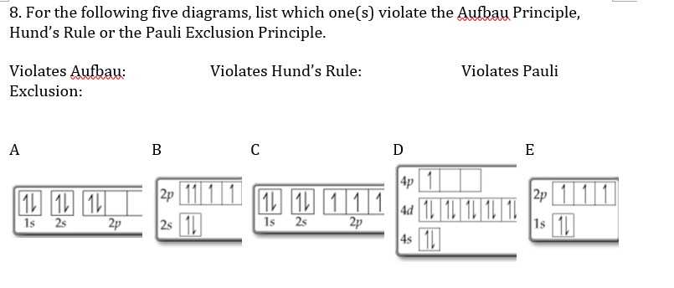

Slide 17
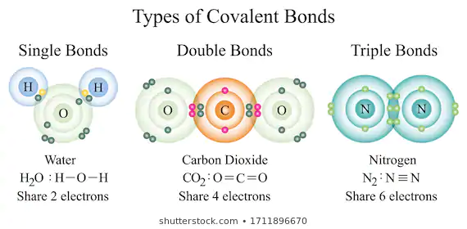
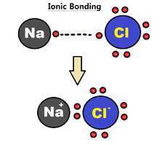
Type of Chemical Bonds
A covalent bond is defined as a chemical bond that is based on the sharing of electrons.
Ionic bond: Ionic bonds are strong bonds based on the transfer of electrons between the atoms and the resulting electrostatic attraction between the negatively and positively charged bond partners

Slide 18
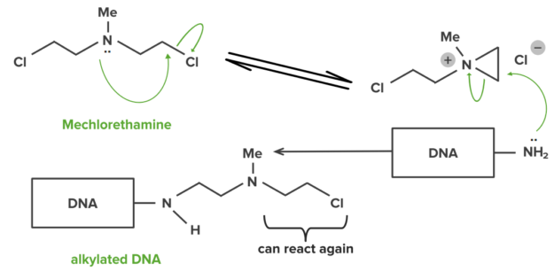
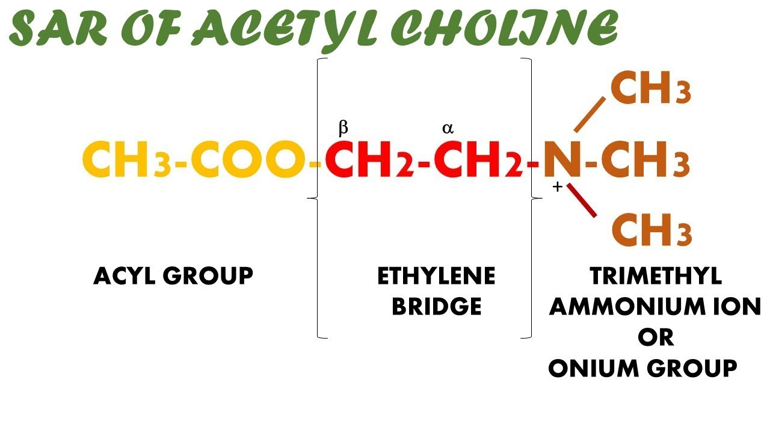
Example of covalent bond between drug and receptor
Example of ionic bond

Slide 19
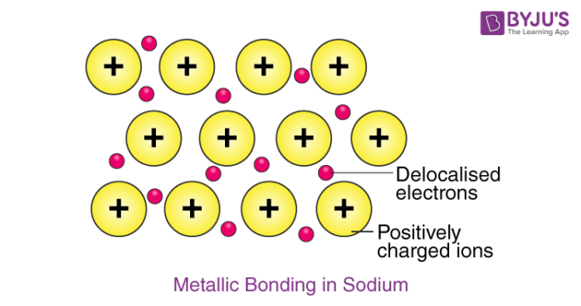
Metallic bond: A metallic bond is most commonly described as a type of chemical bond where the metal atom donates its valence electrons to a ‘pool’ of electrons that surrounds the network of metal atoms.
Electrons are not anymore identified with one particular atom but are seen as delocalised over a wide range. This is a very strong type of chemical bond. Electrical and thermal conductivity as well as malleability of metals can be explained using this model.

Slide 20
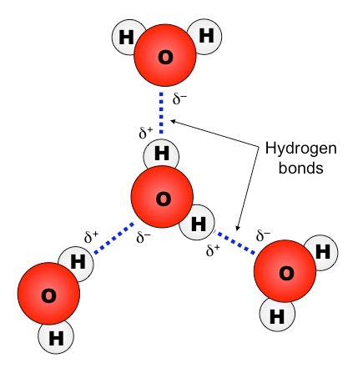
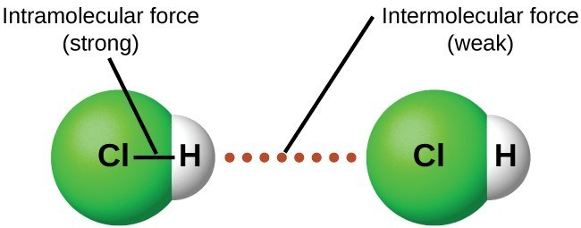
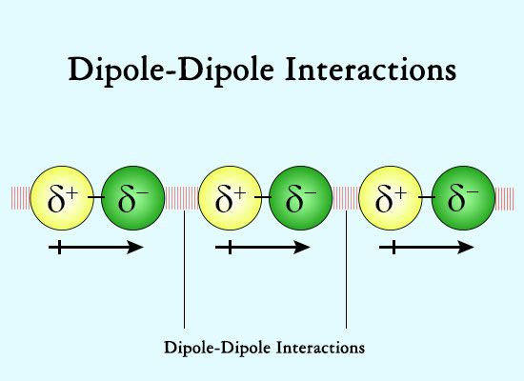
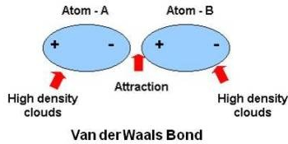
Types of intermolecular forces

Slide 21
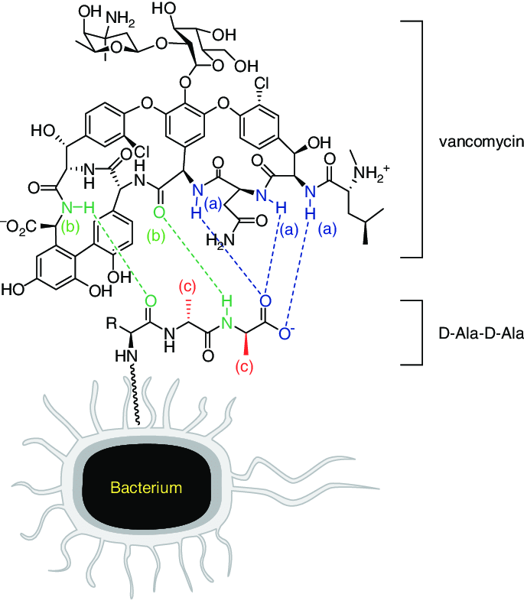
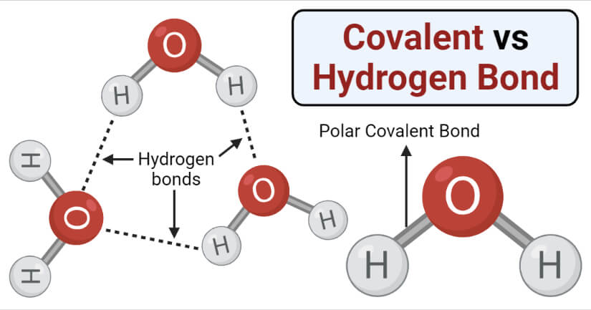
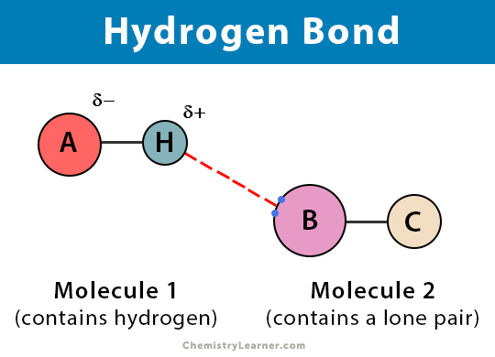


Slide 22
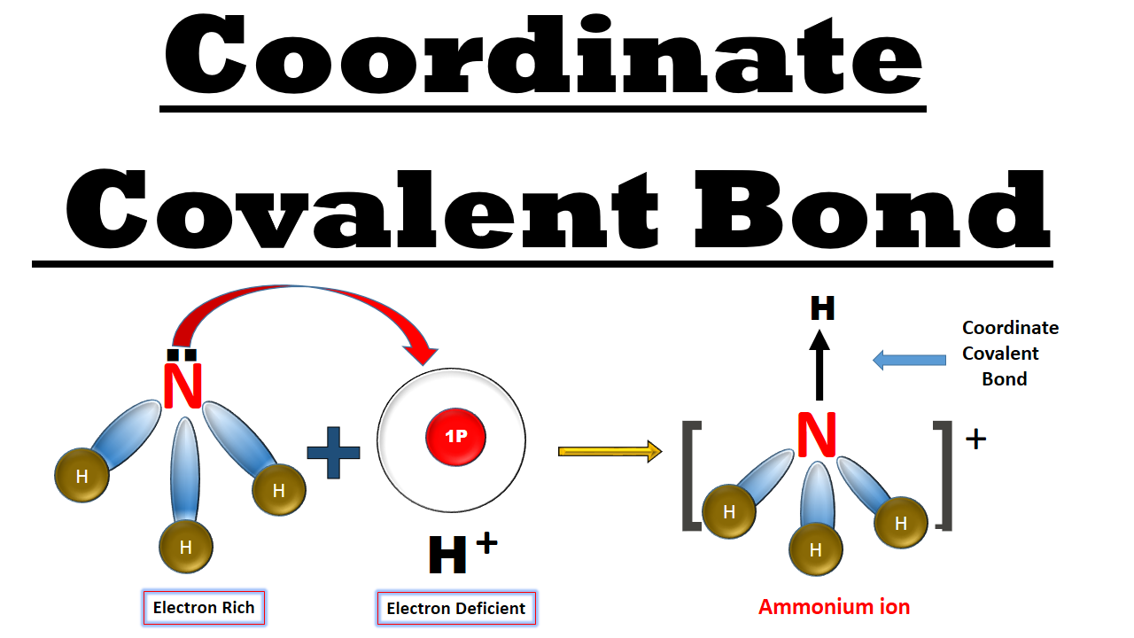
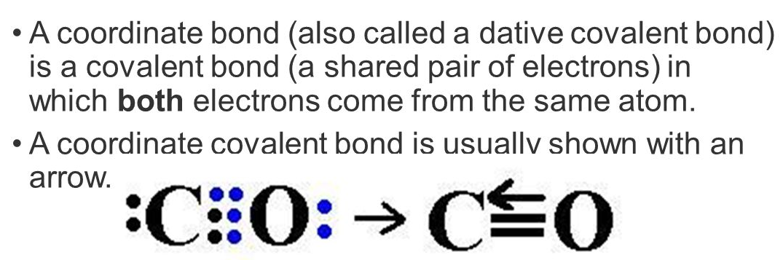

Slide 23
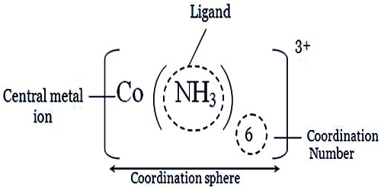
Coordination compound and Complexation:
Coordination complex: A structure containing a metal (usually a metal ion) bonded (coordinated) to a group of surrounding molecules or ions.
Ligand (Latin, to bind): A ligand is a molecule or ion that is directly bonded to a metal ion in a coordination complex.
A ligand uses a lone pair of electrons (Lewis base) to bond to the metal ion (Lewis acid)
Coordination sphere: A metal and its surrounding ligands

Slide 24
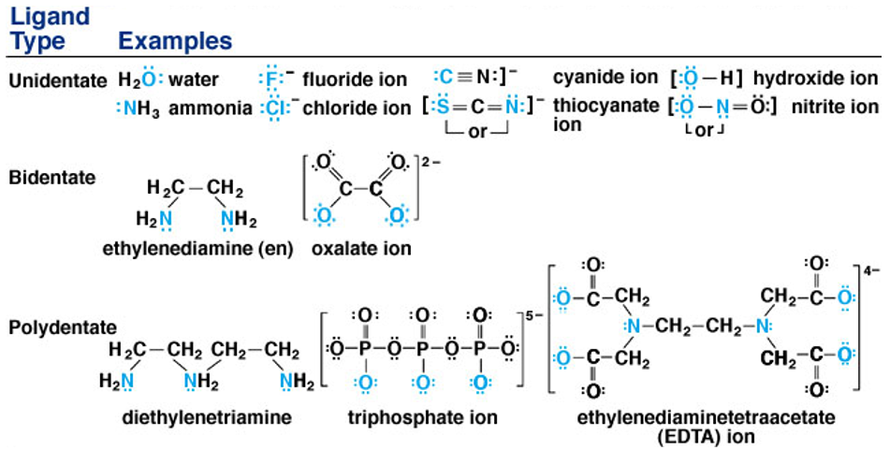
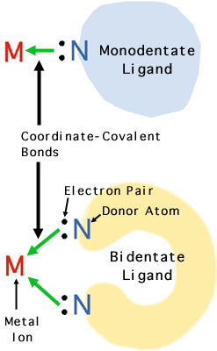

Slide 25
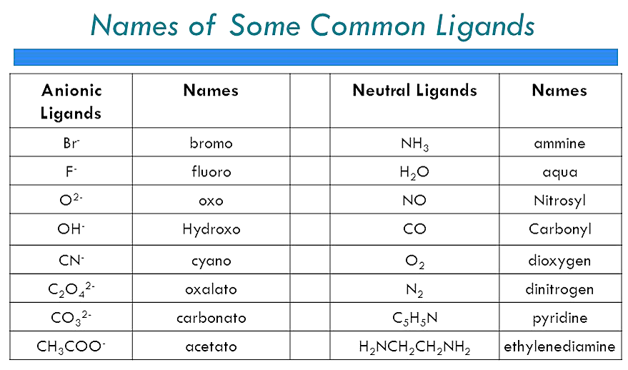

Slide 26
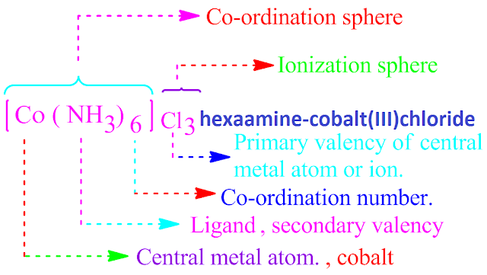
Werner's Coordination Theory:
In coordination compounds, central metal atoms exhibit primary valence and secondary valence.
    Primary valence is ionic that corresponds to oxidation state.
    Secondary valence is not ionic that corresponds to coordination number.
Every metal atom has a fixed number of secondary valence (coordination number).
The metal atom tends to satisfy both its primary valence as well as its secondary valence. Primary valence is satisfied by negative ions (metal ion has a positive charge) whereas secondary valence (coordination number) is satisfied either by negative ions or by neutral molecules).

Slide 27
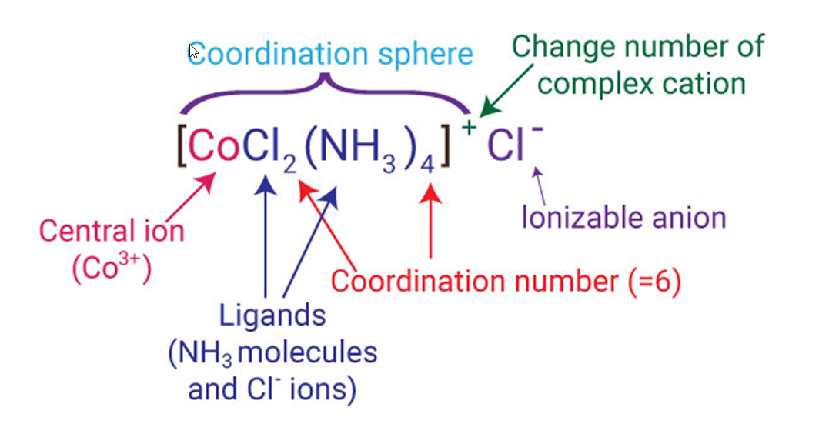
Coordination:
Coordination sphere: The central atom/ion and the ligands attached to it are enclosed in square bracket and is collectively termed as the coordination sphere.
For example: in the complex K₄[Fe(CN)₆], the coordination sphere is [Fe(CN)₆]⁴⁻ .
Counter ions: The ions present outside the coordination sphere are called counter ions. For example: in the complex K₄[Fe(CN)₆], K⁺ is the counter ion.

Slide 28
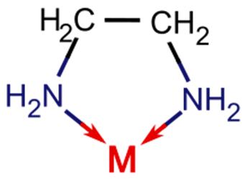
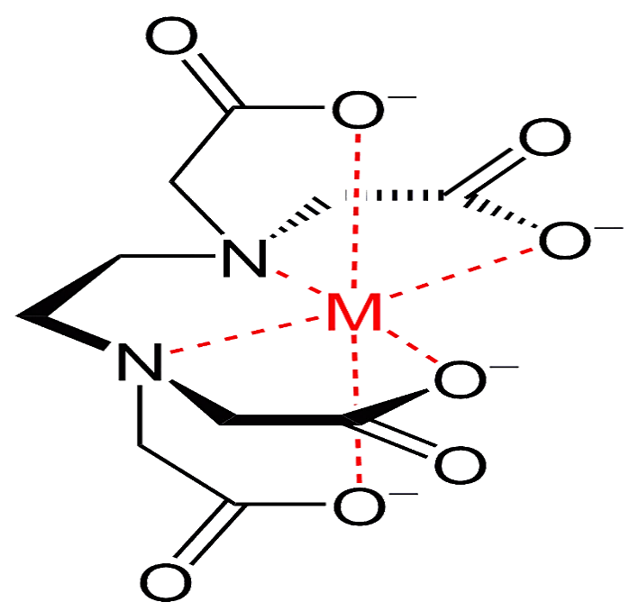
Complexation: chelation
The process of binding to the metal ion with more than one coordination site per ligand is called chelation.
Compounds that bind avidly to form complexes are thus called chelating agents, for example ethylenediamine (abbreviated as “en” when a ligand) and Ethylenediaminetetraacetic acid (EDTA).

Slide 29
Complexation:
The coordination number of a central atom in a molecule is the number of its near neighbours.
For molecules and polyatomic ions the coordination number of an atom is determined by simply counting the other atoms to which it is bonded (by either single or multiple bonds).
For example, [Cr(NH₃)₂Cl₂Br₂]¹⁻ has Cr³⁺ as its central cation, and has a coordination number of 6.
What is the coordination number of iron in K₄[Fe(CN)₆]

Slide 30
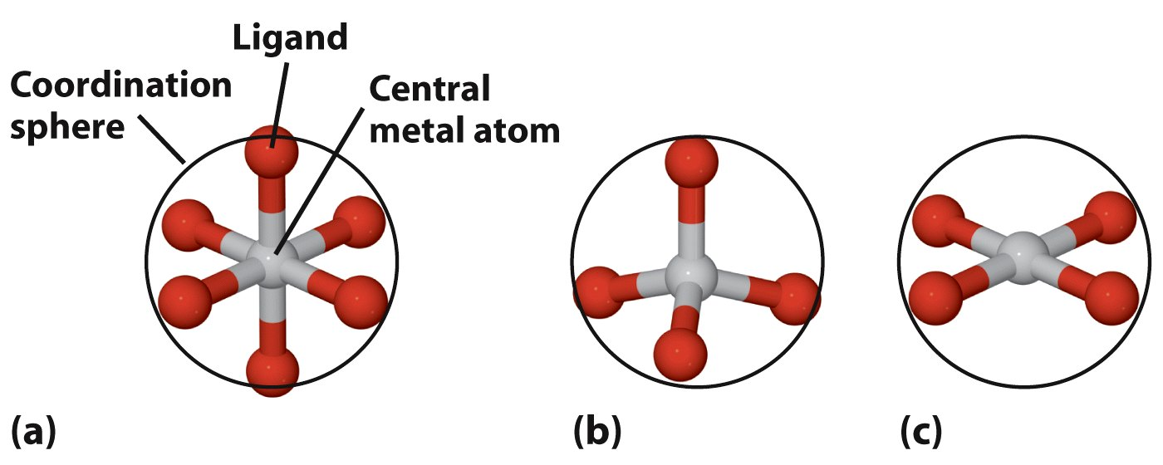
Geometry of Complex ions: Three common structural types
Octahedral:
Most important
Tetrahedral
Square planar

Slide 31
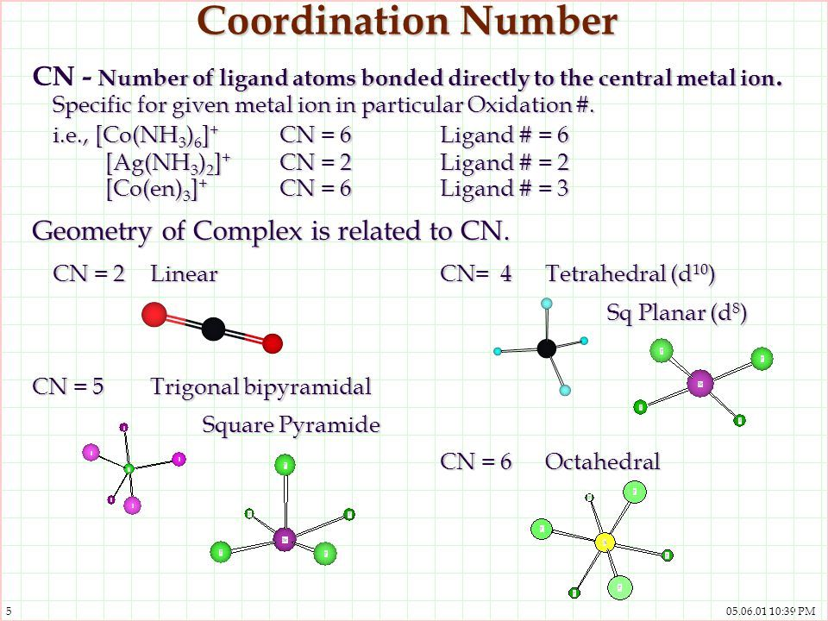

Slide 32
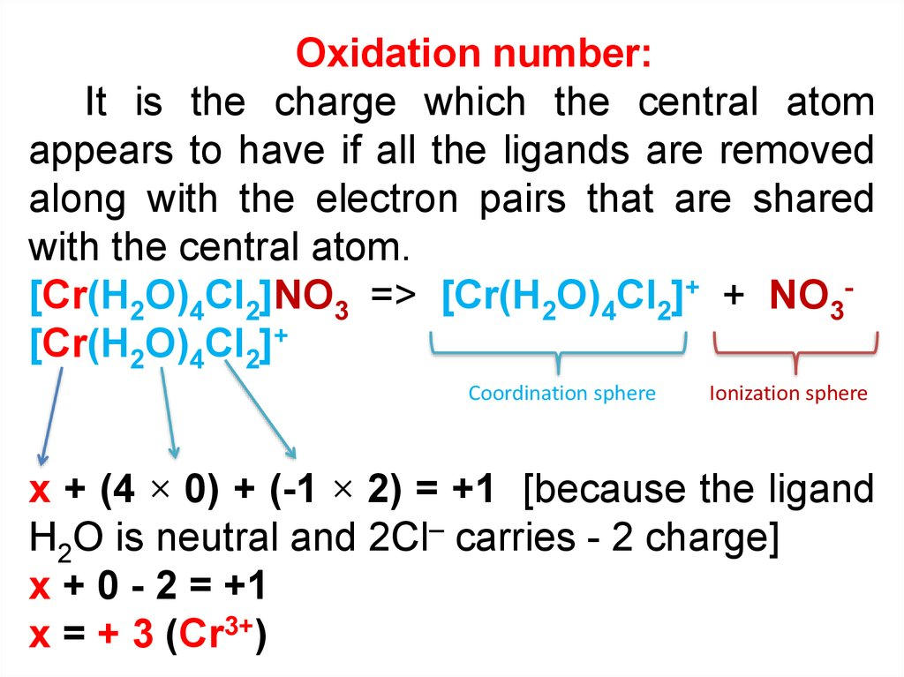

Slide 33
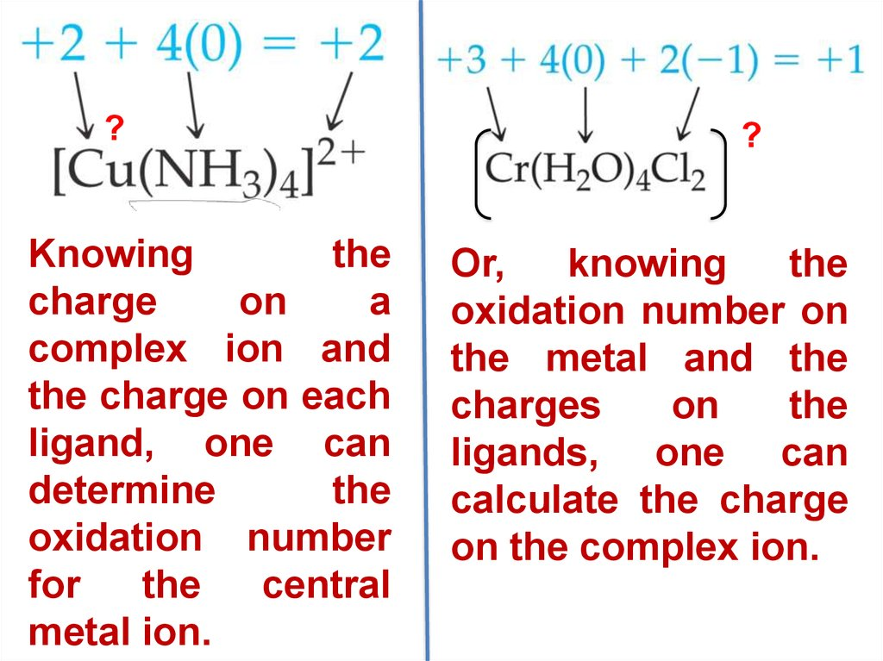

Slide 34

Deferoxamine mesylate
Deferoxamine is produced by removal of the trivalent iron moiety by Streptomyces pilosus. It is used to treat acute Iron toxicity. It is chelating agents reacts with ferric to produce feroxamine and hence reduce the damage to various organs and tissue such as liver, heart and endocrine glands

Slide 35


It is specifically used in iron overdose, hemochromatosis either due to multiple blood transfusions or an underlying genetic condition.

Slide 36


Dimercaprol is a medication used to treat acute poisoning by arsenic, mercury, gold, and lead. Arsenic and some other heavy metals act by chemically reacting with adjacent thiol residues on metabolic enzymes, creating a chelate complex that inhibits the affected enzyme's activity.
Dimercaprol competes with the thiol groups for binding the metal ion, which is then excreted in the urine
Is penicillamine a penicillin?
Penicillamine is d-isomer of dimethylcysteine, a breakdown product of penicillin, which was originally isolated from the urine of patients with liver disease receiving penicillin. It was later found to have chelating properties against copper and used in Wilson disease (genetic disorder, copper accumulation in tissue).

Slide 37

Homework:
Give the coordination number and the oxidation state for the following central metal atoms:

