Slide 1
Inhalation Anesthetics
Dr : Miaad Adnan
2022/2023
Dr. Bassim Mohammed Jabbar

Slide 2
Basic Principles of Anesthesia :
1
Anesthesia defined as the abolition of sensation
Analgesia defined as the abolition of pain
“Triad of General Anesthesia”
  Need for unconsciousness
  Need for analgesia
  Need for muscle relaxation

Slide 3
Inhalational Anesthetic Agents :
2
Inhalational anesthesia refers to the delivery of gases or vapors from the respiratory system to produce anesthesia
Pharmacokinetics--uptake, distribution, and elimination from the body
Pharmacodyamics-- MAC value

Slide 4
Ideal Characteristics :
3
1. Be pleasant to inhale, permitting a smooth induction and emergence.
2. Be potent to allow the concomitant administration of high oxygen.
3. Rapid induction and emergence (low solubility).
4. Be easy to administer .

Slide 5
Ideal Characteristics :
4
5. Be easily and cheaply prepared in pure form.
6. Be stable in storage and with soda-lime, not flammable, not metabolized.
7. Act at specific CNS sites to cause unconsciousness.
8. No CVS or respiratory effects, non-toxic to organ systems.
9. Provide postop pain relief .

Slide 6
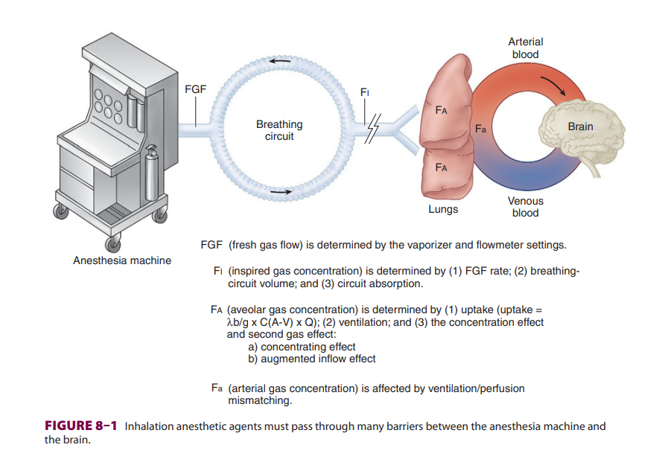

Slide 7
Pharmacokinetics of Inhalation Anesthetics
5
I) FACTORS AFFECTING INSPIRED GAS CONCENTRATION (FI)
II) FACTORS AFFECTING ALVEOLAR GAS CONCENTRATION (FA)
A ) Uptake
B ) Ventilation
C ) Concentration

Slide 8
I) FACTORS AFFECTING INSPIRED GAS CONCENTRATION (FI)
6
Fresh Gas Flow Rate ↗ ( Increase )
Volume of Breathing system ↘ ( Decrease )
Gas Absorption by anaesthetic machine or breathing circuit ↘ ( Decrease )
So Inspired Gas Concentration near to fresh gas Concentration

Slide 9

II) FACTORS AFFECTING ALVEOLAR GAS CONCENTRATION (FA) :
7
A ) Uptake :
Uptake $\frac{1}{∝}$ alveolar gas Concentration
If Decrease or no uptake (alveolar gas Concentration reach to the inspired gas Concentration)
If uptake ↗ → slow raise in alveolar Concentration slow induction

Slide 10
II) FACTORS AFFECTING ALVEOLAR GAS CONCENTRATION (FA) :
9
A ) Uptake :
Therefore, the greater the uptake of anesthetic agent, the greater the difference between inspired and alveolar concentrations, and the slower the rate of induction.

Slide 11
II) FACTORS AFFECTING ALVEOLAR GAS CONCENTRATION (FA) :
10
A ) Uptake / FACTOR Affecting uptake :
1) Solubility in the blood
2) Alveolar blood flow
3) Difference in partial pressure between alveolar gas and venous blood

Slide 12
II) FACTORS AFFECTING ALVEOLAR GAS CONCENTRATION (FA) :
11
A ) Uptake / FACTOR Affecting uptake :
1 - Solubility ( partition coefficient )
Less Soluble --→ less uptake --→ more raise in alveolar Concentration --→ rapid induction of anaesthetic
E.g : ( Nitrous Oxide )
more Soluble --→ more uptake --→ less raise in alveolar concentration --→ slow induction
E.g ( Halothane )

Slide 13
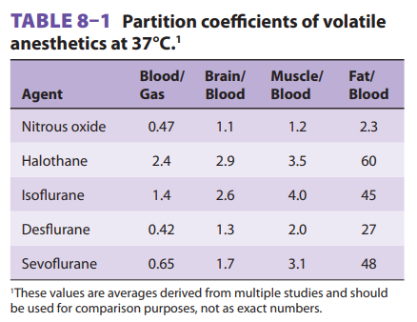
Inhalation Anesthetics / Table 1 :
13

Slide 14
II) FACTORS AFFECTING ALVEOLAR GAS CONCENTRATION (FA) :
13
A ) Uptake / FACTOR Affecting uptake :
2 ) Alveolar blood flew ( Cardiac output “COP” ) :
↘ COP ∝ ↘ uptake ---→ ↗ raise in alveolar partial pressure ---→ rapid induction of anaesthesia (This effect for soluble more than in soluble ---→ so in ↘ COP (shock PT ) so need to ↘ in MAC

Slide 15
II) FACTORS AFFECTING ALVEOLAR GAS CONCENTRATION (FA) :
14
A ) Uptake / FACTOR Affecting uptake :
3 ) Difference in partial pressure between alveolar gas and venous blood
If not pass to organs E.g. ( Brain )
(venous and alveolar partial pressure ) equal ---→ No uptake

Slide 16
II) FACTORS AFFECTING ALVEOLAR GAS CONCENTRATION (FA) :
14
A ) Uptake / FACTOR Affecting uptake :
Systemic Uptake
Transfer of anesthetic agent from blood to tissues ---→ systemic uptake
1 – Tissue /blood partition coefficient (solubility )
2 – Tissue blood flow
3 – Deference in partial pressure between Arterial blood and tissue

Slide 17
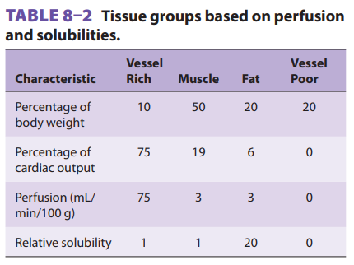
Inhalation Anesthetics / Table 2 :
15

Slide 18
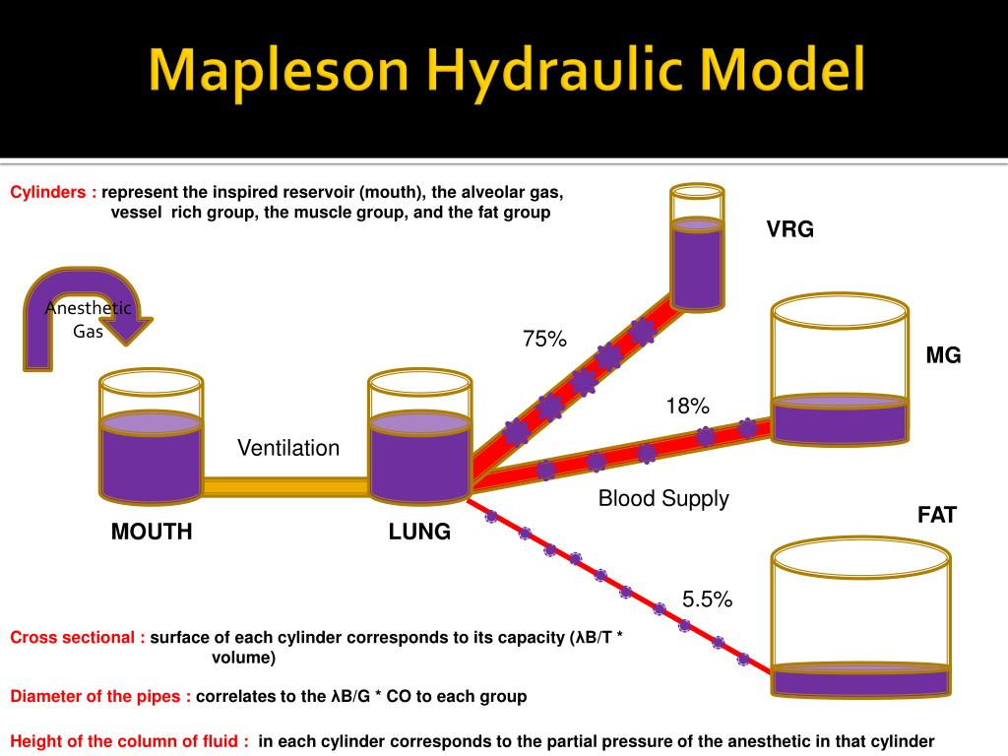

Slide 19
II) FACTORS AFFECTING ALVEOLAR GAS CONCENTRATION (FA) :
16
B ) Ventilation
↗ Ventilation ---→ ↗ alveolar anaesthetic concentration ---→ rapid induction in (soluble) anaesthetic agent
No effect for (insoluble) agent
C ) Concentration
↗ Anaesthetic gas concentration ---→ rapid induction of anaesthesia

Slide 20
What is MAC ? :
18
Minimum Alveolar Concentration :
Minimal alveolar concentration of inhalational agent that prevent movement in 50% of the patients in response to surgical stimulation (skin incision)
Equivalent to ED50
For the same agent, varies with age, temperature and other drugs on board

Slide 21
A -Respiratory Effects of Inhalation Anesthetics
19
Abolish the hypoxic response
at less than half MAC concentrations
Fantastic bronchodilators by
direct action on smooth muscle

Slide 22
B - Cardiovascular Effects of Inhalation Anesthetics :
20
All cause cardiac depression
Cardiac depression causes an increased rate of gas alveolar concentration rise
Isoflurane and desflurane cause increased heart rate which may mask cardiac depression
Systemic vascular resistance
• Isoflurane and desflurane decrease (great for starting IVs)
• Halothane and nitrous oxide do not change
• Steal phenomena

Slide 23
C - CNS Effects of Inhalation Anesthetics :
22
Hypnotic, not analgesic
Cause unconsciousness
Spinal cord depression (lack of reflexes)
D - Renal Effects of Inhalation Anesthetics :
All decrease arterial pressure
RBF (Renal Blood Flow) and GFR (Glomerular Filtration Rate) will be maintained until threshold of autoregulation,
Enflurane nephrotoxic

Slide 24
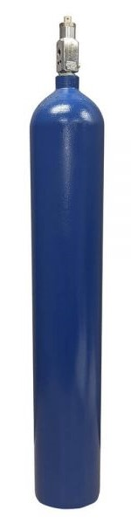
1 - Nitrous Oxide :
24
Characterized by inert nature with minimal metabolism
Colorless, odorless, tasteless, and does not Flammable
Only anesthetic agent that is inorganic
Week Anesthetic good analgesic agent
Not metabolized
N2O

Slide 25
1 - Nitrous Oxide :
25
low potency
MAC value is 105%
Weak anesthetic, powerful analgesic
Needs other agents for surgical anesthesia
Low blood solubility (quick recovery)

Slide 26
1 - Nitrous Oxide :
27
Minimal effects on heart rate and blood pressure
May cause myocardial depression in sick patients
Little effect on respiration

Slide 27
1 - Nitrous Oxide / Side Effects :
27
Hypoxic mixtures can be used
Large volumes of gases can be used
Beginning of case: second gas effect
End of case: diffusion hypoxia
Diffusion into closed spaces
Inhibits vitamin B-12 metabolism

Slide 28
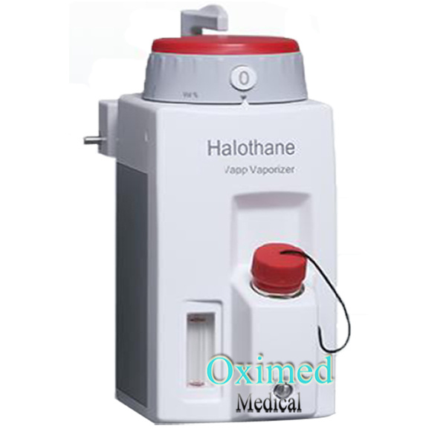
2 – Halothan :
28
Halogen substituted ethane
Volatile liquid easily vaporized, stable, and nonflammable
Most potent inhalational anesthetic
MAC of 0.75%
Very soluble in blood and adipose

Slide 29
2 – Halothane Systemic Effects :
29
Inhibits sympathetic response to painful stimuli
Inhibits sympathetic driven baroreflex response (hypovolemia)
Sensitizes myocardium to effects of exogenous catecholamines-- ventricular arrhythmias

Slide 30
2 – Halothane Systemic Effects :
30
Decreases respiratory drive-- central response
to CO2 and peripheral to O2
Depresses myocardium-- lowers BP
Mild peripheral vasodilation

Slide 31
2 – Halothane Systemic Effects :
31
“Halothane Hepatitis” -- 1/10,000 cases
  fever, jaundice, hepatic necrosis, death
  metabolic breakdown products are hapten-protein conjugates
  immunologically mediated assault
  exposure dependent

Slide 32
2 – Halothane Systemic Effects :
32
Malignant Hyperthermia-- 1/60,000 with succinylcholine
to 1/260,000 without
Classic-- rapid rise in body temperature, muscle rigidity, tachycardia, rhabdomyolysis, acidosis, hyperkalemia, DIC
Family history

Slide 33
2 – Halothane Systemic Effects :
33
Malignant Hyperthermia
  high association with muscle disorders
  autosomal dominant inheritance
  diagnosis--previous symptoms, increase CO2, rise in CPK
  levels, myoglobinuria, muscle biopsy
  physiology--hyper metabolic state by inhibition of calcium
  reuptake in sarcoplasmic reticulum

Slide 34
2 – Halothane Systemic Effects :
34
Malignant Hyperthermia (Treatment) :
  Early detection .
  Stop agents .
  Change breathing circuit .
  Change anesthetic machine if possible .
  Hyperventilate (Increase respiratory rate ) .
  Sodium Bicarbonate .
  Antidot IV dantrolene (2.5 mg/kg) .
  Ice packs/cooling blankets.
  Lasix / Mannitol / Fluids.
  ICU monitoring

Slide 35
3 – Enflurane /Systemic Effects :
36
Stable, nonflammable liquid
MAC 1.68%
Stable, nonflammable liquid MAC 1.68%
Potent inotropic and chronotropic depressant and decreases systemic vascular resistance-- lowers blood pressure and conduction dramatically
Inhibits sympathetic baroreflex response
Sensitizes myocardium to effects of exogenous catecholamines-- arrhythmias

Slide 36
3 – Enflurane /Systemic Effects :
37
Respiratory drive is greatly depressed-- central and peripheral responses
‣ Increases dead space
‣ Produces hypercarbia (icrease CO2 ) in
Spontaneously breathing patient

Slide 37
3 – Enflurane /Systemic Effects :
38
Metabolism one-tenth that of halothane-- does not release quantity of hepatotoxic metabolites
Metabolism releases fluoride ion-- renal toxicity
Epileptiform EEG patterns

Slide 38
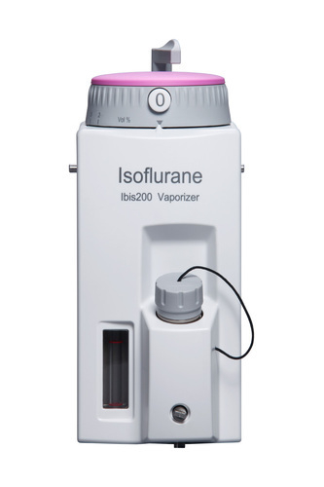
4 – Isoflurane :
39
Nonflammable,pungent
Less soluble than halothane or enflurane
MAC of 1.30 %
Steal phenomena
Not carcinogenic

Slide 39
4 – Isoflurane / Systemic Effects :
40
Depresses respiratory drive and ventilatory responses-- less than Enflurane
Myocardial depressant-- less than Enflurane
Inhibits sympathetic baroreflex response-- less than Enflurane
Sensitizes myocardium to catecholamines -- less than halothane or Enflurane

Slide 40
4 – Isoflurane / Systemic Effects :
41
Produces most significant reduction in systemic vascular resistance-- coronary steal syndrome, increased ICP
Excellent muscle relaxant-- potentiates effects of neuromuscular blockers

Slide 41
4 – Isoflurane / Systemic Effects :
42
Little metabolism (0.2%) -- low potential of organ toxic metabolites
No EEG activity like Enflurane
Broncho irritating, laryngospasm

Slide 42
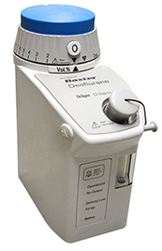
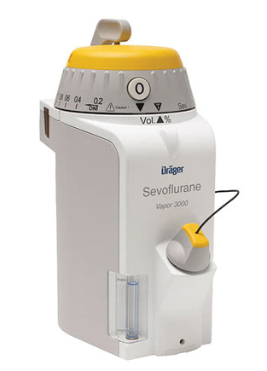
5 – Sevoflurane and Desflurane:
43
Low solubility in blood-- produces rapid induction and emergence
Minimal systemic effects-- mild respiratory and
cardiac suppression
Few side effects
Expensive
Sevoflarane …….compound A
Desflurane ……….Special vaporizer

Slide 43
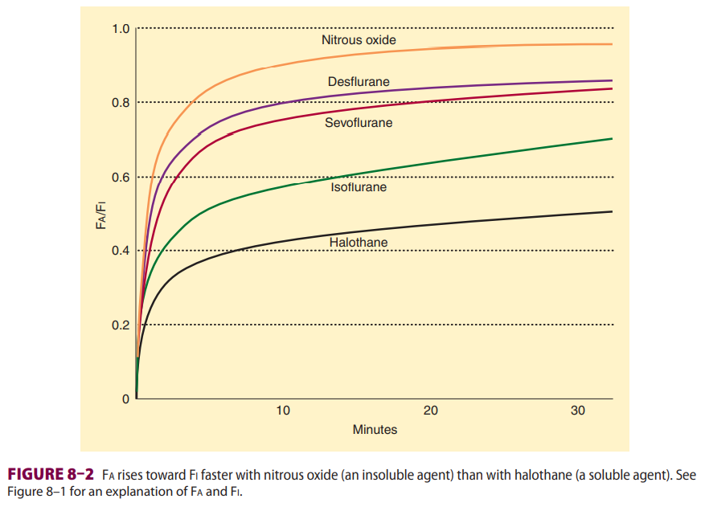
Table 3 :
44

Slide 44
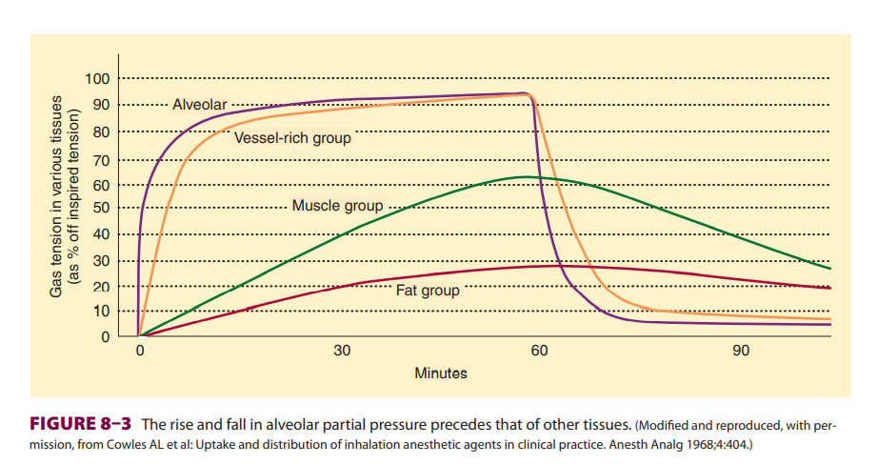
Inhalation Anesthetics / Table 4 :
45

Slide 45
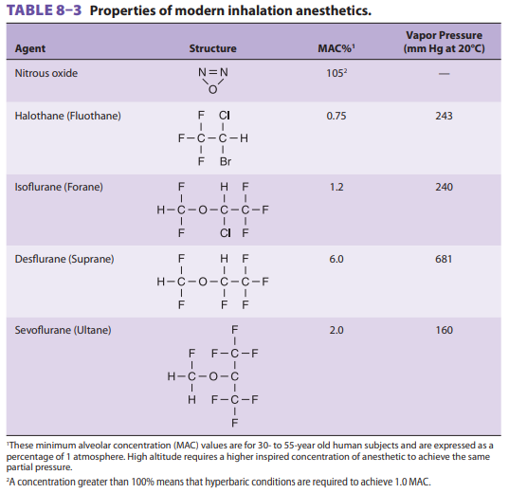
Table 6 :
46

Slide 46
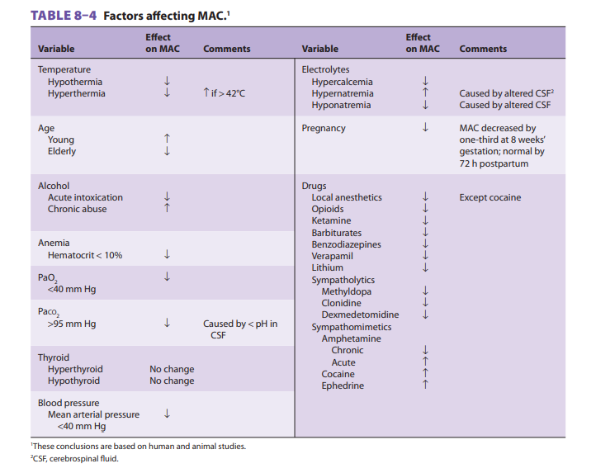
Table 7 :
47
2

Slide 47
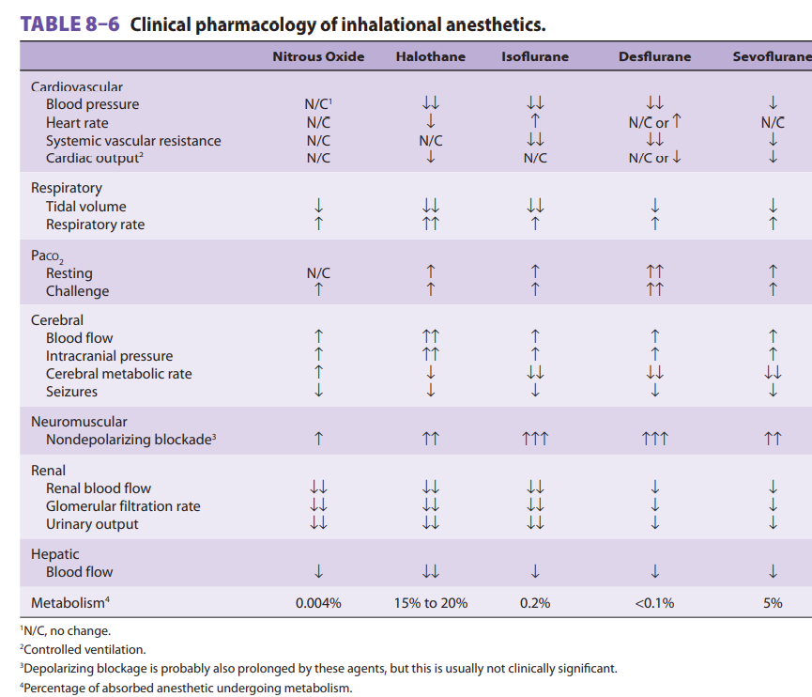
Table 9 :
48

Slide 48
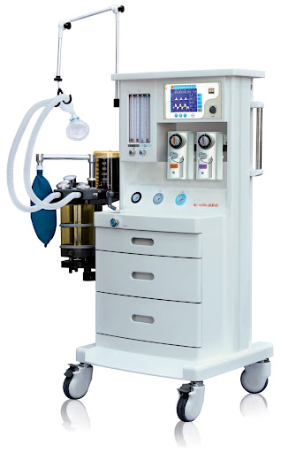
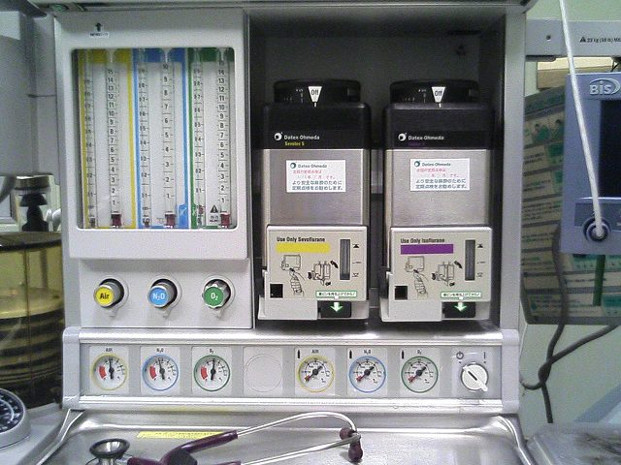
Anesthetic machine
49

Slide 49
Thank You
f
End of lecture

