Slide 1
Premedication of anesthesia
Dr : Miaad Adnan
27 / 10 / 2021
FIBMS Anaesthesia

Slide 2
Premedication :
1
Definition : Administration of drugs before
induction of anaesthesia
Components : Psychological
Pharmacological

Slide 3
Premedication :
1
Psychological Premedication is provided by the anesthesiologist's preoperative visit and interview with the patient and family members .
Pharmacological Premedication is administration of drugs orally orintramuscularly 1 to 2 hours before the anticipated induction of anesthesia

Slide 4
Goals of Premedication ?
1
Anxiety relief (anxiolysis )
Amnesia
Sedation
Analgesia
Antiemtic
Antisalogogoue effect
Increased in gastric fluid PH

Slide 5
Goal of Premedication ?
2
Decreased in gastric fluid volume
Attenuation of sympathetic nervous system
Reflex response
Decrease in anesthetic requirements
Prophylaxis against allergic reaction

Slide 6
Premedication :
3
• Anxiolysis
  benzodiazepines
  B-blockers
• Amnesia
  lorazepam
  anterograde amnesia

Slide 7
Premedication :
4
• Anti-emetic
- Dopamine antagonists
- Antihistamines
- Anticholinergics
- 5-hydroxytryptamine antagonists
- A2- agonists: clonidine, Dexmetomidine

Slide 8
Premedication :
5
Antacid
    Patients who have received opiates
    present as emergencies
    If in pain
    delayed gastric emptying
    hiatus hernia
  Oral sodium citrate
  Ranitidine , Proton pump inhibitors
  Metoclopramide
  naso- or orogastric tube

Slide 9
Premedication :
2
Anti-autonomic
  Parasympathetic reflexes
    Excessive vagal activity causing profound bradycardia
    Halothane
    Suxamethonium
    Surgery
    Traction on the extraocular muscles
    Handling of the viscera
    During elevation of a fractured zygoma

Slide 10
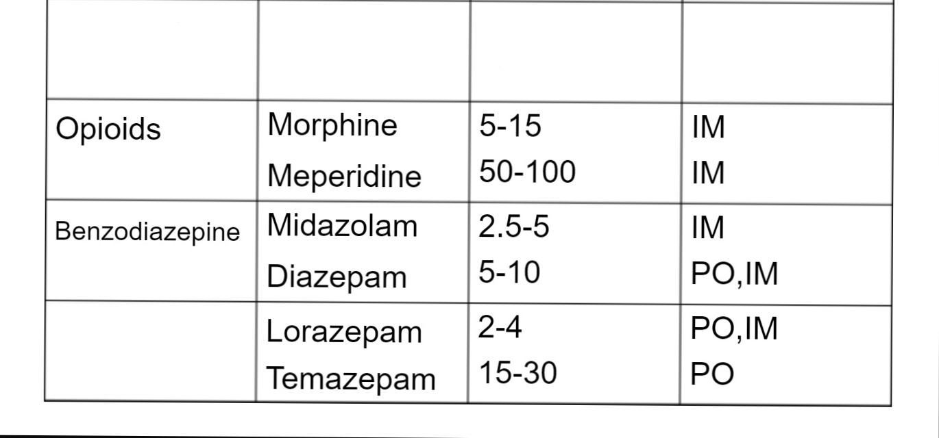
Premedication :
2
Classification
Drugs
Typical Adult
Dose (mg)
Route

Slide 11
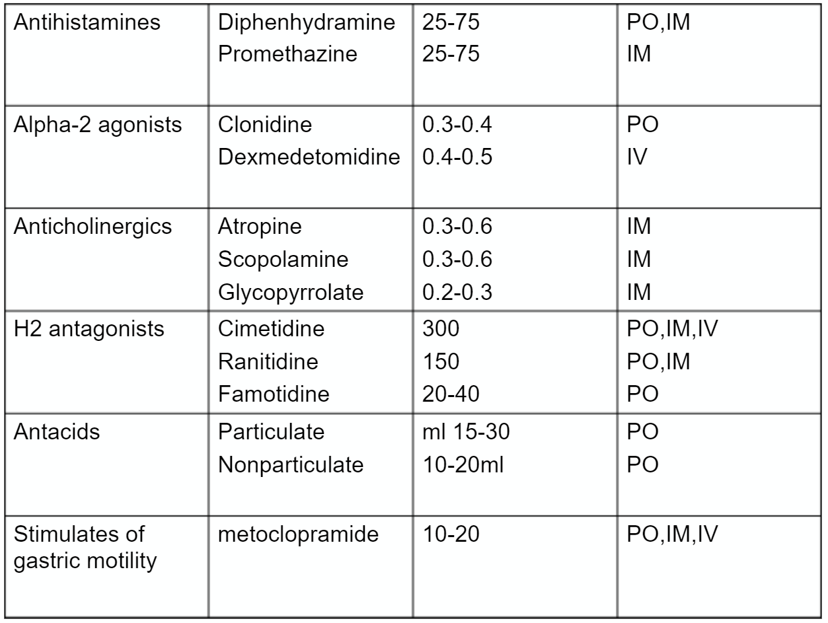
2

Slide 12
Premedication :
2
Reduce or withhold sedatives and analgesics in
- elderly
- debilitated patients (severely ill patient)
- acutely intoxication
- upper airway obstruction
- trauma
- central apnea
- neurologic deterioration
- severe pulmonary and valvular heart diseases

