Slide 1


Inorganic Pharmaceutical Chemistry
Radiopharmaceutics

Slide 2
Radiopharmacy (Nuclear Pharmacy)
Nuclear pharmacy, also known as radiopharmacy, involves preparation of radioactive materials for patient administration that will be used to diagnose and treat specific diseases in nuclear medicine.
Isotopes of an atom have the same number of protons,
but a different number of neutrons.
Example:
Consider a carbon atom:
It has 6 protons and 6 neutrons - we call it "carbon-12
because it has an atomic mass of 12 (6 plus 6). One useful isotope of carbon is "carbon-13", which has 6 protons and 7 neutrons.

Slide 3
Radioisotopes, Radionuclides: unstable isotopes which are distinguishable by radioactive transformation. Each radionuclide is characterized by energy which expressed by electron volt, kilo electron volt and mega electron volt.
Radioactivity: the process in which an unstable isotope undergoes changes until a stable state is reached and the radiation emits (alpha particles, beta particles and gamma rays).The measurement of radioactivity is termed as radiation or radiation dosimetry, which depend on collection of photon or ions.
Photon : is an elementary particle that is a quantum of the electromagnetic field, including electromagnetic radiation such as light and radio waves

Slide 4
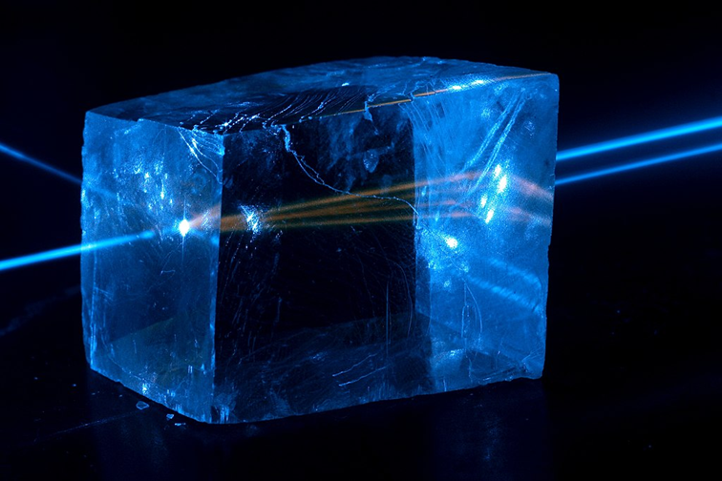
Photon

Slide 5
The effect of radioactive particles passing through the biological tissue depend upon energy of radiation, dose rate of radiation and the ability of radiation to penetrate the tissue.
The radioactive material must be storage in a suitable labeled container and never touched with hand in addition to sufficient clothing while handling.
Radiation refers to particles or waves coming from the nucleus of the atom (radioisotope or radionuclide) through which the atom attempts to attain a more stable configuration. When the nucleus losses one particle of α and β the radiation will accompanied by x rays and gamma rays.

Slide 6
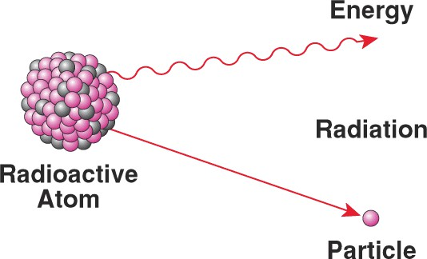

Slide 7
How to produce a radioactive nuclide ?
1 - Natural radioactivity:
Nuclear reactions occur spontaneously
2 -Artificial radioactivity:
The property of radioactivity produced by particle bombardment or electromagnetic irradiation.
A) Charged-particle induced reactions
e.g. protons, deuterons* and alpha particles
*Deuterons is a positively charged particle consisting of a proton and a neutron, equivalent to the nucleus of an atom of deuterium.

Slide 8
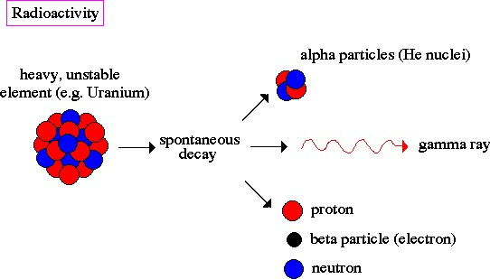

Slide 9
B) Photon-induced reactions
The source of electromagnetic energy may be gamma-emitting radionuclide or high-voltage x-ray generator.
C- Neutron-induced reactions
It is the most widely used method
It is the bombardment of a nonradioactive target nucleus with a source of thermal neutron

Slide 10
3-Radionuclide generator systems
Principle
A long-lived parent radionuclide is allowed to decay to its short-lived daughter radionuclide and the latter is chemically separated in a physiological solution.
Example
Technetium-99m(is a metastable nuclear isomer of technetium-99)
obtained from a generator constructed of molybdum-99 absorbed to an alumina column.
99Mo e- + 99mTc

Slide 11
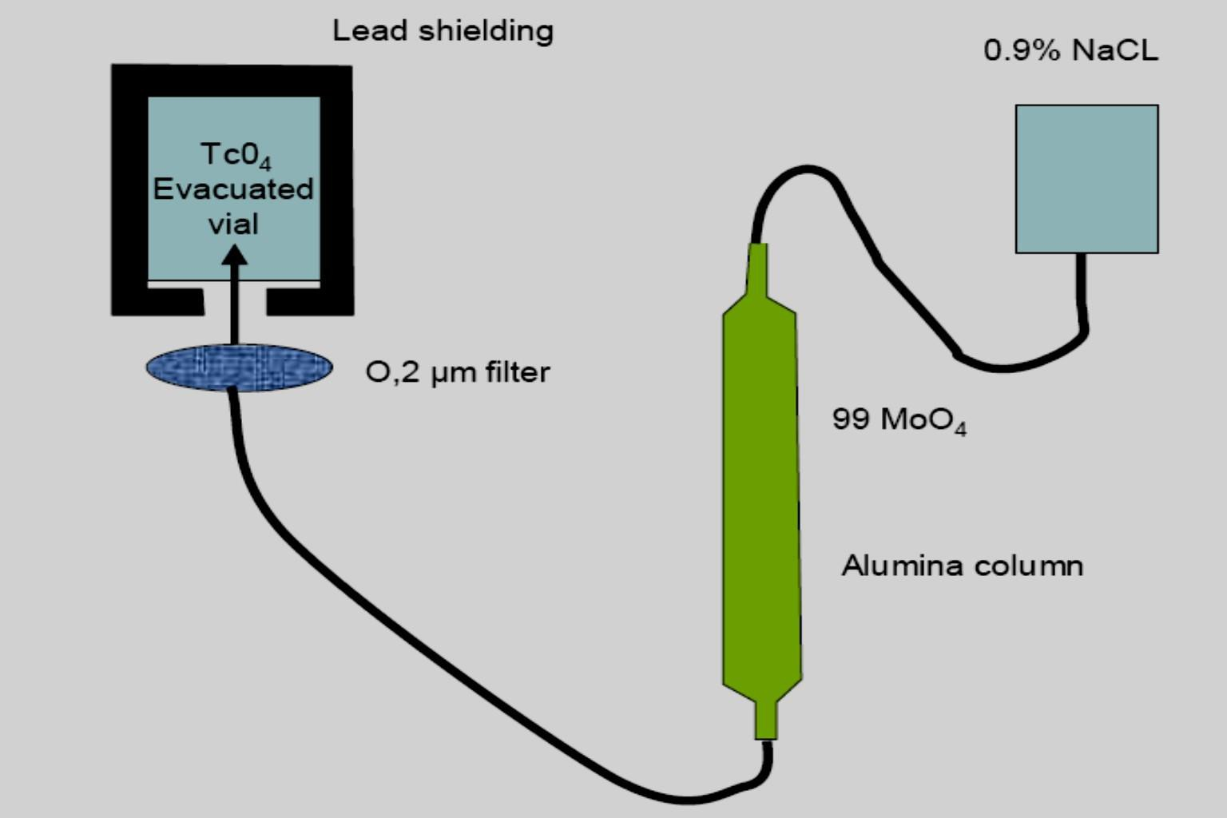

Slide 12
Mode of Radioactive decay
Radioactive decay is the process in which an unstable atomic nucleus spontaneously loses energy by emitting ionizing particles and radiation.
This decay, or loss of energy, results in an atom of one type, called the parent nuclide transforming to an atom of a different type, named the daughter nuclide.
- when unstable nucleus decays, It may give out:
1- Alpha particle decay:
Alpha particles are made of 2 protons and 2 neutrons.
We can write them as ⁴₂α or ⁴_{2He} , because they're the same as a helium nucleus. This means that when a nucleus emits an alpha particle, its atomic number decreases by 2 and its atomic mass decreases by 4.

Slide 13
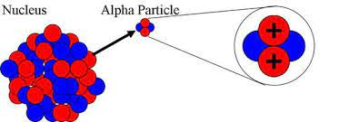

Slide 14
Alpha particles are relatively slow and heavy.
• They have a low penetrating power - you can
stop them with just a sheet of paper.
Because they have a large charge, alpha particles ionize other atoms strongly
Alpha-decay occurs in very heavy elements, for
example, Uranium and Radium.

Slide 15
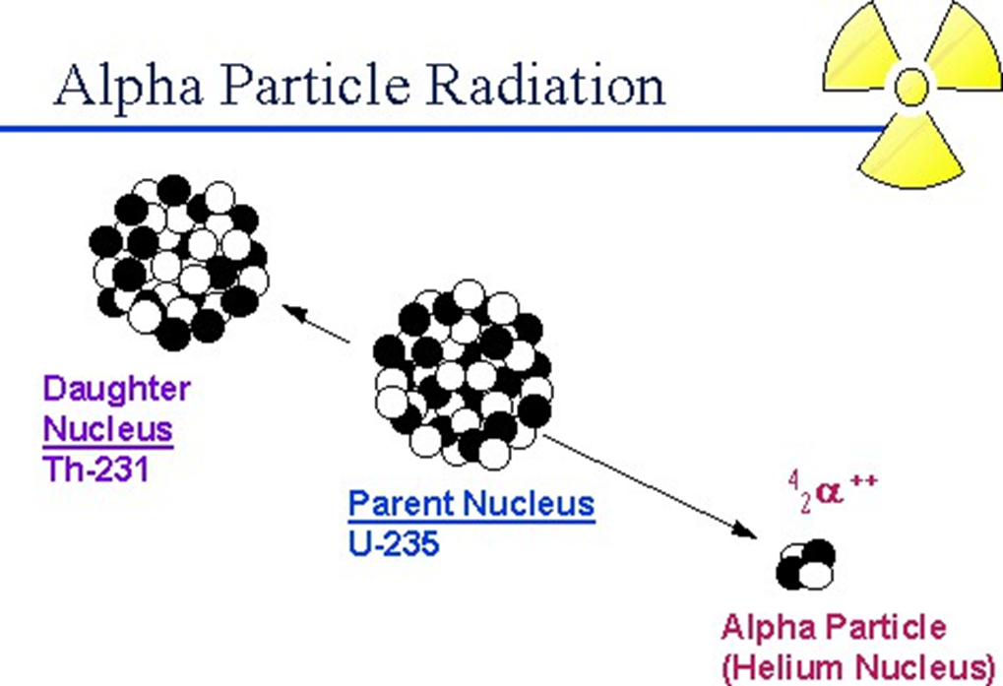

Slide 16
2- Beta particle decay:
● Beta particles have a charge of minus 1.
● This means that beta particles are the same as an
electron.
We can write them a β- or e- , because they're the same as an electron.
This means that when a nucleus emits particle: the atomic mass is unchanged
● They are fast, and light.
● Beta particles have a medium penetrating power
they are stopped by a sheet of aluminium.
● Example of radiopharmaceutical emits
phosphorus-32

Slide 17
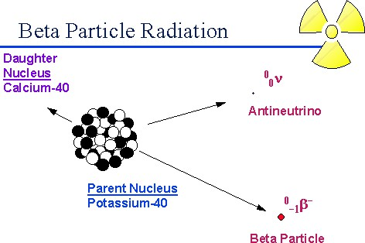

Slide 18
3- Gamma ray γ:
Gamma rays are electromagnetic radiation with wave length shorter than those of light ,it is not particles, this means that they have no mass and no charge.
in Gamma decay:
atomic number unchanged.
atomic mass unchanged.
Gamma rays have a high penetrating power - it takes a thick sheet of metal such as lead to reduce them.
Gamma rays do not directly ionize other atoms, although they may cause atoms to emit other particles which will then cause ionization.
We don't find pure gamma sources - gam rays emitted alongside alpha or beta particles.

Slide 19
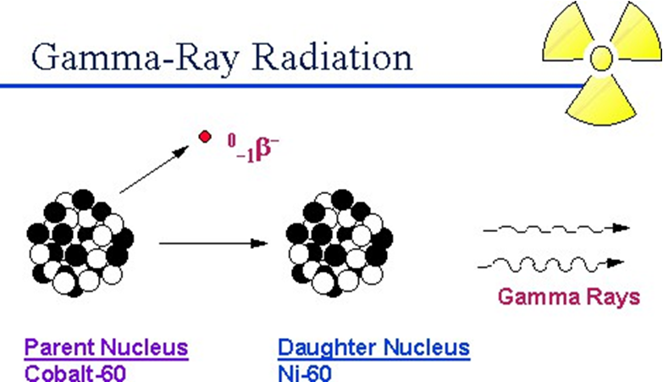

Slide 20
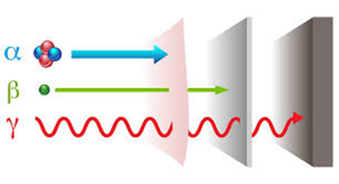
penetrating power of radiation

Slide 21
Gamma rays | Beta particle | Alfa particle | Type of radiation
γ | β | α | Symbol
0 | -1 | +2 | charge
Very fast | fast | slow | Speed
0 | medium | high | Ionizing ability
high | medium | low | Penetrating power
Lead | aluminium | paper | Stopped by

Slide 22
Radiation measurement:
( R) the roentgen:
Is the amount of γ radiation that produces ionization of one electrostatic unit of either positive or negative charge per cubic centimeter of air at 0 ºC and 760 mmHg.
1Roentgen is equivalent to 2.58 * 10-4 C kg-1
(rad) radiation absorbed, it is a measure of the energy deposited in unit mass of any material by any type of radiation.
1rad is equivalent to 10-2 Jkg-1
(rem) has been developed to account for the differences in effectiveness of different radiations in causing biological damage.

Slide 23
RBE is the relative biological effectiveness of the radiation
Rem = rad x RBE
The basic unit for quantifying radioactivity (i.e.
describes the rate at which the nuclei decay).
Curie (Ci):
Curie (Ci), named for the famed scientist Marie Curie Curie = 3.7 x 10¹⁰ atoms disintegrate per second (dps)
Millicurie (mCi) = 3.7 x 10⁷ dps
Microcurie (micCi) = 3.7 x 10⁴ dps

Slide 24
Properties of an Ideal Diagnostic Radioisotope
1. Types of Emission:
Pure Gamma Emitter: (Alpha & Beta Particles are
unimaginable & Deliver High Radiation Dose.)
2. Energy of Gamma Rays:
Ideal: 100-250 keV
3. Easy Availability:
Readily Available, Easily Produced & Inexpensive:
e.g. 11C, 99mTc

Slide 25
4. Target to Non target Ratio:
It should be high to:
maximize the efficacy of diagnosis
minimize the radiation dose to the patient
5. Effective Half-life:
It should be short enough to minimize the radiation dose to patients and long enough to perform the procedure. Ideally 1.5 times the duration of the diagnostic procedure
Example: For a Bone Scan which is a 4-h procedure,
99mTc- phosphate compounds with an effective half-life of 6
h are the ideal radiopharmaceuticals.
6. Patient Safety:
Should exhibit no toxicity to the patient.

Slide 26
7. Preparation and Quality Control:
1) Should be simple with little manipulation.
2) No complicated equipment.
3) No time consuming steps.

Slide 27
Preparation of Radiopharmaceutical
1- Sterilization:
Radiopharmaceutical preparations intended for parenteral
administration are sterilized by a suitable method.
Terminal sterilization by autoclaving is recommended for
heat stable products
For heat labile products, the filteration method is recommended.
2-Addition of antimicrobial preservatives: Radiopharmaceutical injections are commonly supplied in multi-dose containers.
3 -compounding:
compounding can be as simple as:
adding a radioactive liquid to a commercially available reagent kit

Slide 28
Application of radiopharmaceuticals:
1- Treatment of disease: (Therapeutic radiopharmaceuticals) They are radiolabeled molecules designed to deliver
therapeutic doses of ionizing radiation to specific diseased
sites.
Chromic phosphate P32 for lung, ovarian, uterine, and prostate cancers.
Sodium iodide I 131 for thyroid cancer.
Chromium 51 is supplied as sodium chromate solution or injection it is used for label RBC
Sodium phosphate P 32 for cancerous bone tissue and other
types of cancers

Slide 29
Strontium chloride Sr 89 for cancerous bone tissue.
Gold 198 use in rheumatoid arthritis.
I 125 is used as thyroid functioning and to detect and estimate drug hormones in the body fluid.
Calcium 47 is supplied as calcium chloride in the form of an injection as a urinary and faecal marker.

Slide 30
2- As an aid in the diagnosis of disease (diagnostic
radiopharmaceuticals)
The radiopharmaceutical accumulated in an organ of interest emit gamma radiation which are used for imaging of the organs with the help of an external imaging device called gamma camera.
Radiopharmaceuticals used in tracer techniques for measuring physiological parameters (e.g. 51 Cr-EDTA for measuring glomerular filtration rate).
Radiopharmaceuticals for diagnostic imaging
(e.g.99m TC-methylene diphosphonate (MDP) used in bone scanning).

