Slide 1
Inorganic phrmaceutical chemistry
Gastrointestinal Agents

Slide 2
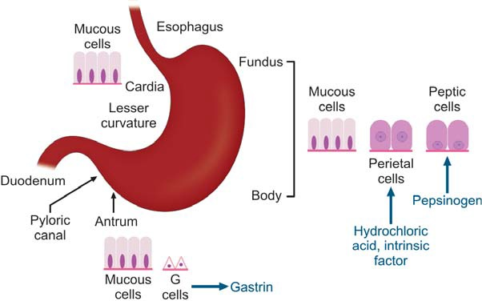
The stomach secretes:
-Hydrochloric acid(HCL)
-Bicarbonate
-Pepsinogen
-Intrinsic factors
-Mucus
-Prostaglandins
Parts of stomach and their lining cells

Slide 3
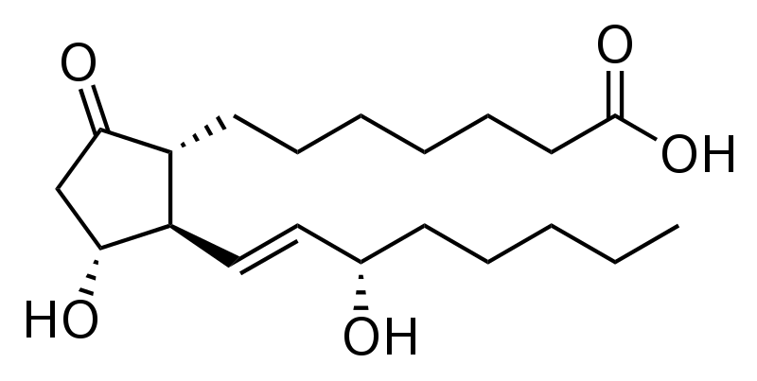
prostaglandins
The prostaglandins are a lipid compounds having hormone-like effects formed by the gastric mucosa. Prostaglandins have been shown to protect against gastric and duodenal mucosal damage in animals and humans.

Slide 4
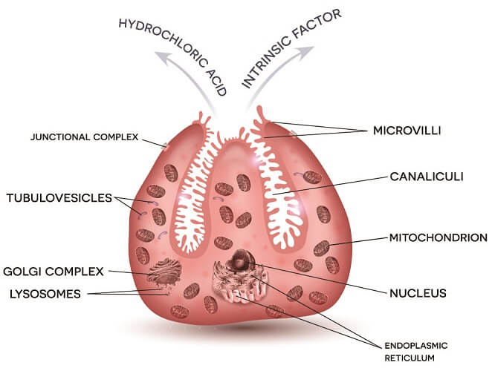
Intrinsic factor (IF), cobalamin binding intrinsic factor, also known as gastric intrinsic factor (GIF), is a glycoprotein produced by the parietal cells (in humans) of the stomach. It is necessary for the absorption of vitamin B_{12.}
_{parietal cell}

Slide 5
Cells in the Gastric Gland
Parietal Cells
Produce and secrete HCl
Primary site of action for many acid controller drugs.
Chief cells (peptic cells)
Secrete pepsinogen, a pro enzyme
Pepsinogen becomes pepsin when activated by exposure to acid
Pepsin breaks down proteins (proteolytic)

Slide 6
Mucoid cells
Mucus-secreting cells (surface epithelial cells), secrete mucus and bicarbonate, This mucus-bicarbonate barrier is an important first line of defence against damage by gastric acid and pepsin
Hydrochloric Acid
Secreted by the parietal cells when stimulated by food
Maintains stomach at pH of 1 to 4
Secretion also stimulated by:
Large fatty meals
Excessive amounts of alcohol
Emotional stress

Slide 7
Acid Related Disease
Achlorhydria
is the medical term for a lack of stomach acid (hydrochloric acid) due to the failure of the parietal cells to produce gastric acid. Patient with achlorhydia suffering from epigastric pain, frequent bowel movement and diarrhea
Causes
1-Gastric atrophy
This is a result of chronic inflammation of the gastric mucosa and there is a loss of glandular gastric cells.

Slide 8
2-Chronic gastritis
usually due to Helicobacter Pylori (H. pylori) infection.
3-Autoimmune gastritis
as a result of antibodies against the parietal cells which seen in pernicious anemia.
4-Drugs
Long term use or excessive use of the following drugs may result in iatrogenic achlorhydria.
Proton Pump Inhibitors (PPI’s)
These drugs work by inhibiting the H+/K+ ATPase enzyme pump which is responsible for transporting hydrogen and the subsequent production of HCl.

Slide 9
Histamine H2-Receptor Antagonist
Also known as H2 blockers, decrease gastric acid secretion by reversibly binding to histamine H2 receptors located on gastric parietal cells, thereby inhibiting the binding and activity of the endogenous ligand histamine.
5-Tumors
Gastric cancer
Tumors that affect the fundus of the stomach are more likely to result in achlorhydria as it destroys the parietal cells which are responsible for the secretion of HCl.

Slide 10
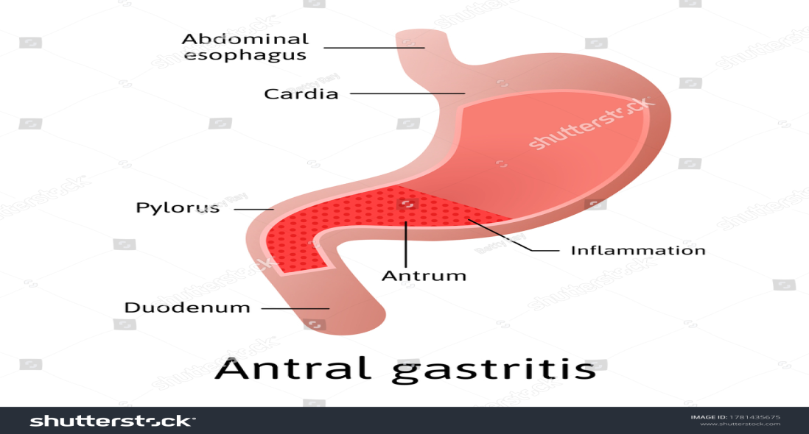
6-Surgery
Gastric resection for the treatment of certain stomach conditions like antroctomy or certain types of weight loss surgery
Achlorhydria treated by use 0.1 N HCL

Slide 11
Hyperacidity (overproduction of HCL)
Caused by
-imbalance of the three cells of the gastric gland and their secretions.
H. pylori
-Bacterium found in GIT
Symptoms of hyperacidity are:
A burning sensation in the chest (heartburn), usually after eating, which might be worse at night or while lying down.
Regurgitation of food or sour liquid.
Upper abdominal or chest pain.
Trouble swallowing (dysphagia).
Sensation of a lump in the throat

Slide 12
Gastric mucosal defense mechanisms
Secretion of :
1-Mucus: protective barrier against HCL
2-Bicarbonate: helps buffer acidic properties of HCL
3-Prostaglandins:prevent activation of proton pump which result in decrease HCL production

Slide 13
Types of Acid-Controlling Agents
1-Antacids 2-H2 antagonists 3-Proton pump inhibitors
Antacids: Mechanism of Action
-Antacids DO neutralize the acid once it’s in the stomach
-Antacids DO NOT prevent the over-production of acid and not cause systemic alkalosis
-Reduction of pain associated with acid-related disorders
-Raising gastric pH from 1.3 to 1.6 neutralizes 50% of the gastric acid
-Raising gastric pH (1.3 to 2.3) neutralizes 90% of the gastric acid, generally ideal antacid buffer in the pH range 4- 6
Used alone or in combination

Slide 14
Antacids: Aluminum Salts
Have constipating effects
Often used with magnesium to counteract constipation
Delay onset, but long duration of action
Contraindication for patient with hypophosphatemia Examples : Aluminum carbonate,
Hydroxide salt, combination products (aluminum and magnesium): Gaviscon, Maalox.

Slide 15
Antacids: Magnesium Salts
Forms: carbonate, hydroxide, oxide, trisilicate
-In addition to the GI irritation magnesium salts cause watery diarrhea, usually used with other agents to counteract this effect
-Contraindicated with Renal failure because the patients cannot excrete extra magnesium leading to Hypermagnesemia
-Delay onset but long duration of action
-Combination products such as Maalox, Gaviscon (aluminum and magnesium).

Slide 16
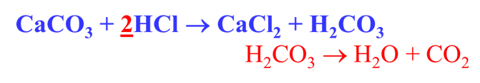
Antacids: Calcium Salts
Forms many, but carbonate is most common.
May cause constipation, kidney stones and renal failure in addition to the hyperphosphatemia
Burnett syndrome is occur due to prolong used of calcium containing antacid
Delay onset, but long duration of action
Example: calcium carbonate

Slide 17
Calcium containing antacid do not have amphoteric effect but they depend on their basic properties and not cause systemic alkalosis.
Milk-alkali syndrome: is a condition in which there is a high level of calcium in the body as a result, there can be a loss of kidney function.

Slide 18
Antacids: Sodium Bicarbonate
Highly soluble
Buffers the acidic properties of HCl
Quick onset, but short duration
May cause metabolic alkalosis
Sodium content may cause problems in patients with HF, hypertension, or renal insufficiency (fluid retention)
The ideal neutralizing capacity of an antacid should be at least 5 meq. of HCL per dosage unit.

Slide 19
Antacids and Antiflatulents
Antiflatulents: used to relieve the painful symptoms associated with gas, several agents are used to bind or alter intestinal gas by reducing the surface tension of bubbles in the stomach and are often added to antacid combination products.
Examples
Activated charcoal and simethicone
Alter elasticity of mucous-coated bubbles causing them break
Antacids side effect:
1- Aluminum and calcium = Constipation
2-Magnisum = diarrhea
3-Calcium carbonate
Produces gas and belching; often combined with simethicone

Slide 20
Antacids contraindictions
2-Fluid imbalances 3- HF 1-Renal disease
4-GI obstruction 5-Pregnancy 6-Allergy
-Patients with HF or hypertension should use low-sodium antacids.
-Use with caution with other medications due to the many drug interactions
-Most medications should be given 1 to 2 hours after giving an antacid
-Antacids may cause premature dissolving of enteric-coated medications, resulting in stomach upset
-Be sure that chewable tablets are chewed thoroughly, and liquid forms are shaken well before giving
-Caffeine, alcohol, harsh spices, and black pepper may aggravate the underlying GI condition

Slide 21
Antacid: Drug interactions
-Adsorption of other drugs reduces the ability of these drugs to be absorbed into the body
- Chelation
Chemical binding or inactivation of another drug produces insoluble complexes, result in reduce drug absorption
Antidiarrheals
Diarrhea
Abnormal frequent passage of loose stool or
Abnormal passage of stools with increased frequency, fluidity, or increased stool water excretion

Slide 22
Antidiarrheal drugs act as adsorbents:
-Coat the walls of GIT
-Bind to the causative agents(bacteria or toxins) and eliminated them with stool examples: Bisumth subsalicylate, Kaolin-pectin, Activated charcoal(Kaopectate)
Side Effects Adsorbents
-Increased bleeding time
-Constipation, dark stools
-Confusion, twitching
Hearing loss, tinnitus, metallic taste
Antidiarrheal Agents: Interactions
Adsorbents decrease the absorption of many drugs including digoxin, clindamycin, quinidine, and hypoglycemic agents
Adsorbents cause increased bleeding time when given with anticoagulants.

Slide 23
Acute diarrhea
Sudden onset in a previously healthy person lasts from 3 days to 2 weeks, self-limiting
Chronic diarrhea
Lasts for more than 3 weeks
Associated with recurring passage of diarrheal stools, fever, loss of appetite, nausea, vomiting, weight loss, and chronic weakness
Causes of Diarrhea:

Slide 24
Laxatives(Cathartics)
Constipation
Abnormally infrequent and difficult passage of feces through the lower GI tract due to the disorder of movement in the colon and/or rectum
It is not a disease Can be caused by a variety of diseases or drugs
Act by:
Bulk forming
-Absorbs water to increase bulk
-Distends bowel to initiate reflex bowel activity
Examples:
psyllium (Metamucil)
methylcellulose (Citrucel)
Polycarbophil (FiberCon)

Slide 25
Emollient
Stool softeners and lubricants Promote more water and fat in the stools(docusate salts)
Lubricate fecal material and intestinal walls (mineral oil)
Hyperosmotic
Increase fecal water content
Bowel distention, increased peristalsis and evacuation, examples:
Polyethylene glycol
Sorbitol(increases fluid movement into intestine)
Glycerin
Lactulose
Saline
Increase osmotic pressure within the intestinal tract causing more water to enter the intestines

Slide 26
bowel distention, increased peristalsis, and evacuation, should not be given to patient with low sodium diet.
Examples:
magnesium sulfate
magnesium hydroxide
magnesium citrate
sodium phosphate
Stimulant
Increases peristalsis via intestinal nerve stimulation leading to local irritation of intestinal tract.
Examples:
castor oil
senna
cascara

Slide 27
Laxatives: Indications
Bulk forming
Acute and chronic constipation and Irritable bowel syndrome
Emollient
Softening of fecal impaction; facilitation of BMs in anorectal conditions
Hyperosmotics
Chronic constipation
Diagnostic and surgical preps

Slide 28
Saline
Removal of helminths and parasites
Diagnostic and surgical preps
Stimulant
Acute constipation
Diagnostic and surgical bowel preps

Slide 29
Side Effects of laxatives:
Bulk forming
Impaction
Fluid overload
Emollient
Skin rashes
Decreased absorption of vitamins
Hyperosmotic
Abdominal bloating
Rectal irritation

Slide 30
Saline
Excessive loss of body fluid in form of watery stools Magnesium toxicity (with renal insufficiency)
Cramping
Diarrhea
Increased thirst
Stimulant
Nutrient malabsorption
Skin rashes
Gastric irritation
Rectal irritation
All laxatives can cause electrolyte imbalances

