Slide 1
The Scapula and Clavicle radiological anatomy
Dr.Zaid Saad Al-Nasrawi
Trauma and Orthopedics surgeon

Slide 2
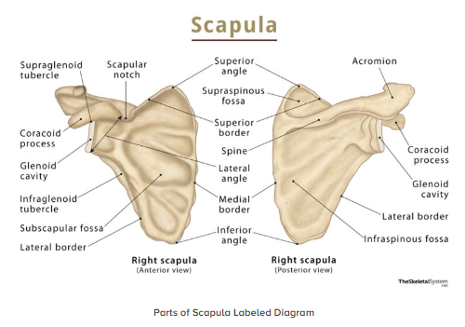
The Scapula
This flat triangular bone has three processes:
• The glenoid process, which is separated from the remainder by the neck of the scapula. The glenoid cavity forms part of the shoulder joint.
• The spine, which arises from the posterior surface of the scapula and separates the supraspinous and infraspinous fossae. The spine extends laterally over the shoulder joint as the acromion.
• The coracoid process, which projects anteriorly from the upper border of the neck of the scapula.

Slide 3
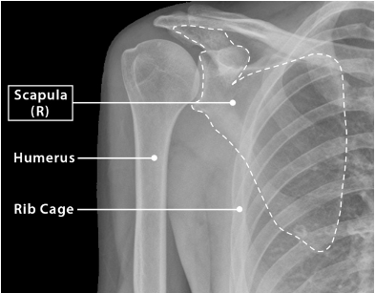
Radiological features of the scapula
Plain radiographs
The inferior angle of the scapula lies over the seventh rib or interspace – this is a useful guideline in identifying ribs or thoracic vertebral levels.
The scapula lies over the ribs and obscures some of the lung fields in PA chest radiographs unless the shoulders are rotated forwards.

Slide 4
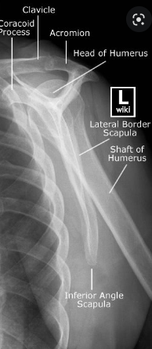
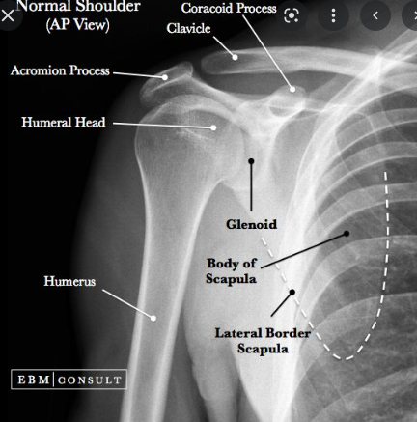
In AP view of scapula the beam is centred over the head of the humerus to project the thoracic cage away from the scapula.
In lateral chest radiographs, the lateral border of the scapula may be confused with an oblique fissure. The inferior angle of the scapula may be slightly bulbous and simulate a mass on this view.

Slide 5
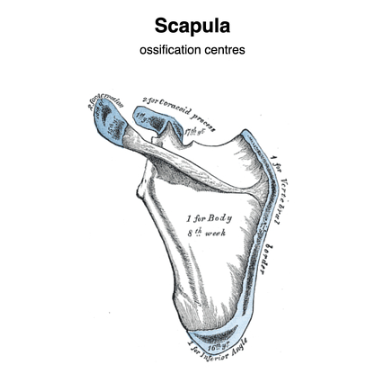
Ossification
The scapula ossifies in the eighth week of fetal life.
An ossification centre appears in the middle of the coracoid process in the first year of life and fuses at 15 years of age.
Secondary centres appear in the root of the coracoid process, the medial border and the inferior angle of the scapula between 14 and 20 years, and fuse between 22 and 25 years of age.

Slide 6
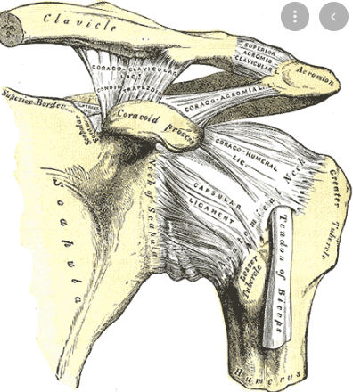
The clavicle
The clavicle lies almost horizontally between the sternoclavicular and the acromioclavicular joints.
It is also attached to the first costal cartilage by the costoclavicular ligament.
It is connected to the coracoid process by the coracoclavicular ligament .
The subclavian vessels and the trunks of the brachial plexus pass behind its medial third

Slide 7
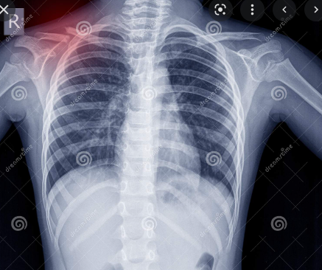
Radiological features of the clavicle
Chest radiograph
The clavicle overlies the apices of the lungs in chest radio graphs
Apical or lordotic views are used to project the clavicles above the lungs to evaluate this area.
On a chest radiograph, the distance between the medial end of the clavicle and the spine of the vertebrae is equal on both sides unless the patient is rotated

Slide 8
Ossification of the clavicle
The clavicle begins to ossify before any other bone in the body
It ossifies in membrane from two centres that appear at the fifth and sixth fetal weeks, and fuses in the seventh week
A secondary centre appears at the sternal end at 15 years in females and 17 years in males, and fuses at 25 years of age

Slide 9
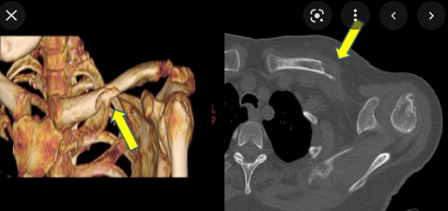
Multislice CT with reformatted images allows excellent tomographic assessment of the long axis of the clavicle.
The articulation with the sternum is best visualized using MRI with a surface coil placed over the anterior chest wall

Slide 10
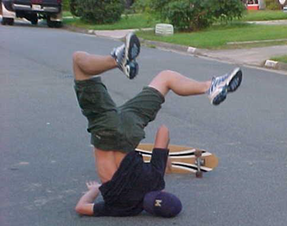
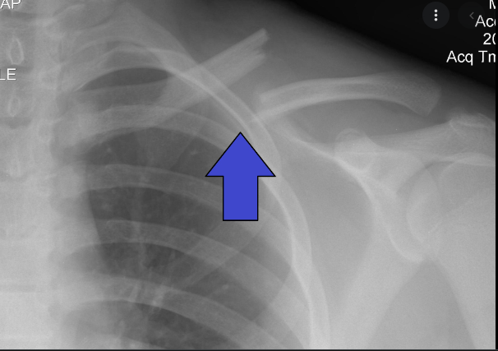
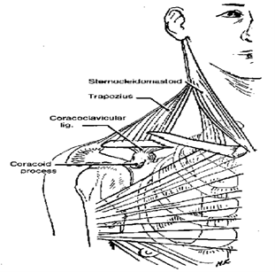
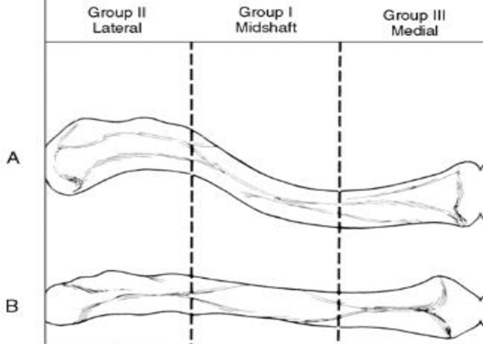
Clavicle fracture

